Slide 1
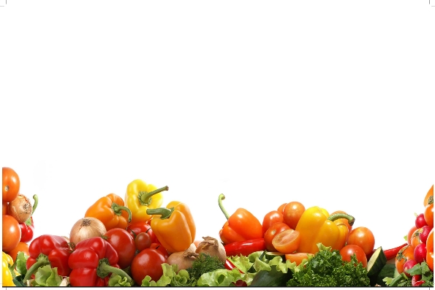
Fruit & Vegetable Processing Technology-FST 303
Dr. SARFRAZ HUSSAIN
Professor
Institute of Food Science & Nutrition
University Of Sargodha

Slide 2
Shriveling and bitter taste of pickle
Shriveling occurs when vegetables are placed directly in a very strong solution of salt or sugar and even in very strong vinegar
Remedy
Weak solutions should be used to start with, increasing their strength gradually
The vegetable used was not fresh
Overprocessing or overcooking
Bitter Taste
Results from the use of strong vinegar.
Over dose of spices,
Remedy
Use 4-6% acetic acid
Avoid over dozing of spices

Slide 3
Blackening of pickle
Minerals are present in the water used
Brass, iron, copper, zinc, aluminum utensils are used
Ground spices cause black speaks
Also by the oxidation
Remedy
Always use good quality rock salt free from Iron and other impurities
Do not use iron spoons for stirring or pouring of pickle,
Do not use colored plastic drums as they can dissolve plasticizers in foods
Always use white plastic drums internally lined with food grade protective layer

Slide 4
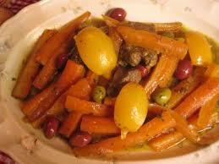
Dull or faded product
Inferior quality material is used
Pickles become dull and faded due to insufficient curing
Remedy:
Always use fresh and good quality raw material, because good quality product cannot be made from bad quality raw material

Slide 5
Softness and Slipperiness
Owning to the action of bacteria it is the most common form of spoilage
It is invariably owing to inadequate covering with brine
Can also be causeddue to the use of weak brine
Remedy
Use a brine of proper strength
keep the pickle well below the surface of the brine,
Amount of salt should be gradually increased to optimum level to avoid shrinkage

Slide 6
Cloudy Pickling liquid
Food spoilage caused by under processing, discard it
Minerals are present in the water used
Anti-caking agent, an additive found in table salt
Pink Pickling liquid
Over mature dill is used
Yeast has grown on the pickles. It will make the pickle slimy. Discard it
(Anonymous., 2013)

Slide 7
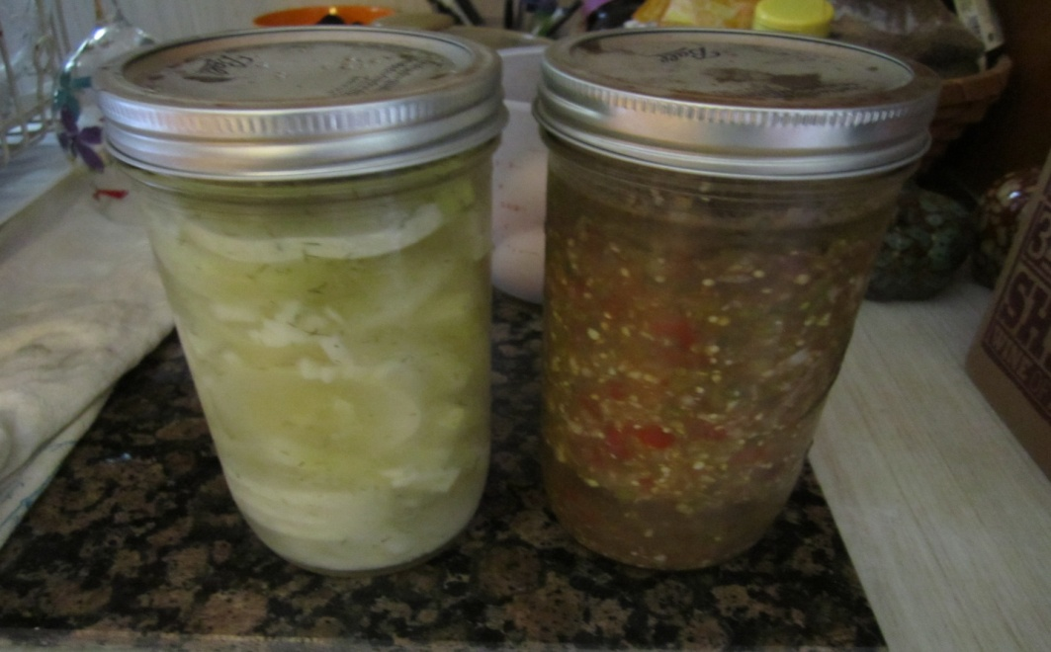
White sediments at the bottom of the jar
Harmless yeast has grown on the surface and then settled down at the bottom
Additives in table salt
The vinegar used was too strong
The spices used were too old or the quantity used was excessive
(Anonymous., 2013)

Slide 8
Scum formation
When vegetables are placed in the brine for curing, a thin or thick white scum is invariably formed on the surface owing to the growth of wild yeast & molds
As this action may help the growth of putrefactive bacteria, which causes the vegetable to become soft and slippery
Scum appear, varying from an almost imperceptible film to a thick wrinkled layer
it is essential to remove the scum as soon as it is formed because it retards the formation of lactic acid
(Doan et al., 2012)
Remedy:
Remove the scum and add 1% acetic acid in curing brine to correct the situation without hampering the lactic acid fermentation
For this reason, some manufacturers add a small amount of vinegar to the brine in the initial stage. (Girdhari Lal et al., 1998)

Slide 9
Blackening of brined vegetable raw material
If stored at high temperature
Turn black in color due to enzymatic browning,
Microorganisms also cause blackening of pickle
Use of appropriate chemical preservatives as sodium benzoate, potassium metabisulfite other chemicals are recommended
These chemicals should not hamper the process of fermentation
Remedy:
Store at a cool temperature and away from intense light

Slide 10
Pressing of pickling vegetables
It is a traditional way to store cut vegetables in underground storage tanks to save additional cost on storage utensils.
Due to heavy weight on lower layers, the vegetables are pressed and become flat and soft.
As a result natural shape is destroyed, during utilization of raw material human and environmental contaminations take place,
Remedy:
Store vegetable raw materials in large size (120Kg) plastic drums to avail easy handling, loading & unloading

Slide 11
Pressing of pickling vegetable Conti….
Remedy
Heavy losses can occur if any low spoilage due to mold occurs,
Such large size underground storage tanks should be avoided,
Raw material should not be exposed to dirt, dust or other environmental conditions,
Water used for brine should be potable to avoid any undesirable textural changes in vegetables,
In case of long time storage of raw material, SO₂ as bleaching agent can be used,

Slide 12
Constraints for Storage of raw material
Fresh fruits are highly perishable and their quality declines rapidly after harvest,
Proper post harvest handling procedures are not followed,
Desirable quality maintenance can be achieved by harvesting fruits at optimal maturity,
Storing fruits at the proper temperature, humidity and atmosphere,

Slide 13
Constraints for Storage of raw material Continued……
Small-scale processors lack the necessary facilities and knowledge.
Small scale processors often lack storage capacity and can not purchase raw materials at low cost during the peak fruiting season,
Unavailability of good-quality raw materials on a year-round basis.
(Wang, 1999)

Slide 14
Constraints for better Production
Good quality product cannot be made from bad quality raw materials,
Best pickling vegetables are grown in the wild and need to be collected at high costs,
Such vegetables are collected from the wild and sold fresh on a seasonal basis,
Many fruits have limited industrial processing (Azam-Ali, 2003).
To plan the optimal utilization of their factories, Processors do not obtain the necessary amount of such fruit at reasonable costs (Shepherd, 2003).

Slide 15
Constraints for better Production continued…..
Inconsistent supply chain for fresh fruits is one of the major issues inhibiting the development of profitable year-round businesses,
Lack of consistent market demand for the raw materials,
Scattered cultivation of underutilized fruit species,
Unavailability of raw materials in large quantities,
High raw material and labor costs have reduced the profitability of enterprises.
(Shepherd, 2003)

Slide 16
Reasons for low profitability due to Seasonality
Machinery of enterprises lies idle during the off-season because of unavailability of raw materials, resulting in low profitability.
In order to overcome issues of seasonality, micro-enterprises are encouraged to use their machinery and equipment to process several fruit species during the year.
Seasonal likings may increase depending on season and availability of fruits.

Slide 17
Problems in Packaging
Leakage of oil from glass bottles,
Label contaminated with oil,
Products that are packaged very tightly,
Dissolving of color of plastic lid in acids of pickle,
Display of glass jars in direct sun light causing photolytic rancidity in pickle oil,
but due to heavy weight, costly to exported,
Danger of breakability and may cause injury,
High cost of glass jars and high handling and transportation charges,

Slide 18
Problems in Packaging Conti …….
Remedies:
Pickles are preferred to be packed in glass jar due to visual advantage of the product,
transparent PET bottles lined with HDPE pouches,
White plastic jars with the advantage of aluminum lined sealable lid to avoid oil leakage can be used,

Slide 19
conclusion
The pickle industry is being run on experience basis and not on scientific basis,
Pickle industry need food technologists and trained workers to run this industry on scientific basis and practice GMP,
Mal practices in this industry is causing serious health problems as liver, kidney damage, high blood pressure, and even cancer by using un approved ingredients in excessive doses,
GMP and awareness can result in increased export to earn valuable foreign exchange,
Flourishing of this industry will use local raw material and create employment

