Slide 1
SPINA BIFIDA

Slide 2
SPINA BIFIDA
Neural Tube defects are largest group of congenital anomalies.
Failure of neural tube to close produces defects of either entire neural tube or small areas.

Slide 3
Etiology
Anacephaly and spina bifida occur together very often.
Higher in females than males
50% occur due to nutritional deficiency (folic acid)

Slide 4
Spina Bifida
Defined as midline defects involving failure of the bony spine to close.
Spina bifida occulta- defect not visible externally.
Occurs most often in lumbosacral area.
Not apparent unless there are gait disturbances, foot deformities, sphincter dysfunction or other neuromuscular manifestations.
Many people with occulta will never have any deficits and may not know they have it.

Slide 5
Spina Bifida
Spina Bifida cystica- visible defect with external saclike protrusion.
A. meningocele- encases meninges and spinal fluid, but no neurological deficits.
B. meningomyelocele-contains meninges, spinal fluid, and nerves. Neuromotor deficits depend on anatomic level of protrusion and nerves involved.

Slide 6
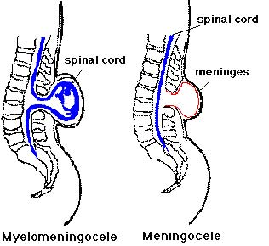

Slide 8
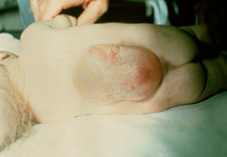

Slide 9
Meningomyelocele
AKA spina bifida
Develops during first 28 days of pregnancy when neural tube fails to close and fuse.
90% of spinal cord lesions, and may occur at any point along spine.
Sac usually enclosed in fine membrane that is prone to tears.

Slide 10
meningomyelocele
Largest number in lumbar or lumbosacral area
90-95% of children have hydrocephalus
Careful monitoring of head size important
Chiari malformation may be present: observe infant for stridor, hoarse cry from vocal cord paralysis; feeding difficulties, deteriorating upper extremity function.

Slide 11
Clinical manifestations
S/S vary according to degree of spinal defect.
Readily apparent on inspection!
Loss of sensation below lesion
Poor urinary and bladder control
Joint deformities in lower extremities
Scoliosis or kyphosis
Hip dislocations

Slide 12
Diagnostic evaluation
Examination of meningeal sac and clinical manifestations
MRI, CT to assess condition of brain and spinal cord. Other defects may be present.
Prenatal- fetal ultrasound or amniotic fluid sample for (alpha-fetal protein (AFP).
Test should be done between 16 and 18 weeks of gestation. Afterwards AFP level drops, making detection of SB difficult. Also, therapeutic abortion not option after this time.

Slide 13
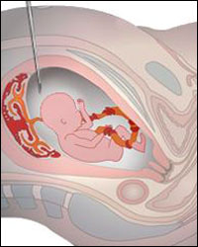

Slide 14
Therapeutic management
Multi-disciplinary approach
Neurology, neuro-surgery, pediatrics, urology, orthopedics, rehabilitation, PT, OT, social services, intensive nursing in many areas.

Slide 15
Goals
1. prevent infection
2. early closure of lesion, within 72 hours (prevents infection and trauma to exposed tissues, and prevents further motor impairment). Goal is satisfactory skin coverage of lesion!
3. PT for specific deformity

Slide 16
Goals
Physical therapy to prevent joint contractures.
Correct deformity, prevent skin breakdown, obtain best ambulatory functioning

Slide 17
Goals
Management of genitourinary function:
Mylemeningocele is a common cause of neurogenic bladder which leads to urinary system distress (frequent UTI’s, ureterohydronephrosis, vesicoureteral reflux, renal insufficiency.
Urinary incontinence is common

Slide 18
Goals
Clean, intermittent catherization as a conservative treatment.
Vesicostomy (anterior wall of bladder brought through abdominal wall to create stoma) may be done for bladder control.
Meticulous skin care is needed!

Slide 19
Post-op
Use touch for stimulation, since can’t hold
Observe for increased ICP, such as bulging fontanels
Assess for infection:
Increased or decreased temperature, irritability, nuchal rigidity,

Slide 20
Home Care
Involve parents in care
Positioning/feeding/skin care/range of motion exercises/ clean catheterization when prescribed, complications.
Help with assistive devices (if child is paraplegic use hands/arms, etc.)
Long range planning

