Slide 1
Name: Samia Asghar 05 Nimra Ayub 30 Sibgha Awais 06
Group:
3 Topic: Nature And Function Of Educational Psychology.
Four Way Agenda Of Teaching Educational Psychology.
Date: November 22,20

Slide 2
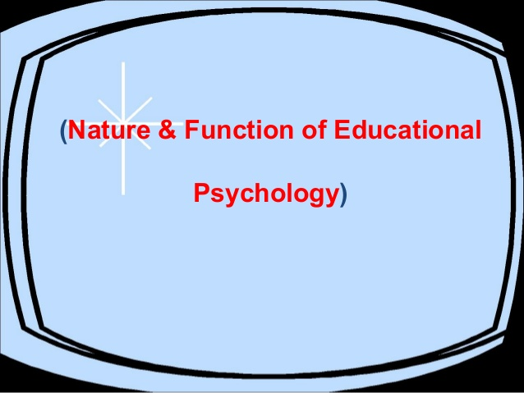

Slide 15
Four Way Agenda Of Teaching Educational Psychology

