Slide 1
Scheme of Work BS Education-V Teaching Mathematics (EDU-511)
Department of Education University of Sargodha

Slide 2
بسم الله الرحمن الرحيم

Slide 3
Scheme of Work
Muhammad Usman (Roll No: BEUF18M024)
Teaching of Mathematics (EDU-511)
BS Education (Semester 5)
Department of Education,
University of Sargodha, 40100 Sargodha, Pakistan
21st Oct,2020

Slide 4
Introduction
What is Scheme of Work?
A scheme of work is a plan of what will be covered in week or session of the learning program or course. It can be very detailed or brief.
A scheme of work may consider how many lessons will be needed to cover a specific theme. Once it has been finalized, a scheme of work can be used to write lesson plan.
Organizes course content and describes how it will be delivered.
Provides framework for sessional planning.
Requires teachers to work together to plan a coherent program.

Slide 5
Importance of scheme of work
Why scheme of work?
Provide units of work
Indicate time available for teaching each unit.
Map the learning and teaching activities
Identify appropriate resources
Sequence units into coherent way

Slide 6
Purpose of a scheme of work
Underpins a comprehensive learning experience for the learner
Requires teachers to work together to plan a coherent program
Helps teachers plan common activities, for example work experience, visits, visiting speakers and so on.
Help teachers plan resources
Help teachers create their individual session plans
Helps new teacher joining the program.
Requires us to think about the essential underpinning skills that learners need and plan to incorporate strategies to ensure these skills are learnt
Helps teachers plan assessment methods and coherent schedule

Slide 7
Who plans the scheme of work
Teachers plan a particular standard to work together on the scheme of work for the year. There are many reasons for this:
To synchronize what is taught and the order in which it is taught.
All the teachers’ perception on the syllabus items become known to everyone else.
Teaching resources, especially audio-visual aids can be shared.

Slide 8
Scheme of Work Model 1st Section

Slide 9
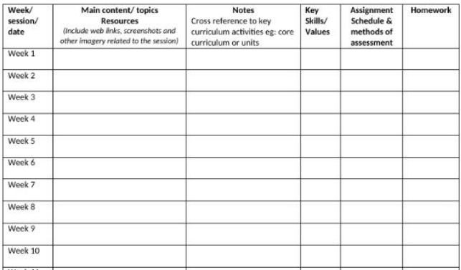
Scheme of Work Model 2nd Section

Slide 10
MCQs
1. Scheme of work is __________.
detailed
concise and short
one paged
none
2. A scheme of work can be used to write _________.
a) Notes b) Lesson Plans c) Books d) None
3. Scheme of work provides ___________ of lesson planning.
a) Notes b) Summary c)Key points d) Frame work
4. Working together of the teachers makes the system ___________.
a) Coherent b) Distributive c) acceptable d) None
5. Learning outcomes are always at the ______ of the programs.
a) Start b) End c) Center d) None

Slide 11
Key for MCQs
Detailed
Lesson plan
Framework
Coherent System
End

Slide 12
References
https://www.slideshare.net/RabiatulZahidahMohdZaidi/scheme-of-work-10219186; (accessed on October 21, 2020)
https://www.slideshare.net/dreinu/scheme-of-work
http://dera.ioe.ac.uk/3445/7/2542_1_sec_ma_plan_0004907_hbkks4_Redacted.pdf
https://www.pearsonschoolsandfecolleges.co.uk/secondary/Mathematics/11-16/KS3MathsProgress/schemes-of-work/schemes-of-work.aspx

Slide 13
THANK YOU ALL…!

