Slide 2
Run Test

Slide 3
Solution
H₀ = the pattern of departure is the result of random process
H₁₌ the pattern of departure is the result of non random process
Level of significance :
α=0.05
Test statistics :
number of runs denoted by r
run=8.
n=30
${ n}_{1}$=the number with +ve signs=17
$n_{2}$=the number with –ve signs=13

Slide 4
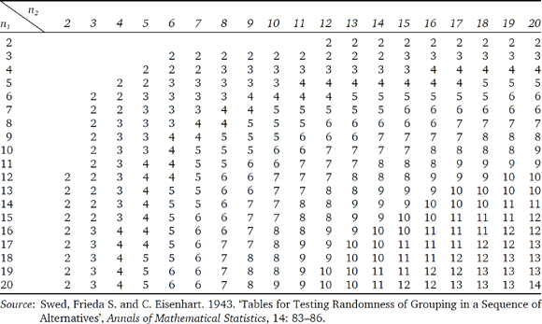
Table

Slide 5
Critical value:
r < lower critical value
r=8 & lower critical value =10
= 8 <10
Decision : Reject our null hypothesis and conclude that the pattern is the result of a non random process.

Slide 6
Home Assignment
The data below represents the daily performance of a popular stock. Letter A represents a gain and letter B represents a loss. Use an appropriate test to analyze the stock′s performance for randomness. Set α=0.05 .Report the results with interpretation.
BAABBAABBBBBAABAAAAB

