Slide 1
XML

Slide 2
XML
XML is a general purpose tag based language and very easy to transfer and store data across applications.
Like HTML , XML is a subset of SGML - Standard Generalized Markup Language.
XML files are made up of tags that contains data.
Notes:
SGML (Standard Generalized Markup Language) is a standard for how to specify a document markup language or tag set.

Slide 3
XML (Cont.)
While creating an XML file , some important points have to remember :
XML is case sensitive
ex: <Header> is not same as <HeadeR>
Tags must be closed in the reverse order that they were opened
ex : < first-tag >< second-tag > Data here < /second-tag > < /first-tag >

Slide 4
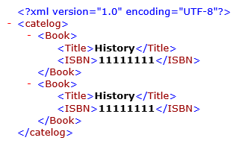
XML Example

