Slide 1
Lecture 3: logic gates & Switching Circuits & Boolean Algebra
Engr. Muhammad SaadUllah

Slide 2
Out Line
Lecture 2 remaining Topic (Binary Codes, Binary Logic)
Switching Circuits
Logic Gates ( AND, OR, NOT, NAND, NOR, XOR,XNOR)
Logic Circuits / Combinational logic circuits
Introduction to Boolean algebra
Question & Answers

Slide 3
Binary Codes
Digital systems use signals that have two distinct values and circuit elements that have two stable states
A binary number of n digits, for example, may be represented by n binary circuit elements, each having an output signal equivalent to 0 or 1.
the codes must be in binary because, in today’s technology, only circuits that represent and manipulate patterns of 0’s and 1’s can be manufactured economically for use in computers.

Slide 4
Binary Codes
An n‐bit binary code is a group of n bits that assumes up to 2^{n} distinct combinations of 1’s and 0’s, with each combination representing one element of the set that is being coded.
A set of four elements can be coded with two bits, with each element assigned one of the following bit combinations: 00, 01, 10, 11.
The bit combination of an n‐bit code is determined from the count in binary from 0 to 2^{n} - 1

Slide 5
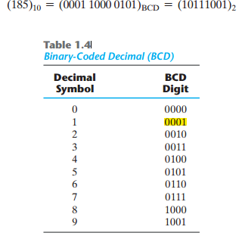
Binary-Coded Decimal Code
binary‐coded decimal and is commonly referred to as BCD. A number with k decimal digits will require 4k bits in BCD. Decimal 396 is represented in BCD with 12 bits as 0011 1001 0110, with each group of 4 bits representing one decimal digit

Slide 6
Extra Information

Slide 7
BINARY STORAGE AND REGISTERS
A binary cell is a device that possesses two stable states and is capable of storing one bit (0 or 1) of information
Registers
A register is a group of binary cells. A register with n cells can store any discrete quantity of information that contains n bits. The state of a register is an n‐tuple of 1’s and 0’s, with each bit designating the state of one cell in the register.
Consider, for example, a 16‐bit register with the following binary content:
1100001111001001
A register with 16 cells can be in one of 2¹⁶ possible states
Tuple
In mathematics, an n-tuple is a sequence (or ordered list) of n elements, where n is a non-negative integer. There is only one 0-tuple, an empty sequence. An n-tuple is defined inductively using the construction of an ordered pair.
The device most commonly used for holding data is a register

Slide 8
B I NARY L O G I C
Binary logic deals with variables that take on two discrete values (logical meaning).
The two values the variables assume may be called by different names (true and false,
yes and no but it is convenient to think in terms of bits and assign the values 1 and 0).
Definition of Binary Logic
Binary logic consists of binary variables and a set of logical operations.
The variables are designated by letters of the alphabet, such as A, B, C, x, y, z, etc. with each variable having two and only two distinct possible values: 1 and 0.
There are three basic logical operations: AND, OR, and NOT. Each operation produces a binary result, denoted by z.
AND and OR are the same as those used for multiplication and addition.
However, binary logic should not be confused with binary arithmetic

Slide 9
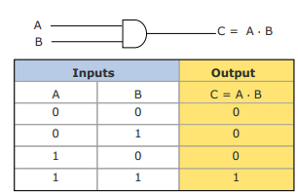
The AND operation
1. AND
This operation is represented by a dot (.)or by the absence of an operator. For example, x . y = z or C or xy = z is read “x AND y is equal to z.”
The logical operation AND is interpreted to mean that C = 1 if and only if x = 1 and y = 1; otherwise C= 0

Slide 10
The OR & NOT Operation
2. The OR Operation
This operation is represented by a plus sign. For example, x + y = z is read “x OR y is equal to z,” meaning that z = 1 if x = 1 or if y = 1 or if both x = 1 and y = 1. If both x = 0 and y = 0, then z = 0.
3. NOT:
This operation is represented by a prime (sometimes by an overbar). For example, x/ = z (or x– = z) is read “not x is equal to z,” meaning that z is what x is not. In other words, if x = 1, then z = 0, but if x = 0, then z = 1. The NOT operation is also referred to as the complement operation, since it changes a 1 to 0 and a 0 to 1.

Slide 11
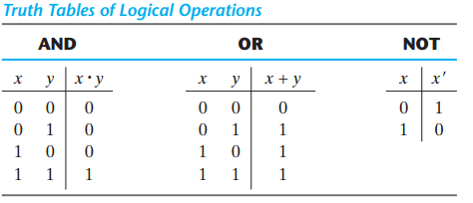
Truth Tables of Logical Operations

Slide 12
Switching Circuits
Electronic digital circuits are sometimes called switching circuits because they behave like a switch.
The use of binary variable & the application of binary logic are demonstrated by the simple switching circuits.
L = A.B for the circuit of AND operation (Series Switches) &
L= A+B for the circuit of OR operation (Parallel Switches)
A
B
L
Voltage Source

Slide 13
Logic Gates
DEFINITION:
A logic gate is a an electronics circuit which makes logic decision.
In other words
“ A logic gate is an electronic circuit having one or more inputs and only one output which will be either high or low (based on the input status)
Logic gates are electronic circuits that operate on one or more input signals to produce an output signal
Logic gates are widely used in digital computers and in different types of system and circuits.

Slide 14
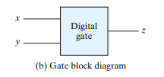
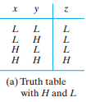
Types of Gates
AND
OR
NOT Or Inverter
NAND
NOR
Exclusive-OR (XOR)
Exclusive-NOR or
equivalence
Buffer

Slide 15
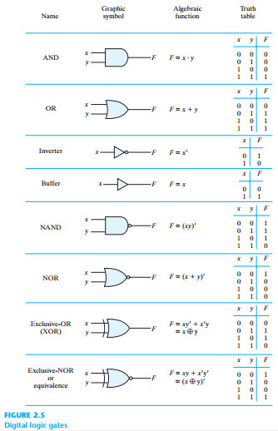

Slide 16
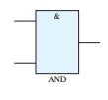
AND Gate (BLOCK DIAGRAME & Truth table)
Physical realization of logical multiplication (AND) operation.
Generates an output signal of 1 only if all input signals are also 1
Any input is zero output is zero

Slide 17
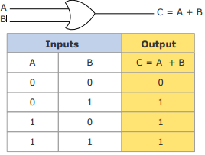
or Gate (BLOCK DIAGRAME & Truth table)
Physical realization of logical addition (OR) operation.
Generates an output signal of 1 if at least one of the input signals is also 1

Slide 18
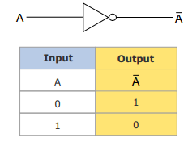
Not Gate (BLOCK DIAGRAME & Truth table)
Output is always the complement of the input.
Physical realization of complementation operation Generates an output signal, which is the reverse of the input signal
When the Input is Low, The output is High & Vice versa.

Slide 19
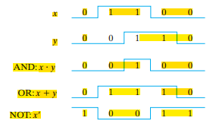
Wave form input and out put signal

Slide 20
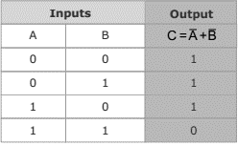
Nand Gate (BLOCK DIAGRAME & Truth table)
Complemented AND gate “ Abbreviation of not-AND”
Generates an output signal of:
1 if any one of the inputs is a 0
0 when all the inputs are 1
Any Input is Zero (low), output is One (High)
The NAND gate is combination of AND-NOT gate
The NAND gate used as Universal gate:
NAND gate can be used in combination to
perform the AND, OR and Inverter Operation.

Slide 21
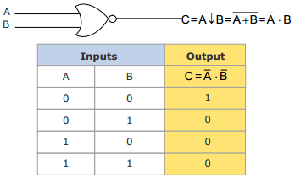
NOR Gate (BLOCK DIAGRAME & Truth table)
Complemented OR gate Generates an output signal of: 1 only when all inputs are 0 0 if any one of inputs is a 1
The NOR function is the complement of the OR function & its name is an abbreviation of not-OR.

Slide 22
Buffer

Slide 23
The exclusive-or gate (xor)
Output is high when both inputs are at opposite level or
Output is low when both inputs are at same level.
XOR gate sometime called “any but not all gate”

Slide 24
The exclusive-Nor gate (xnor)
Output is high when both inputs are at same level
logical complement of the exclusive OR (XOR) gate

Slide 25
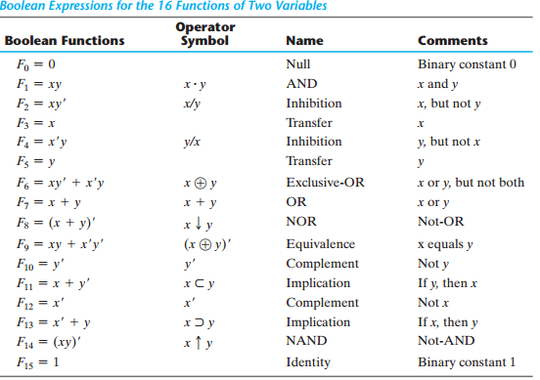
Logic Operators

Slide 26
Logic circuits/ combinational logic circuits
When logic gates are interconnected to form a gating / logic network, it is known as a combinational logic circuit. The Boolean algebra expression for a given logic circuit can be derived by systematically progressing from input to output on the gates.
The three logic gates (AND, OR, and NOT) are logically complete because any Boolean expression can be realized as a logic circuit using only these three gate

Slide 27
Assignment
1. Develop the truth table for a 3-input AND gate
And develop output using following inputs for AND gate in wave form (timing diagram) of input
A= 1 0 1 1 0 and B = 1 1 1 0 0
. 2 Designed a simplified portion of an intrusion detection & alarm system using OR gate.
3. A wave form is applied to an inverter in figure. Determine the output waveform corresponding to the input and show the timing diagram to the placement of the bubble, what is active output state.
1
0
As a part of aircraft’s functional monitoring system, a circuit is required to indicate the status of the landing gear prior to landing.
Implement a circuit to meet following requirement using NOR and negative AND gate.

Slide 28
Boolean Algebra
An algebra that deals with binary number system
George Boole (1815-1864), an English mathematician, developed it for:
Simplifying representation
Manipulation of propositional logic
In 1938, Claude E. Shannon proposed using Boolean algebra in design of relay switching circuits
Provides economical and straightforward approach
Used extensively in designing electronic circuits used in computers

Slide 29
Fundamental Concept of Boolean Algebra
Use of Binary Digit
Boolean equations can have either of two possible values, 0 and 1
Logical Addition Symbol ‘+’, also known as ‘OR’ operator, used for logical addition. Follows law of binary addition
Logical Multiplication Symbol ‘.’, also known as ‘AND’ operator, used for logical multiplication. Follows law of binary multiplication
Complementation Symbol ‘-’, also known as ‘NOT’ operator, used for complementation. Follows law of binary complimen

Slide 30
References
Digital Design by M Morris Mnao
Computer Fundamentals- Pradeep K.Sinha & Proti Shina

Slide 31
THANK YOU!
QUESTIONS

