Slide 1
AWARNESS OF TOOLS AND EQUIPMENTS
PRINTMAKING

Slide 2
LINOCUT TOOLS AND PLATE

Slide 3
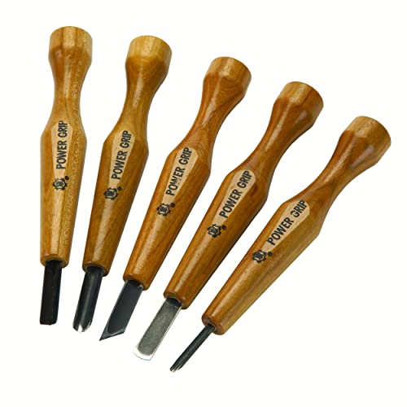

Slide 5
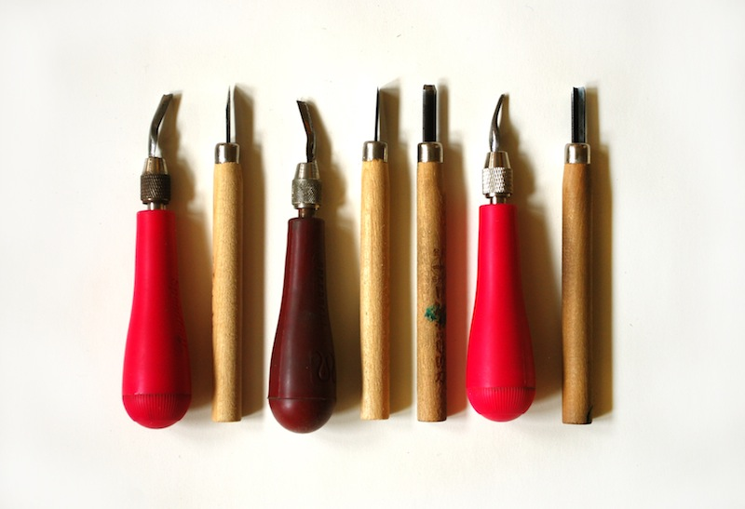

Slide 7
MEZZOTINT TOOLS AND COPPER PLATE

Slide 8
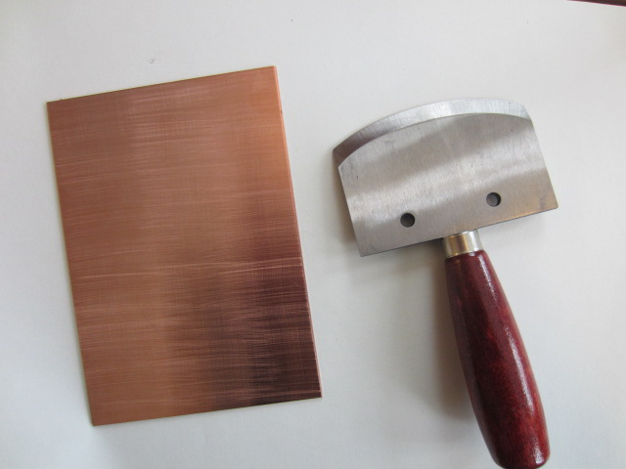
PLATE AND ROCKER

Slide 9
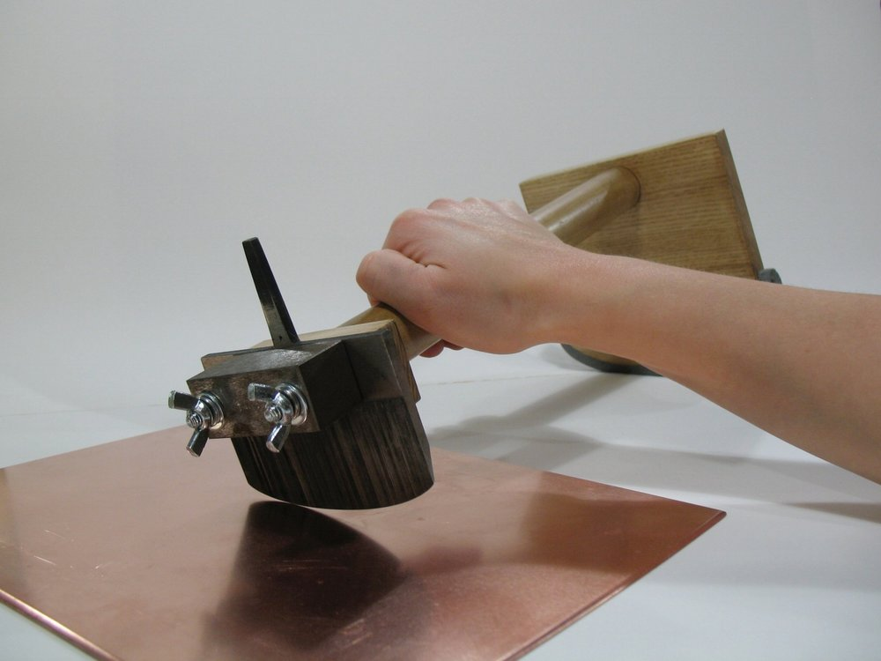

Slide 10
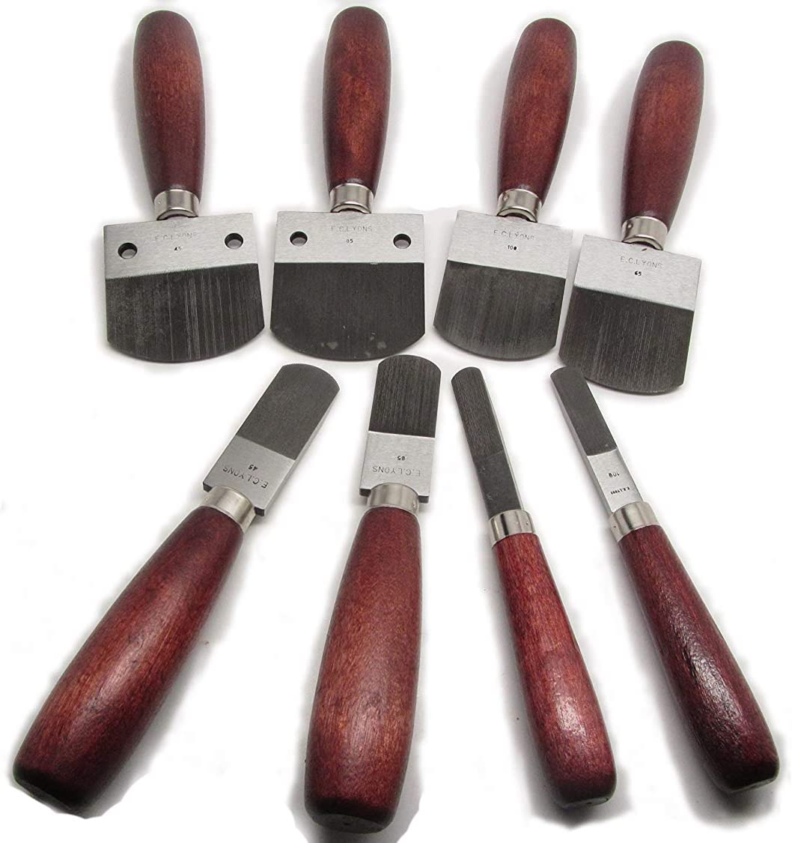

Slide 11
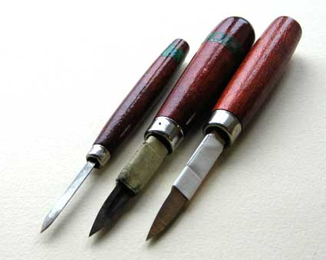
BURNISHERS

Slide 12
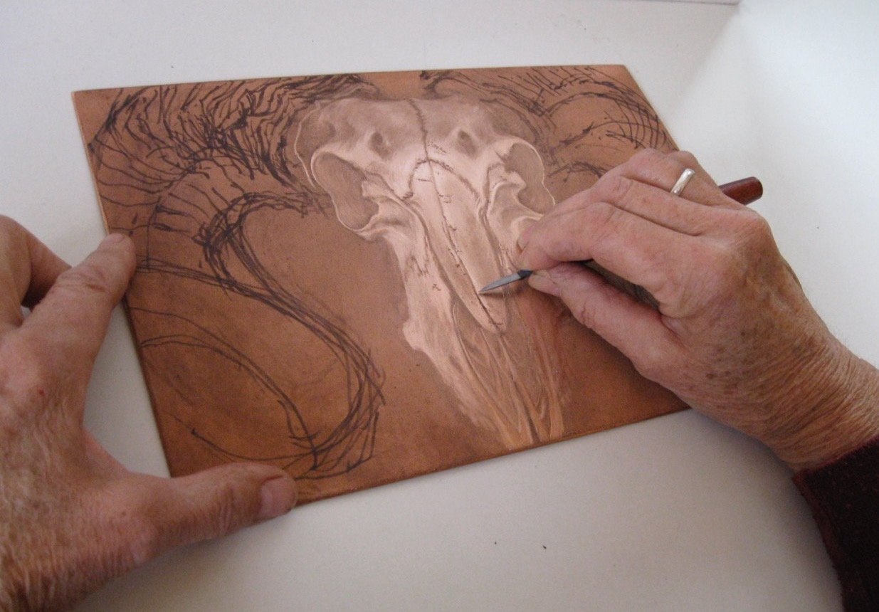

Slide 13
SCREEN PRINTING TOOLS

Slide 14
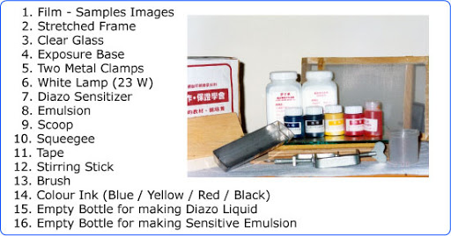

Slide 15
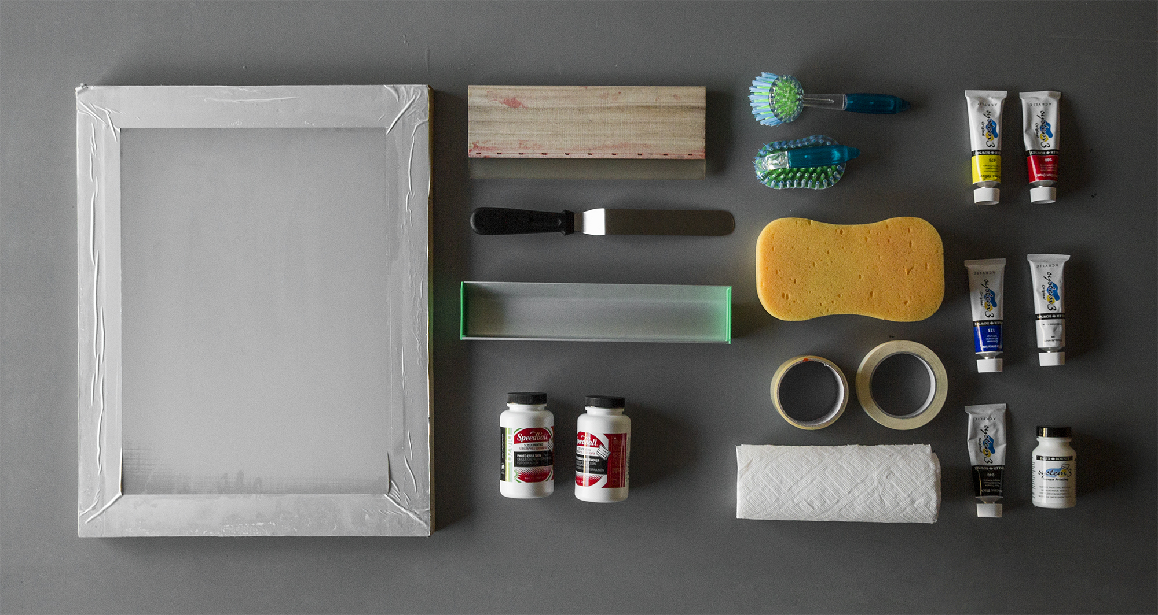

Slide 16
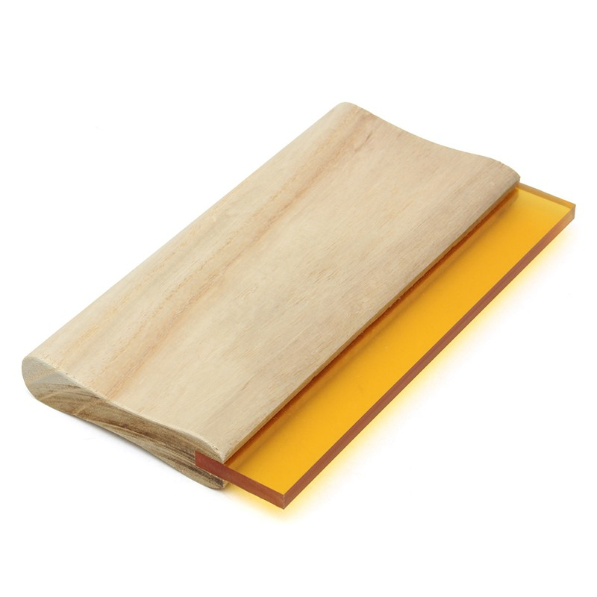
SQUEEGEE

Slide 17
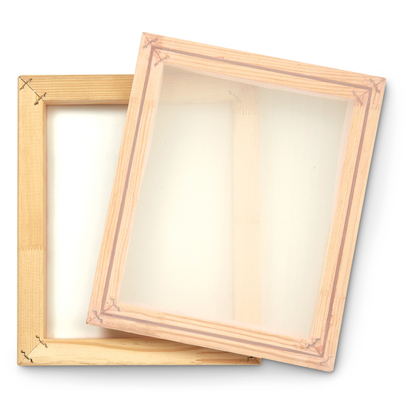
SCREEN PRINTING FRAME

Slide 18
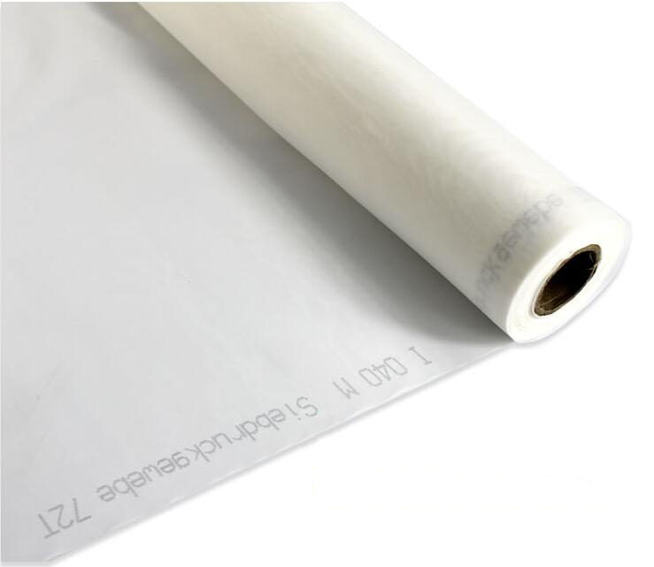
SCREEN MESH

Slide 19
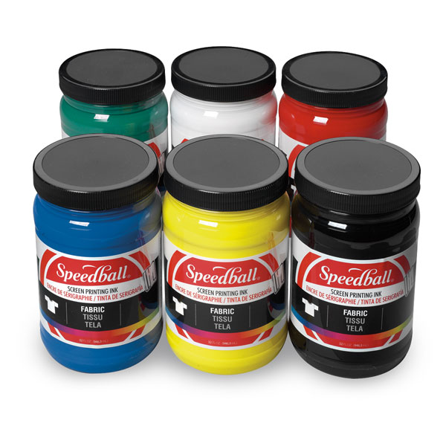
SCREEN PRINTING INKS

Slide 20
LINE ENGRAVING TOOLS

Slide 21
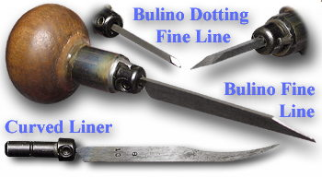

Slide 22
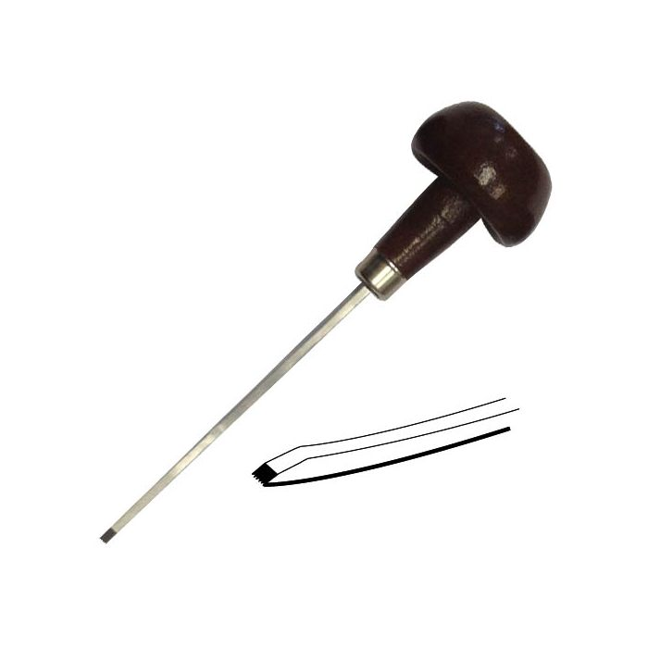

Slide 23
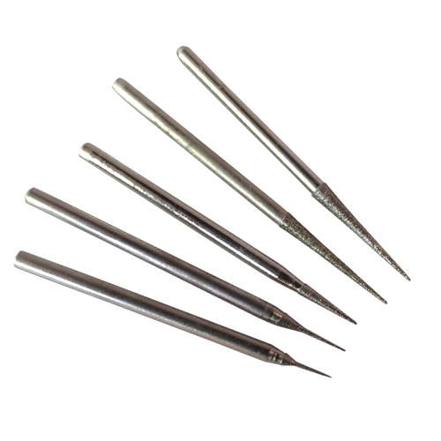
DIAMOND POINT ENGRAVING TOOLS

Slide 24
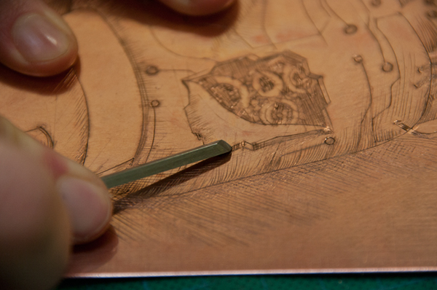

Slide 25
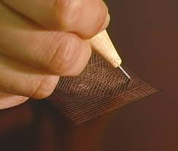

Slide 26
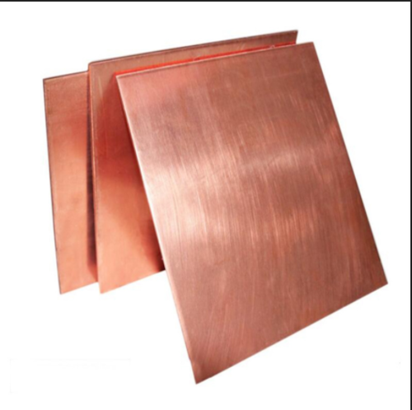
COPPER PLATE

Slide 27
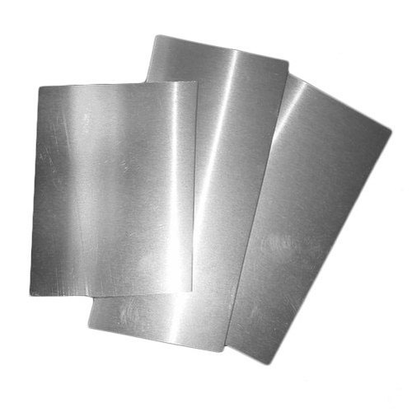
ZINC PLATE

Slide 28
LITHOGRAPHY TOOLS

Slide 29
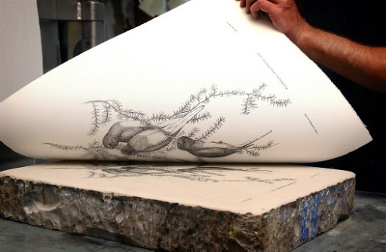

Slide 30
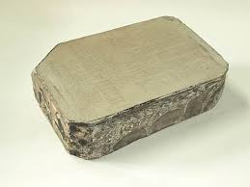
LITHO STONE

Slide 31
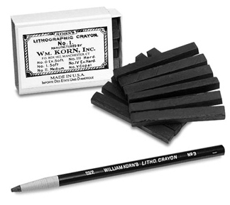
LITHO CRAYON PENCIL

Slide 32
THE END

