Slide 1
Haemorrhoids
Dr Ahmad Hassan Khan
Associate Professor Surgery
Sargodha Medical College

Slide 2
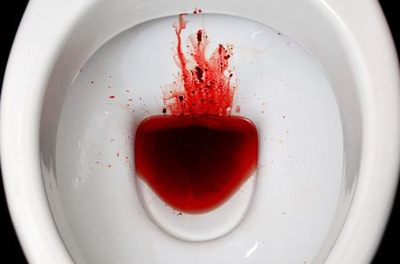

Slide 3
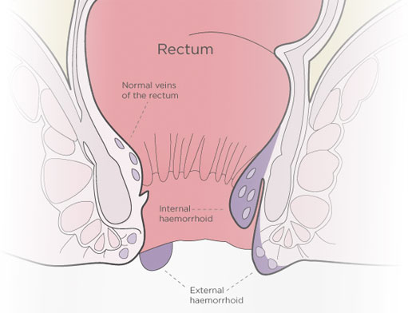
Hemorrhoids( meaning)
Haema blood
Rhoos flowing

Slide 4
Anal cushions to Haemorroids
Anal cushions are aggregation of blood vessels, smooth muscles and elastic connective tissue in sub-mucosa
Haemorrhoids are downward sliding of anal cushions due to straining or some other causes.

Slide 5
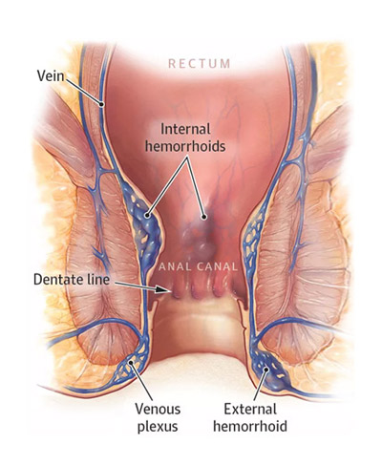

Slide 7
5

Slide 8
Types of Hemorrhoids
Internal
External
Internoexternal

Slide 11
Primary or secondary
Primary – when there is no known cause
Secondary – when there is a cause for example a Rectal Tumour

Slide 16
How many anal cushions
3
What are the positions in lithotomy position
3 7 and 11 o clock
What are the types of Haemorrhoids
Internal, external, internoexternal

Slide 21
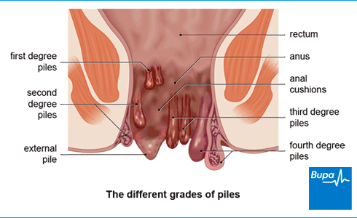

Slide 23
Treatment

Slide 26
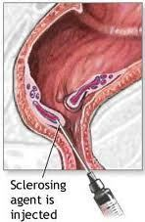

Slide 28
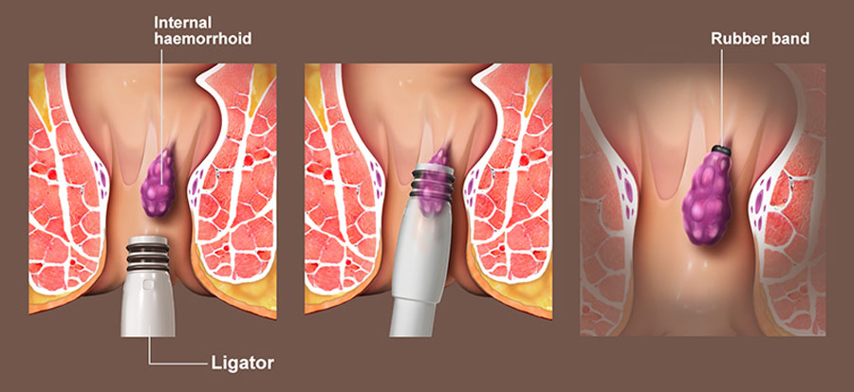

Slide 29
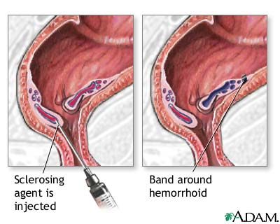

Slide 40
Anal Fissure

Slide 52
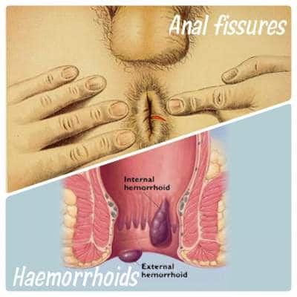

Slide 53
Thank you

