Slide 1
Head sclerites
Dr. M. Asam Riaz
Assistant Professor
Entomology, College of Agriculture, University of Sargodha, Sargodha, Pakistan

Slide 2
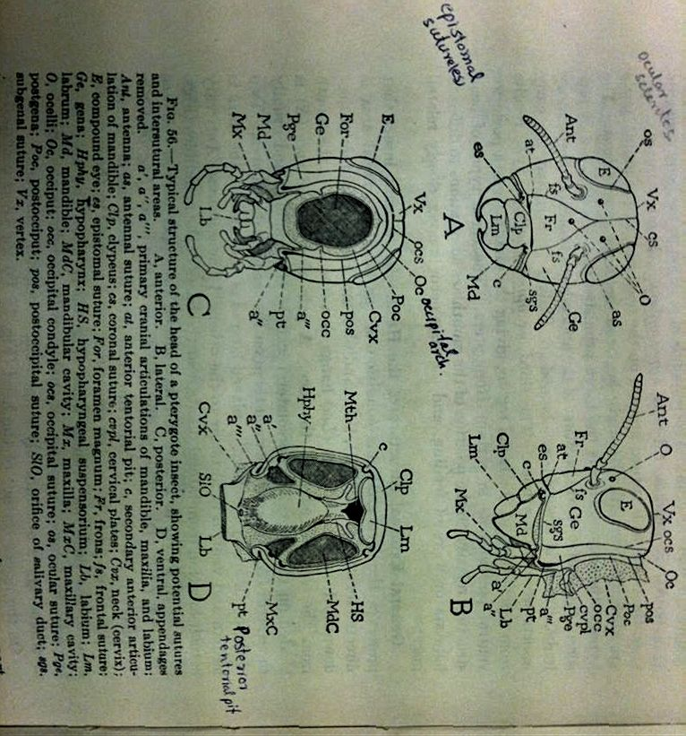
Sclerites of head
O: occelus
as: antenal sclerite
Ge: gena
Fr: fron
Clp: clypeus
Lm: labrum
occ: occipital condyle
oc: occipital arch
Pge: postgena
Vx: vertex
at: anterior tentorial pit

Slide 3
1-Fron (Fr)
It is the unpaired, upper facial part of head.
It is the part of head which bears median ocellus .
And is delimited by frontoclypeal distally and frontogenal sulcus laterally

Slide 4
Clypeus (Clp):
It lies immediately anterior(next/near) to the fron
Have two fused or partially or completely divided sclerite by transverse suture.

Slide 5
3-Labrum (Lm):
Unpaired sclerite.
Articulated with clypeus by means of clypeolabral sulcus.
.

Slide 6
4-Epicranium: (cranium>>>skull)
Upper region of head. Dorsal part of head
Longitudinal divided into two epicranial plates by ecdysial cleavage line or median sulcus or epicranial suture.
Vertex (Vx):
Portion of epicranium which lies between compound eyes.
Dorsal surface of gena/parietal plates
Fastigium
Area/ part between vertex and fron.
.

Slide 7
5-Gena (Ge):
Lateral area of cranium is known as gena.
It bears antennae, one lateral ocellus and one compound eye.

Slide 8
Ocular sclerites:
A band encircling compound eye, consists of sclerites which are known as ocular sclerites.
Antennal sclerites:
Marginal area of antennal socket consists of sclerites known as antennal sclerites.

Slide 9
Occipital arch (Oc):
Present on posterior surface of head
Horse shoe- shaped band/arch
Dorsal part of occipital arch is known as occiput
Lateral part of occipital arch is known as postgena (Pge).

Slide 10
Post Occiput (Poc):
Narrow posterior ring/rim next to occipital arch.
Neck membrane/cervical membrane (Cvx) is attached with it
Posterior lateral margin has a process called occipital condyl (Occ)

Slide 11
Subgenal Area/ Subgena:
Sclerite below gena
Part of subgena above mandibles is distinguished as Pleuostoma (Plst)
And part of subgena behind the mandibles is known as Hypopostoma (Hst)

Slide 12
Cs = coronal suture
Ocs = occipital suture
Pos= postoccipital suture
Sgs=subgenal suture

Slide 13
Fig 57
ps=pleurostomal suture
hs=hypostomal suture

Slide 14
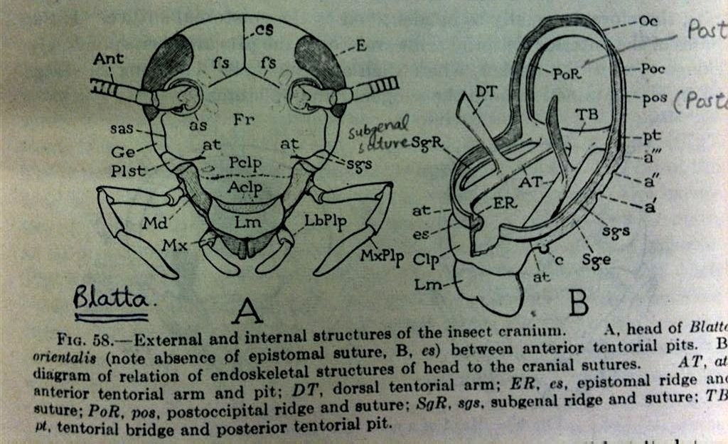
Fig 58
sgs=subgenal suture

Slide 15
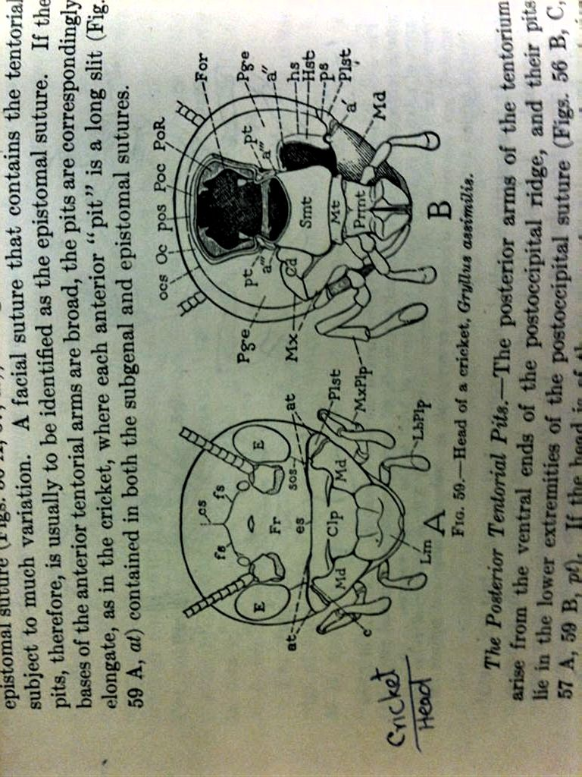
Fig 59 A (Crickets)
Fs (frontal suture: incomplete)

Slide 16
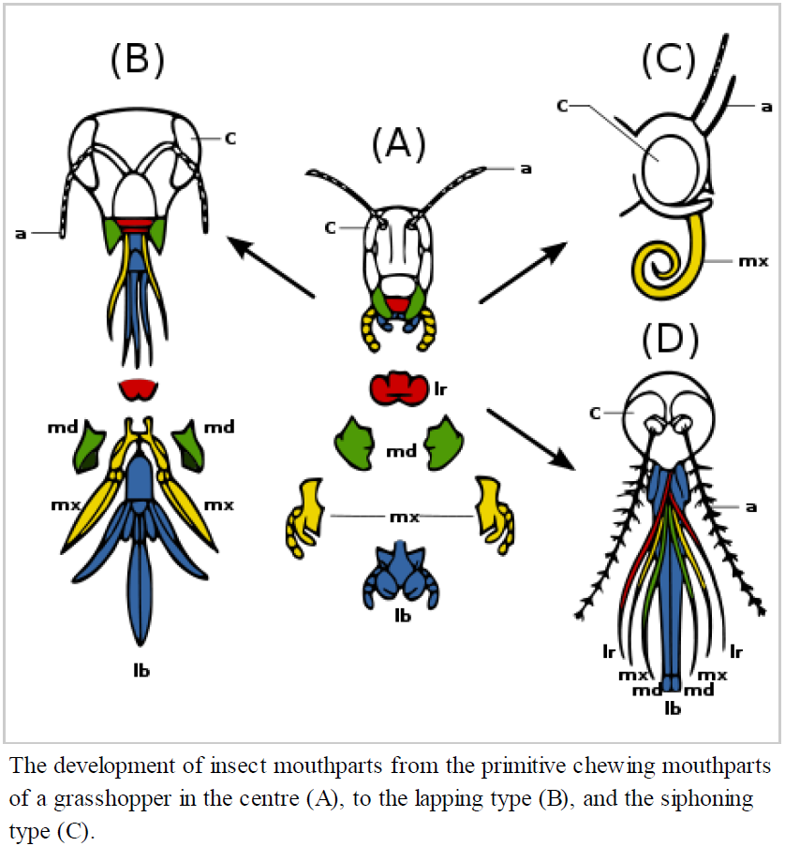
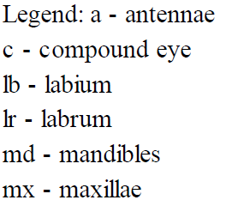

Slide 17
