Slide 1
ENZYME ,STRUCTUE AND FACTOR EFFECTING ITS RATE

Slide 2
Enzyme Introduction
“Enzyme is a substance that acts as a catalyst in living organisms, regulating the rate which chemical reactions proceed without itself being altered in the process”
The cytoplasmic matrix and many cellular organelles contain very important organic compounds known as the enzymes.
The word enzyme (Greek. “in yeast”) had been proposed by Kuhne in 1878
the enzymes are the catalysts of the biological world and they influence the rate of a chemical reaction, while themselves remain quite unchanged at the end of the reaction.

Slide 3
Continue……..
The substance on which the enzymes act is known as substrate.
The enzymes play a vital role in various metabolic and biosynthetic activities of the cell such as synthesis (anabolism) of DNA, RNA and protein molecules and catabolism of
carbohydrates,
lipids,
fats and other chemical substances.
Enzyme are classified on the bases og cellular organelles

Slide 4
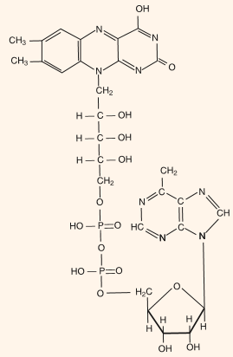

Slide 5
Classifications
Oxireductases.
The enzymes catalyzing the oxidation and reduction reaction of the cell are known as oxireductases. These enzymes transfer the electrons and hydrogen ions from the substrates, e.g., hydrogenases or reductases, oxidases, oxygenases and peroxidases.
Transferases.
The enzymes which transfer following groups from one molecule to other are known as transferases : one carbon, aldehydic or ketonic residues, acyl, glycosyl, alkyl, nitrogenous, phosphorus containing groups and sulphur containing groups.
Hydrolases:
These enzymes hydrolyse a complex molecule into two compounds by adding the element of the water across the bond which is cleaved. These enzymes act on the following bonds– ester, glycosyl, ether, peptide, other C–N bonds, acid anhydride, C–C, halide and P–N bonds. Certian important hydrolase enzymes are the proteases, esterases, phosphatases, nucleases and phosphorylases.

Slide 6
Continue
Lysases:
he lysase enzymes add or remove group to or from the chemical compounds containing the double bonds. The lysases act on C–C, C–O, C–N, C–S and C–halide bonds.
Isomerases.
These enzymes catalyse the reaction involving in the isomerization or intramolecular rearrangements in the substrates, e.g., intramolecular oxidoreductases, intramolecular transferases, intramolecular lysases, cis-trans-isomerases, racemases and epimerases.
Ligases or synthetases.
These enzymes catalyze the linkage of the molecules by splitting a phosphate bond. The synthetase enzymes form C–O, C–S, C–N and C–C bonds.

Slide 7
Chemical nature
According to the chemical nature of the substrate the enzymes have also been classified as follows:
1. Carbohydrases,
2. Proteases (endopeptidases and exopeptidases),
3. Amylases
, 4. Esterases,
5. Dehydrogenases,

Slide 8
Continue
6. Oxidases,
7. Decarboxylases,
8. Hydrases,
9. Transferases,
10. Isomerases

Slide 9
Continue….
The enzymes are specific in action and many factors such as pH, temperature and concentration of the substrate affect the rate of the activity of enzymes.
Certain enzymes occur in the inactive form (called proenzymes or zymogens) and
These are activated by other enzymes known as kinases to perform catalytic activities. Likewise, the enzyme trypsinogen of the pancreatic cells is activated in the intestine by the enzyme enterokinase and the enzyme pepsinogen of the Chief cells of the stomach is activated by the hydrochloric acid which is secreted by parietal cells

Slide 10
Enzyme as protein
Protease belongs to a group of proteolytic enzymes that is to hydrolyze peptide bonds of proteins.
These enzymes are widely distributed in nearly all plants, animals, and microorganisms.
The partial digestion by proteases produces peptide sequences that may have biological properties and important functional food ingredients
Proteases constitute one of the most important groups of industrial enzymes, capturing almost 60% of the total enzyme market

Slide 11
Continue …

Slide 12
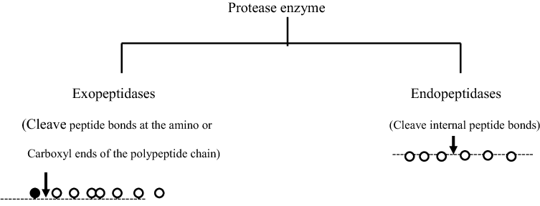
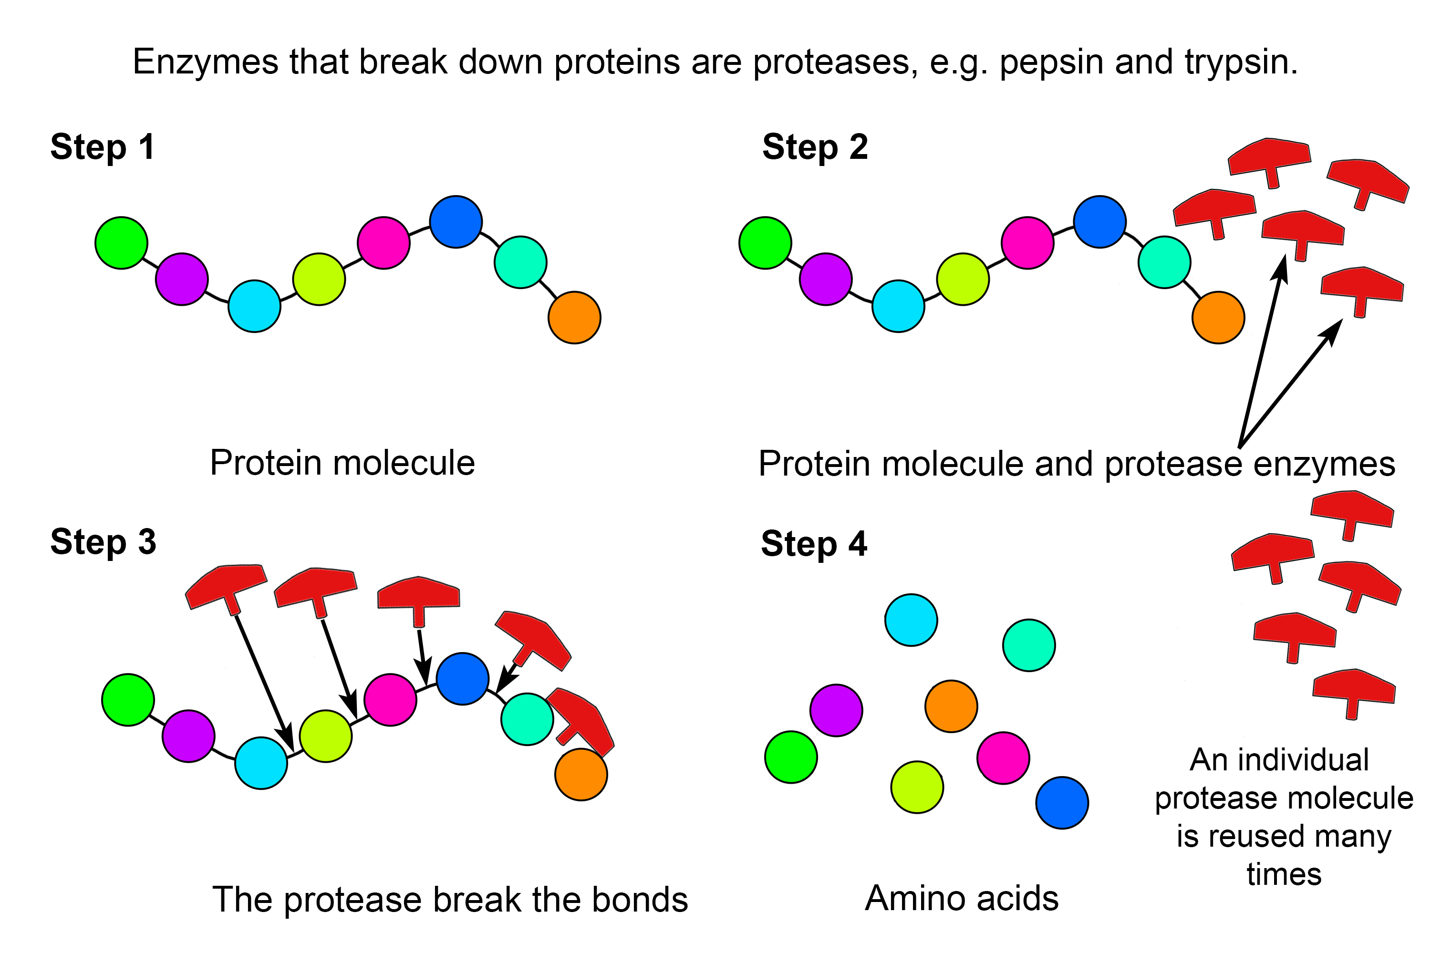

Slide 13
Enzyme as catalyst
This is a model of catalase, showing the globular structure - a bit like a tangled mass of string:
They act as a catalyst to a chemical or biochemical reaction, with a defined mechanism.
They increase the speed of that reaction, typically by 10⁶-10¹⁴ times faster than the rate of the uncatalysed reaction.
They are selective for a single substrate.
They speed up rate of reaction by lowering the activation energy (Ea).
They are stereospecific, meaning the reaction produces a single product.

Slide 14
Continue

Slide 15
Prosthetic groups
Prosthetic Groups and Coenzymes
Certain enzymes such as cytochromes are the conjugated proteins and contain prosthetic group as metalloporphyrins complex in their molecules. Certain enzymes cannot function singly but they can function only by the addition with the small molecules of other chemical substances which are known as coenzymes.
The inactive enzyme (which cannot function singly) is known as the apoenzyme. The apoenzyme and coenzyme are collectively known as holoenzyme. For instance, the enzyme hydrogenase is an apoenzyme which can function either with the coenzyme NAD+ or NADP

Slide 16
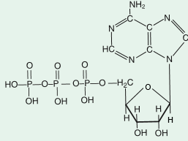

Slide 17
Active site
the active site is the region of an enzyme where substrate molecules bind and undergo a chemical reaction The active site consists of amino acid residues that form temporary bonds with the substrate (binding site) and residues that catalyse a reaction of that substrate (catalytic site).
Although the active site occupies only ~10–20% of the volume of an enzymeit is the most important part as it directly catalyzes the chemical reaction.
It usually consists of three to four amino acids, while other amino acids within the protein are required to maintain the tertiary structure of the enzyme

Slide 18
Bonding site
Usually, an enzyme molecule has only two active sites, and the active sites fit with one specific type of substrate.
An active site contains a binding site that binds the substrate and orients it for catalysis.
The orientation of the substrate and the close proximity between it and the active site is so important that in some cases the enzyme can still function properly even though all other parts are mutated and lose function

Slide 19
Lock and key model
Lock and Key Theory:
The specific action of an enzyme with a single substrate can be explained using a Lock and Key analogy first postulated in 1894 by Emil Fischer. In this analogy, the lock is the enzyme and the key is the substrate. Only the correctly sized key (substrate) fits into the key hole (active site) of the lock (enzyme).
Smaller keys, larger keys, or incorrectly positioned teeth on keys (incorrectly shaped or sized substrate molecules) do not fit into the lock (enzyme). Only the correctly shaped key opens a particular lock. This is illustrated in graphic on the left.

Slide 20
The induced-fit theory assumes that the substrate plays a role in determining the final shape of the enzyme and that the enzyme is partially flexible.
Daniel Koshland's theory of enzyme-substrate binding is that the active site and the binding portion of the substrate are not exactly complementary.
The induced fit model is a development of the lock-and-key model and assumes that an active site is flexible and changes shape until the substrate is completely bound.

Slide 21
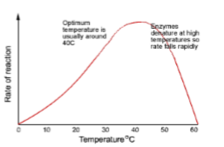
Factors affecting its action rate
Temperature
A higher temperature generally makes for higher rates of reaction, enzyme-catalyzed or otherwise. However, either increasing or decreasing the temperature outside of a tolerable range can affect chemical bonds in the active site, making them less well-suited to bind substrates. Very high temperatures,

Slide 22
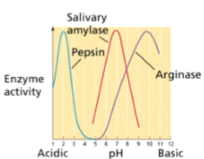
PH
pH can also affect enzyme function. Active site amino acid residues often have acidic or basic properties that are important for catalysis. Changes in pH can affect these residues and make it hard for substrates to bind. Enzymes work best within a certain pH range, and, as with temperature, extreme pH values (acidic or basic) can make enzymes denature

Slide 23
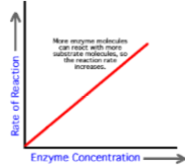
Enzyme concentration
As the enzyme concentration increases the rate of the reaction also increases, because there are more enzyme molecules (and so more active sites), available to catalyse the reaction therefore more enzyme-substrate complexes form. In cells, the substrate is always in excess, so the graph does not level out. In the lab, these conditions need not apply and a plateau can be reached.

Slide 24
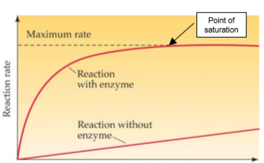
Substrate concentration
The rate of an enzyme-catalysed reaction is also affected by substrate concentration. As the substrate concentration increases, the rate increases because more substrate molecules can collide with active sites, so more enzyme-substrate complexes form.

Slide 25
Covalent modification
Covalent modification
The activity of some enzymes is controlled by other enzymes, which modify the protein chain by cutting it, or adding a phosphate or methyl group. This modification can turn an inactive enzyme into an active enzyme (or vice versa),
and this is used to control many metabolic enzymes and to switch on enzymes in the gut e.g. HCl in stomach → activates pepsin → activates rennin.

Slide 26
Inhibitors
Inhibitors inhibit the activity of enzymes, reducing the rate of their reactions. They are found naturally, but are also used artificially as drugs, pesticides and research tools. There are two kinds of inhibitors.
(a) A competitive inhibitor molecule has a similar structure to the substrate molecule, and so it can fit into the active site of the enzyme. It therefore competes with the substrate for the active site, so the reaction is slower. Increasing the concentration of substrate restores the reaction rate and the inhibition is usually temporary and reversible. Competitive inhibitors increase KM for the enzyme, but have no effect on vmax, so the rate can approach a normal rate if the substrate concentration is increased high enough.

Slide 27
Inhibitors

