Slide 1
Command Design Pattern

Slide 2
The Command Pattern encapsulates a request as an object, thereby letting you parameterize other objects with different requests, queue or log requests, and support undoable operations.
In other Words
Command pattern is a data driven design pattern and falls under behavioral
pattern category. A request is wrapped under an object as command and
passed to invoker object. Invoker object looks for the appropriate object
which can handle this command and passes the command to the
corresponding object which executes the command.

Slide 3
Problem
Need to issue requests to objects without knowing anything about the operation being requested or the receiver of the request.

Slide 4
Vocabulary
Command
The command that is being sent
Client
The sender of the command
Invoker
the one that performs the operation
Receiver
The one who gets the command
ConcreteCommand
Implements execute( ) by invoking the corresponding operation(s) on Receiver(s)

Slide 5
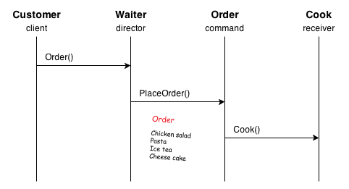
Problem

Slide 6
Pick two students as volunteers
Setting is in a resturant
One student is the customer
One student is the cook
One student is the bartender
One student is the waiter ( invoker)
Pass the peice of paper as the order to the customer
customer ( client ) writes down a drink order on the paper and give to waiter
waiter gives the order (invoke command ) to the barender ( receiver )
bartender makes the food
customer ( client ) writes down food order on the paper and give to waiter
waiter gives the order ( invoke command ) to the cook ( receiver )
cook makes the food (executes the command)

Slide 7
Pros & Cons
Pros
Decreasing the dependency/coupling of the system
New commands can be added into the system easily
Macro Instructions are easier to implement now
Making it easier to undo and redo commands. e.g. use Memento to maintain
the states

Slide 8
Cons
Using command design pattern may requires more effort on implementation, since each command requires a concrete command class, which will increase the number of classes significantly.

