Slide 1
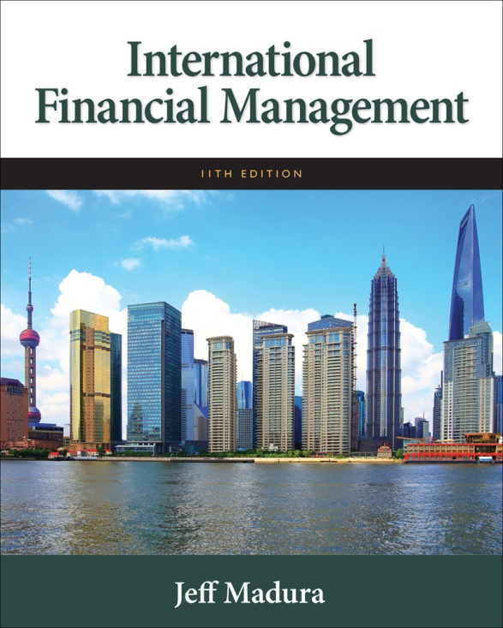

Slide 2
8
Relationships among Inflation, Interest Rates and Exchange Rates
Chapter Objectives
Explain the purchasing power parity (PPP) theory and its implications for exchange rate changes
Explain the International Fisher effect (IFE) theory and its implications for exchange rate changes
Compare the PPP theory, the IFE theory, and the theory of interest rate parity (IRP), which was introduced in the previous chapter
2

Slide 3
Purchasing Power Parity (PPP)
Interpretations of Purchasing Power Parity
Absolute Form of PPP: without international barriers, consumers shift their demand to wherever prices are lower. Prices of the same basket of products in two different countries should be equal when measured in common currency.
Relative Form of PPP: Due to market imperfections, prices of the same basket of products in different countries will not necessarily be the same, but the rate of change in prices should be similar when measured in common currency

Slide 4
Rational Behind Relative PPP Theory
Exchange rate adjustment is necessary for the relative purchasing power to be the same whether buying products locally or from another country.
If the purchasing power is not equal, consumers will shift purchases to wherever products are cheaper until the purchasing power is equal.

Slide 5
Purchasing Power Parity
Relationship between relative inflation rates (I) and the exchange rate (e).
Simplified PPP relationship

Slide 6
Using PPP to Estimate Exchange Rate Effects
The relative form of PPP can be used to estimate how an exchange rate will change in response to differential inflation rates between countries.
International trade is the mechanism by which the inflation differential affects the exchange rate according to this theory (Exhibit 8.1)

Slide 7
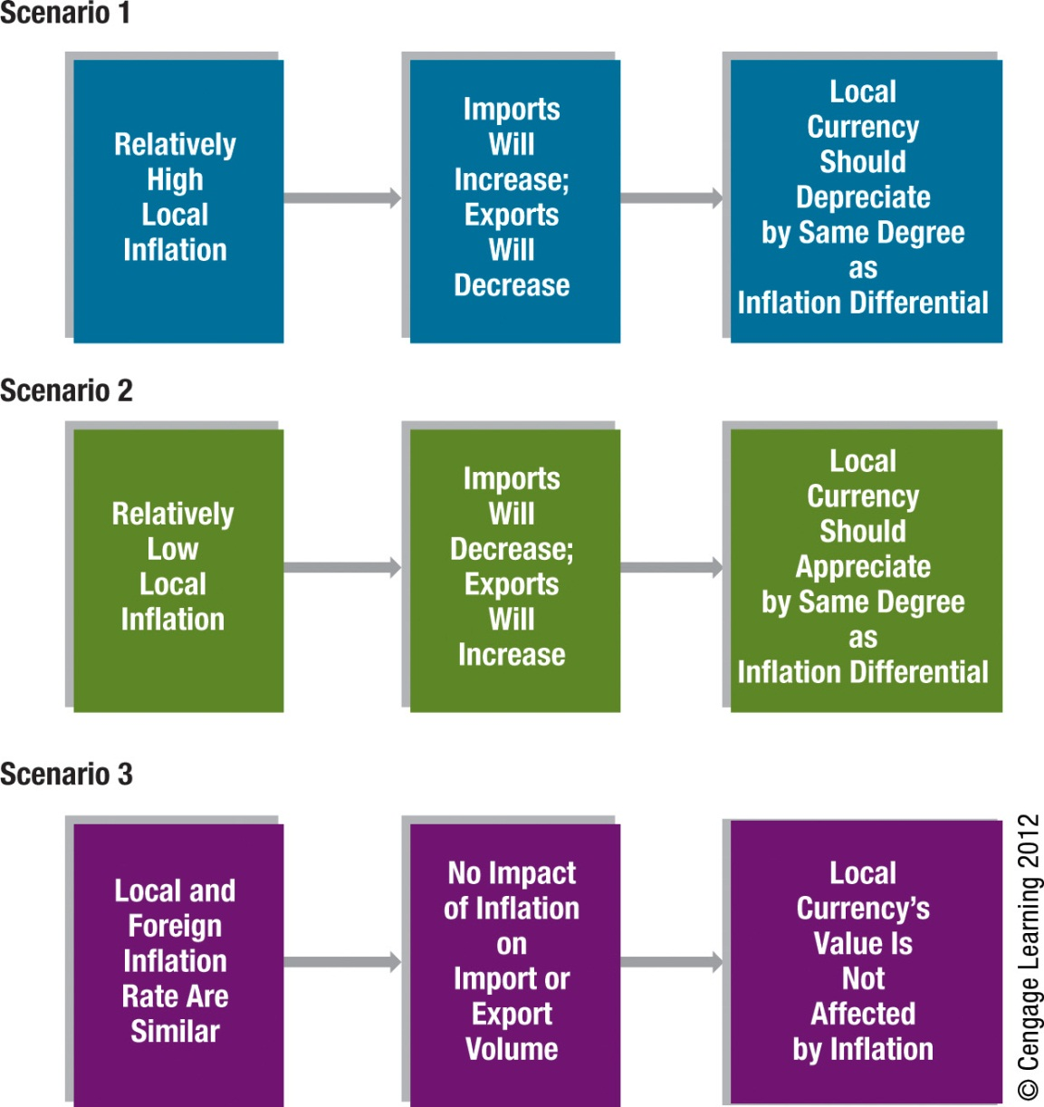
Exhibit 8.1 Summary of Purchasing Power Parity

Slide 8
Graphic Analysis of Purchasing Power Parity
Using PPP theory, we should be able to assess the potential impact of inflation on exchange rates. The points on the Exhibit 8.2 suggest that given an inflation differential between the home and the foreign country of X percent, the foreign currency should adjust by X percent due to that inflation differential.
PPP Line - The diagonal line connecting all these points together.

Slide 9
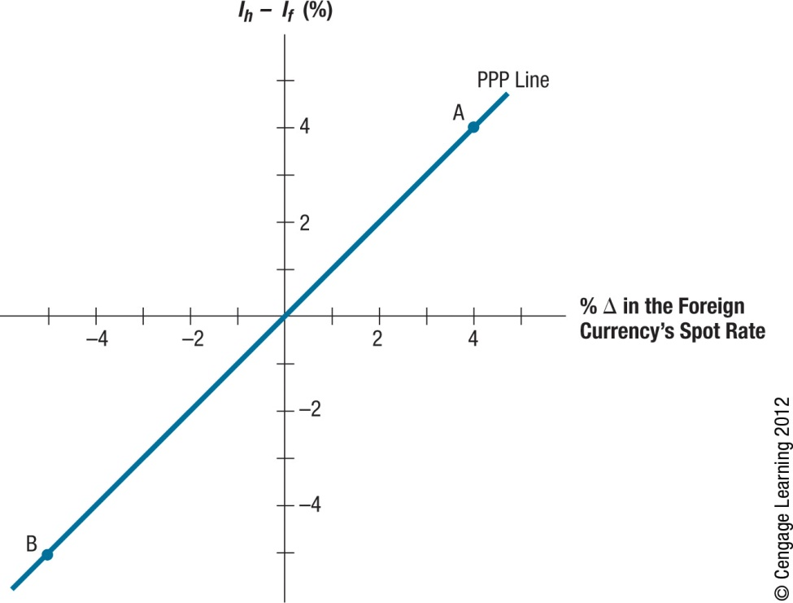
Exhibit 8.2 Illustration of Purchasing Power Parity

Slide 10
Purchasing Power Disparity
Any points off of the PPP line represent purchasing power disparity. If the exchange rate does not move as PPP theory suggests, there is a disparity in the purchasing power of the two countries.
Point C in Exhibit 8.3 represents a situation where home inflation (I_{h}) exceeds foreign inflation (I_{f} ) by 4 percent. Yet, the foreign currency appreciated by only 1 percent in response to this inflation differential. Consequently, purchasing power disparity exists.

Slide 11
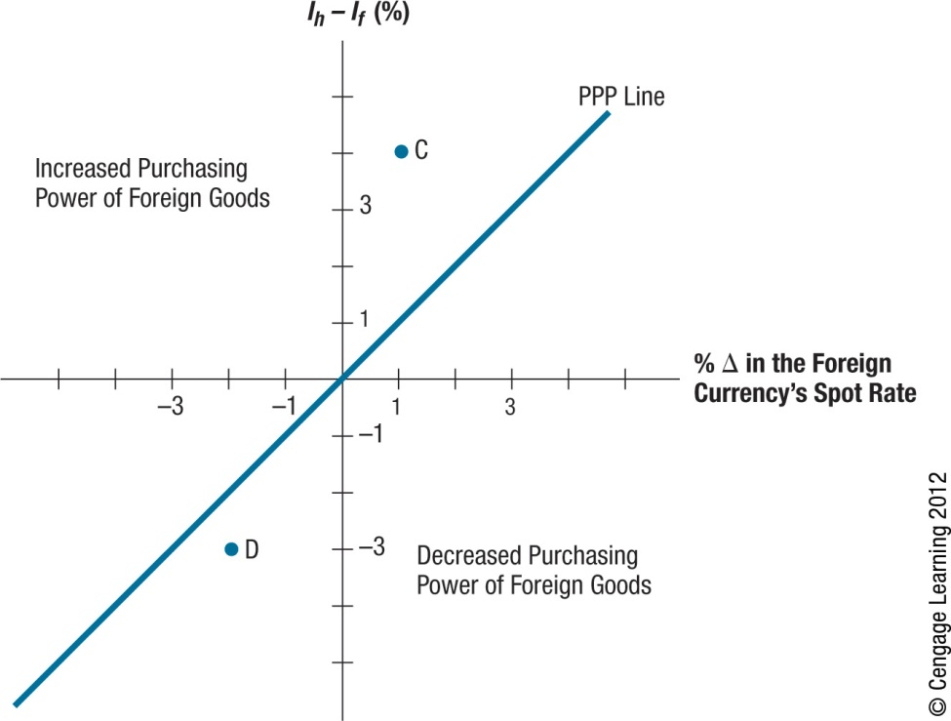
Exhibit 8.3 Identifying Disparity in Purchasing Power

Slide 12
Testing the Purchasing Power Parity Theory
Simple tests of PPP (Exhibit 8.4)
Choose two countries (such as the United States and a foreign country) and compare the differential in their inflation rates to the percentage change in the foreign currency’s value during several time periods.
Statistical Test of PPP
Apply regression analysis to historical exchange rates and inflation differentials.
Results of Tests of PPP
Deviations from PPP are not as pronounced for longer time periods, but they still exist. Thus, reliance on PPP to derive a forecast of the exchange rate is subject to significant error, even when applied to long-term forecasts.

Slide 13
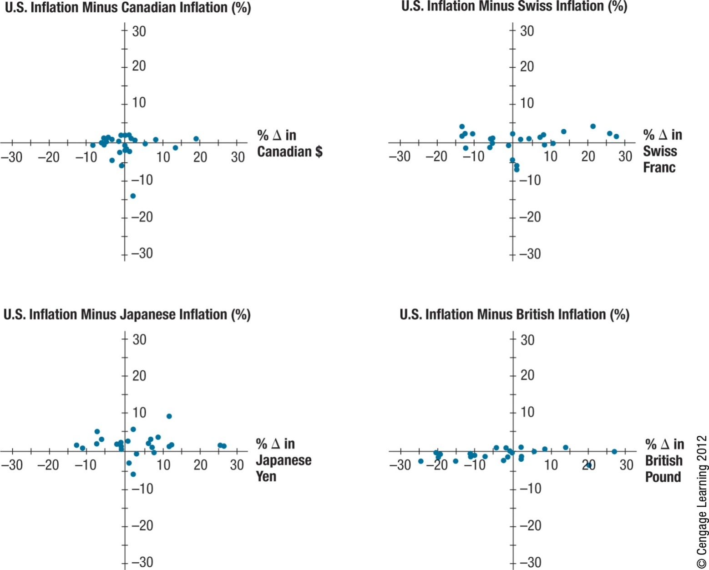
Exhibit 8.4 Comparison of Annual Inflation Differentials and Exchange Rate Movements for Four Major Countries

Slide 14
Testing the Purchasing Power Parity Theory (Cont.)
Limitation of PPP Tests
Results vary with the base period used. The base period chosen should reflect an equilibrium position since subsequent periods are evaluated in comparison to it. If a base period is used when the foreign currency was relatively weak for reasons other than high inflation, most subsequent periods could show higher appreciation of that currency than what would be predicted by PPP.

Slide 15
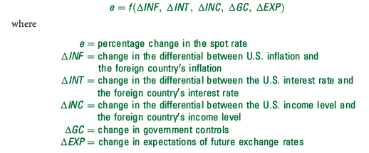
Why Purchasing Power Parity Does Not Occur
Confounding effects
A change in a country’s spot rate is driven by more than the inflation differential between two countries:
Since the exchange rate movement is not driven solely by ΔINF, the

Slide 16
Why Purchasing Power Parity Does Not Occur (Cont.)
No Substitutes for Traded Goods
If substitute goods are not available domestically, consumers may not stop buying imported goods.

Slide 17
International Fisher Effect (IFE)
The Fisher effect suggests that the nominal interest rate contain two components:
Expected inflation rate
Real interest rate
The real rate of interest represents the return on the investment to savers after accounting for expected inflation.

Slide 18
Using the IFE to Predict Exchange Rate Movements
Apply the Fisher Effect to Derive Expected Inflation per Country
The first step is to derive the expected inflation rates of the two countries based on the Fisher effect. The Fisher effect suggests that nominal interest rates of two countries differ because of the difference in expected inflation between the two countries.
Rely on PPP to Estimate the Exchange Rate Movement
The second step of the international Fisher effect is to apply the theory of PPP to determine how the exchange rate would change in response to those expected inflation rates of the two countries.

Slide 19
Implications of the International Fisher Effect
The international Fisher effect (IFE) theory suggests that currencies with high interest rates will have high expected inflation (due to the Fisher effect) and the relatively high inflation will cause the currencies to depreciate (due to the PPP effect).
Implications of the IFE for Foreign Investors
The implications are similar for foreign investors who attempt to capitalize on relatively high U.S. interest rates. The foreign investors will be adversely affected by the effects of a relatively high U.S. inflation rate if they try to capitalize on the high U.S. interest rates.
Implications of the IFE for Two Non-U.S. Currencies
The IFE theory can be applied to any exchange rate, even exchange rates that involve two non-U.S. currencies.

Slide 20
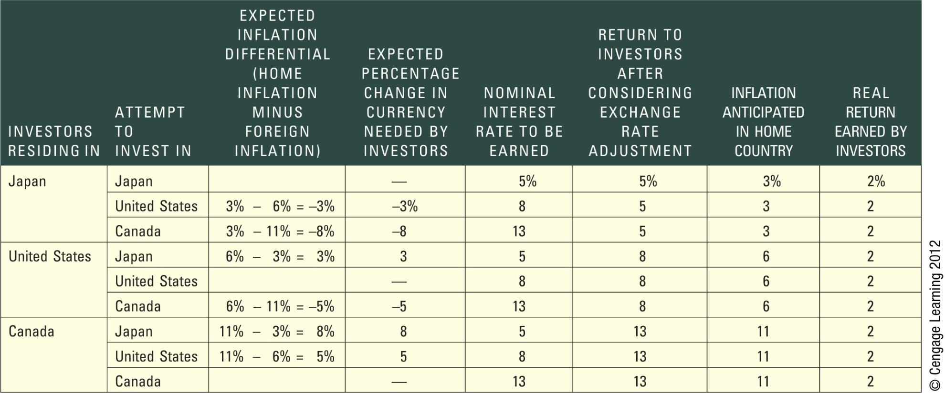
Exhibit 8.5 Illustration of the International Fisher Effect (IFE) from Various Investor Perspectives

Slide 21
Derivation of the International Fisher Effect
Relationship between the interest rate (i) differential between two countries and expected exchange rate (e)
Simplified relationship
Summarized in Exhibit 8.6

Slide 22
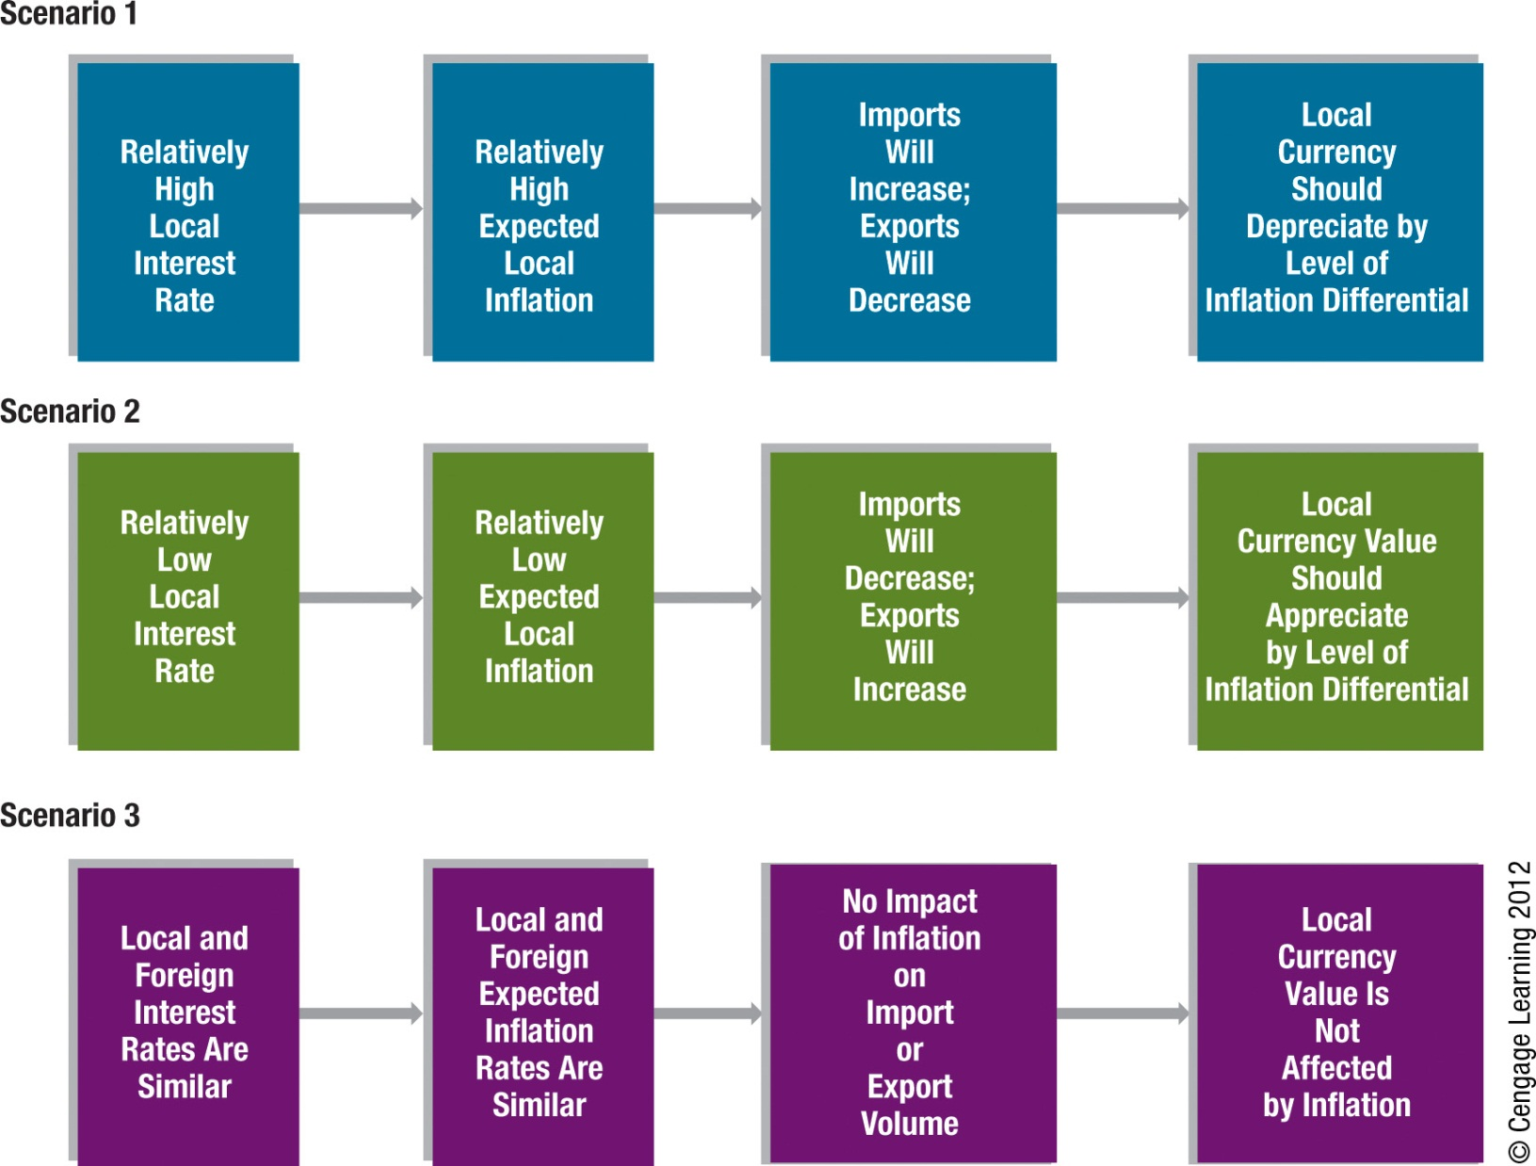
Exhibit 8.6 Summary of International Fisher Effect

Slide 23
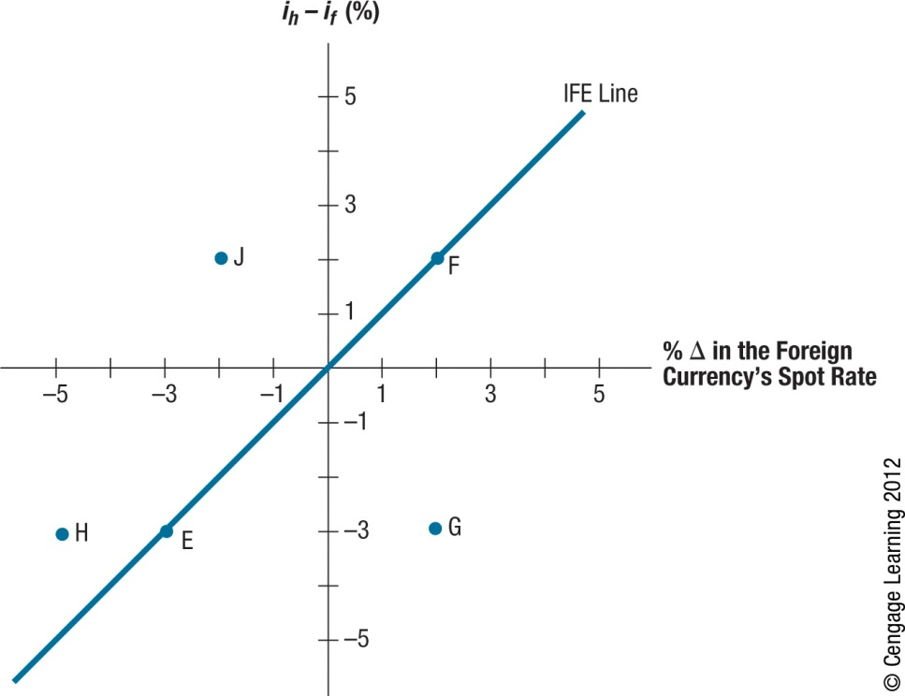
Exhibit 8.7 Illustration of IFE Line (When Exchange Rate Changes Perfectly Offset Interest Rate Differentials)

Slide 24
Graphic Analysis of the International Fisher Effect
Point E in Exhibit 8.7 reflects a situation where the foreign interest rate exceeds the home interest rate by three percentage points. The foreign currency has depreciated by 3 percent to offset its interest rate advantage.
Point F represents a home interest rate 2 percent above the foreign interest rate. IFE theory suggests that the currency should appreciate by 2 percent to offset the interest rate disadvantage.
Point F illustrates the IFE from a foreign investor’s perspective. The home interest rate will appear attractive to the foreign investor. However, IFE theory suggests that the foreign currency will appreciate by 2 percent.

Slide 25
Graphic Analysis of the International Fisher Effect
Points on the IFE Line
All the points along the IFE line reflect exchange rate adjustments to offset the differential in interest rates. This means investors will end up achieving the same yield (adjusted for exchange rate fluctuations) whether they invest at home or in a foreign country.
Points below the IFE Line
Points below the IFE line generally reflect the higher returns from investing in foreign deposits.
Points above the IFE Line
Points above the IFE line generally reflect returns from foreign deposits that are lower than the returns possible domestically.

Slide 26
Tests of the International Fisher Effect
What Can be Tested
If the actual points (one for each period) of interest rates and exchange rate changes were plotted over time on a graph, we could determine whether
the points are systematically below the IFE line (suggesting higher returns from foreign investing),
above the line (suggesting lower returns from foreign investing), or
evenly scattered on both sides (suggesting a balance of higher returns from foreign investing in some periods and lower foreign returns in other periods).
Statistical Test of the IFE
Apply regression analysis to historical exchange rates and the nominal
interest rate differential.

Slide 27
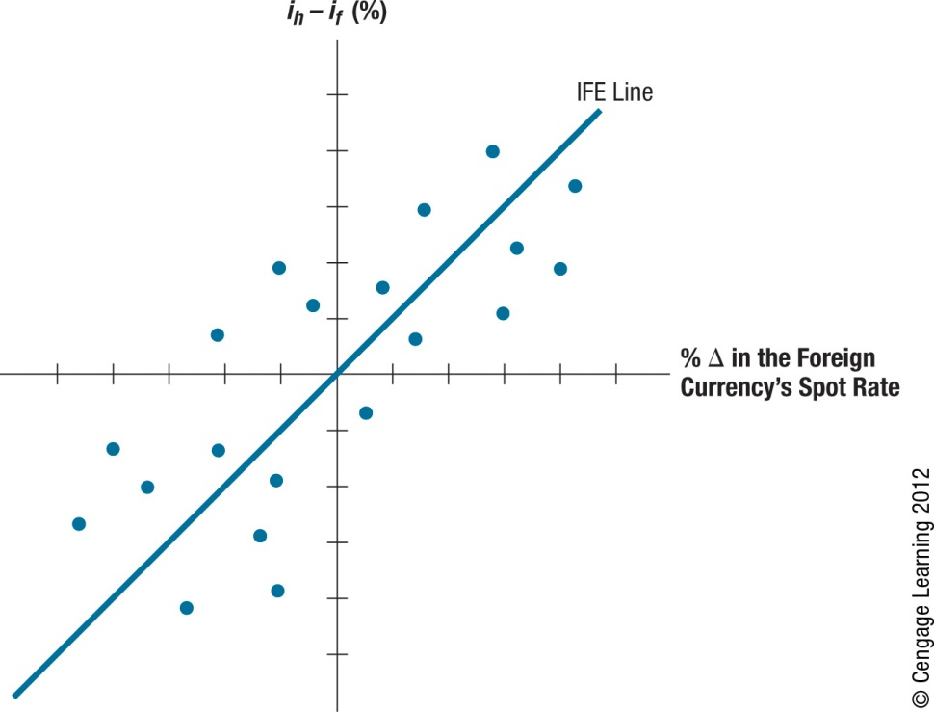
Exhibit 8.8 Illustration of IFE Concept (When Exchange Rate Changes Offset Interest Rate Differentials on Average)

Slide 28
Limitations of the IFE
The IFE theory relies on the Fisher effect and PPP
Limitation of the Fisher Effect
The difference between the nominal interest rate and actual inflation rate is not consistent. Thus, while the Fisher effect can effectively use nominal interest rates to estimate the market’s expected inflation over a particular period, the market may be wrong.
Limitation of PPP
Other country characteristics besides inflation (income levels, government controls) can affect exchange rate movements. Even if the expected inflation derived from the Fisher effect properly reflects the actual inflation rate over the period, relying solely on inflation to forecast the future exchange rate is subject to error.

Slide 29
IFE Theory versus Reality
The IFE theory contradicts how a country with a high interest rate can attract more capital flows and therefore cause the local currency’s value to strengthen (Ch 4).
IFE theory also contradicts how central banks may purposely try to raise interest rates in order to attract funds and strengthen the value of their local currencies (Ch 6).
Whether the IFE holds in reality is dependent on the countries involved and the period assessed.
The IFE theory may be especially meaningful to situations in which the MNCs and large investors consider investing in countries where the prevailing interest rates are very high.

Slide 30
Comparison of the IRP, PPP, and IFE
Although all three theories relate to the determination of exchange rates, they have different implications.
IRP focuses on why the forward rate differs from the spot rate and on the degree of difference that should exist. It relates to a specific point in time.
PPP and IFE focus on how a currency’s spot rate will change over time.
Whereas PPP suggests that the spot rate will change in accordance with inflation differentials, IFE suggests that it will change in accordance with interest rate differentials.
PPP is related to IFE because expected inflation differentials influence the nominal interest rate differentials between two countries.

Slide 31
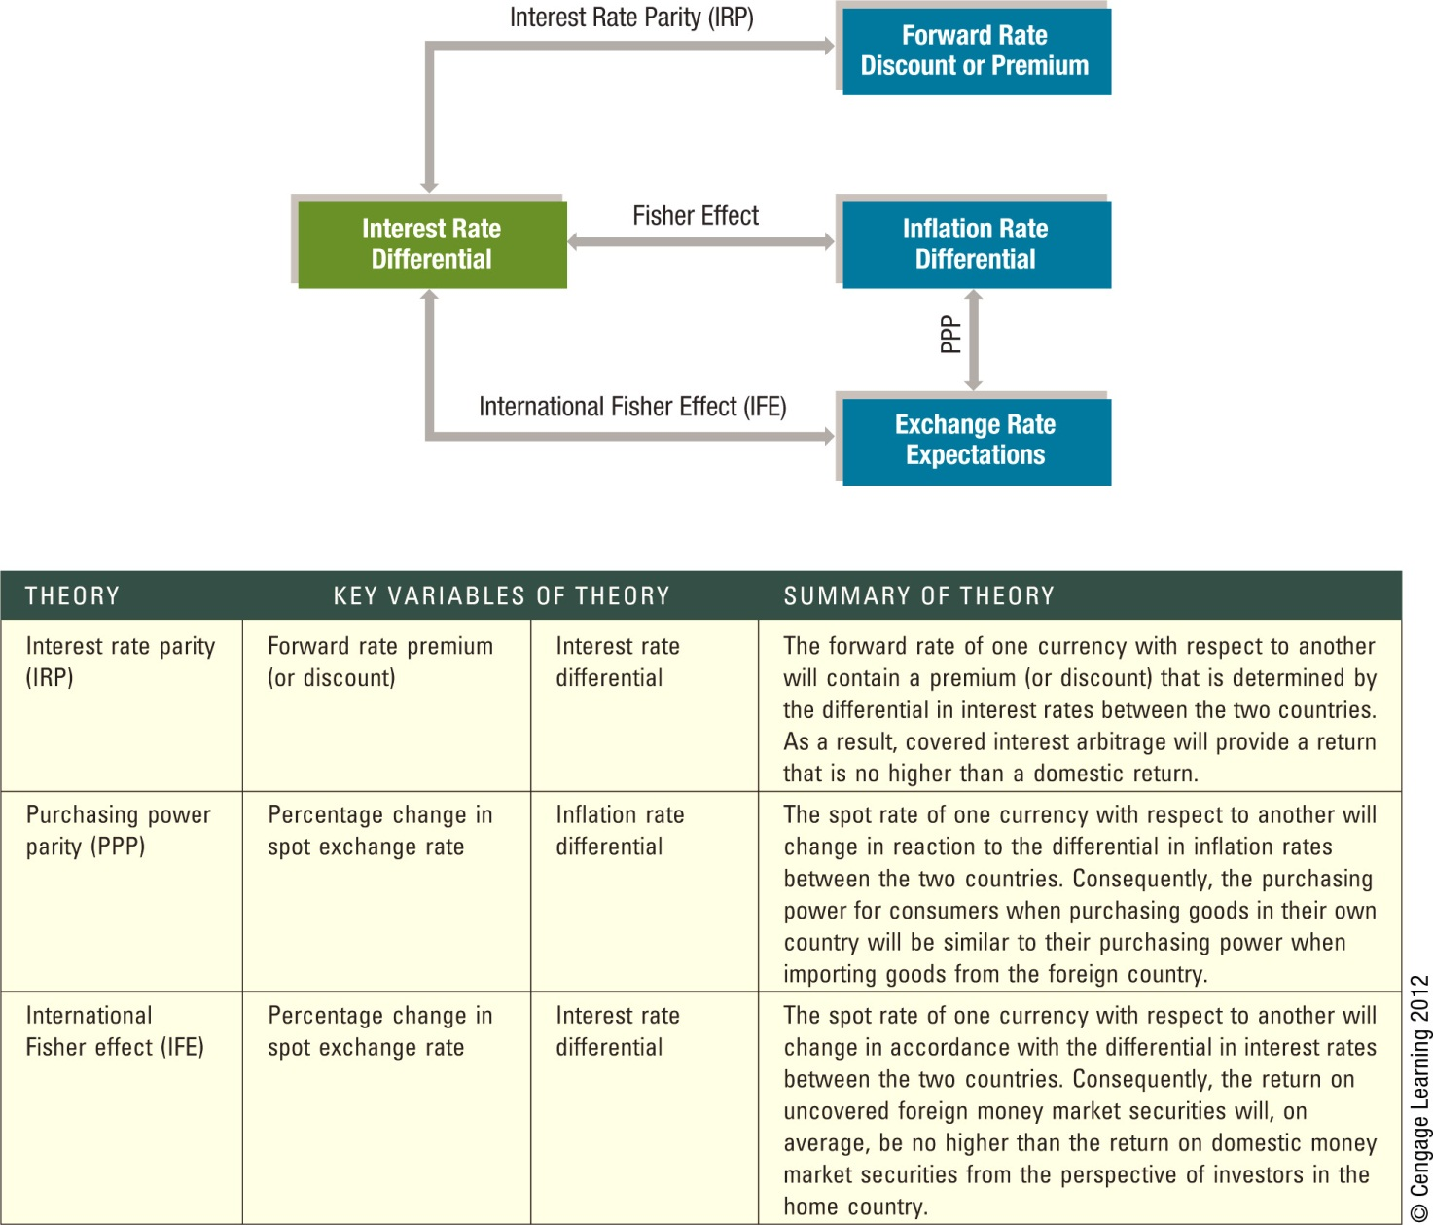
Exhibit 8.9 Comparison of the IRP, PPP, and IFE Theories

Slide 32
SUMMARY
Purchasing power parity (PPP) theory specifies a precise relationship between relative inflation rates of two countries and their exchange rate. In inexact terms, PPP theory suggests that the equilibrium exchange rate will adjust by the same magnitude as the differential in inflation rates between two countries. Though PPP continues to be a valuable concept, there is evidence of sizable deviations from the theory in the real world.

Slide 33
SUMMARY (Cont.)
The international Fisher effect (IFE) specifies a precise relationship between relative interest rates of two countries and their exchange rates. It suggests that an investor who periodically invests in foreign interest-bearing securities will, on average, achieve a return similar to what is possible domestically. This implies that the exchange rate of the country with high interest rates will depreciate to offset the interest rate advantage achieved by foreign investments. However, there is evidence that during some periods the IFE does not hold. Thus, investment in foreign short-term securities may achieve a higher return than what is possible domestically.

Slide 34
SUMMARY (Cont.)
The PPP theory focuses on the relationship between the inflation rate differential and future exchange rate movements. The IFE focuses on the interest rate differential and future exchange rate movements. The theory of interest rate parity (IRP) focuses on the relationship between the interest rate differential and the forward rate premium (or discount) at a given point in time.

