Slide 1
Physical examination Dr.Waqas

Slide 2
Physical examination
Inspection
Palpation
Percussion
Auscultation

Slide 3
Inspection
Inspection involves a close examination of the injured area looking for deformity, contusions, abrasions, swelling, and bleeding.

Slide 5
Palpation
Palpation involves touching the injured area to note abnormal findings such as deformity or crepitus.

Slide 7
Percussion
Percussion consists of tapping the injured area to elicit tympanic sounds.
Percussion is used for thoracic and abdominal injuries and is difficult to perform in the athletic arena

Slide 9
Auscultation
Auscultation refers to listening to lung sounds with a stethoscope and, although difficult in a noisy environment, it is a crucial skill for any seriously injured athlete, especially when the athlete is short of breath.

Slide 11
Evaluation of the injured or ill athlete consists of conducting a physical examination and obtaining a complete set of vital signs.
Physical examination can be either a focused body systems approach or a global head-to-toe approach.

Slide 12
Golden hour
The Golden hour is time between onset of injury and definitive surgical treatment.
This universally accepted concept for the management of trauma patients means that paramedics concentrate on a rapid assessment and packaging of the patient to keep their on-scene time to less than 10 minutes.
If the response time was 10 minutes and the transport time is also 10 minutes, you can readily see that half of the golden hour is gone before the patient even arrives at a hospital, preferably a trauma center.

Slide 13
Therefore, it is important that no time is lost by the athletic trainer in deciding to summon EMS after the injury occurs.
Although not all athletic injury emergencies are related to trauma, it is reasonable to extend the trauma management concept to medical patients to avoid delays in getting the athlete to definitive care.

Slide 14
Scene Assessment and Safety
When approaching an athlete who is down, avoid tunnel vision; instead, get a global picture of the scene. Is the scene safe? How many athletes are injured? Are there hazards in the area such as electrical cords, water, or blood?
Is the athlete moving? Are bystanders or teammates trying to move the athlete? Do you have sufficient resources and equipment to manage the injured athlete?

Slide 15
If the athlete is an assault victim, where are the assailant and the weapon?
All of these questions must be answered as you approach so that you do not become injured yourself.
Failure to see the big picture is often called tunnel vision and can lead to significant dangers being missed.

Slide 16
Scene Assessment and Safety
Avoid tunnel vision
Get global Vision
Check the Hazards
See assaulting or Weapon
Make sure your safety

Slide 17
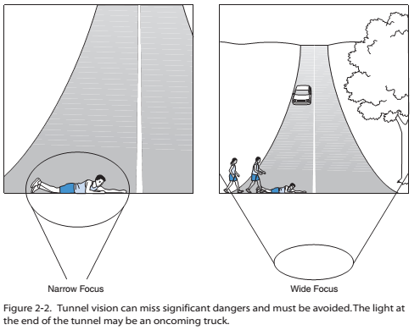

Slide 18
Body Substance Isolation Precautions
Protection against the transmission of infectious diseases such as hepatitis or HIV is an important consideration when treating any patient.
The degree of protection depends on the procedure performed and the body fluids you might come in contact with.
Hand washing is the single most effective way to prevent the transmission of diseases, and the provider should always wash his or her hands before and after each patient contact.

Slide 19
Use warm water and thoroughly spread the lathered
soap over the entire hand and wrist areas for at least 15 seconds.
Rinse completely with a strong stream of water and dry completely.
If soap and water are not available, waterless alcohol based soap can be used until soap and water become available.
Repeated use of these waterless soaps will lead to dry and
cracked skin, which increases the likelihood of disease transmission because the skin is no longer intact.

Slide 20
Wearing disposable latex or vinyl gloves is mandatory
when there is any chance of coming into contact with blood
or bodily fluids.
With the increasing concerns over latex
allergies, the use of vinyl gloves is preferred.
The use of eye goggles, gowns, and masks is frequently indicated for many invasive procedures performed by advanced providers, but their use in the athletic environment is rare.

Slide 21
Level of protection
Procedure | Gloves | Mask | Gown | Eye Protection
Control minor bleeding | Yes | No | No | No
Control major bleeding | Yes | Yes | Yes | Yes
IV stars | Yes | No | No | No
Vital signs | No | No | No | No
IM Injection | Yes | No | No | No
Advance airway Procedure | Yes | Yes |  | Yes

Slide 22
Primary survey
The primary survey is a rapid head-to-toe assessment designed to identify and immediately correct life- and limb threatening injuries.
Within the first minute, you must determine if the athlete is critically injured and activate the emergency action plan (EAP).
“load and go,”

Slide 23
Primary Survey
A: Stabilize cervical spine and check the airway
B: Check for breathing
C: Check for circulation
D: Check for neurological disability(or apply defibrillator)
E: Check level of exposure

Slide 24
Airway..Breathing
Look and feel for the chest to rise, indicating the athlete is
breathing. Look to see that the chest rises in a symmetrical
fashion.
Asymmetry may indicate significant chest trauma.
Evaluate the rate and quality of breathing.
If the athlete is not breathing, begin rescue breathing with either a pocket mask or bag valve mask.
A respiratory rate less than 8 or greater than 30 is significant and cause for concern. Note the color of the oral mucosa and nail beds to look for cyanosis, which is a bluish color indicating
hypoxia. Breathing must be adequate to ensure oxygenation
of tissues (ventilation).

Slide 25
Circulation
Quickly feel the radial pulse and note if it is fast or slow,
regular or irregular, and strong or weak. If the radial pulse
is absent, check the carotid pulse. A weak or absent radial
pulse is a strong indication that the athlete is in critical
condition and mortality and morbidity are increased
Now check capillary refill. Press on the nail bed
of any finger and quickly release, noting how quickly color
returns. Color should return within 3 seconds or as
quickly as you can say the words “capillary refill.” If capillary refill is delayed, the athlete’s circulation is not sufficient to perfuse the vital organs.

Slide 26
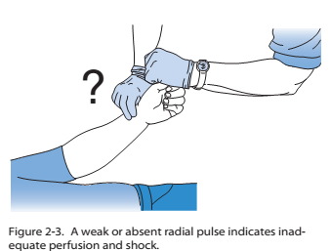

Slide 27
Disability/Defibrillation
Disability refers to a brief neurological examination. It is time consuming to perform a focused neurological examination, and merely asking the athlete to move his or her arms and legs is sufficient for a primary survey.

Slide 28
Exposure
Clothing or equipment may need to be removed to examine the injured athlete.
Modesty or environmental concerns should be taken into account but should never inhibit the examination.

Slide 29
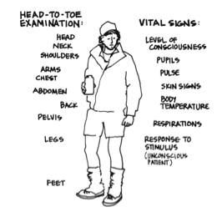
secondary survey
Complete head-to-toe examination to rule out other injuries

Slide 30
Starting at the head use a look, listen, and palpate approach.
Look for contusions, abrasions, lacerations, and deformity.
Listen to breath sounds in the chest.
Palpate body parts for crepitus, pain, and rigidity or masses. Listen for abnormal sounds while palpating.

Slide 31
Head-to-Toe Examination
Look at the Pupils while examining the head. Pupils should be midline, equal, and round, and they should react to light and accommodation;
The acronym PERRLA is frequently.

Slide 33
Palpate for deformity or pain in the cervical spine and ensure the trachea is in a midline position.
Auscultate lung sounds high in the axilla bilaterally to determine the presence of equal breath sounds.
Palpate each quadrant of the abdomen for pain or rigidity. Compression of the iliac crests evaluates stability of the pelvis. Carefully but quickly palpate each leg and arm for deformity or pain

Slide 34
Check pulses in each extremity to ensure they are present and equal. For the lower extremities, use of the posterior tibial or dorsal pedal pulse is recommended.
This entire examination should be accomplished in 1 minute or less.
Once the primary and secondary surveys are completed, a complete set of vital signs should be obtained and recorded.

Slide 35
Vital Signs
Pulse
Blood pressure
Respiratory rate
Temperature
Pulse oxymetry
Pain assessment

Slide 36
Normal Vital Signs
Adult Child
Pulse 60-100 >20
Blood pressure 120/80 70+2 x age
Respiratory rate 10–20 >20
Temperature 98.6°F 98.6°F
(37.0°C) (37.0°C)
Pulse oximetry 95% 95%
Pain 0 0

Slide 37
Pulse Rate
Count the pulse rate by palpating the radial artery at the wrist.
An accurate pulse rate requires counting the rate for at least 30 seconds.
Very slow or fast rates may require a full minute to obtain an accurate pulse rate.

Slide 38
Pulse Rate
Weak pulse is considered thready and may indicate inadequate tissue perfusion, one form of shock
An irregular rate requires careful evaluation and could indicate anything from sinus arrhythmia (a benign rhythm common in athletes) to premature beats to atrial fibrillation
Electrocardiogram (EKG) monitor

Slide 39
A normal pulse rate is 60 to 100 beats per minute.
Rates higher than 100 are called Tachycardia
Lower than 60 are called Bradycardia
Rates higher than 150 are called Supraventricular tachycardia.
Notes:
The young athletic population is different than the general population, and resting pulse rates less than 60 are common and are no cause for alarm as long
as the athlete is alert and oriented. Rates higher than 100 are expected during physical activity and are cause for alarm only if they do not quickly return to
a normal level when activity ceases.

Slide 40
The young athletic population is different than the general population, and resting pulse rates less than 60 are common and are no cause for alarm as long as the athlete is alert and oriented.
Rates higher than 100 are expected during physical activity and are cause for alarm only if they do not quickly return to a normal level when activity ceases.

Slide 41
The radial artery is used most often only because it is
readily accessible. Pulse rates may be determined by palpating any artery. Other arteries used include the femoral,carotid, brachial, temporal, posterior tibial, and dorsal pedal.
The brachial artery is most commonly used in children younger than age 6. Direct pressure to the brachial and femoral pulse sites will slow or stop arterial bleeding distally. These are referred to as pressure points

Slide 42
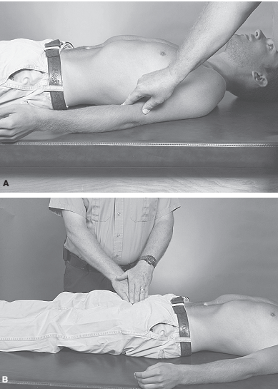
Severe bleeding in the arm or leg
can be controlled using pressure points.
A: Brachial pressure point on inside of arm.
B: Femoral pressure point in groin.

Slide 43
Blood pressure is most commonly measured using a stethoscope and a device called an aneroid sphygmomanometer (blood pressure cuff).
This device consists of a cuff with an inflatable bladder, a bulb to inflate the bladder, a valve to release the air from the bladder, and a pressure dial that displays cuff pressure in millimeters of mercury (mm Hg).
Blood pressure is most often measured using the upper arm, although the forearm and thigh may also be used.

Slide 44
The cuff must be an appropriate size for the athlete and it
must be applied snugly. Cuffs that are too small will give
falsely high readings, whereas cuffs that are too large will
give falsely low readings. The cuff width should cover at least 80% of the arm or be 20% to 50% greater than the diameter of the arm.
Many cuffs have proper sizing guides easily visible on the cuff itself; it is important to follow manufacturer’s instructions for use of these sizing guides. Pediatric cuffs and large adult and thigh cuffs should be available so that proper-sized cuffs are used when appropriate.

Slide 45
The cuff is placed on the upper arm directly on the skin,
and the brachial artery is palpated at the elbow. The cuff
should never be applied over clothing, and the arm should be at the level of the heart.
Once the artery is located, the stethoscope is placed over the artery and the cuff is inflated.
Korotkoff sounds are the noises heard through the stethoscope and are the result of the cuff collapsing the artery and producing turbulent blood flow.

Slide 46
The cuff should be inflated15 to 20 mm Hg beyond the point that the Korotkoff sounds disappear. The valve is then slowly opened and air is allowed to escape from the bladder.
Systolic blood pressure (SBP) is
when the Korotkoff sounds are heard again and the diastolic blood pressure (DBP) is when the sounds are absent.
Systolic blood pressure is the pressure during ventricular contraction, whereas diastolic pressure is the pressure during ventricular rest. The gradient between the two is referred to as pulse pressure.

Slide 47
Automatic blood pressure cuffs are available, but they
may not be cost effective for the athletic training room.
These are referred to as noninvasive blood pressure (NIBP) units and are either electric or battery powered

Slide 48
Hypotension less than 100 in general population
Expect less in athletes
A normal systolic pressure is between 100 and 140 mm Hg, whereas a normal diastolic pressure is between 60 and 85 mm Hg
The diagnosis of hypertension is made based on high diastolic pressure and requires additional evaluation and possible treatment.

Slide 49
Athletes have low heart rate because of hypertrophy or growth of their left ventricle. This hypertrophy occurs because heart needs to pump more blood in athletes.
When this enlarged ventricle pumps, huge amount of blood goes in blood capillaries which activates circulatory reflex and other mechanisms which slows down heart beat so that normal blood flows in body. As a result heart rate slows down.
Pulse is 60 and blood pressure 100/60.

Slide 50
Respiratory Rate
To do this, when taking a pulse, tell the athlete
Count the pulse for the first 30 seconds and the respiratory rate is 30
Normal resting respiratory rate is between 10 and
20 breaths per minute
A rapid respiratory rate higher than 30 (tachypnea) also may be caused by anxiety, pain, excitement, or acidosis
Bradypnea is a rate less than 10 and is always a cause for alarm in someone who is injured.

Slide 51
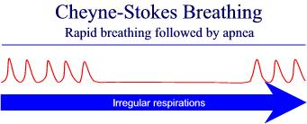
Respiratory Rate
Irregular respirations are cause for alarm, especially if found in athletes.
Cheyne-Stokes respirations are characterized by an increasing rate and depth followed by a period of apnea. This pattern is a sign of significant brain injury

Slide 52
Symptoms of increased work of breathing include intercostal retractions, nasal flaring, pursed lip breathing, sternocleidomastoid muscle contractions, and upright posturing. A well-conditioned athlete should only manifest these symptoms if an underlying pathology is present such as an acute asthma attack.
Poorly conditioned athletes may exhibit these signs but they should resolve spontaneously with rest.

Slide 53
Temperature
Temperature measurement is not usually obtained in the pre hospital arena but it is still important, especially if heat illness is suspected
Rectal temperatures
Oral temperatures..........core temperature
Tympanic temperatures
Axillary or skin temperatures if level of consciousness is an issue
Normal temperature for a healthy person at rest is 98.6°F (37°C).

Slide 54
Rectal temperatures have long been considered the gold standard for accurately measuring core body temperature but are typically not used for obvious reasons. Oral temperatures may be an accurate reflection of core temperature.
Tympanic temperatures are easy to obtain and are strongly favored by parents of small children, but the accuracy is questionable.
Axillary or skin temperatures may be substituted for oral temperatures if an athlete has a decreased level of consciousness

Slide 55
A recent study evaluating temperature measures taken at various sites (mouth, ear, axilla, and forehead) showed that these temperatures may be several degrees cooler than those taken rectally, calling into question their usefulness in assessing core body temperature.

Slide 56
Pulse Oximetery
Oximetry operates under the principle that oxygenated hemoglobin and deoxygenated hemoglobin absorb infrared and red light differently
Oxyhemoglobin absorbs infrared light at 990 nm, whereas deoxyhemoglobin absorbs red light at 660 nm.
The gradient is measured by the pulse oximeter
and provides a percentage of oxyhemoglobin.
The expected value for a healthy non smoker is in the range of 99% to 100%.
Notes:
Oxyhemoglobin absorbs infrared light at 990 nm, whereas deoxyhemoglobin absorbs red light at 660 nm

Slide 57
Values less than 90% require supplemental oxygen.
Very large athletes who are in a supine position may have pulse oximeter readings of 90% to 95%, but a few deep breaths will easily increase the reading to the optimal range.
Several factors may interfere with pulse oximeter readings including cold fingers, low blood pressure, fast or irregular pulse rates, and bright ambient light

Slide 58
The pulse oximeter is a noninvasive monitor consisting
of a clothespin-like probe that is placed on a fingertip, toe, or ear.
Light passes through the skin and the oxyhemoglobin percentage is displayed on the screen along with a pulse rate.

Slide 59
The probe can be placed anywhere on the body that will allow the passage of light. Time should not be lost obtaining an accurate pulse oximeter reading on an athlete in critical condition, and it is crucial to remember that pulse oximetry is not a measurement of ventilation.
Pulse oximetry only measures the amount of oxyhemoglobin (saturation) and not oxygen/carbon dioxide gas exchange in the lungs (ventilation).
.

Slide 60
Although very unusual in athletics, it should be noted that patients exposed to carbon monoxide will have falsely high pulse oximeter readings because of its higher binding affinity to hemoglobin as compared to oxygen

Slide 61
Pain
The easiest method of pain assessment is to ask the athlete to rate his or her pain on a scale of zero to 10 with zero meaning no pain and 10 meaning the worst pain ever felt.
Serial assessments allow the health professional to measure the effectiveness of the pain treatment.

Slide 62
This scale is universal and gives a frame of reference to other health professionals who may take over care of the athlete at a later time.
The importance of pain control can never be underestimated. “No pain, no gain” is an archaic philosophy that has no place in the treatment of acute injuries.

Slide 63
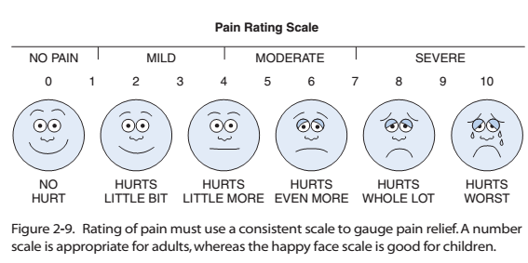

Slide 64
