Slide 1
What are viruses?
The word virus is a LATIN word means slimy liquid or poison .
An infectious agent composed of nucleic acid (RNA and DNA),a protein shell known as capsid and in some cases lipid envelop .
Capsid is the protein coat surrounds the viral nucleic acid composed of subunits called capsomeres .
Complete protein nucleic acid complex is called nucleocapsid.

Slide 2
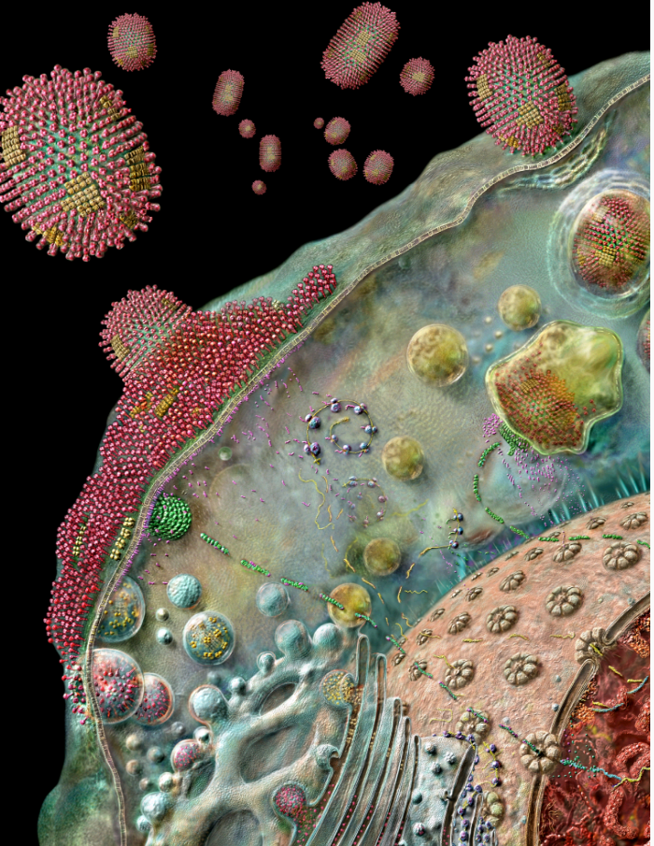

Slide 3
Discovery of viruses
During 18th century when people were aware of many human and animal diseases but now we know the cause of these diseases like influenza ,AIDS,in humans ,TMV in plants .The discovery of viruses directly related to the porcelain filters .
Porcelain filters by Charles Chammberland
Adolf .E. Mayer
Dmitri Ivanoski
Martinus beijerinck
Discovery of first animal virus
Discovery of first human virus

Slide 4
Porcelain filters
These were developed in 1884 by charles chammberland who worked with LOIUS PARTEUR.
This filter consists of a permeable unglazed porcelain tube with pores of size 0.1 to 1 micron.
This filter allows the small bacteria to pass through it .
Completely removes germs from a liquid suspension .
This simple invention leads to a new science known as VIROLOGY.

Slide 6
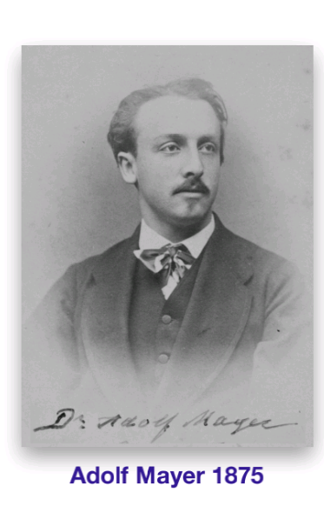
ADOLF .E. MAYER
He was a GERMAN scientist ,his work was published in 1886 .
According to his research at HOLLAND the mosaic disease of tobacco plant could be transmitted to healthy leaves by rubbing the extract of liquid filtrate of diseased leave.
He concluded that it must be a bacterial disease.

Slide 7
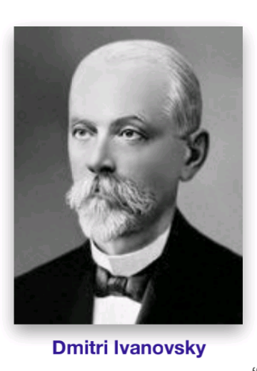
Dmitri Ivanosky
He was a RUSSIAN botanist ,discoverer of viruses and one of the founders of virology.
He used filter on infectious extract of tobacco plant with mosaic disease but it remain infectious.
He concluded it as a toxin.

Slide 8
Martinus willem beijerinck
He was DUTCH microbiologist and botanist .founder of virology and environmental microbiology.
He had done a similar experiment with a bacteria free filtered extract .
He concluded that the agent is smaller then bacteria and named the agent CONTAGIUM VIVUM FLUIDIUM .

Slide 9
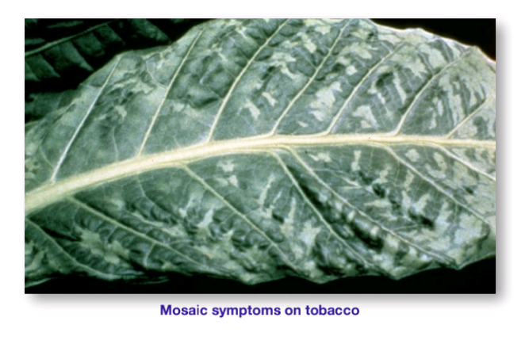

Slide 10
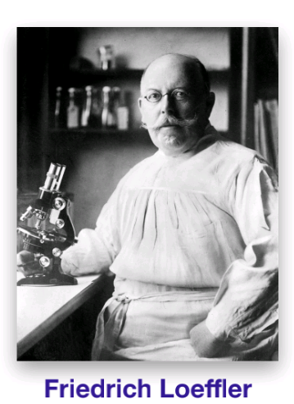
FMDV
The animal virus discovered by GERMAN scientists F.LOFFLER and P.FROSCH
They concluded that the tiny particle was not a liquid .
Theyy showed how to vaccinate cows and sheep against this disease by using the filtered extract.

Slide 11
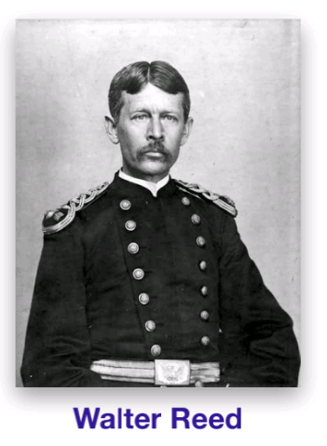
Yellow fever
The agent responsible for this was first reported by a US army PHYSICISAN WALTER in 1901.

Slide 12
Characteristics of virus
They are obligate intracellular parasites.
Having DNA or RNA inside a protein coat .
They are inert particles ,no metabolism ,no replication ,no motility without their living host.
Infectious agents

Slide 13
Cont …
Most virues size ranges from 10 nm to 500nm.
Around nucleic acid a protein coat is present called capsid ,the term we used for both is NUCLEOCAPSID .
Enveloped viruses have a lipid bilayer .
Matrix proteins between nuleocapsid and envelop.

Slide 14
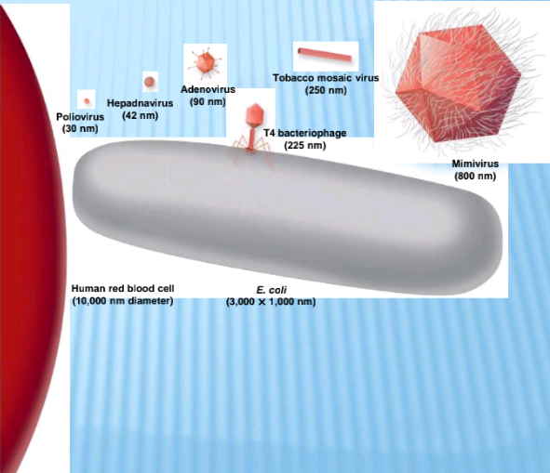

Slide 15
Cont …
Naked viruses lack envelop .
Viruses have protein components for attachment .
Phages have tail fibers
Animal viruses have spikes
Allow virion to attach to specific receptor sites.

Slide 16
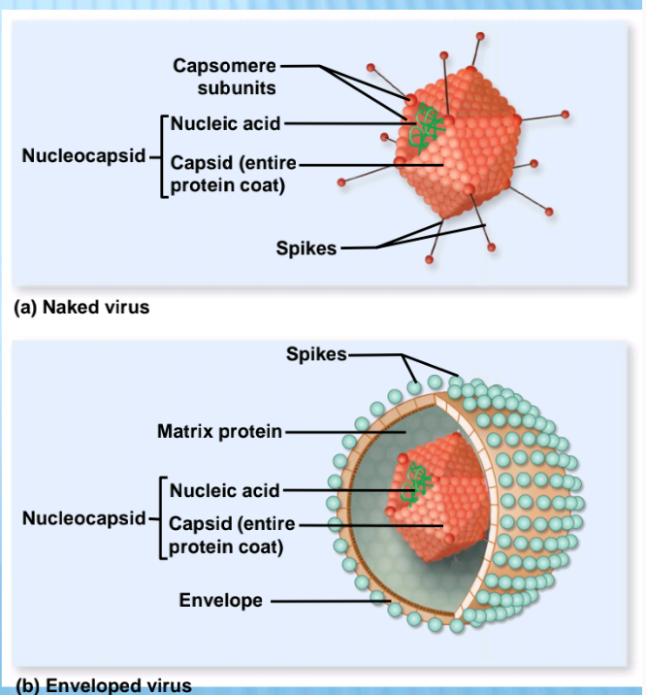

Slide 17
Cont …
Generally three different shapes
Icosahedral
Helical
Complex

Slide 18
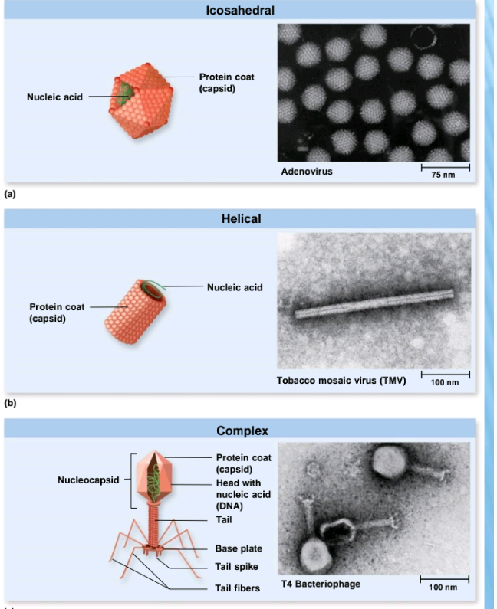

Slide 19
Cont …
according to report of Icvt ,international committee on viral taxonomy ,viruses are classified into 348 genera,87 families ,6 orders ,6000 viruses,2288 species.
Virus families end in suffix –viridae ,name follow no consistent pattern,some indicate appearance .
Genus ends in virus
Species names often names of diseases.

