Slide 1
Chapter 2
Using Information Technology to engage in electronic commerce

Slide 2
Electronic Commerce (E-commerce)
A business transaction that uses network access, computer-based systems, and a web browser interface qualifies as Electronic commerce (E-commerce).

Slide 3
E-Commerce beyond the boundary of the firm
B2B (Business-to-Business) e-Commerce:
Refers to transaction between a business and the final consumer of the product.
B2C (Business-to-consumer) e-Commerce:
Refers to the transactions between business in which neither one is the final consumer.

Slide 4
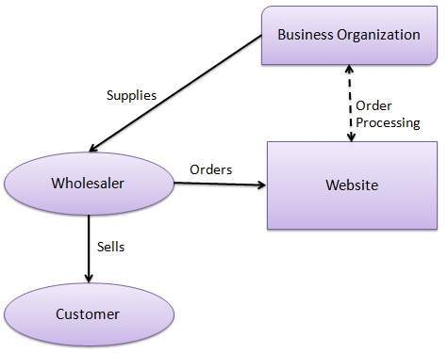
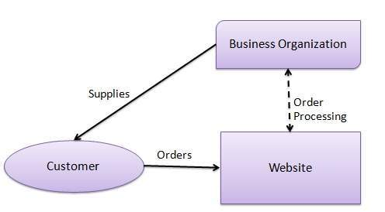
E-Commerce beyond the boundary of the firm
Business to Business Business to Consumer

Slide 5
Anticipated Benefits from e-commerce
Improved customer service before, during and after the sale.
Improved relationship with suppliers and the financial community.
Increased economic return on stockholders and owner investments.

Slide 6
Mobile commerce (m-commerce)
Mobile Commerce is the use of cell phones or the personal digital assistants (PDAs) to engage in wireless e-commerce.

Slide 7
Using the internet
The idea became a reality in mid 1992 in the form of World Wide Web.
Hypermedia is a type of multimedia consisting of text, graphics, audio and video over the world wide web.
The World Wide Web is also called Web, and WWW, is information accessible via the internet whereby hypermedia documents (computer files) are stored and then retrieved by means of unique addressing system.
Protocol Hypertext Markup Language
http://www.prenhall.com/mcleod/index.html
Domain Name Path

Slide 8
Using the internet
Website: A collection of Web pages (generally located on a single computer) linked to the internet that hosts hypermedia files that can be accessed from any other computer on the network by means of hypertext links.
Hypertext link: A pointer consisting of text or a graphic that is used to access hypertext stored at any website address.
Web page: A hypertext file Stored at a unique website address.
Home page: The first page of the Website. Other pages of the website can be reached from the home page.
Browser: Software that is designed to find and read files on the internet that are written in hypertext markup language (HTML).

Slide 9
Using the internet
Uniform Resource Locator (URL): The unique address of the webpage.
Protocol: A set of standard that governs the communication of data. HTTP (hypertext transport protocol) is a protocol for hypertext. Another common protocol on the web is FTP (File transfer protocol). In URL, the protocol name is followed by a colon (:) and two slashes (//).
Domain name: The address of the website where a webpage is stored.
Path: A certain directory/ subdirectory and files at a website. HTML or HTM is the suffix for the program code that designates hypertext file.

Slide 10
Cyberspace and the information superhighway
The term Cyberspace was coined in 1984, which means the world of internet and the World Wide Web.
The term information superhighway is normally used to describe a positive force that gives everyone access to the wealth of information that exist in our modern society.

