Slide 1
PROTOCOL OF GENE THERAPY PLANT EXTRACT IN HUMAN BEINGS
SUBMITTED BY:
M.MUDASSIR NAWAZ
ROLL NO. PPMS20E011
SUBMITTED TO:
DR.ABDUL MALIK
ASSISTANT PROFESSOR
COLLEGE OF PHARMACY
UNIVERSITY OF SARGODHA

Slide 2
CONTENTS:
INTRODUCTION
TYPES
GENE THERAPY STRATEGIES
APPLICATION
PROBLEMS
PROTOCOL
REFERANCES

Slide 3
INTRODUCTION:
The introduction of nucleic acids into cells has as a purpose of medical condition or disease.
Currently, gene therapy studies a broad range of potential therapeutic interventions, including the body's immune reaction to tumors, new blood vessels in the heart to alleviate heart attacks and to stop HIV-replication in patients with AIDS.
There is also renewed emphasis on the gene therapy of genetic diseases, such as hemophilia A and B, and cystic fibrosis.
Human gene therapy experimentation raises many issues.
In this review article, background of gene therapy, introduction, genetic diseases, gene function, germ line gene therapy, hurdles in gene therapy, methods for gene therapy, ex vivo, in vitro and in vivo-gene therapy, risks associated with gene therapy, have been given.

Slide 4
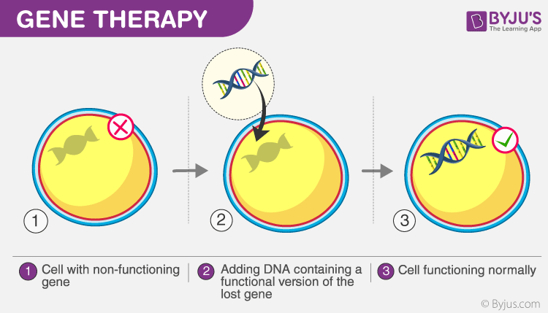
Gene therapy can be broadly defined as a transfer of genetic material to cure a disease or at least to improve the clinical status of a patient.
One of the basic concepts of gene therapy is to transform viruses into genetic shuttles, which would deliver the gene of interest into the target cells.

Slide 5
In the figure, the cell with the defective gene is injected with a normal gene which helps in the normal functioning of the cell.
This technique is employed mainly to fight against the diseases in the human body and also to treat genetic disorders. The damaged proteins are replaced in the cell by the insertion of DNA into that cell. Generally, improper protein production in the cell leads to diseases.
These diseases are treated using a gene therapy technique. For example, cancer cells contain faulty cells which are different from the normal cells and have defective proteins. Hence, if these proteins are not replaced, this disease would prove to be fatal.( Goswami, R., 2019).

Slide 6
Types of gene therapy:
Two types of gene therapy
Somatic gene therapy
Germ line gene therapy
Somatic gene therapy:
Somatic gene therapy involves introducing a ‘good’ gene into targeted cells with the end results of treating the patient – not the future children. Three categories of somatic cell gene therapy:
Ex vivo
In situ
In vivo

Slide 7
A | B | C
Ex vivo | In situ | In vivo
Cells removed from body. Incubated with vector and gene- engineered cells returned to body. | Vector is placed directly into the affected tissues. | Vector injected directly into the blood stream

Slide 8
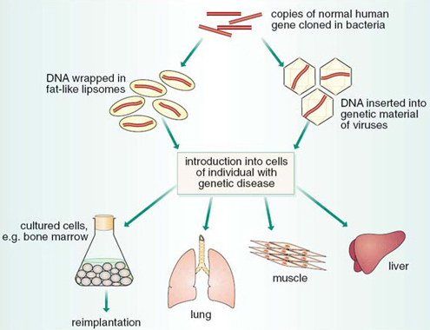

Slide 9
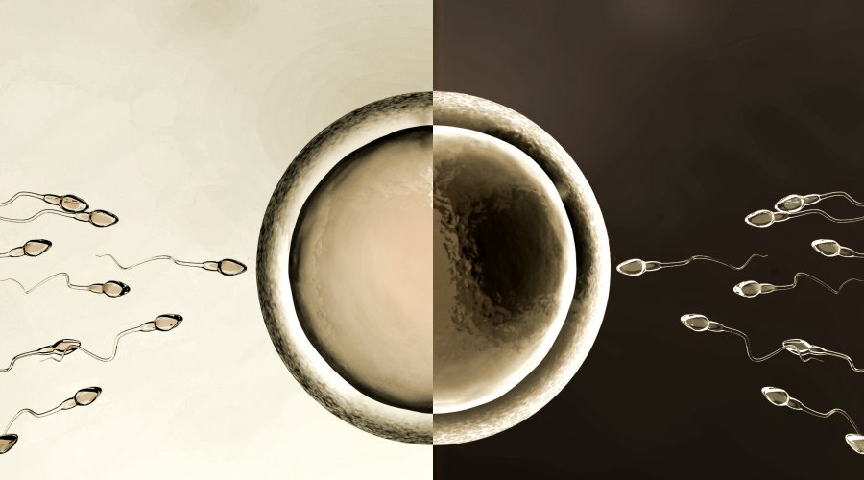
Germ line gene therapy
Germ line gene therapy involves modifying the genes in egg or sperm cells, which will then pass any genetic changes to future generations as well.(Moss JA.2014)

Slide 10
GENE THERAPY STRATEGIES
Gene augmentation therapy
Gene inhibition therapy
Gene replacement therapy
Gene correction
Prodrug therapy (Anguela, X. M.2019)

Slide 11
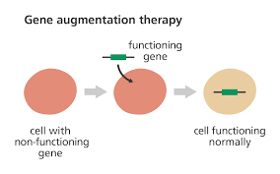
1: Gene augmentation therapy:
This is used by a mutation that stops a gene from producing a functional product such protein.
Example:
This can be used to treat loss of function disorders such as cystic fibrosis by introducing a functional copy of the gene to correct the disease.

Slide 12
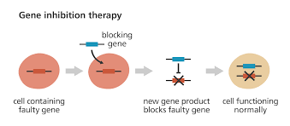
2: Gene inhibition therapy
This is the regulation of gene expression in a cell to prevent expression of a certain gene.
Example:
Cancer is sometimes the result of the over- activation of an oncogene. So, by eliminating the activity of that oncogene through gene inhibition therapy, it is possible to prevent further cell growth and stop the cancer in its tracks.

Slide 13
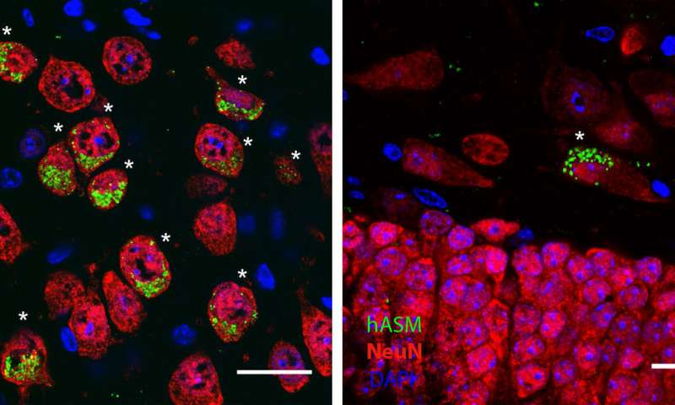
3: Gene replacement therapy
This technique of recognizing faulty gene, applying a piece of DNA in it’s correct from through a viral vector to the gene.
Example:

Slide 14
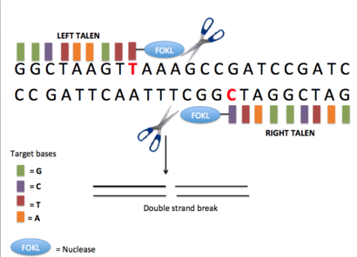
4: GENE CORRECTION
Gene correction give us the tools for both repairing and mutating gene/DNA.
Example:
The exogenous gene is constitutively expressed, unaffected by the native chromatin structure of the endogenous locus, at a level that differs from that of the endogenous gene.

Slide 15
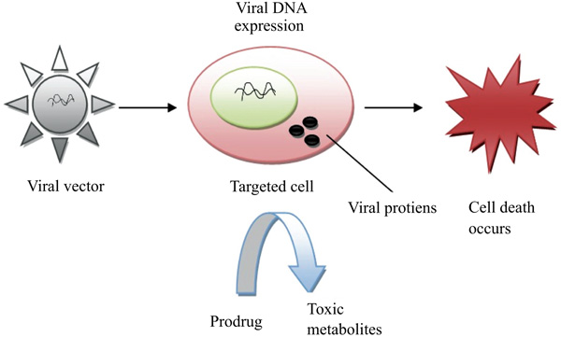
5. PRODRUG THERAPY
It is a medication or compound that after administration is metabolized into pharmacologically active drug.

Slide 16
APPLICATION
Cancers
Inherited disorders
Infectious diseases
Immune system disorders
Vaccination (Takeoka, Y., 2020)

Slide 17
Problems with gene therapy
Short lived.
Immune response
Viral vectors
Multi gene disorders
Heart disease, high blood pressure, arthritis and diabetes are hard to treat because you need to introduce more than one gene.
Patient could have toxic, immune, inflammatory response.
Would have to have multiple rounds of therapy (Iqubal, A., 2020)

Slide 18
Protocol
Plant Transformation Methods:
Transformation is defined as the process in which the genetic material of an organism is altered by the integration of new genes into its genome.
The transformation is done by using vectors such as plasmids.
The importance to produce transgenic plants is to:
Improve crop yields.
transgenic plants have protection against their parasites, pests and harsh weather conditions.
History:
The transformation was the first time applied by British Bacteriologist Frederick Griffith in 1928 in diplococcus pneumonia.

Slide 19
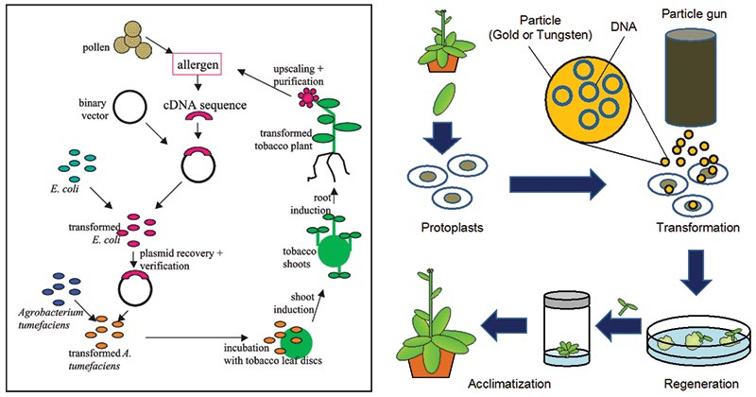
Transformation using electroporation was developed in the late 1980s.
Particle bombardment discovered (gene gun) by John Sanford in the 1980s.

Slide 20
Methods of plant transformation
Indirect method:
Direct method:
Indirect method:
Agrobacterium-mediated gene transfer.
Direct method:
Particle gun/biolistic/ballistic method of DNA delivery.
Chemical method; Polyethylene glycol (PEG)/protoplast fusion.
Laser-induced DNA delivery.
Electroporation

Slide 21
Indirect method:
Agrobacterium-mediated gene transfer:
Agrobacterium tumefaciens is a natural genetic engineer
It is achieved in two ways:
Co-culture with tissue explants.
In-plant transformation.
Agrobacterium tumefaciens Characteristics:
Soil-borne, gram – ve, motile, rod-shaped bacteria that are present in the rhizosphere.
Have able to transferred bacterial genes into the plant genome.
Causes Crown gall disease.

Slide 22
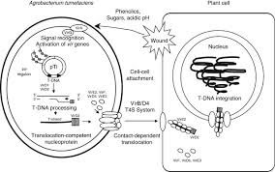

Slide 23
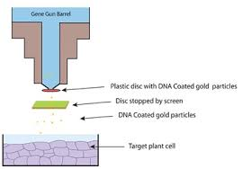
Direct Methods
Particle gun method:
A biolistic particle or gene gun system are designed for the transformation of the plant.
It is a device that injects cells with genetic information.

Slide 24
2. Polyethylene (glycol mediated transformation) the chemical method:
The transformation of plant protoplast done with naked DNA through treatment with PEG, the treatment also takes place in the presence of divalent cations.
The divalent cations and PEG de-stabilize the plant protoplast plasma membrane and provide it permeable to naked DNA.
DNA then enters into the nucleus and integrates into the genome of the host.
Advantages
Protoplast are isolated and transformed into a number of plant species.
Disadvantages
The transformation of DNA is susceptible to rearrangement and degradation.

Slide 25
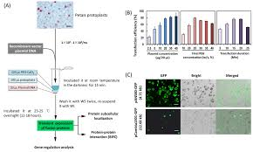

Slide 26
3. Electroporation
The delivery of DNA into the plant cells and protoplasts is done through electroporation.
Plant regulatory sequence is necessary for the gene of interest.
After that incubate the plant material in a buffer solution that contains DNA and subjected to high-voltage electric current.
The DNA than transfer through high voltage and induced opening in the plasma membrane and enter into the plant genome.
It may be used to transform all the major cereals particularly rice, wheat, maize
Advantages:
Both intact cells and tissue can be transformed.
The efficiency of transformation depends upon the plant materials, electroporation and tissue treatment conditions used for transformation.

Slide 27
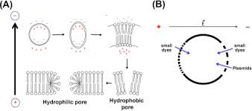
Disadvantages:
Only 40 to 50% of incubated cells receive DNA.
Around 50% of the transformed cells can survive

Slide 28
4. Laser-induced DNA delivery
LASERs produce holes that are transient in the cell membrane in which DNA enters into the cell cytoplasm.
But, no information about gene expression and stable integration.
Advantage
The cereal crops that are transformed are widely used which is difficult to transform with agrobacterium.
Disadvantage
They have a tendency to guide better frequency of transgene rearrangement and better copy range.
This can result in a high frequency of gene silencing

Slide 30
Gene therapy in human diseases:
NAME OF DISEASE CLASS | EXAMPLES
Monogenic disorders, Single locus (gene) is defective and responsible for the disease, 100% heritable. | Sickle cell anemia, Severe combined immunodeficiency, Cystic fibrosis, Hemophilia, Huntington’s disease, Alpha-1 antitrypsin, Chronic granulomatous disease, Parkinson’s Hypercholesterolemia etc.
Polygenic disorders, Multiple genes involved, Disease may be dependent on environmental factors and lifestyle. | Heart disease, Cancer, Diabetes, Schizophrenia and Alzheimer’s disease.
Infectious diseases | HIV

Slide 31
Severe Combined immune deficiency:
ADA-SCID is also known as the bubble boy disease.
Affected children are born without an effective immune system and will succumb to infections outside of the bubble without bone marrow transplantation from matched donors.
The therapeutic gene called ADA was introduced into the bone marrow cells of such patients in the laboratory, followed by transplantation of the genetically corrected cells back to the same patients.
The immune system was reconstituted in all six treated patients without noticeable side effects, who now live normal lives with their families without the need for further treatment.(see also description of ADA deficiency, ADA: The first gene therapy trial, from the National institutes of health and SCID.net)

Slide 32
Chronic Granulomatous disorder:
CGD is a genetic disease in the immune system that leads to the patients inability to fight off bacterial and fungal infections that can be fatal.
Using similar technologies as in the ADA-SCID trail, investigators in Germany treated two patients with this disease, whose reconstituted immune systems have since been able to provide them with full protection against infections for at least two years.
HEMOPHILIA:
Patients born with hemophilia are not able to induce blood clots and suffer from external and internal bleeding that can be life threatening.
The therapeutic effect however, was transient b/c the genetically corrected liver cells were recognized as foreign and rejected by the healthy immune system in the patients.

Slide 33
Blindness:
Liber's congenital amaurosis is a rare inherited eye disease that appears at birth or in the first few months of life, and affects around 1 in 80,000 of the population.
It was first described by Theodore Liber in 19th century.
LCA is typically characterized by nystagmus, sluggish or no pupillary responses, and severe vision loss or blindness.
The first patient was operated upon in early 2007. Researchers at children’s hospital of Philadelphia and the university of Pennsylvania have treated six young people via gene therapy.

Slide 34
CANCER:
Multiple gene therapy strategies have been developed to treat a wide variety of cancers, including suicide gene therapy, oncolytic virotherapy, anti- angiogenesis and therapeutic gene vaccines.
Two- thirds of all gene therapy trails are for cancer and many of these are entering the advanced stage, including a phase three trial of Ad.p53 for head and neck cancer and two different phase three gene vaccine trials for prostate cancer and pancreas cancer.
Additionally, numerous PHASE 1 and PHASE 2 clinical trials for cancers in the brain, skin, colon, breast, and kidney among others, are being conducted in academic medical centers and biotechnology companies, using novel technologies and therapeutics developed on-site.

Slide 35
Neurodegenerative
Recent progress in gene therapy has allowed for novel treatments of neurodegenerative diseases such as Parkinson’s disease and Huntington’s disease, for which exciting treatment results have been obtained in appropriate animal models of the corresponding human diseases.
Phase 1 clinical trials for these neurodegenerative disorders have been, or will soon be, launched.
MESOTHELIOMA:
Gene therapy research could result in effective treatments for mesothelioma patients.
Suicide genes have also been used in clinical trials with pleural mesothelioma patients.
While early results are positive, more work is necessary to develop effective gene therapy treatments.

Slide 36
REFERANCES
Goswami, R., Subramanian, G., Silayeva, L., Newkirk, I., Doctor, D., Chawla, K., ... & Betapudi, V. (2019). Gene therapy leaves a vicious cycle. Frontiers in oncology, 9, 297
Hanna, E., Rémuzat, C., Auquier, P., & Toumi, M. (2017). Gene therapies development: slow progress and promising prospect. Journal of market access & health policy, 5(1), 1265293.
Moss JA. Gene therapy review. Radiol Technol. 2014 Nov-Dec;86(2):155-80; quiz 181-4
Anguela, X. M. & High, K. A. Entering the modern era of gene therapy. Annu Rev. Med. 70, 273–288 (2019).
Takeoka, Y., Yurube, T., & Nishida, K. (2020). Gene therapy approach for intervertebral disc degeneration: an update. Neurospine, 17(1), 3.
Iqubal, A., Iqubal, M. K., Khan, A., Ali, J., Baboota, S., & Haque, S. E. (2020). Gene therapy, a novel therapeutic tool for neurological disorders: Current progress, challenges and future prospective. Current Gene Therapy, 20(3), 184-194.

Slide 37
https://www.ncbi.nlm.nih.gov/pubmed/12378268
https://bioone.org/journals/the-arabidopsis-book/volume-2017/issue-15/tab.0186/Agrobacterium-Mediated-Plant-Transformation-Biology-and-Applications/10.1199/tab.0186.full
https://www.intechopen.com/books/transgenic-plants-advances-and-limitations/methods-to-transfer-foreign-genes-to-plants.
https://onlinelibrary.wiley.com/doi/abs/10.1002/0470869143.kc014
http://nepad-abne.net/biotechnology/process-of-developing-genetically-modified-gm-crops/plant-transformation-using-particle-bombardment/
https://www.ncbi.nlm.nih.gov/pubmed/15310913
https://en.wikipedia.org/wiki/Electroporation
https://link.springer.com/chapter/10.1007/978-1-4613-1159-1_10
https://www.sciencedirect.com/science/article/pii/S0091679X08610432

