Slide 1
Week 2

Slide 2
Lecture Contents
Dual Mode Operations
Timer
Operating System Services
Computing Environments
Process Concept
Process Scheduling

Slide 3
Lecture Objectives
Illustrate the transition from user mode to kernel mode
Discuss how operating systems are used in various computing environments
Provide examples of free and open-source operating systems
Identify the separate components of a process and illustrate how they are represented and scheduled in an operating system.

Slide 4
Computing Environments
Traditional
Mobile
Client Server
Peer to Peer
Cloud Computing

Slide 5
Chapter 3

Slide 6
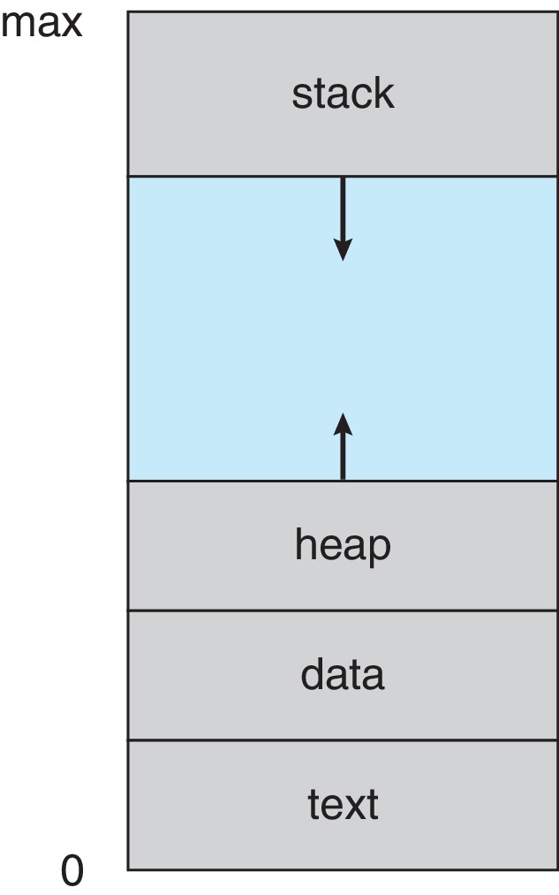
Process in Memory

Slide 7
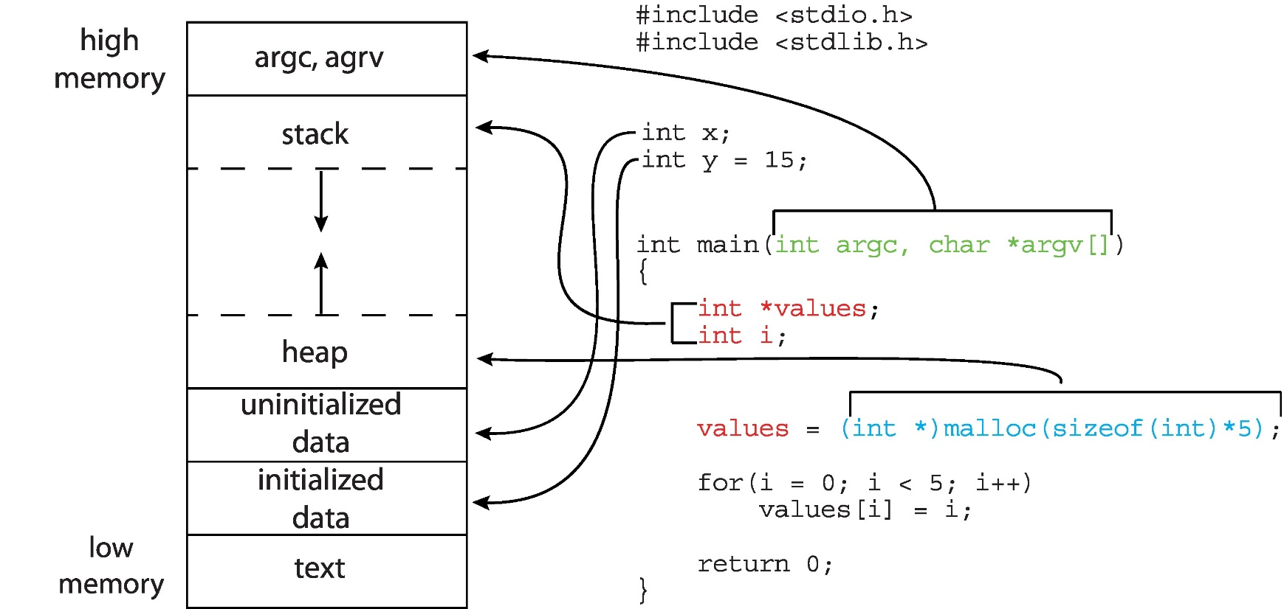
Memory Layout of a C Program

Slide 8
Process State
As a process executes, it changes state
New: The process is being created
Running: Instructions are being executed
Waiting: The process is waiting for some event to occur
Ready: The process is waiting to be assigned to a processor
Terminated: The process has finished execution

Slide 9
Lecture Material
Slides of chapter 1 & 3 can be found from the given link
https://codex.cs.yale.edu/avi/os-book/OS10/slide-dir/index.html

