Slide 1
Floating DDS
Floating systems or dynamically controlled systems are low-density systems that have sufficiently buoyancy to float over the gastric contents and remain buoyant in the stomach without affecting the gastric emptying rate for a prolonged period of time.
This results in an increased gastric retention time and a better control of the fluctuations in plasma drug concentration.
Many buoyant systems have been developed based on
Granules,
Powders,
Capsules,
Tablets,
Laminated films
Hallow Microspheres

Slide 2
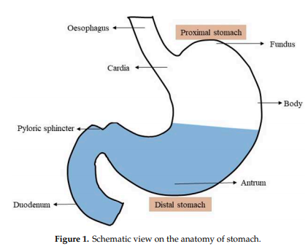
PHYSIOLOGY OF STOMACH
In the FDDS, the stomach has a crucial role; therefore, a good understanding of the anatomy and physiology of the stomach is a prerequisite for successful development of the gastroretentive dosage form.
Anatomically, the stomach is divided into two parts:
The proximal stomach, which consists of the fundus and body;
The distal stomach, which consists of the antrum and the pylorus (Figure 1).

Slide 3
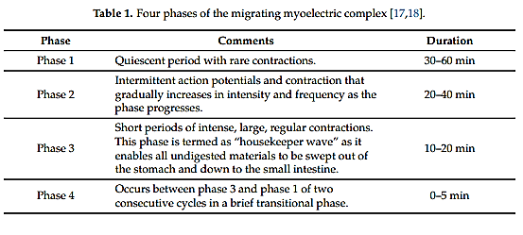
The main role of the stomach is to store the food temporarily, grind it, and then slowly release it into the duodenum.
The fundus and body primarily act as reservoirs for undigested food, whereas the antrum acts as a pump to assist in gastric emptying by a propelling action.
The mobility pattern of the stomach is termed as the migrating myoelectric complex (MMC); the different phases of the MMC are presented in Table 1.
Gastric emptying occurs in both the fed and fasted states, but the pattern of gastric emptying drastically varies between both states.
In the fasted state, an interdigestive sequence of electrical events follows in a cyclic manner through both the stomach and the small intestine every 90–120 min

Slide 4
During the interdigestive phase, the diameter of the pylorus increases up to approximately 19 mm.
As a result, particles smaller than the diameter of pyloric sphincter can easily evacuate from the pylorus to the duodenum during the interdigestive phase.
However, in the fed state, motor activity* is generated 5–10 min after ingestion of a meal and continues as long as the food remains in the stomach, which can delay the gastric emptying rate
*It is responsible for the churning of nutrients with secretions to initiate early digestion and empty stomach contents into the upper small intestine.

Slide 5
CLASSIFICATION OF FLOATING DRUG DELIVERY SYSTEMS
Floating drug delivery systems are classified depending on the use of 2 formulation variables:
Effervescent FDDS
Non effervescent FDDS
Effervescent Floating Dosage Forms
These are matrix types of systems prepared with the help of swellable polymers such as methylcellulose and chitosan and various effervescent compounds, eg, sodium bicarbonate, tartaric acid, and citric acid.
They are formulated in such a way that when in contact with the acidic gastric contents, CO2 is liberated and gets entrapped in swollen hydrocolloids, which provides buoyancy to the dosage forms.

Slide 6
The multiparticulate floating reservoir types of delivery systems may contain double or triple layers.
The triple layered tablets may be prepared, which contains swellable gas generating layer, sustainable approach was utilized in the development of floating or pulsatile drug delivery system based on the coated effervescent core.
The dosage form had two layers, first layer consisted of
drug,
cellulose acetate or
HPMC as a sustained release core and
second layer consisted of effervescent agents,
PEG 4000 (4%based on the weight of the second layer)
lactose or microcrystalline cellulose as filler.
Sodium bicarbonate and citric acid were used as an effervescent agent in a ratio of 1:0. in the concentration of 30-50 % of the w/w of the core.
The carbon dioxide is generated upon contact with the medium and gets entrapped in the polymeric matrix, which provides buoyancy to the dosage form.
It was observed that addition of 10-20% w/w of HPMC significantly retarded drug release compared to the dosage form without HPMC.

Slide 7
Non-Effervescent Floating Dosage Forms
Non-effervescent floating dosage forms use a gel forming or swellable cellulose type of hydrocolloids, polysaccharides, and matrix-forming polymers like polycarbonate, polyacrylate, polymethacrylate, and polystyrene.
The formulation method includes a simple approach of thoroughly mixing the drug and the gel-forming hydrocolloid.
After oral administration this dosage form swells in contact with gastric fluids and attains a bulk density of G 1.
The air entrapped within the swollen matrix imparts buoyancy to the dosage form.
The so formed swollen gel-like structure acts as a reservoir and allows sustained release of drug through the gelatinous mass.

Slide 8
ADVANTAGES OF FDDS
Floating dosage forms such as tablets or capsules will remains in the solution for prolonged time even at the alkaline pH of the intestine.
FDDS are advantageous for drugs meant for local action in the stomach eg: Antacids
FDDS dosage forms are advantageous in case of vigorous intestinal movement and in diarrhea to keep the drug in floating condition in stomach to get a relatively better response.
Acidic substance like aspirin causes irritation on the stomach wall when come in contact with it hence; FDDS formulations may be useful for the administration of aspirin and other similar drugs.
The FDDS are advantageous for drugs absorbed through the stomach eg: Ferrous salts, Antacids.

Slide 9
DISADVANTAGES OF FDDS
Floating systems are not feasible for those drugs that have solubility or stability problems in gastric fluids.
Drugs such as Nifedipine, which is well absorbed along the entire GI tract and which undergo significant first-pass metabolism, may not be suitable candidates for FDDS since the slow gastric emptying may lead to reduced systemic bioavailability. Also there are limitations to the applicability of FDDS for drugs that are irritant to gastric mucosa.
One of the disadvantages of floating systems is that they require a sufficiently high level of fluids in the stomach, so that the drug dosages form float therein and work efficiently
These systems also require the presence of food to delay their gastric emptying

Slide 10
Applications of Floating Drug Delivery Systems
Floating drug delivery offers several applications for drugs having poor bioavailability because of the narrow absorption window in the upper part of the gastrointestinal tract. It retains the dosage form at the site of absorption and thus enhances the bioavailability.
Sustained Drug Delivery
FDDS systems can remain in the stomach for long periods and hence can release the drug over a prolonged period of time. The problem of short gastric residence time encountered with an oral CR formulation hence can be overcome with these systems. These systems are relatively large in size and passing from the pyloric opening is prohibited.
Site-Specific Drug Delivery
These systems are particularly advantageous for drugs that are specifically absorbed from stomach or the proximal part of the small intestine, eg, riboflavin and furosemide.

