Slide 1
Introduction to Computer (Comp-201)

Slide 2
Ports
A port is an interface or connection point through which peripheral devices connect to the computer.
A computer has different type of ports to connect different devices.
Each type of port operates at a certain speed, which is measured in kilobits per second, megabits per second or gigabits per second.

Slide 3
Types of Ports
Serial Ports
Parallel Ports
Universal serial Bus Port
Thunderbolt Port
HDMI Port
eSATA Port
Ethernet Port
Audio Port

Slide 4
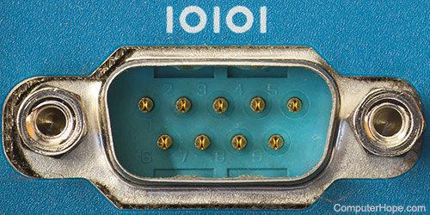
Serial Ports
It transmits one bit at a time.
It is used to connect devices that do not require fast data transmission like mouse and keyboard.
Data travels over a serial port at 115 kilobits per second.
Serial ports are older ports and not typically found on modern computers.

Slide 5
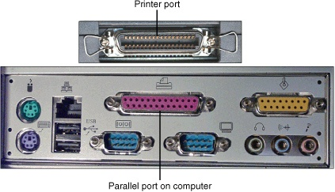
Parallel Ports
It transmits many bits at a time.
It is used to connect devices that transfer many bits at a time and require fast data transmission like printer and scanner.
The speed of parallel port is 12 Mbps.
These are also older ports and are not found in modern computer.

Slide 6
Universal Serial Bus Port
USB is the most common type of port, it can connect up to 127 different peripheral devices.
It is used to connect devices such as keyboard, mouse, digital camera, scanner, printer, external hard disk and USB flash drive etc.
USB ports can also be used as a power supply for different devices like smart phones and tablets.
Most laptops and desktop computers normally come with at least two USB ports.

Slide 7
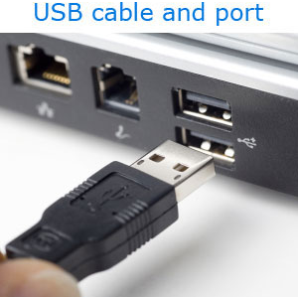
Universal Serial Bus Port
USB ports support hot swapping and Plug and Play.
Hot Swapping is the ability to connect and disconnect devices without shutting down the computer.
Plug n Play enables a computer to automatically detect and configure a device when it is connected to a computer.

Slide 8
Thunderbolt Port
It is the fastest type of port used to connect devices to the computer.
It supports a transfer speed of up to 10 Gbps.
It can connect up to six different peripheral devices.
It is very useful for laptop and ultra books due to slim design.

Slide 9
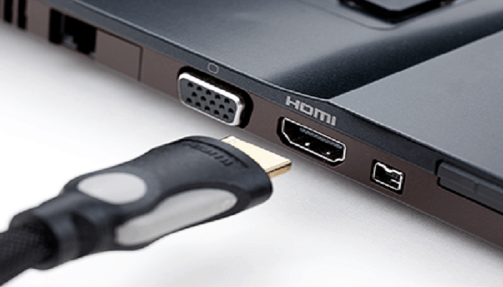
HDMI Port
HDMI stands for High Definition Multimedia Interface.
It is a digital port that can transmit both audio and video signals.
It is the most common multimedia port.
It is the standard connection for high definition TVs, Video game consoles and other media devices.
All currently available monitors, DVD players, televisions and game consoles have at least one HDMI port.

Slide 10
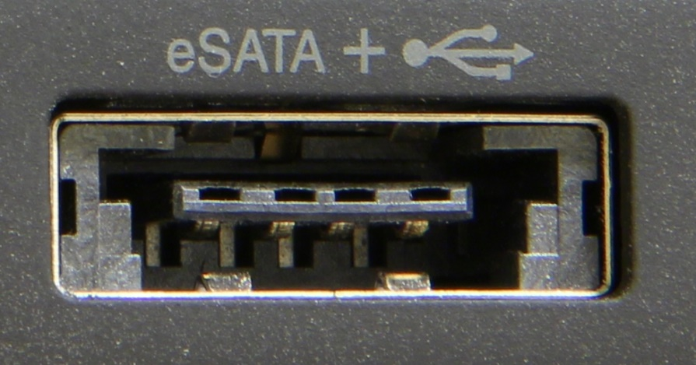
eSATA Port
eSATA stands for external Serial Advanced Technology Attachment.
It is used to connect an external SATA hard disk to a computer.
SATA hard disks are popular because of their fast data transmission speeds.
It provides up to six times faster data transmission speeds than other external hard disks.

Slide 11
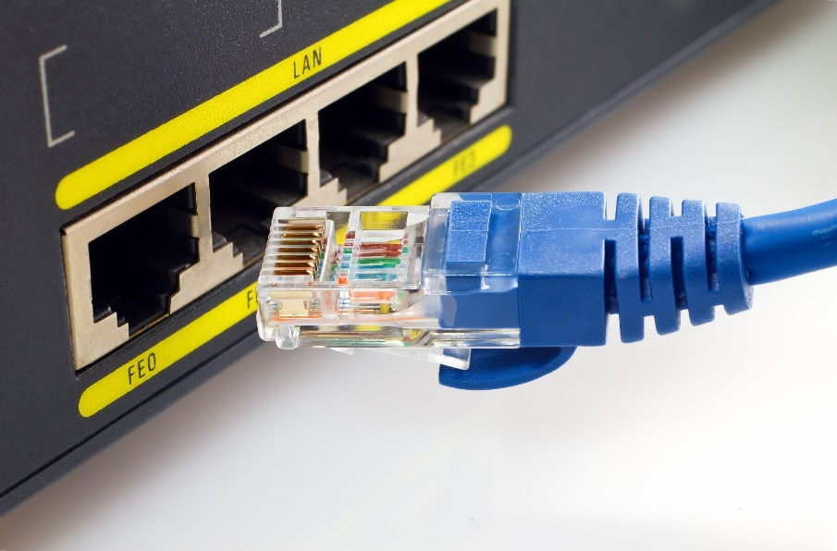
Ethernet Port
It is used to connect a computer to local network or cable modem.
Ethernet originally offered a transfer rate of 10 Mbps.
Fast Ethernet provides a transfer rate of 100 Mbps.
Gigabit Ethernet provides higher speed of transmission with transfer rates of 1 Gbps.

Slide 12
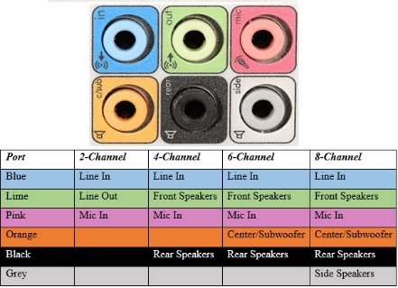
Audio Port
Audio port is used to connect headphones, microphones, and speakers to the computer.

Slide 13
Buses
A computer system consists of multiple devices and CPU must be able to communicate with all devices.
The devices are connected together by a communication channel called BUS.
A bus consists of a set of communication lines to move a large amount of bits in the form of electronic pulses from one unit to another.

Slide 14
Buses
The bus is used to connect the following units
CPU
ALU
CU
Main Memory (RAM,ROM)
Input / Output Devices
Bus is a common path to transfer data and commands between CPU, memory and input/output devices.
It is also used to send or receive data from secondary storage.

Slide 15
Buses
The amount of data that a bus can carry at one time is called bus width.
A higher bus width means that a bus can carry more data.
The speed at which data moves from one component to another component of the computer is called bus speed.
Bus width and bus speed affects the overall performance of the computer.

Slide 16
System Buses
System buses are the part of motherboard.
They connect the processor to the main memory.
Different type of system buses are
Data bus
Address bus
Control bus

Slide 17
Data Bus
Data bus is used to transfer data between different components of the computer.
It transfers instructions from memory to CPU for execution.
It transfers data between memory and the I/O during input/output operations.
The number of lines in data bus affects the speed of data transfer between different components.
A data bus with more lines can carry more data.
The data bus lines are bi-directional and can carry data to or from memory.

Slide 18
Address Bus
It is used to connect the CPU with main memory to identify particular addresses in main memory.
The number of lines in the address bus determines the amount of memory that can be directly addressed.
The address bus is a unidirectional bus.
It carries address of memory location from CPU to the main memory.

Slide 19
Control Bus
It is used to transmit different commands from one component to another component.
For example, if CPU wants to read data from main memory, it uses control bus to send the memory read command to the main memory of the computer.
The control bus is also used to transmit control signals like ACKS (Acknowledgement signals).
A control signal contains the following
Timing Information: It specifies the time for which a device can use data and address bus.
Command Signal: It specifies the type of operation to be performed.

Slide 20
Control Bus
Command | Purpose
MEMORY WRITE | Write data to a given location in main memory.
MEMORY READ | Read data from a given location in main memory.
I/O WRITE | Write data to a given output device.
I/O READ | Read data from a given input device.
BUS REQUEST | Request for a control on the bus for transmitting data.
BUS GRANT | Indicate the grant of the bus to a device.

Slide 21
Bays
Bay is an open area inside the system unit to install additional equipment such as storage drives.
Some bays are rectangular opening to hold disk drives.
Some bays hold card readers and ports such as USB.
Drive bays typically hold disk drives.

Slide 22
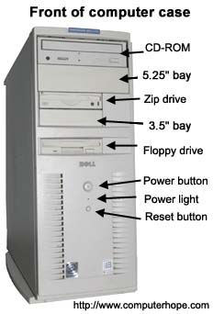
Bays

Slide 23
Types of Bays
External Drive Bay
It is used to access the drive from outside the system unit.
Examples are CD drive, DVD drive and flash memory card reader.
Internal Drive Bay
It is hidden inside the system unit.
An example is the hard disk drive

Slide 24
Power supply and Battery
Power supply is located in the back of the computer case.
It is also called power supply unit (PSU).
Most PCs plug in to a standard electrical outlet that supply an alternating current.
Power supply converts alternating current to the direct current.
Battery is a component that supplies power to a device.
It enables the device (laptop, tablets) to work without a power outlet.
Batteries can supply power to a laptop for several hour depending on how much power it requires.

Slide 25
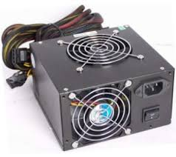
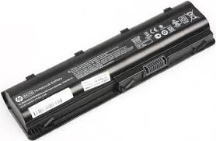
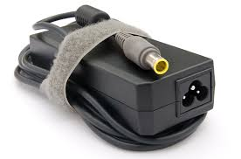
Power supply and Battery

