Slide 1
Subject: Population Studies
Class: MSc 4th
Lecture: 5th week
Topic: Life Tables

Slide 2
Assumptions of Life Table:
A life table is based on the following assumptions:
1. A hypothetical cohort of life table usually comprises of 1,000 or 10,000 or 1,00,000 births.
2. The deaths are equally distributed throughout the year.
3. The cohort of people diminish gradually by death only.
4. The cohort is closed to the in-migration and out-migration.
5. The death rate is related to a pre-determined age specific death rate.
6. The cohort of persons die at a fixed age which does not change.
7. There is no change in death rates overtime.
8. The cohort of life tables are generally constructed separately for males and females.

Slide 3
Importance of Life Tables
We can determine the importance of life tables by the following facts
1. Life table is used to project future population on the basis of the present death rate.
2. It helps in determining the average expectation of life based on age specific death rates.
3. The method of constructing a life table can be followed to estimate the cause of specific death rates, male and female death rates, etc.
4. The survival rates in a life table can be used to calculate the net migration rate on the basis of age distribution at 5 or 10 year interval.
5. Life tables can be used to compare population trends at national and international levels.
6. By constructing a life table based on the age at marriage, marriage patterns and changes in them can be estimated.

Slide 4
7. Instead of a single life table, multiple decrement life tables relating to cause specific death rate, male and female death rates, etc. can be constructed for analyzing socio-economic data in a country.
8. Life tables are particularly used for formulating family planning programs relating to infant mortality, maternal deaths, health programs, etc. They can also be used for evaluating family planning programs.
9. Now a days, life tables are used by life insurance companies in order to estimate the average life expectancy of persons, separately for males and females. They help in determining the amount of premium to be paid by a person falling in a specific age group.
Besides, if an insured person dies before the policy matures, the life table provides economic support to the insurance company without facing financial loss and it is able to give the insured amount to the legal heirs of the deceased.

Slide 5
Survivorship curves
A life table isn't the easiest thing to read. In fact, I'd rather see all that survival data as a graph—that is, as a survivorship curve.
A survivorship curve shows what fraction of a starting group is still alive at each successive age.
Survivorship curves are usually created by plotting lx on the y-axis and I. Occasionally you may see nx plotted on the y-axis. The y-axis is usually logarithmic, i.e., log10 (lx), to allow comparisons among different studies and species. In other words, log transformations standardize the survivorship curve.
For example, the survivorship curve for Dall mountain sheep is shown in the next slide.
The graph makes it nice and clear that there's a small dip in sheep survival early on, but most of the sheep die relatively late in life.

Slide 6
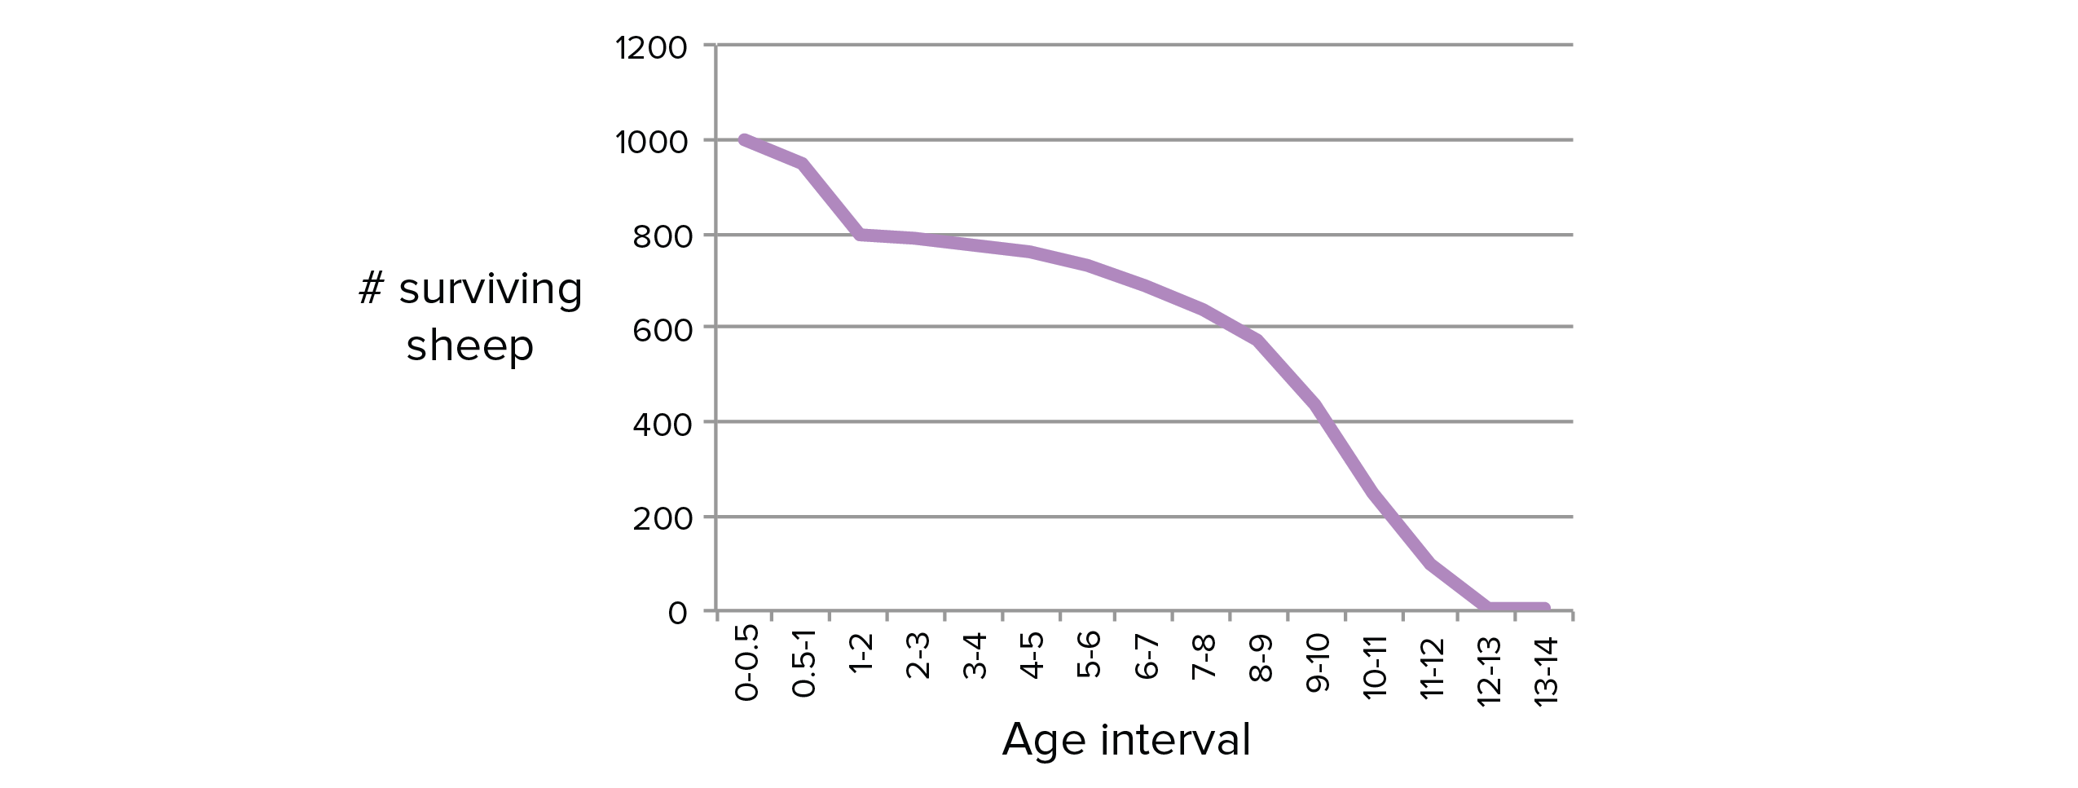

Slide 7
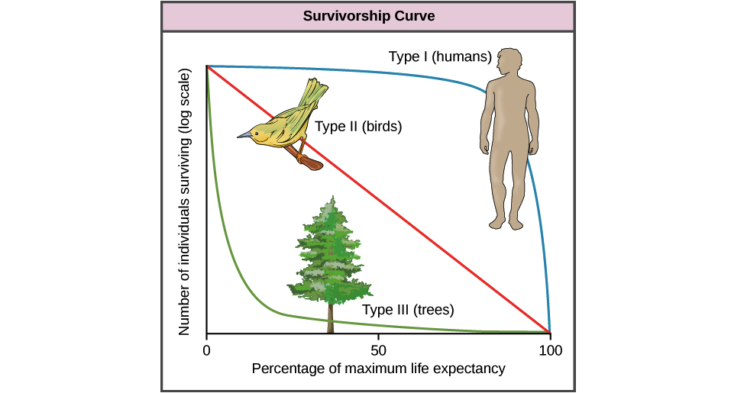

Slide 8
Types of Survivor Curve
Different species have differently shaped survivorship curves. In general, we can divide survivorship curves into three types based on their shapes:
Type I. Humans and most primates have a Type I survivorship curve. In a Type I curve, organisms tend not to die when they are young or middle-aged but, instead, die when they become elderly. Species with Type I curves usually have small numbers of offspring and provide lots of parental care to make sure those offspring survive.
Type II. Many bird species have a Type II survivorship curve. In a Type II curve, organisms die more or less equally at each age interval. Organisms with this type of survivorship curve may also have relatively few offspring and provide significant parental care.
Type III. Trees, marine invertebrates, and most fish have a Type III survivorship curve. In a Type III curve, very few organisms survive their younger years. However, the lucky ones that make it through youth are likely to have pretty long lives after that. Species with this type of curve usually have lots of offspring at once—such as a tree releasing thousands of seeds—but don't provide much care for the offspring.

Slide 9
Task
What is mortality curve? Describe the three types of mortality curves.

