Slide 1
DAS
Department of Animal Sciences, UOS
Reproduction Cycle
Introduction to Animal Husbandry
2020
Notes:
Experimental—deceleration, disability, supine, mice
Theory—mites, honeybees, identity, probit
Lifespan—primates, etc
Human—self reinforcing, wasp, NBA
Thank
Background
Invasive/Greece/Hawaii
CDFA Medfly panel
Aging research
LBAM
Workshop
Zalom et al
Retreat/Workshop
LMAM see that little changes
New day in science/policy

Slide 2
Puberty (sexual maturity)
It is the period in the life of a female when she becomes capable for production and when the reproductive process begins to function
In males the age at which it can produce spermatozoa (capable of fertilization) is called age at puberty
In females, puberty occurs before mature body size is attained and she is capable of supplying nutrients for the growth and development of her own body as well as for the growth and development of her young.
Puberty is controlled by certain physiological mechanisms involving the gonads and the anterior pituitary gland, it is influenced by several factors of both a hereditary and an environmental nature e.g. season, temperature, nutrition, etc.
Notes:
Experimental—deceleration, disability, supine, mice
Theory—mites, honeybees, identity, probit
Lifespan—primates, etc
Human—self reinforcing, wasp, NBA
Thank
Background
Invasive/Greece/Hawaii
CDFA Medfly panel
Aging research
LBAM
Workshop
Zalom et al
Retreat/Workshop
LMAM see that little changes
New day in science/policy

Slide 3
Breeding season
Females of farm livestock have a continuous estrus cycles throughout the year if they do not become pregnant
Although, a tendency of seasonality occurs in sheep and to some extent in buffaloes as occurrence of successive estrus cycles in the non-pregnant female is more in a particular season of the year
During the breeding season the reproductive functions are the same as in females which are not seasonal breeders
Before and after the sexual season, however, the reproductive tract and the ovaries of the seasonal breeding females are in a state of relative quiescence, this condition is known as anoestrus
Notes:
Experimental—deceleration, disability, supine, mice
Theory—mites, honeybees, identity, probit
Lifespan—primates, etc
Human—self reinforcing, wasp, NBA
Thank
Background
Invasive/Greece/Hawaii
CDFA Medfly panel
Aging research
LBAM
Workshop
Zalom et al
Retreat/Workshop
LMAM see that little changes
New day in science/policy

Slide 4
The reproductive cycle
Oestrus cycle
Once puberty has been reached and the sexual season has been initiated, oestrus occurs in the non-pregnant female in a characteristic rhythmic cycle
The interval between the onset of one oestrus period and the onset of the next is known as the oestrus cycle
These intervals are accompanied by a series of definite physiologic changes within the reproductive tract of the female
Notes:
Experimental—deceleration, disability, supine, mice
Theory—mites, honeybees, identity, probit
Lifespan—primates, etc
Human—self reinforcing, wasp, NBA
Thank
Background
Invasive/Greece/Hawaii
CDFA Medfly panel
Aging research
LBAM
Workshop
Zalom et al
Retreat/Workshop
LMAM see that little changes
New day in science/policy

Slide 5
Phases of estrus cycle
The oestrus cycle in farm mammals can be divided into .four different phases for the purpose of understanding i.e.
1. Pro-oestrus
2. Oestrus,
3. Metoestrus
4. Dioestrus.
Notes:
Experimental—deceleration, disability, supine, mice
Theory—mites, honeybees, identity, probit
Lifespan—primates, etc
Human—self reinforcing, wasp, NBA
Thank
Background
Invasive/Greece/Hawaii
CDFA Medfly panel
Aging research
LBAM
Workshop
Zalom et al
Retreat/Workshop
LMAM see that little changes
New day in science/policy

Slide 6
Pro-Estrus
Pro-oestrus:
It is the phase of the cycle just before the occurrence of oestrus in which the reproductive system is beginning preparations for the release of the ovum from the ovary
Notes:
Experimental—deceleration, disability, supine, mice
Theory—mites, honeybees, identity, probit
Lifespan—primates, etc
Human—self reinforcing, wasp, NBA
Thank
Background
Invasive/Greece/Hawaii
CDFA Medfly panel
Aging research
LBAM
Workshop
Zalom et al
Retreat/Workshop
LMAM see that little changes
New day in science/policy

Slide 7
Oestrus
During oestrus under the influence of estrogens, the reproductive tract and especially the uterus and uterine horns become oedematous and increase greatly in vascularity
During oestrus, female show heat symptoms due to the oestrogen secretions
During this phase, peristaltic movements of the uterus and oviducts occur which assist in the transport of the egg and sperm
Synchronization of ovum and sperm is necessary for fertilization because the life of the ovum after ovulation and that of the sperm in the female reproductive tract is limited to a few hours
The length of oestrus varies a lot among species and may be between 12 to 48 hours in our farm animals
Notes:
Experimental—deceleration, disability, supine, mice
Theory—mites, honeybees, identity, probit
Lifespan—primates, etc
Human—self reinforcing, wasp, NBA
Thank
Background
Invasive/Greece/Hawaii
CDFA Medfly panel
Aging research
LBAM
Workshop
Zalom et al
Retreat/Workshop
LMAM see that little changes
New day in science/policy

Slide 8
Metoestrus
Metestrous is the period immediately following oestrus when the reproductive system comes under the influence of progesterone which is secreted by the newly formed corpora lutea
During metoestrus the uterus makes preparations to receive and nourish the embryos
Notes:
Experimental—deceleration, disability, supine, mice
Theory—mites, honeybees, identity, probit
Lifespan—primates, etc
Human—self reinforcing, wasp, NBA
Thank
Background
Invasive/Greece/Hawaii
CDFA Medfly panel
Aging research
LBAM
Workshop
Zalom et al
Retreat/Workshop
LMAM see that little changes
New day in science/policy

Slide 9
Dioestrus
If pregnancy does not occur, the uterus and the rest of the reproductive tract regress toward a less active state similar to that before proestrus
In the cow, buffalo, goat and mare, the length of the oestrus cycle is 20-21 days while ewes have a shorter oestrus cycle averaging between 16 and 17 days in length
Notes:
Experimental—deceleration, disability, supine, mice
Theory—mites, honeybees, identity, probit
Lifespan—primates, etc
Human—self reinforcing, wasp, NBA
Thank
Background
Invasive/Greece/Hawaii
CDFA Medfly panel
Aging research
LBAM
Workshop
Zalom et al
Retreat/Workshop
LMAM see that little changes
New day in science/policy

Slide 10
Reproductive Cycle
Parturition
Birth
Postpartum
Quiescence
Puberty
Abortion
Ovarian
Activity
Gestation
Embryonic
Death
Estrous
Cycle
Estrous Metestrous Diestrous Proestrous
Fertilization
Failure
Insemination
Conception
Notes:
Experimental—deceleration, disability, supine, mice
Theory—mites, honeybees, identity, probit
Lifespan—primates, etc
Human—self reinforcing, wasp, NBA
Thank
Background
Invasive/Greece/Hawaii
CDFA Medfly panel
Aging research
LBAM
Workshop
Zalom et al
Retreat/Workshop
LMAM see that little changes
New day in science/policy

Slide 11
Signs of oestrus
The outward signs or symptoms of oestrus are somewhat similar in females of the different species of farm mammals, although there are some variation of behaviour between and within species; During oestrus a cow becomes:
Very restless,
Does not eat,
Spends little or no time on rumination
Some times hauls ,and search for the males
She attempts to mount other cows and will stand while they mount her
During oestrus she will stand when the bull mounts and is receptive to the act of mating
The vulva of the cow may become enlarged and congested and mucus secretions may be seen around the tail head or coming from the vuIva
Notes:
Experimental—deceleration, disability, supine, mice
Theory—mites, honeybees, identity, probit
Lifespan—primates, etc
Human—self reinforcing, wasp, NBA
Thank
Background
Invasive/Greece/Hawaii
CDFA Medfly panel
Aging research
LBAM
Workshop
Zalom et al
Retreat/Workshop
LMAM see that little changes
New day in science/policy

Slide 12
Duration of Oestrus
The duration of oestrus varies considerably between species and between individuals within a species
Several factors affect the duration of oestrus in the cows
It ranges from 6 hours to 30 hours with a mean of about 18 hours
Mostly cows in oestrus early in the morning seldom show oestrus by late in the evening and cow in oestrus the first time in the evening tend to be silent the next morning
In buffaloes signs might be less prominent at least in some cases because of silent heat problem
They sometimes go unnoticed because such an activity occurs more at night than during the day
Notes:
Experimental—deceleration, disability, supine, mice
Theory—mites, honeybees, identity, probit
Lifespan—primates, etc
Human—self reinforcing, wasp, NBA
Thank
Background
Invasive/Greece/Hawaii
CDFA Medfly panel
Aging research
LBAM
Workshop
Zalom et al
Retreat/Workshop
LMAM see that little changes
New day in science/policy

Slide 13
Best time of service:
Since there is an interval between the end of heat and ovulation, correct timing of service or insemination may be important
Accordingly it is necessary to obtain as accurate an idea as possible of the time at which ovulation occurs and of the range of time over which it happens
It is in general agreement that ovulation occurs, on the average, 13 to 14 hours after the end of heat
Assuming that the spermatozoa are fertile and are capable of reaching the egg, fertility depends upon several factors such as
time of deposition of the semen in relation to the time of ovulation,
the duration of fertile life of the spermatozoa and
the duration of fertile life of the egg
Notes:
Experimental—deceleration, disability, supine, mice
Theory—mites, honeybees, identity, probit
Lifespan—primates, etc
Human—self reinforcing, wasp, NBA
Thank
Background
Invasive/Greece/Hawaii
CDFA Medfly panel
Aging research
LBAM
Workshop
Zalom et al
Retreat/Workshop
LMAM see that little changes
New day in science/policy

Slide 14
Conti…
Evidently the spermatozoa can survive in the tract of the cow for a little beyond 24 hours, whereas the egg probably has a very short survival time, about 6 hours at the most
Optimum fertility is apparently obtained when inseminations or services are performed 12 to 18 hours before ovulation
Notes:
Experimental—deceleration, disability, supine, mice
Theory—mites, honeybees, identity, probit
Lifespan—primates, etc
Human—self reinforcing, wasp, NBA
Thank
Background
Invasive/Greece/Hawaii
CDFA Medfly panel
Aging research
LBAM
Workshop
Zalom et al
Retreat/Workshop
LMAM see that little changes
New day in science/policy

Slide 15
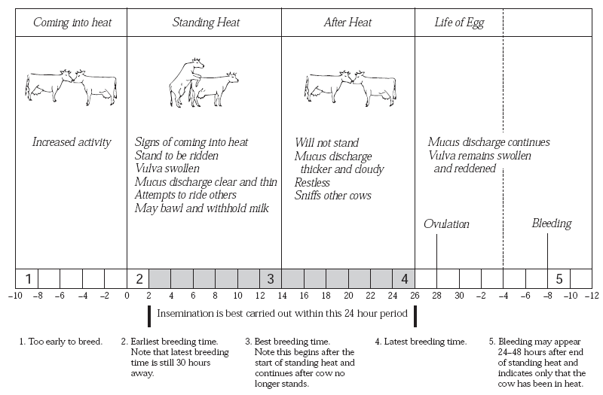
Notes:
Experimental—deceleration, disability, supine, mice
Theory—mites, honeybees, identity, probit
Lifespan—primates, etc
Human—self reinforcing, wasp, NBA
Thank
Background
Invasive/Greece/Hawaii
CDFA Medfly panel
Aging research
LBAM
Workshop
Zalom et al
Retreat/Workshop
LMAM see that little changes
New day in science/policy

Slide 16
Cow first showing oestrus Should be bred/inseminated
In the morning → → Same day afternoon
In the afternoon → → Next day morning
Notes:
Experimental—deceleration, disability, supine, mice
Theory—mites, honeybees, identity, probit
Lifespan—primates, etc
Human—self reinforcing, wasp, NBA
Thank
Background
Invasive/Greece/Hawaii
CDFA Medfly panel
Aging research
LBAM
Workshop
Zalom et al
Retreat/Workshop
LMAM see that little changes
New day in science/policy

