Slide 4
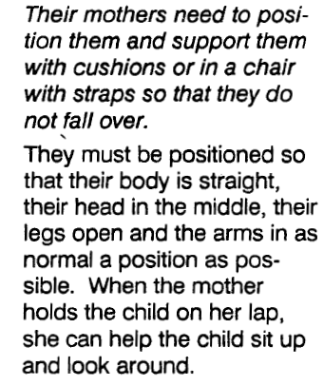

Slide 5
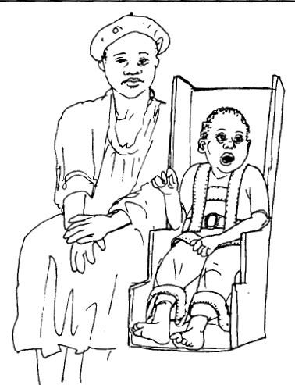

Slide 6
Development of a tight child
At first the child learns to control her head

Slide 7
Examination of a tight child (spastic quardiplegic)

Slide 8
Signs of spastic quadriplegia (of 3 year child)
Child is very tight
Canot sit up and hold her head up
Feeding is very difficult
a) She pushes the food out of her mouth with her tongue
b) Vomits very easily
She is unable to talk
Her arms and legs are very tight and stiff and cannot be moved easily

Slide 9
Problems of a spastic quardiplegic

Slide 11
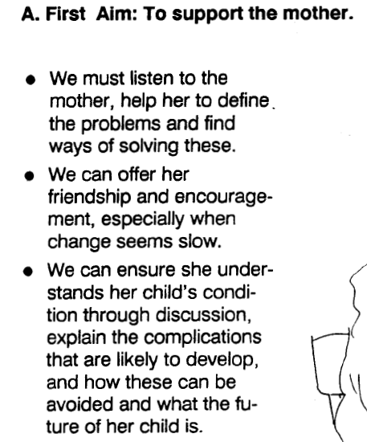

Slide 12
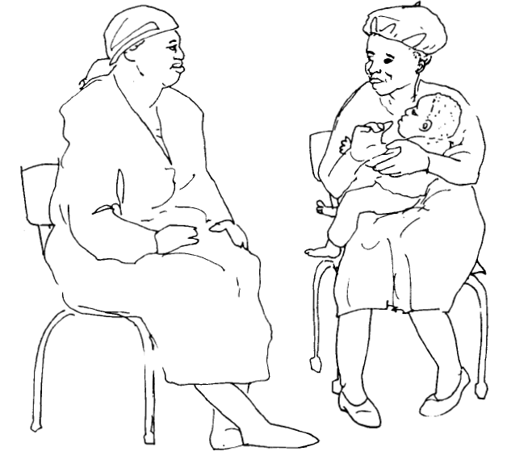

Slide 13
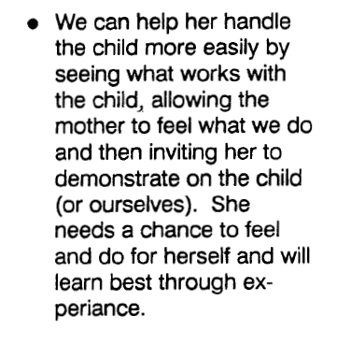

Slide 15
If we notice her head control

Slide 16
Instructions to physical therapist
Don’t
Don’t put your hand behind the head of spastic child
Complications
The child ll push back into the hand of therapist and her whole body ll get more tight

Slide 17
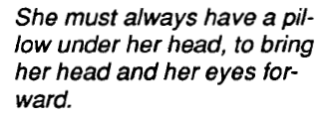
Instructions to physical therapist
Do

Slide 18
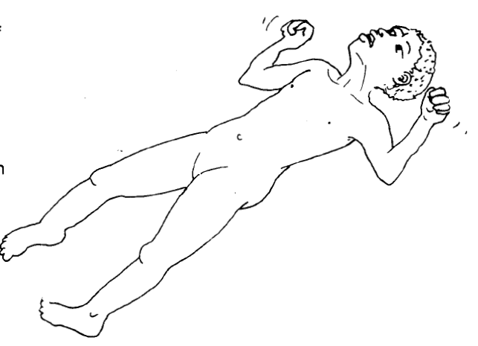

Slide 19
Instructions to physical therapist
Don’t
On her prone position

Slide 20
Instructions to physical therapist
Do

Slide 21
Instructions to physical therapist
N.B
Nothing else can develop until she has head control
It is much easier to turn her head up when it is in the middle

Slide 22
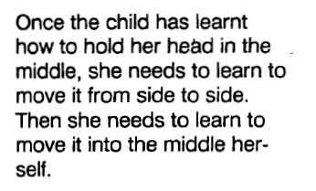
Instructions to physical therapist

Slide 23
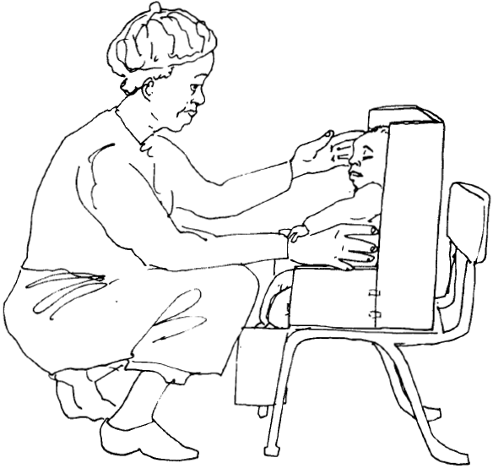
Instructions to physical therapist

Slide 24
Instructions to physical therapist
How to get child to look at one side

Slide 25
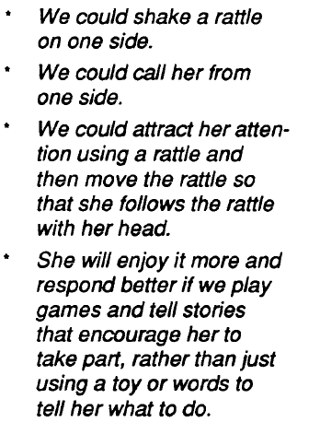

Slide 26
Instructions to physical therapist
A spastic child can turn eaily her head to the left but she struggle to turn her head to the right side as her head usually falls to the right
A spastic child usually respond slowly so a physical therapist needs to be patient and let her to take time

Slide 27
Instructions to physical therapist
It is not possible for a spastic child to do the things by her self so a physical therapist must help her to be put in a good starting position and then to be stimulated in this position

Slide 28
Instructions to physical therapist
If a child can not see its use a toy that rattles or make noise

Slide 30
Role of a mother for a spastic child

