Slide 1
Chapter Fourteen
Communicating Customer Value: Integrated Marketing Communications Strategy

Slide 2
Communicating Customer Value: Integrated Marketing Communications Strategy
Topic Outline
The Promotion Mix
Integrated Marketing Communications
A View of the Communications Process
Steps in Developing Effective Marketing Communication
Setting the Total Promotion Budget and Mix
Socially Responsible Marketing Communication

Slide 3
The Promotion Mix
The promotion mix is the specific blend of advertising, public relations, personal selling, and direct-marketing tools that the company uses to persuasively communicate customer value and build customer relationships

Slide 4
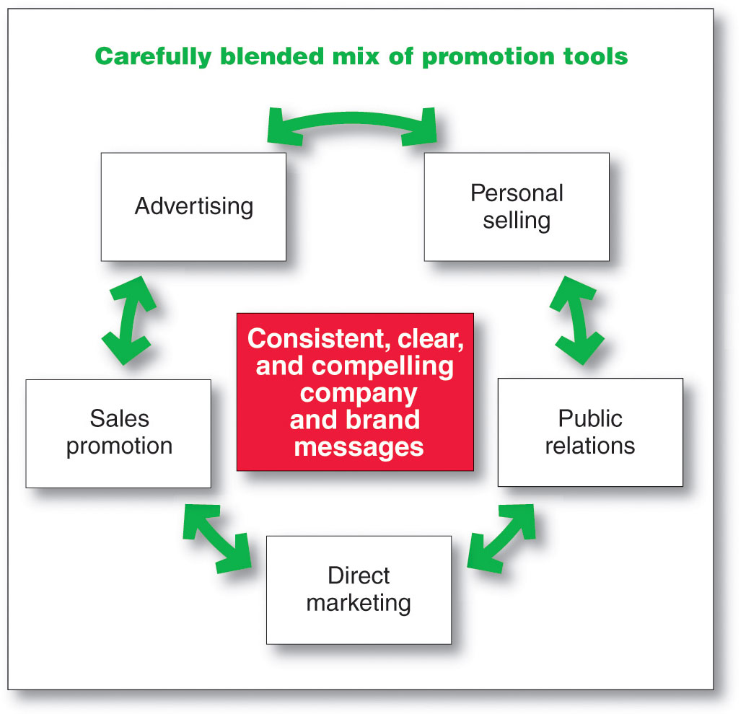
The Promotion Mix
Major Promotion Tools
Notes:
Note to Instructor
Discussion Question
Which of these do you think is most effective?
They will realize that different tools are better for different targets, products, stages in the product life cycle, and goals of the marketer.

Slide 5
The Promotion Mix
Major Promotion Tools
Advertising is any paid form of non-personal presentation and promotion of ideas, goods, or services by an identified sponsor
Broadcast
Print
Internet
Outdoor

Slide 6
The Promotion Mix
Major Promotion Tools
Sales promotion is the short-term incentives to encourage the purchase or sale of a product or service
Discounts
Coupons
Displays
Demonstrations
Notes:
Note to Instructor
Discussion Question
What sales promotions have you seen in the last two months?
They will often mention similar coupon books, fast food contests, and demonstrations in stores.

Slide 7
The Promotion Mix
Major Promotion Tools
Public relations involves building good relations with the company’s various publics by obtaining favorable publicity, building up a good corporate image, and handling or heading off unfavorable rumors, stories, and events
Press releases
Sponsorships
Special events
Web pages
Notes:
Note to Instructor
This link is to McDonald’s Web page for press releases. Before clicking you might ask the students what kind of information McDonald’s might issue press releases about. You can then see the press releases which talk about finances, marketing strategies, and organizational issues.

Slide 8
The Promotion Mix
Major Promotion Tools
Personal selling is the personal presentation by the firm’s sales force for the purpose of making sales and building customer relationships
Sales presentations
Trade shows
Incentive programs

Slide 9
The Promotion Mix
Major Promotion Tools
Direct marketing involves making direct connections with carefully targeted individual consumers to both obtain an immediate response and cultivate lasting customer relationships—through the use of direct mail, telephone, direct-response television, e-mail, and the Internet to communicate directly with specific consumers
Catalog
Telemarketing
Kiosks
Notes:
Note to Instructor
This Web link is to boston.com—a regional news Web site. This site usually has extensive banner advertising and sponsorships. A good question to ask students is “Why is this considered direct marketing.” Tell them that it is targeted, expects an immediate response, and is measurable.

Slide 10
Integrated Marketing Communications
The New Marketing Communications Landscape
Consumers are better informed
More communication
Less mass marketing
Changing communications technology
Notes:
Note to Instructor
Although television, magazines, and other mass media remain very important, their dominance is declining. Advertisers are now adding a broad selection of more-specialized and highly targeted media to reach smaller customer segments with more-personalized, interactive messages. The new media range from specialty magazines, cable television channels, and video on demand (VOD) to Internet catalogs, e-mail, podcasts, cell phones, and online social networks. In all, companies are doing less broadcasting and more narrowcasting. Ask students how they have changed as consumers in the past year and how that might affect marketer’s.

Slide 11
Integrated Marketing Communications
The Need for Integrated Marketing Communications
Integrated marketing communications is the integration by the company of its communication channels to deliver a clear, consistent, and compelling message about the organization and its brands
Notes:
Note to Instructor
Integrated marketing communications calls for recognizing all contact points where the customer may encounter the company and its brands. These contact points are called brand contact.
In slideshow view, click on movie icon to launch CP+B video snippet. See accompanying DVD for full video segment.

Slide 12
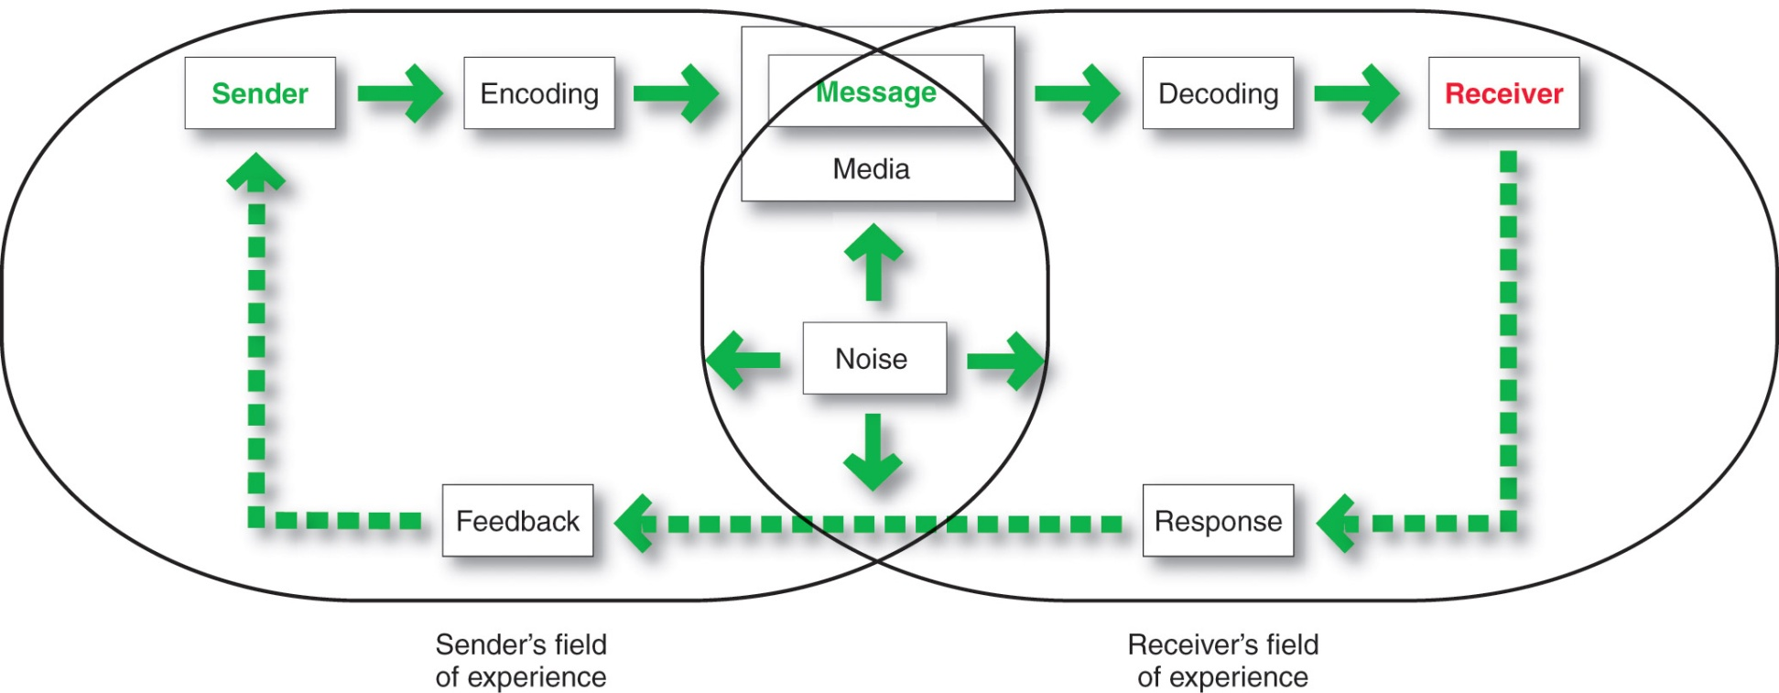
A View of the Communication Process
The Communication Process
Notes:
Sender is the party sending the message to another party.
Encoding is the process of putting thought into symbolic form.
Message is the set of symbols the sender transmits.
Media is the communications channels through which the message moves from sender to receiver.
Decoding is the process by which the receiver assigns meaning to the symbols.
Receiver is the party receiving the message sent by another party.
Response is the reaction of the receiver after being exposed to the message.
Feedback is the part of the receiver’s response communicated back to the sender
Noise is the unplanned static or distortion during the communication process, which results in the receiver’s getting a different message than the one the sender sent.

Slide 13
Steps in Developing Effective Marketing Communication
Identify the target audience
Determine the communication objectives
Design the message
Choose the media
Select the message source
Notes:
Note for Instructor
For a message to be effective, the sender’s encoding must mesh with the receiver’s decoding process.
Best messages consist of words and other symbols that are familiar to the receiver.
Marketers may not share their consumer’s field of experience but must understand the consumer’s field of experience.

Slide 14
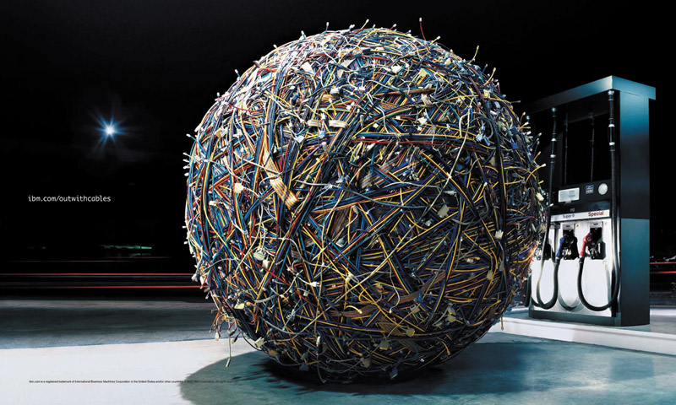
Steps in Developing Effective Communication
Identifying the Target market
What will be said
How it will be said
When it will be said
Where it will be said
Who will say it

Slide 15
Steps in Developing Effective Marketing Communication
Determining the Communication Objectives
Marketers seek a purchase response that results from a consumer decision-making process that includes the stages of buyer readiness

Slide 16
Steps in Developing Effective Marketing Communication
Designing a Message
AIDA Model
Get Attention
Hold Interest
Arouse Desire
Obtain Action

Slide 17
Steps in Developing Effective Marketing Communication
Designing a Message
Message content is an appeal or theme that will produce the desired response
Rational appeal
Emotional appeal
Moral appeal
Message Format
Notes:
Note to Instructor
Other factors to include are message structure. Does the advertiser draw a conclusion or leave it to the audience. Do they present the strongest arguments first or last? Is the message one sided (strengths only) or two-sided?
Message format is also important to consider. What will be the color, the text, the copy, the images?

Slide 18
Steps in Developing Effective Marketing Communication
Designing a Message
Rational appeal relates to the audience’s self-interest
Emotional appeal is an attempt to stir up positive or negative emotions to motivate a purchase

Slide 19
Steps in Developing Effective Marketing Communication
Designing a Message
Moral appeal is directed at the audience’s sense of right and proper

Slide 20
Steps in Developing Effective Marketing Communication
Choosing Media
Personal communication involves two or more people communicating directly with each other
Face to face
Phone
Mail
E-mail
Internet chat
Notes:
Note to Instructor
This link is to Lands End—a leading clothing retailer with catalog, online, and sales through Sears stores. On the homepage (often at the bottom) you can see that they have online live chat available to customers with questions. This is a good way to provide personal communication at a reduced cost to the retailer.

Slide 21
Steps in Developing Effective Marketing Communication
Choosing Media
Personal communication is effective because it allows personal addressing and feedback
Control of personal communication
Company
Independent experts
Word of mouth

Slide 22
Steps in Developing Effective Marketing Communication
Choosing Media
Personal Communication
Opinion leaders are people within a reference group who, because of their special skills, knowledge, personality, or other characteristics; exerts social influence on others
Buzz marketing involves cultivating opinion leaders and getting them to spread information about a product or service to others in their communities
Notes:
Note to Instructor
If you have not had a chance to talk about Tremor yet, this Web link will bring them to your site. The interesting thing to note about Tremor is that it is owned and operated by Procter & Gamble. As such, it focuses extensively on their own brands.

Slide 23
Steps in Developing Effective Marketing Communication
Non-Personal Communication Channels
Non-personal communication is media that carry messages without personal contact or feedback, including major media, atmospheres, and events that affect the buyer directly

Slide 24
Steps in Developing Effective Marketing Communication
Non-Personal Communication Channels
Major media include print, broadcast, display, and online media
Atmospheres are designed environments that create or reinforce the buyer’s leanings toward buying a product

Slide 25
Steps in Developing Effective Marketing Communication
Nonpersonal Communication Channels
Events are staged occurrences that communicate messages to target audiences
Press conferences
Grand openings
Exhibits
Public tours

Slide 26
Steps in Developing Effective Marketing Communication
Selecting the Message Source
The message’s impact on the target audience is affected by how the audience views the communicator
Celebrities
Athletes
Entertainers
Professionals
Health care providers
Notes:
Note to Instructor
Discussion Question
Why is Michael Phelps a good spokesperson for Rosetta Stone?
This link to YouTube is a Michael Phelps ad for Rosetta Stone. They might mention his likeability, relevance, and every day guy personality.

Slide 27
Steps in Developing Effective Marketing Communication
Collecting Feedback
Involves the communicator understanding the effect on the target audience by measuring behavior resulting from the behavior

Slide 28
Setting the Total Promotion Budget and Mix
Setting the Total Promotion Budget
Affordable budget method sets the budget at an affordable level
Ignores the effects of promotion on sales

Slide 29
Setting the Total Promotion Budget and Mix
Setting the Total Promotion Budget
Percentage of sales method sets the budget at a certain percentage of current or forecasted sales or unit sales price
Easy to use and helps management think about the relationship between promotion, selling price, and profit per unit
Wrongly views sales as the cause rather than the result of promotion

Slide 30
Setting the Total Promotion Budget and Mix
Setting the Total Promotion Budget
Competitive-parity method sets the budget to match competitor outlays
Represents industry standards
Avoids promotion wars

Slide 31
Setting the Total Promotion Budget and Mix
Setting the Total Promotion Budget
Objective-and-task method sets the budget based on what the firm wants to accomplish with promotion and includes:
Defining promotion objectives
Determining tasks to achieve the objectives
Estimating costs
Notes:
Note to instructor
Objective-and-task method forces management to spell out its assumption about the relationship between outlays and results but is difficult to use.

Slide 32
Setting the Total Promotion Budget and Mix
Shaping the Overall Promotion Mix
The Nature of Each Promotion Tool
Advertising reaches masses of geographically dispersed buyers at a low cost per exposure, and it enables the seller to repeat a message many times
Notes:
Note to Instructor
Advertising is impersonal, cannot be directly persuasive as personal selling, and can be expensive.

Slide 33
Setting the Total Promotion Budget and Mix
Shaping the Overall Promotion Mix
The Nature of Each Promotion Tool
Personal selling is the most effective method at certain stages of the buying process, particularly in building buyers’ preferences, convictions, actions, and developing customer relationships

Slide 34
Setting the Total Promotion Budget and Mix
Shaping the Overall Promotion Mix
The Nature of Each Promotion Tool
Sales promotion includes coupons, contests, cents-off deals, and premiums that attract consumer attention and offer strong incentives to purchase, and can be used to dramatize product offers and to boost sagging sales

Slide 35
Setting the Total Promotion Budget and Mix
Shaping the Overall Promotion Mix
The Nature of Each Promotion Tool
Public relations is a very believable form of promotion that includes news stories, features, sponsorships, and events
Direct marketing is a non-public, immediate, customized, and interactive promotional tool that includes direct mail, catalogs, telemarketing, and online marketing

Slide 36
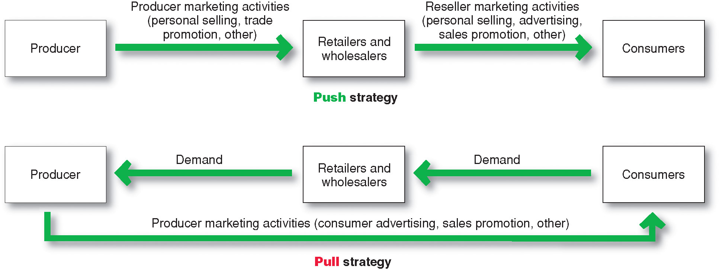
Setting the Total Promotion Budget and Mix
Promotion Mix Strategies
Notes:
Note to Instructor
Push strategy involves pushing the product to the consumers by inducing channel members to carry the product and promote it to final consumers.
Pull strategy is when the producer directs its marketing activities toward final consumers to induce them to buy the product and create demand from channel members.

Slide 37
Setting the Total Promotion Budget and Mix
Integrating the Promotion Mix
Checklist
1. Identify customer touch points
2. Analyze trends—internal and external
3. Audit the pockets of communication spending throughout the organization
4. Team up in communications planning
5. Create compatible themes, tones, and quality across all communications media
6. Create performance measures that are shared by all communications elements
7. Appoint a director responsible for the company’s persuasive communications efforts

Slide 38
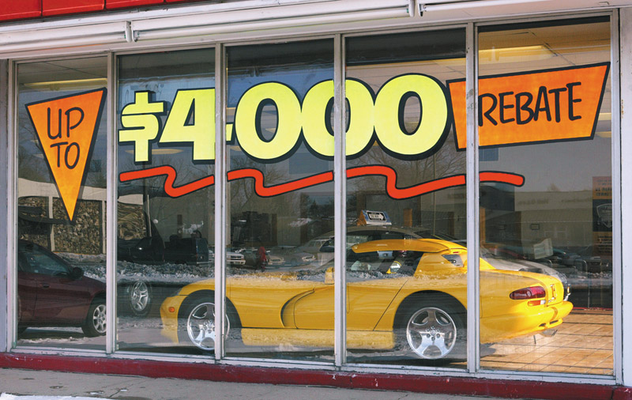
Socially Responsible Marketing Communication
Communicate openly and honestly with consumers and resellers
Avoid deceptive or false advertising
Avoid bait-and-switch advertising
Conform to all federal, state, and local regulations
Follow rules of “fair competition”
Do not offer bribes
Do not attempt to obtain competitors’ trade secrets
Do not disparage competitors or their products

Slide 39
All rights reserved. No part of this publication may be reproduced, stored in a retrieval system, or transmitted, in any form or by any means, electronic, mechanical, photocopying, recording, or otherwise, without the prior written permission of the publisher. Printed in the United States of America.
Copyright © 2010 Pearson Education, Inc.
Publishing as Prentice Hall

