Slide 5
Notes:
Pertinent means “relevant to the matter at hand.” Although the definitions seem similar and many thesauruses interchange these words, there is a subtle difference. When something is relevant, it has something to do with the topic. When something is pertinent, it means it is significant

Slide 7
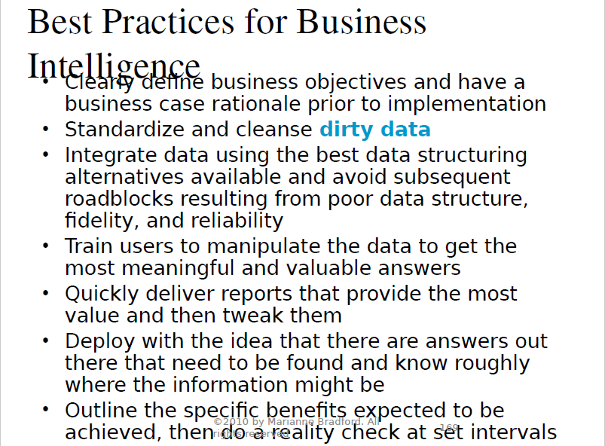

Slide 9
Comparison of BI and BPM

Slide 11
Four Perspectives of the Balanced Scorecard

Slide 12
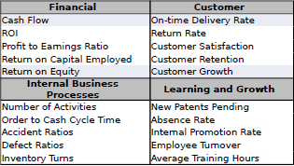
Example of Balanced Scorecard KPIs

