Slide 1
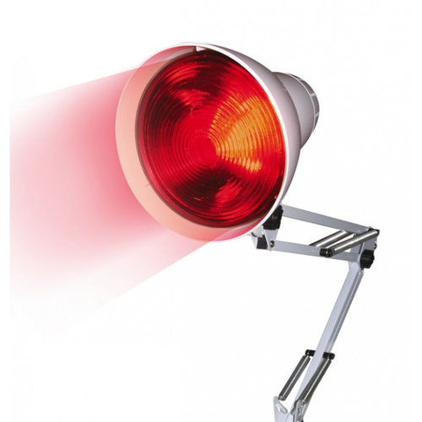
INFRA RED RAYS

Slide 2
INFRA RED RAYS
Electro magnetic waves
Wave length 4,000,000 and 7,700 A
Given off from any hot body
Greater the heating, shorter being the wavelength of the rays emitted

Slide 3
INFRA RED GENERATOR
Various types of generators are employed in the physiotherapy department, two main types are
NON LUMINOUS GENERATOR
LUNIMOUS GENERATOR

Slide 4
NON LUMINOUS GENERATORS
The non luminous generator produces the infra red rays with wavelength between 150,000A and 7,700A
The max emission of rays is in the region of 40,000A
There are further 3 types of non luminous generator

Slide 5
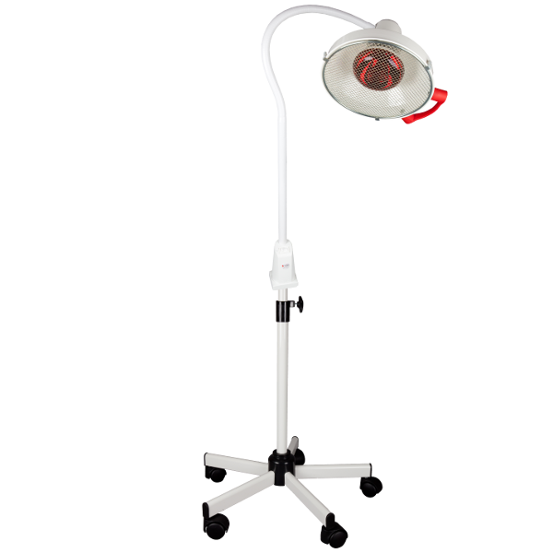

Slide 6
1ST TYPE OF NON LUMINOUS GENERATOR
It consist of a Coil of wire, wound on cylinder of some insulation material like, fireclay or porcelain
Electric current is passed through the wire and produced heat
Infrared rays are emitted from the wire and fireclay, while fireclay is heated by conduction
Some visible rays are also emitted( like red glow)
So it is not perfectly the non luminous

Slide 8
2ND TYPE OF NON LUMINOUS GENERATOR
Coil is embed in the fireclay or placed behind the plate of this material
Rays are purely emitted by the plate
Plate is painted black, so very few visible rays are produced
Both type of elements are connected to a circuit and placed to the focal point of parabolic or gently curved reflector
the reflector is mounted on a stand and its position is adjustable as required

Slide 9
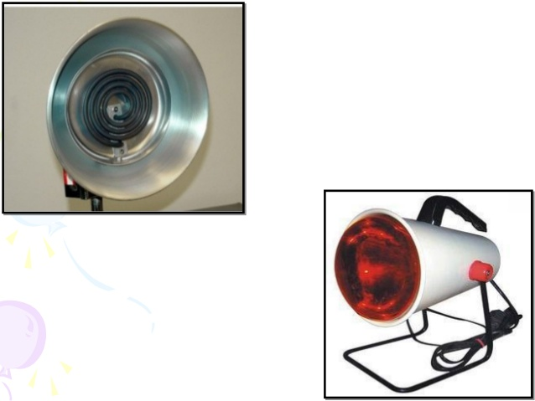

Slide 10
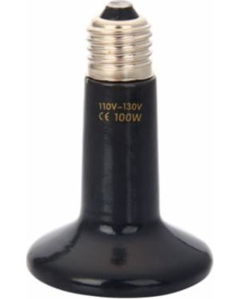
3RD TYPE OF NONLUMINOUS GENERATOR
Consist of steel tube of approximately 8 mm in diameter
Within which a spiral coil embedded on electrical insulator but heat conductor material
Current passed through wire, heat produced conducted through insulator to steel tube and infra red are emitted
Tube is bend in 2 or 3 large turns
And mounted on a reflector

Slide 11
TIME OF HEATING
All non luminous generators take some type to heat up
5 min for 1st type
10 to 15 min for 2nd n 3rd type
so lamps must be switch on an appropriate time before they are requird

Slide 12
CARE
Construction must be such that reflectors and other apparatus must not be unduly hot during use
ENERGY CONSUMPTION
Small elements consume 500 watts( light circuits can be use)
Lager consumes 750 – 1000 watts( heavy cicuits)

Slide 13
LUMINOUS GENERATORS
Rays produced by one or more incandescent lamps
Consist of a wire filament enclosed in a glass bulb, which may be evacuated or contain an inert gas at low pressure
Filament is made up of tungsten wire.

Slide 14
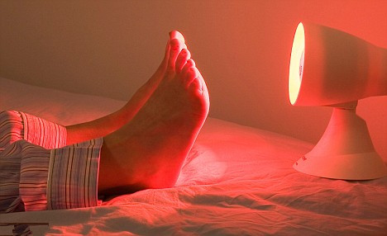

Slide 15
WATTAGE
60 – 1000 watts
Inadvisable to use bulbs of high wattgae as they can explode
For using bulb of 300 watts a mesh wire gauze is placed in front of reflector
150 or less watts attached by spring sockets while larger ones by screw cap connections

Slide 16
SPECTURM
Produces heat, infrared, visible and a few ultra violet rays
Specturm is from 40,000 to 3500A
The greatest part of emission is 10,000 A

Slide 17
REFLECTORS
A single bulb may be mounted on a parabolic reflector.
Indication
Treatment of small, particular area, like hand, foot, knee joint
Tunnel bath
Number of bulb are mounted in a semicircular metal frame work
60 watt bulb are connected in parallel
Switches are available so that some or all the bulbs may be included in the circuit
Tunnels are made in various sizes to treat different parts of body

Slide 18
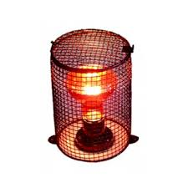
ACCESSORIES
Localizer
Specific areas
Filters
Red glass filters, absorbs visible and UV rays
Resistance
Connected in series, output can be adjusted

Slide 19
PHYSIOLOGICAL EFFECTS
When IR are absorbed by the tissue, heat is produced at the point of absorbtion
The shorter IR rays(7700-12000A) penetrate to deeper parts of dermis, or to subcutaneous tissue
longer IR rays(> 12000A)absorbed to superficial epidermis
Nonluminous generators___ IR 40000A____less penetrating
Luminous generators____ IR 10000A____ more penetrating
Irradiation produce heat to superficial tissue, conveyed to deeper tissue by conduction and by circulating fluids
Irritating effects of Luminous generator is due to visible and UR( produce chemical effects)

Slide 20
1. INCREASED METABOLISM
Van’t Hoff’s law
Increase in metabolism is greatest in the region where most heat is produced ie in superficial tissues.
Increased Metabolism ____ increased demands of oxygen and food stuff_____ increased out put of waste products and metabolites
Notes:
Vant hoff laws stats that chemical change capable of being accelerated by heat is accelerated by rise in temprature.

Slide 21
2. VASODILATATION
Dilatation of capillaries and arterioles in superficial tissue, reason is
Direct effect of heat
Action of metabolites
Irritate the nerve endings causes reflex vasodilatation
So inc.. Blood flow___ inc. O2___ inc foodstuff__ removal of waste products
Erythema of skin
Erythema of IR_____UV
Mottled erythema

Slide 22
3. PIGMENTATION
Caused by repeated exposure to IR
Mottled in appearance
Legs on people who are habitual of sitting near the fire

Slide 23
4. EFFECTS ON SENSORY NERVES
Mild heating, sedative effects
More intense heating, irritating effects
Luminous vs nonluminous generators
Notes:
Irritation is due to the irritation of shorter wavelengths of visible rays and ultra violet rays

Slide 24
5. EFFECTS ON MUSCLE TISSUE
Relaxation
Increased efficienty
Relaxation of antagonistic muscles allows a free action of the prime movers.
6. DESTRUCTION OF TISSUE
7. GENERAL RISE IN TEMPERATURE
extensive and prolonged heating
Blood in superficial vessels is heated
Passed to other parts of body, general rise in temperature
There may be general vasodilatation___ decrease BP

Slide 25
8. FALL IN BLOOD PRESSURE
Generalised vasodilatation, reduced peripheral resistance, fall in BP(reduced viscosity of blood)
9. INCREASED ACTIVITY OF SWEAT GLANDS
Reflex stimulation of sweat glands
As
Effect of heating on sensory nerve endings
Circulation of heated blood
Increase activity of sweat glands leads to increased removal of waste product

Slide 26
INCREASED METABOLISM
VASODILATATION
PIGMENTATION
EFFECTS ON SENSORY NERVES
EFFECTS ON MUSCLE TISSUE
DESTRUCTION OF TISSUE
GENERAL RISE IN TEMPERATURE
FALL IN BLOOD PRESSURE
INCREASED ACTIVITY OF SWEAT GLANDS

Slide 27
THERAPEUIC EFFECTS AND USES
RELEIF OF PAIN
An effective mean of pain relief
mild heating__ sedative effects on the superficial sensory nerves
Stronger heating____ counter irritation
Pain may be due to accumulation of waste products __ removal of waste product due to increase blood flow__ relieves pain
Pain relieves by muscle relaxation.
Acute inflammation___ mild heating
Intense heating on acute injury may cause an increase in the exudation of fluid into the tissue and so increase pain.
Chronic conditions____ intense heating___ treatment for 30 min

Slide 28
2. MUSCLE RELAXATION
Relax more readily when tissues are warmth
Relief of pain also facilitates muscle relaxation
By achieving muscle relaxation Relief of muscle spasm is obtained.
Preliminary to PT
Following irradiation movement can frequently be carried through a greater range than before,
And relief of pain makes it possible to perform exercises more effieciently

Slide 29
3. INCREASED BLOOD SUPPLY
Marked in superficial tissue an d may be used in the treatment of superficial wounds and infections.
Good blood supply, essential for healing
Remove infection by increasing number of WBC and removing exudate
Warm the cold limbs( lower motor neuron lesions)by soaking in warm water
Arthritis of joints, especially of hands( relief pain and muscle spasm)

Slide 30
4. ELIMINATION OF WASTE PRODUCT
Excessive treatment __ increrased activity of sweat glands_____ increased elimination of waste products.

Slide 31
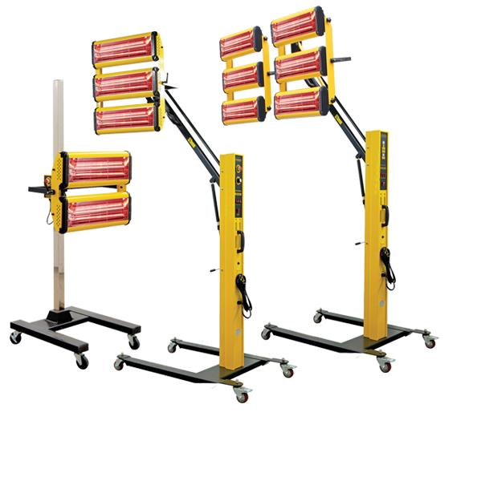

Slide 32
Technique of irradiation

Slide 33
CHOICE OF APPARATUS
Effects required:
sedative or counter irritation??
Type of injury:
acute or chronic??
Luminous or nonluminous
Area to be treated:
smaller or larger??
Check working of lamp
Localiser and filter attached
Preheating time

Slide 34
PREPARATION OF PATIENT
Clothing
Sensation of skin
Comfortable and supported position
Patient education about comfortable warmth
Immediately report about excessive or undue heating

Slide 35
ARRANGEMENT OF LAMP AND PATIENT
Rays at right angle to the skin: max absorption
Distance of pt from lamp: 50 – 75 cm
Tunnel bath, ends open, air circulation
Protection of face, localiser or paper shade
Protection of eyes: damp cotton wool

Slide 36
APPLICATION OF TREATMENT
At the start of treatment: intensity must be low
After 5 to 10 min; it can be increased(as vasodilatation and increased blood flow is established)
Adjust Intensity
By dec. pt lamp distance
by adding bulb in tunnel bath etc
PT should be at hand through out the treatment
Drinking water
Pt should not rise immediately from lying position, not also go to cold

Slide 37
DURATION AND FREQUENCY OF TREATMENT
Acute inflammation, recent injury, wound and infection: 10 to 15 min/ several times per day
Chronic condition: 30 min/ OD or alternate days

Slide 38
DANGERS OF INFRA RED RADIATION
Notes:
Liniments: a liquid that is rubbed on the skin to relieve pain or stiffness in your muscles

Slide 39
1. Burns
IR superficial heat burns
Red patch on skin subsequently lead to blister( during or after treatment)
Reasons are
Too great intensities
Patient fails to report overheating
Moves nearer to the lamp
Fall asleep during treatment
Defective skin sensations
Inadequate preheating time…
Application of liniments__ skin hypersensitivity
Impaired blood flow
Touching the lamp when it is too hot
Explosion of bulb

Slide 40
Electric shock
Precipitation of Gangrene
Headache: (no sweating, too hot environment, give plenty of water, irradiation at the back of head)
Faintness: (fall in blood pressure, anemia of brain, try to rise suddenly from recumbent position
Injury to eye: may predispose to cataract. So protect during treatment

Slide 41
CONTRAINDICATIONS
Areas of defective arterial blood supply
Danger of haemorrage
Where skin sensation is defective
Liniments has recently been used

