Slide 2
Definition
Tuberculosis (TB) is a potentially fatal contagious disease that can affect almost any part of the body but is mainly an infection of the lungs.
Neo-latin word :
“Tubercle”
- Round nodule/Swelling
“Osis”
- Condition

Slide 3
Causative Organisms
Mycobacterium tuberculosis
Human
Mycobacterium Bovis
Animals

Slide 4
Other causative organisms
Mycobacterium africanum
Mycobacterium microti
Non-Mycobacterium Genus
Mycobacterium leprae
Mycobacterium avium
Mycobacterium asiaticum
M.
africanum
M. Bovis
M. Canetti
M. microti
M. tuberculosis complex

Slide 5
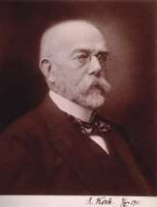
 Discovered in 1882 by Robert Koch.

Slide 6
Classification
Pulmonary TB
Primary Disease
Secondary Disease
Extra pulmonary
Lymph node TB
Pleural TB
TB of upper airways
Skeletal TB
Genitourinary TB
Miliary TB
Pericardial TB
Gastrointestinal TB
Tuberculous Meningitis
Less common forms

Slide 7
In 2011,there were an estimated 8.7million incidence cases of TB globally.
Its equivalent to 125 cases in 1,00,000 population.
Asian : African :
59%
26%
Eastern Mediterranean Region: 7.7%
The European Region : 4.3%
Region of the America : 3%

Slide 8
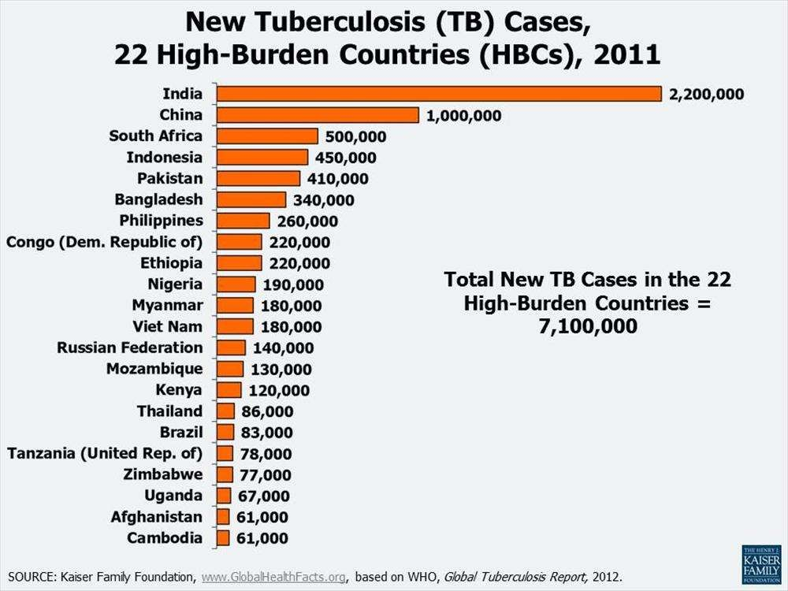

Slide 9
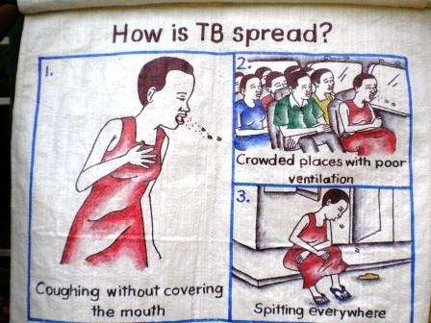
Spread of Tuberculosis

Slide 10
Severe Symptoms
Persistent cough
Chest pain
Coughing with bloody sputum
Shortness of breath
Urine discoloration
Cloudy & reddish urine
Fever with chills.
Fatigue

Slide 11
Based on types of TB

Slide 12
Pathogenesis

Slide 13
Types
A. Pulmonary TB :-
Primary Tuberculosis :-
The infection of an individual who has not been previously infected or immunised is called Primary tuberculosis or Ghon’s complex or childhood tuberculosis.
Lesions forming after infection is peripheral and accompanied by hilar which may not be detectable on chest radiography.
Secondary Tuberculosis :
The infection that individual who has been previously infected or sensitized is called secondary or post primary or reinfection or chronic tuberculosis.

Slide 14
B} Extra Pulmonary TB :-
20% of patients of TB Patient
Affected sites in body are :-
Lymph node TB ( tuberculuous lymphadenitis):-
Seen frequently in HIV infected patients.
Symptoms :- Painless swelling of lymph nodes most commonly at
cervical and Supraclavical (Scrofula)
Systemic systems are limited to HIV infected patients.
Pleural TB :-
Involvement of pleura is common in Primary TB
and results from penetration of tubercle bacilli into pleural
space.

Slide 15
3) TB of Upper airways :-
Involvement of larynx, pharynx and epiglottis. Symptoms :- Dysphagia, chronic productive cough
Genitourinary TB :-
15% of all Extra pulmonary cases.
Any part of the genitourinary tract get infected.
Symptoms :- Urinary frequency, Dysuria, Hematuria.
Skeletal TB :-
Involvement of weight bearing parts like spine, hip, knee.
Symptoms :- Pain in hip joints n knees, swelling of knees, trauma.
Gastrointestinal TB :-
Involvement of any part of GI Tract.
Symptoms :- Abdominal pain, diarrhea, weight loss

Slide 16
7) TB Meningitis & Tuberculoma :-
5% of All Extra pulmonary TB
Results from Hematogenous spead of 1⁰ & 2⁰ TB.
TB Pericardiatis :-
1- 8% of All Extra pulmonary TB cases.
Spreads mainly in mediastinal or hilar nodes or from lungs.
Miliary or disseminated TB :-
Results from Hematogenous spread of Tubercle Bacilli.
Spread is due to entry of infection into pulmonary vein producing
lesions in different extra pulmonary sites.
Less common Extra Pulmonary TB
uveitis, panophthalmitis, painfull Hypersensitivity related phlyctenular conjuctivis.

Slide 17
Diagnosis
1.Bacteriological test:
Zeihl-Neelsen stain
Auramine stain(fluorescence microscopy)
2. Sputum culture test:
Lowenstein –Jensen(LJ) solid medium: 4-18 weeks
Liquid medium : 8-14 days
Agar medium : 7 to 14 days

Slide 18
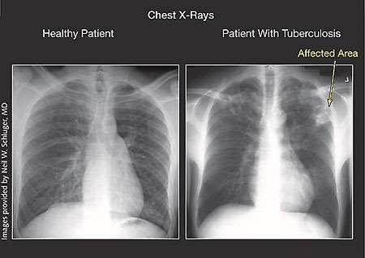
3.Radiography:
Chest X-Ray(CXR)
4.Nucleic acid amplification:
Species identification ; several hours
Low sensitivity, high cost
Most useful for the rapid confirmation of tuberculosis in persons with AFB-positive sputa
Utility
AFB-negative pulmonary tuberculosis
Extra pulmonary tuberculosis

Slide 19
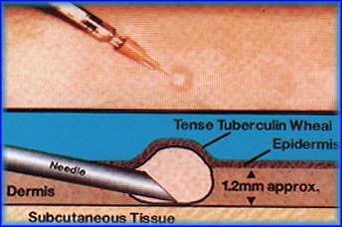
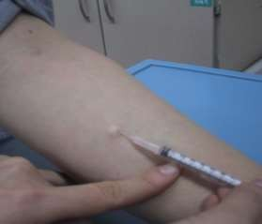
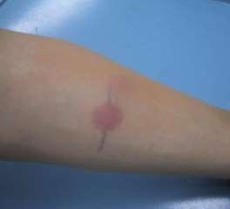
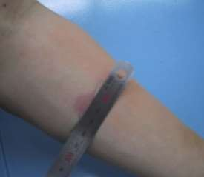
5.Tuberculin skin test (PPD)
Injection of fluid into the skin of the lower arm.
48-72 hours later –
checked for a reaction.
Diagnosis is based on the size of the wheal.
1 dose = 0.1 ml contains 0.04µg Tuberculin PPD.

Slide 20
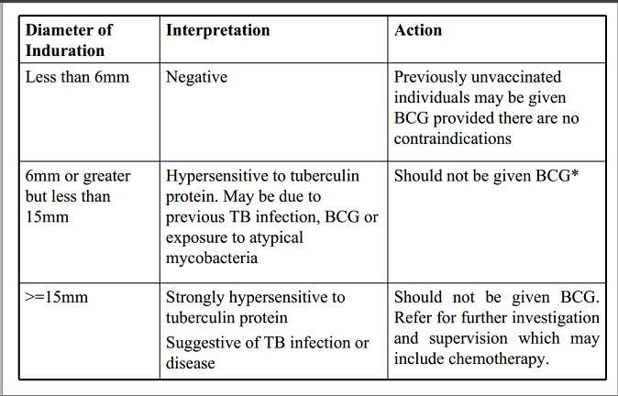
Tuberculin test interpretation

