Slide 1
ENTO-306
Agricultural pests and their management
Identification of important agricultural pests
Their mode of damages
Control measures
By: Dr. Muhammad Zeeshan Majeed

Slide 2
Miscellaneous Agricultural Pests

Slide 3
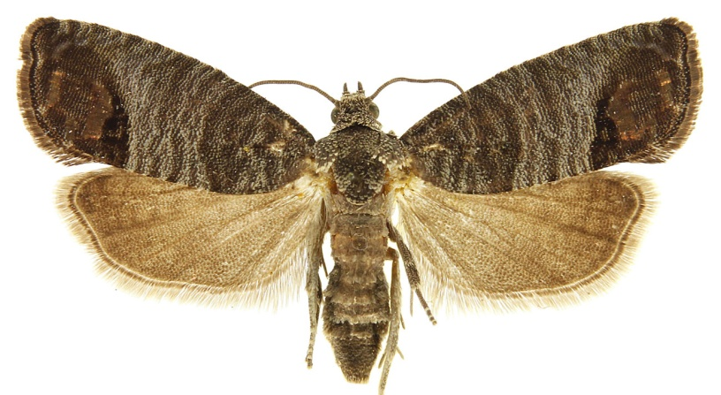
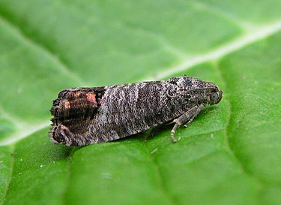
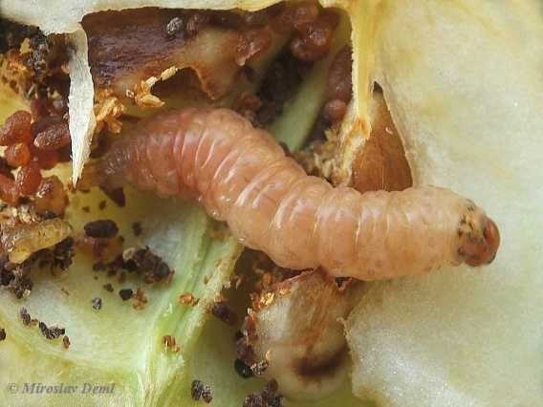
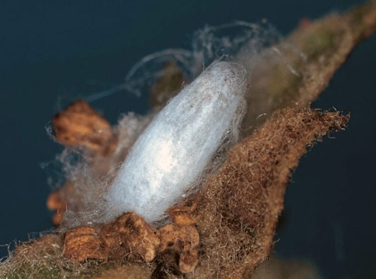
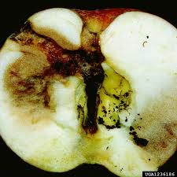
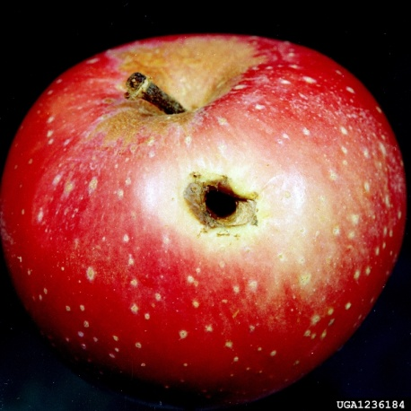
ENTO-306 Fruit Insect Pests
Codling moth of Apple (Cydia pomonella : Eucosmidae, Lepidoptera)
Host plants: Apple, pear, quince, peach
Major pest of apple in hilly areas of Pakistan
Identification
Adult: Greyish brown body with dark brown forewings which
Sculptured apical margins and with fringes of hairs
Eggs: White and flattened (averagely 80 eggs / female moth)
laid singly on the upper surface of leaves, twigs, fruits.
Larva: Pinkish white color with brown head capsule
Pupa: Brown in color envelopped by a silken web (10 mm long)
Life history:
Life cycle: 1.5 – 2 months
Adult: 2-3 weeks
Egg hatching : in 1 -2 weeks
Larva: 4 – 6 weeks
Pupa: 2 – 4 weeks
No. of generations: 3
Damage:
Active period: April to October
Inactive period: November to Feburary
(maxi. Damage June to August)
Larvae upon hatching feed on chlorophyl material of
plant and later on bores into the fruits (mostly by blossom end).
Infested fruit falls down and full grown larva comes out and
pupates under tree bark or other hidden structures
Control:
Scraping (removal) of loose bark of fruit tree
Collection and destruction of infested fruits and other parts
Chemical control (Cypermethrin, Abamectin, Deltamethrin)

Slide 4
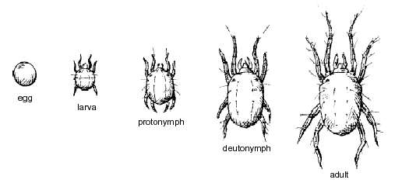
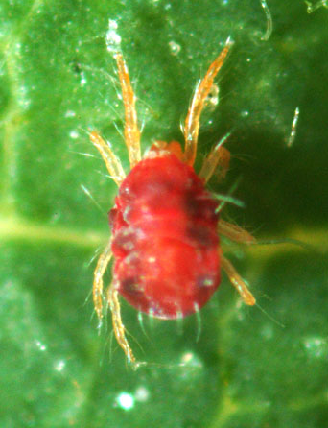
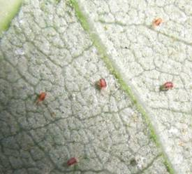
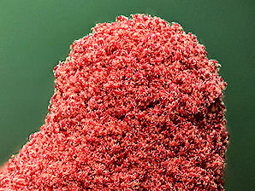
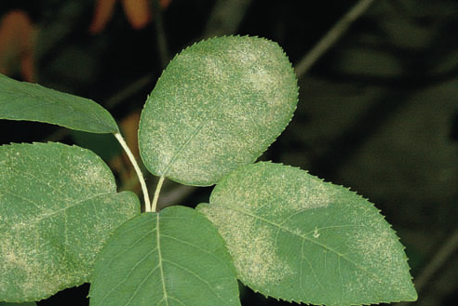
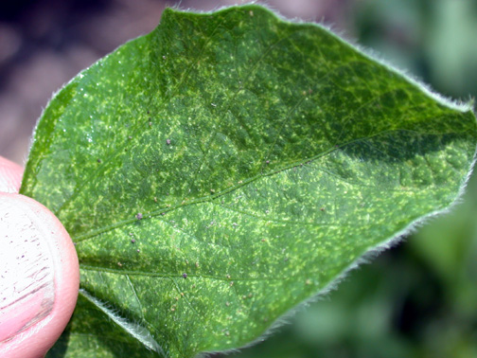
ENTO-306 Vegetable Insect Pests
Red spider mites (Tetranychus urticae : Tetranychidae, Subclass: Acari; Class: Arachnida)
Host plants: Cotton, Tobacco, Tomato, Okra, Brinjal, Citrus, Sunflower, Cucurbits etc.
Identification
Adult: Oval shaped reddish body (0.3 - 0.5 mm long)
hardly visible with naked eyes as red spots
Eggs: Pearly transluscent eggs (50 eggs / female
laid singly along veins under leaf undersides
Nymph: Tiny red-colored nymphs
Life history:
Life cycle: 2-4 weeks
No. of generations per annum: Several overlapping generations.
Damage:
Active period: March to October
(maxi. Damage/infestation June-July in hot and dry season)
De-saping, yellow stippling (speckled look) on upper leaf-surfaces
Usually develop fine webbing on plant (leaf) surface
Sickly appearance on leaves and twigs
Later-on leaves become yellowish, bronze and drop off
Accumulate at plant peaks to be dispersed easily
to other host plants
Control:
Biological control (phytoseiid mites e.g.
Phytoseiulus persimilis and Amblyseius fallacis)
Chemical control (Imidacloprid, Thiamethoxam,
Chlorpyriphos, deltamethrin etc.)
Notes:
microscopic, 40000 mite species, free livinig in soil, water, associated with plants, animals (same groups as tickes, spiders not insects)/ 4 pair of legs, 1st instar having three pair of legs is called larva. 2nd instar has 4 pairs and is called protonymph, then deutomymph and then adult.

Slide 5
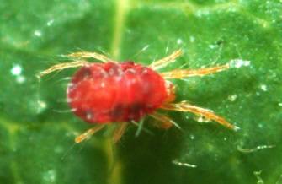
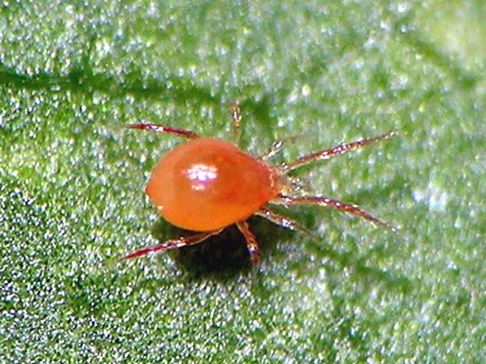
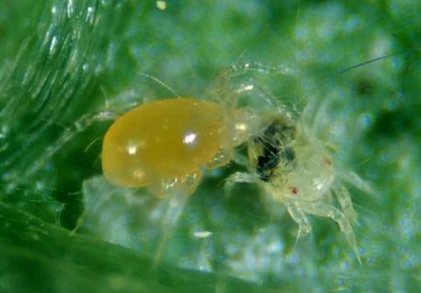
Tetranchus urticae
Phytoseiulus persimilis
Neoseiulus (Amblyseius) fallacis

Slide 6
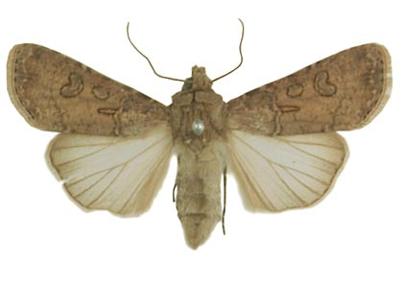
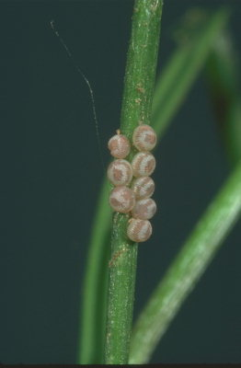
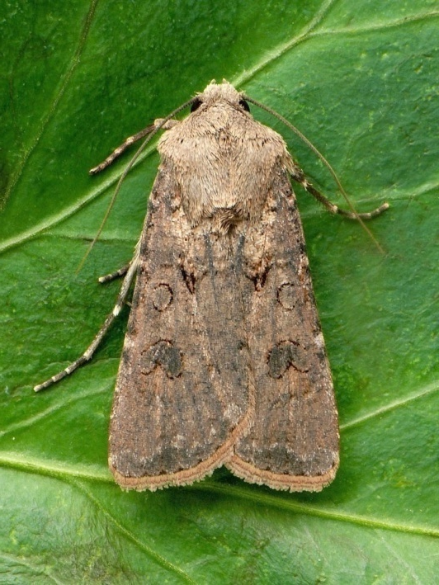
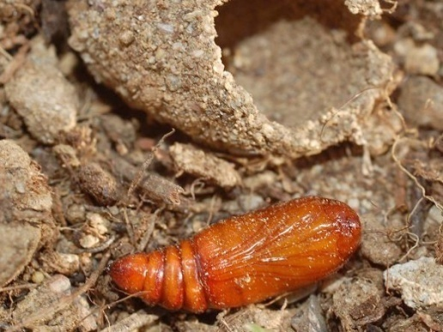
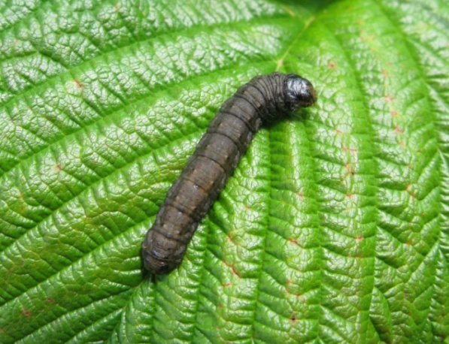
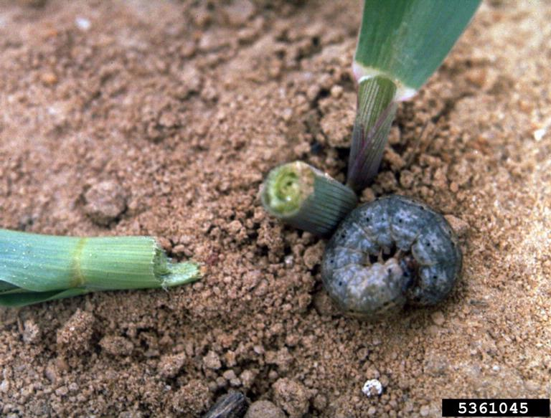
ENTO-306 Vegetable Insect Pests
Gram cutworm( Agrotis segetum :Noctuidae, Lepidoptera)
Host plants: Major pest of gram crop.
Also found infesting potato, cucurbits, wheat, mustard, maize and pulses (polyphagous insect)
Identification
Adult: Grayish brown (20 mm body length / wingspan 50 mm)
Eggs: Creamy white, dome-shaped eggs (laid in clusters of about 15-30 eggs)
200-300 eggs per female
Larva: 1st instar larva_1.5mm/full grown size_42 mm dark
grey in color (6 larval instars)
Pupa: Reddish brown
Life history:
Life cycle: 2-3 months
Egg: hatching: 3-7 days
Adult: 1.5 – 2 weeks
Larva: 1 – 1.5 months
Pupa: 2 – 3 weeks
No. of generations per annum: 1 – 2
Damage:
Active period: November to May
(maxi. Damage/infestation in December-February)
Inactive period: May – Nov. (migration to hilly areas)
Voracious feeding and cutting of roots and shoots
of tender plants during night
Cut-away seedlings in field indicate its attack.
30-80% damage to Rabi crops
Control:
Deep soil ploughing/hoeing
Egg collection and destruction
Light traps / Organic baits / traps
Chemical control (Chlorpyriphos, deltamethrin etc.)

Slide 7
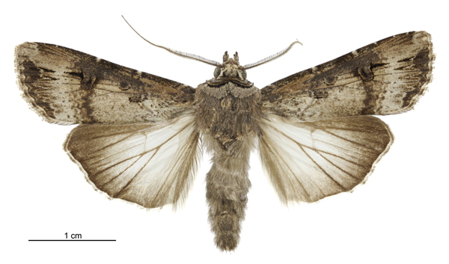
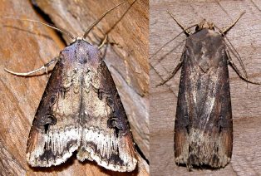
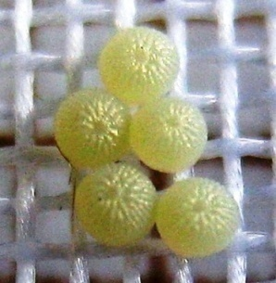
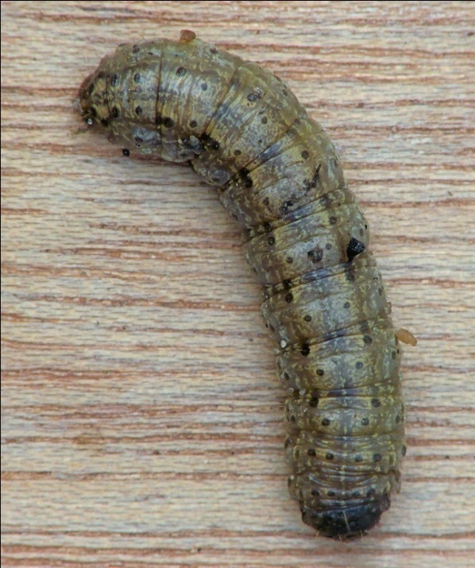
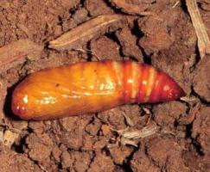
ENTO-306 Vegetable Insect Pests
Greasy / Black cutworm of gram ( Agrotis ipsilon: Notuidae, Lepidoptera)
Notes:
DAMAGE
This pest has solitary habits. They commonly feed on seedlings at ground level, cutting off the stem and sometimes dragging the plants into their burrows. Most of the plant is not consumed but merely eaten enough to cause it to collapse. Since the larvae occur burrowed near the roots of the host, it sometimes feeds on roots and the below ground stem. Because of the nature of their feeding on young plants, this pest can do great damage in newly planted fields.
PUPAE
Mature larvae burrow several inches into the soil where they form a pupation cell. Pupae are dark brown and are about 3/4 inch in length. Pupal development is completed in 10-30 days.
The creamy white eggs are globular with a ribbed surface
The larvae are thin, cylindrical and dark brown to greasy gray
BEHAVIOR
Larvae remain below the surface of the ground, under clods of soil, or other refugia (shelters) during the day and feed at night. The first two larval stages feed on the foliage of the plant. The third and later stages often become cannibalistic and thus adopt solitary habits (Hill, 1983).

Slide 8
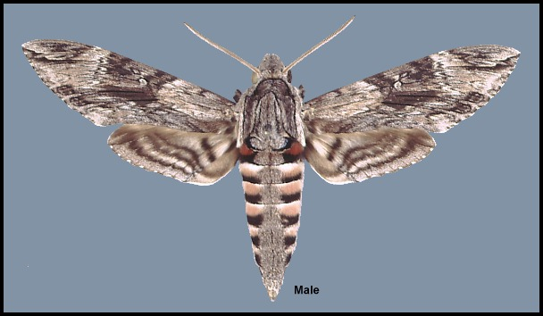
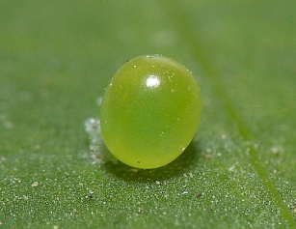
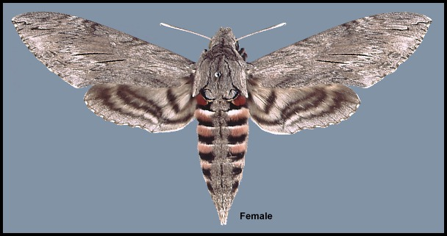
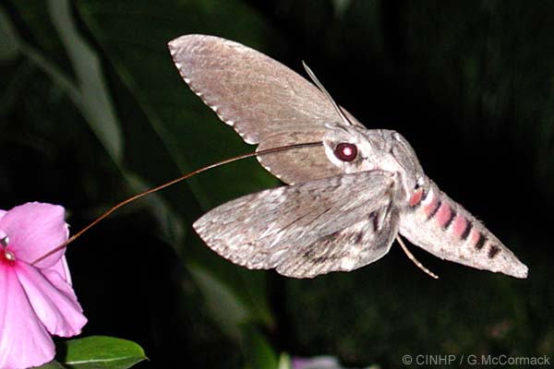
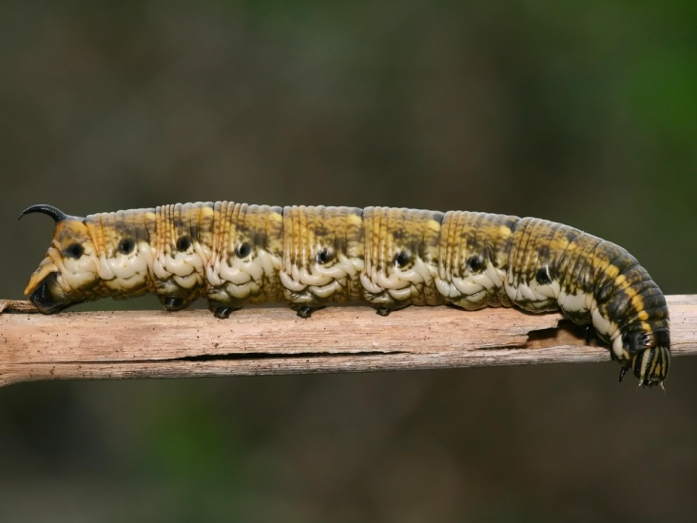
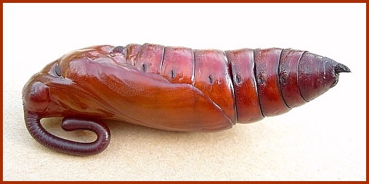
ENTO-306 Vegetable Insect Pests
Til hawk moth_hornworm (Agrius convolvuli : Sphinigidae, Lepidoptera)
Host plants: Major pest of sesame, potato, gram crop
Identification
Adult: Stoutly built body
Grayish colored body, mottled with brown and dark markings
particularly in male forewings. Pink-black bands on abdomen
proboscis length usually around 100 mm (body wingspan_80 mm)
Eggs: Bright bluish green (pearly) eggs laid singly on young crop foliage
Larva: Dark yellowish brown body with black markings on ventral side
and a prominent horn on the pronotum (80 – 100 mm in length)
grey in color (5 larval instars)
Pupa: Reddish brown with coiled hook at apex
Life history:
Life cycle: 3-4 months
Egg: hatching: One week
Adult: 1.5 month
Larva: 2 months
Pupa: 2 – 4months
No. of generations per annum: 2
Damage:
Active period: May – August with maximum damage to sesame crop
Voracious feeding of plants like sheep or goat grazing
Control:
Deep soil ploughing /hoeing for pupal destruction
Light traps
Chemical control (Lambda-cyhalothrin, Chlorpyrifos, Deltamethrin etc.)
Notes:
& ²

Slide 10
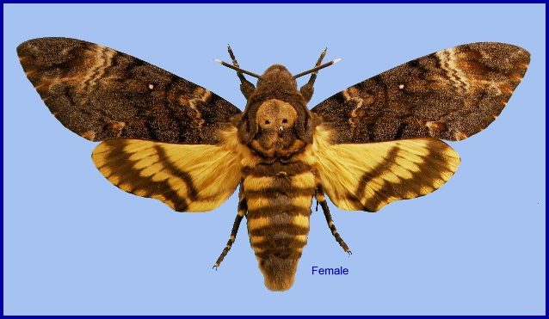
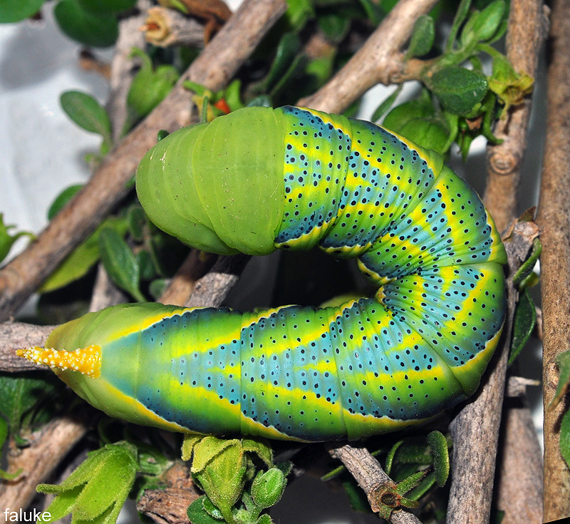
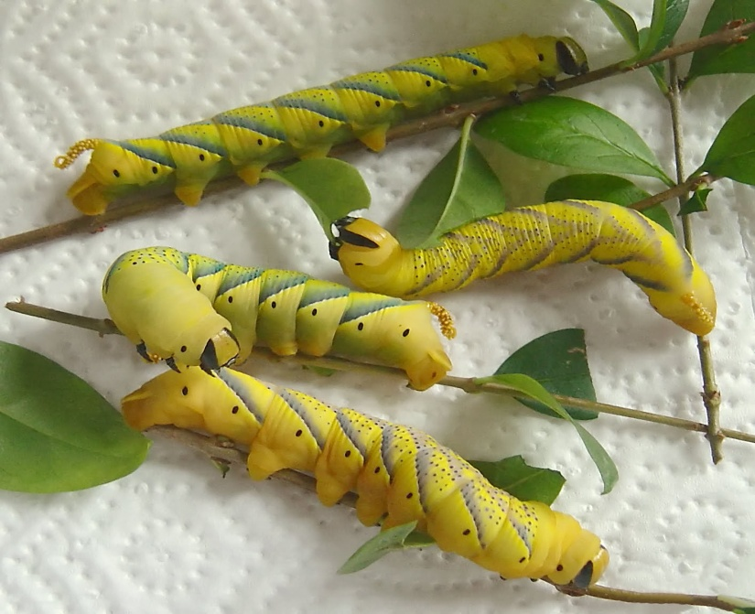
ENTO-306 Vegetable Insect Pests
Til hawk moth_hornworm (Acherontia atropos : Sphingidae, Lepidoptera)

