Slide 1
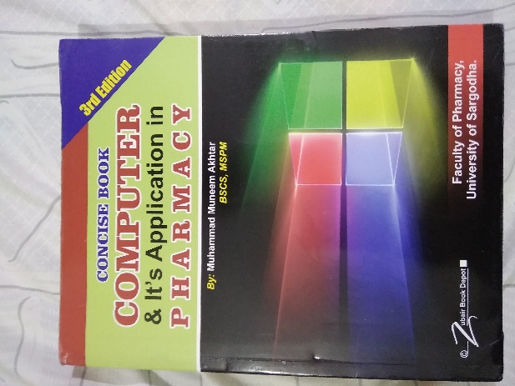
Computer Communication
10
Recommended For
Pharmacy Student !
Part
Pharm-D (Doctor of Pharmacy),
DPT (Doctor of Physiotherapy) &
Pharmacy Technician.
Muhammad Munim Akhtar

Slide 2
Welcome to
Computer & its Application in Pharmacy with Munim Akhtar
Free online quality educational tutorials about Computer in Pharmacy

Slide 4
What is Communication
The exchanging of information or conveying meaningful data, ideas or news among each other.
It is a two way process of reaching mutual understanding in which participants exchange of information among each other.
e.g., Face to face communication, or without face to face communication

Slide 5
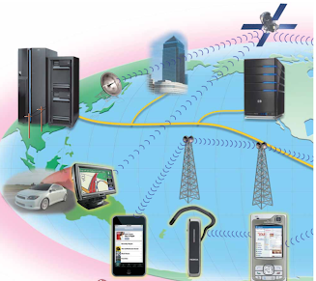
What is Computer communications
Definition: Computer communications is a process in which two or more computers devices transfer data, instructions, and information.
All types of computers and mobile devices serve as sending and receiving in a communications system, Transferring data from one computer to another over a network.
e.g., Sending text messages between mobile devices.
Sending an e-mail.
Collaborating on shared documents and spreadsheets.
Voice chat or calls with other people over the Internet.
Video call or conferencing with other people over the Internet like Zoom app etc.

Slide 6
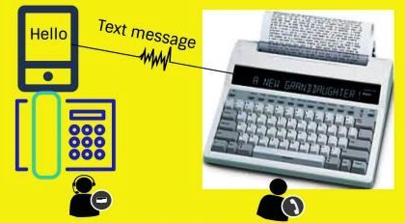
What is Telecommunication
Telecommunications refers to the exchange of information electronically by means over a significant distance.
Telecommunication is the process of transferring data electronically from one place to another.
Communication over a distance by cable, telephone, or broadcasting is called telecommunication.
Data can be transferred using different medium like mobile networks, Computer networks, etc.

Slide 7
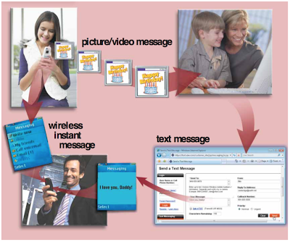
USES OF COMPUTER COMMUNICATIONS
Text Messaging Services: Users can send and receive wireless messages to and from smart phones, cell phones like text messaging typically less than 300 characters.
Instant Messaging: IM is a real-time Internet communications service that allows wireless mobile devices to exchange messages with one or more mobile devices and both parties must be online at the same time like smart phone or other mobile device, e.g., mobile to mobile or conference call etc.
Picture/Video Messaging: Users can send pictures and sound files, as well as short text messages, to a phone or other personal mobile device, or a computer

Slide 8
Information processing steps
Information
Signal
Manipulate
001011101

Slide 9
Basic elements of communication
Sender: The sender is the device that sends the data, also called source
Medium: The medium is the path that connects the sender with receiver. It is also called communication channel, e.g., Computer network, mobile network, Copper wire, Fiber-optic, air waves etc.
Receiver: The receiver is the device that accept the data, Computer, Printer etc.

Slide 10
Communication Channels
The path through which data is transmitted from one place to another is called or communication channel / communication media. Or
Communication channel refers to a physical transmission medium such as a wire, or logical connection over a medium such as wired or wireless media.
Have two types:
1.Wired media
2.Wireless media
Radio waves are use in communication technologies, such as television, mobile phones and radios
Microwaves communications in radar and cooking appliances.

Slide 11
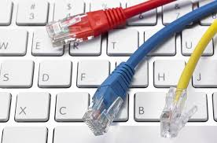
Communication Channels…
1.Wired media
In a wired network, data is transmitted over a physical medium like wires etc.
Some examples of guided media.
Twisted Pair
Coaxial Cable
Fiber Optics

Slide 12
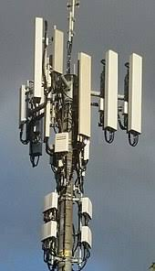
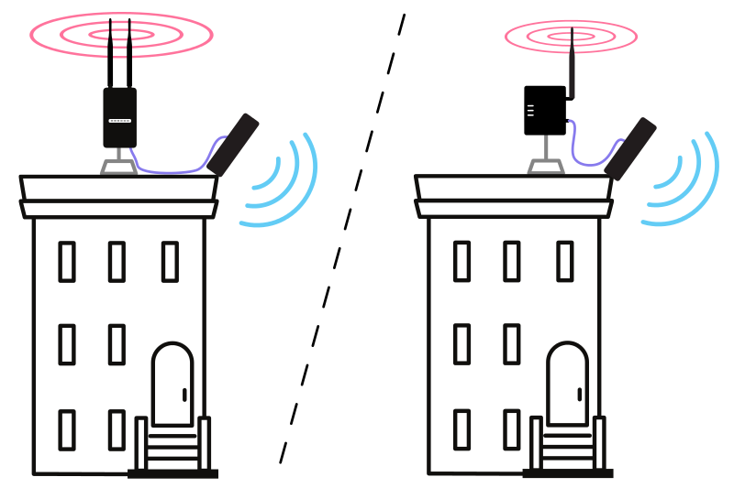
Communication Channels…
2.Wireless Media
In unguided media, communication devices communicate with each other through air or space.
A wireless network is a computer network that uses wireless data connections between networks.
Example.
Communication Satellite,
Cellular Radio etc.

Slide 13
Modes of Communication
The medium or channel through which communicative sent to or expressed is called modes
Data is transferring by three ways:
Simplest mode
Half –Duplex mode
Full -Duplex mode

Slide 14
Simplest
In simplex mode the communication can take place in one direction. The receiver receives the signal from the transmitting device.
Features:
a) one way directional
b) Receive-only devices
c) Rarely used for data communication.
e.g. Television, Radio, data from computer to Printer etc.

Slide 15
Half –Duplex mode
Half-duplex is a type of communication in which data can flow back and forth between two devices, but not simultaneously.
Features:
a unidirectional only.
Can alternately send and receive data.
Transmission direction can be changed when required.
e.g. walkie-talkie etc.

Slide 16
Full-duplex mode
The communication channel is used in both directions at the same time.
There is no need to switch from sending to receive mode like in half duplex.
e.g. This mode of communication is the telephone line
FEATURES:
Communicates in both directions simultaneously.
Much efficient mode.
e.g. Cellular phone, PTC phone etc.

Slide 17
End Note
Wisdom comes only through suffering.
AESCHYLUS

Slide 18
?

