Slide 1
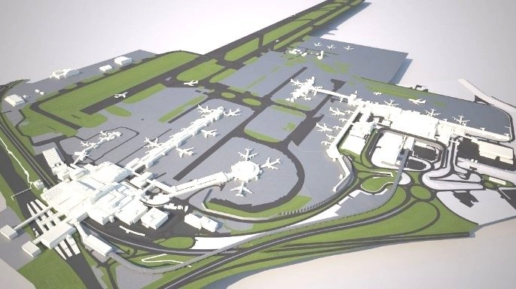
Components of Airport

Slide 2
Runway
Taxiway
Apron
Terminal building
Control tower
Hanger
Parking

Slide 3
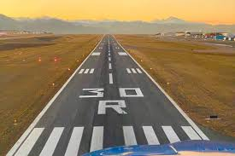
Runway
Runway is a paved land strip on which landing and takeoff operations of aircrafts takes place. It is in leveled position without any obstructions on it.
Special markings are made on the runway to differ it from the normal roadways. Similarly, after sunset, specially provided lightings are helped the aircrafts for safe landing.
Many factors are considered for design of runway. The direction of runway should be in the direction of wind. Sometimes cross winds may happen, so, for safety considerations second runway should be laid normal to the main runway.

Slide 4
Runway
The number of runways for an airport is depends upon the traffic. If the traffic is more than 30 movements per hour, then it is necessary to provide another runway.
Runway can be laid using bitumen or concrete. Bitumen is economic but concrete runways have long span and requires less maintenance cost.
The width of runway is dependent of maximum size of aircrafts utilizing it. The length of runway is decided from different considerations like elevation of land, temperature, take off height, gradients etc.

Slide 5
Runway
The runways at all airports in the world has two numbers on it at the opposite ends
numbers indicate to pilots the runways to be used for takeoff and landing and the same is communicated to the pilots by the air traffic control.
Each of these numbers corresponds to a direction on the compass,

Slide 6
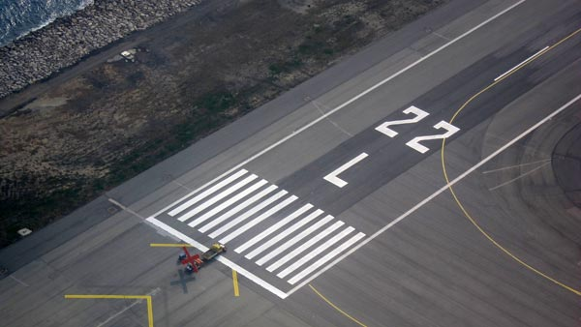
Runway
The numbers are always between 01 and 36, signifying between 10 degrees and 360 degrees on the compass. The difference between both the numbers is always 18, which signifies 180 degrees on the compass. 180-degrees because it is the complete opposite.

Slide 7
Runway Patterns
Single runway
Two runways
Hexagonal runway
45-degree runway
60-degree runway
60-degree parallel runway

Slide 8
Single Runway
Single runway is the most common form. It is enough for light traffic airports or for occasional usages. This runway is laid in the direction of wind in that particular area.

Slide 9
Two Runway
Two runway contains two runway which are laid in different directions by considering cross winds or wind conditions in that particular area. The runways may be laid in the form of L shape or T shape or X shape.

Slide 10
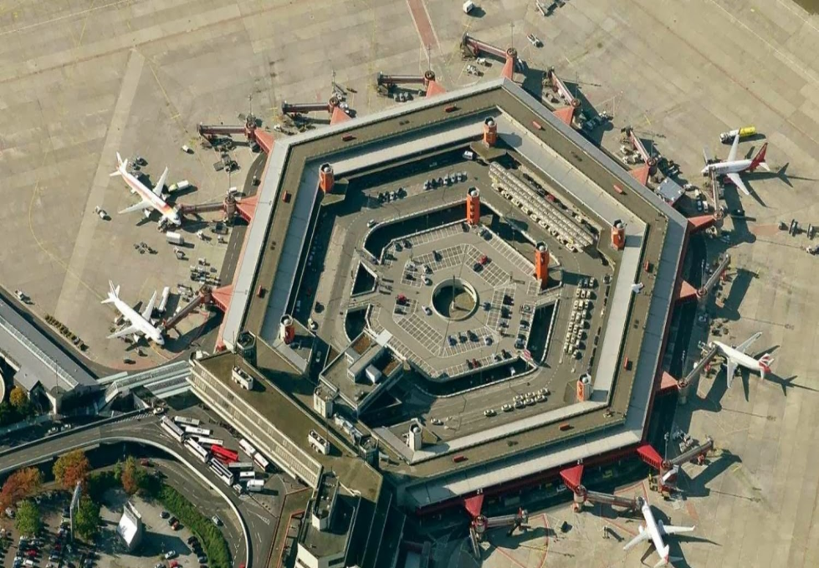
Hexagonal Runway
This is the modern pattern of system of runway laying. In which the takeoff and landing movements of aircrafts can be permitted at any given time without any interference. This is most suitable for heavy traffic airports or busiest airports.

Slide 11
60 Degree Runway
When the wind in that area is prevailing in many directions, so, it is difficult to decide the direction in which runway is to be laid. In that case, 60-degree runway is opted which looks like triangular arrangement of runways.

Slide 12
Taxiway
Taxiway is path which connects each end of the runway with terminal area, apron, hanger etc. These are laid with asphalt or concrete like runways.
In modern airports, taxiways are laid at an angle of 30 degree to the runway so that aircrafts can use it to change from one runway to other easily. The turning radius at taxiway and runway meets should be more than 1.5 times of width of taxiway.

Slide 13
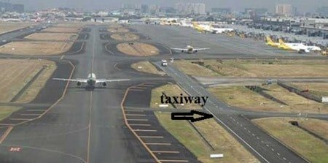

Slide 14
Apron
Apron is a place which is used as parking place for aircrafts. It is also used for loading and unloading of aircrafts. Apron is generally paved and is located in front of terminal building or adjacent to hangers.
The size of area to be allotted for apron and design of apron is generally governed by the number of aircrafts expected in the airport. The aircraft characteristics also considered while design.
Proper drainage facilities should be provided with suitable slope of pavement. Sufficient clearances must be provided for aircrafts to bypass each other.

Slide 15
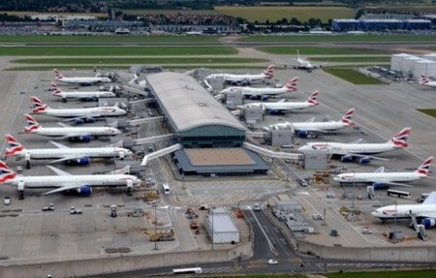

Slide 16
Terminal Building
Terminal building is a place where airport administration facilities takes place. In this building, pre-journey and post journey checking’s of passengers takes place.
Lounges, cafes etc. are provided for the passengers. Passengers can directly enter the plane from terminal buildings through sky bridge, walkways etc.
Similarly, the passengers from plane also directly enter into the terminal building.

Slide 17
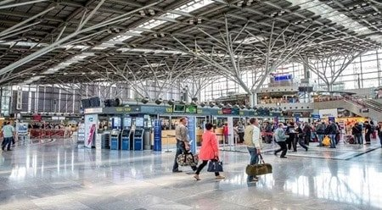

Slide 18
Control Tower
The control tower is a place where aircrafts under a particular zone is controlled whether they are in land or in air. The observation is done by the controller through radars and information is carried through radio.
The controller from the control tower observes all the aircrafts with in that zone and informs pilots about their airport traffic, landing routes, visibility, wind speeds, runway details, etc. based on which the pilot decides and attempts safe landing. So, control tower is like nerve system of an airport.

Slide 19
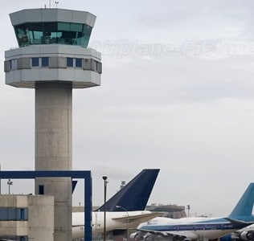

Slide 20
Hanger
Hanger is a place where repairing and servicing of aircrafts is done. Taxiway connects the hanger with runway so, when a repair needed for an aircraft it can be moved to hanger easily.
It is constructed in the form of large shed using steel trusses and frames. Large area should be provided for Hanger for comfortable movement of aircrafts

Slide 21
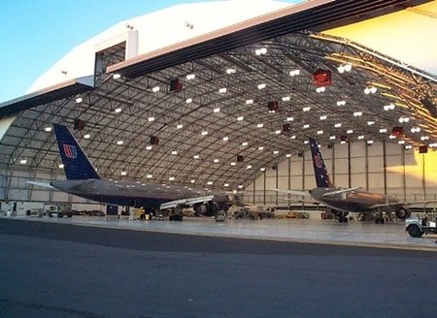

Slide 22
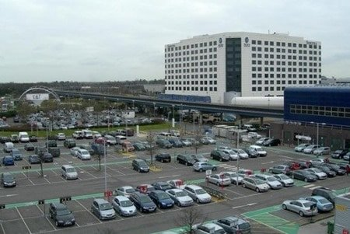
Parking
This is a place provided for parking the vehicles of airport staff or passengers which is outside the terminal building or sometimes under the ground of terminal building.

Slide 23
Further study
https://upcommons.upc.edu/bitstream/handle/2099/16095/26-266-1-PB.pdf

