Slide 1
Dietary Fiber and Coronary Heart Disease

Slide 2
Dietary Fiber Classification and Food Sources
Physical and Physiological Properties of Fiber
Relationship between Cholesterol Levels and CHD
A. Role of Fiber in Reducing Serum Cholesterol
B. Mechanisms for Lowering of Serum Cholesterol by Fiber
C. Other Relevant Considerations for Fiber and CHD Risk
D. Fiber as Adjunct Therapy to Statin Medication
IV. Health Claims Associated with Fiber and CHD

Slide 3
Dietary Fiber Classification and Food Sources
Fiber is generally described as plant material that is resistant to human digestive enzymes.
Most of these plant materials fall into the category of non-starch polysaccharides, with the exception of plant lignins, which are actually polyphenolic by nature.

Slide 4
Fiber is typically subdivided into two groups based on solubility in water. Soluble (water) fibers include pectin (pectic substances), gums, and mucilages, whereas the insoluble fibers include cellulose, hemicellulose, lignin, and odified mcellulose.
Some of the better food sources of soluble fibers are fruit, legumes, oats, and some vegetables.
Meanwhile, those foods known to be richer sources of insoluble fibers include cereals, grains, legumes, and vegetables.
The amount of fiber present within the human diet can vary geographically.

Slide 5
In more industrially developed countries, such as the U.S., fiber consumption is relatively lower than in other societies.
For example, the average intake of fiber in the U.S. is only about 12–15 g daily.
This consumption falls well below current recommendations of the World Health Organization of 25–40 g of fiber daily.
The American diet tends to derive less than half of its dietary carbohydrate intake from fruit, vegetables, and whole grains.
On the other hand, the people of some African societies are known to eat as much as 50 g of fiber daily.

Slide 6
Digestible polysaccharides in plant foods such as starch, and, to a much lesser degree, glycogen in meats, have repeating monosaccharide units bonded by 1–4 linkages.
These bonds are readily digested by amylase in both salivary and pancreatic secretions.
Branch points in the starch and glycogen chains are joined through 1–6 linkages that are hydrolyzed by the enzyme 1–6 dextrinase (isomaltase) in pancreatic secretions.
On the contrary, 1–4 linkages are formed by plants instead of 1–4 linkages between monosaccharides in fibrous polysaccharides.
Both salivary and pancreatic amylases are unable to hydrolyze 1–4 covalent bonds efficiently.

Slide 7
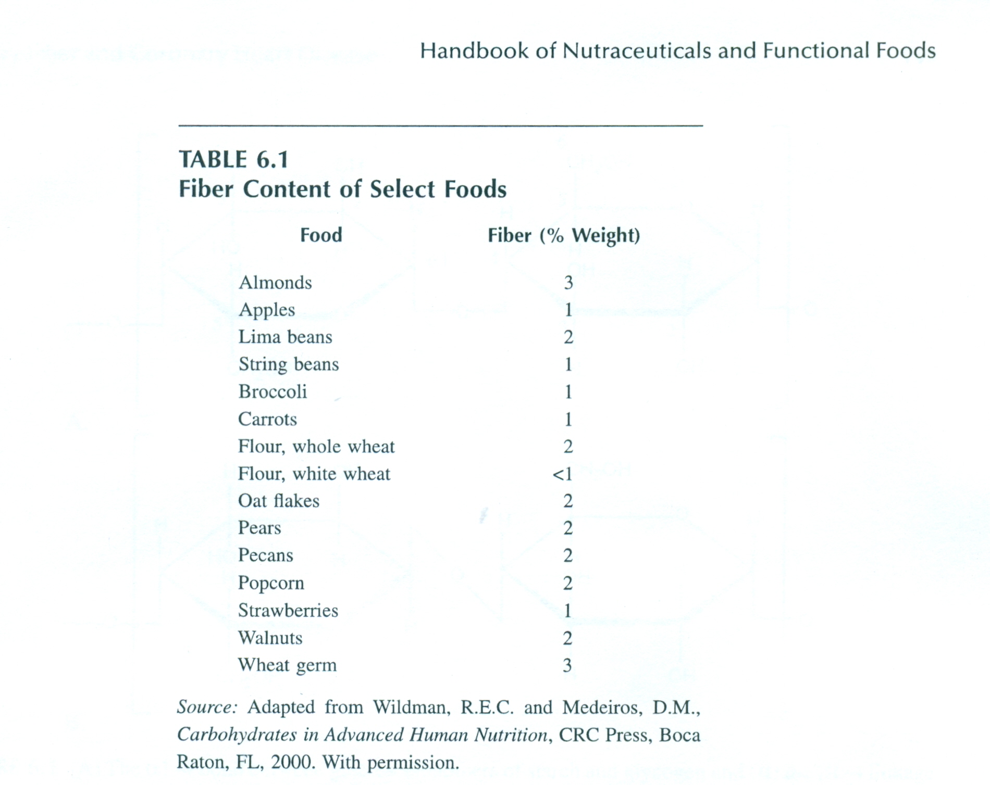

Slide 8
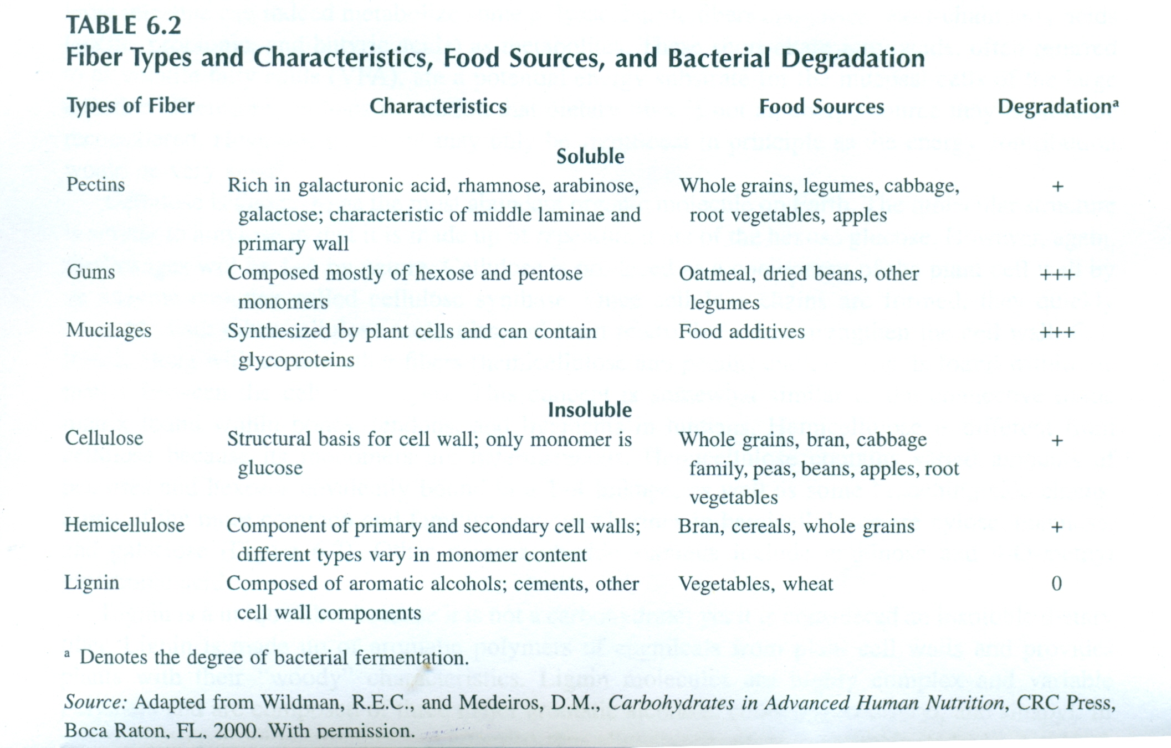

Slide 9
This renders such polysaccharides resistant to human digestive action.
However, bacteria inhabiting the large intestine can indeed metabolize some polysaccharide fibers and create short-chain fatty acids (acetic, propionic, and butyric acids) as metabolites.
These short-chain fatty acids, often referred to as volatile fatty acids (VFA), are a potential energy substrate for the mucosal cells of the large intestine.

Slide 10
Therefore, perhaps the notion that dietary fiber is not an energy source may need to be reconsidered.
However, this point may only be significant in principle as the energy contribution would be very small.
Cellulose is known to be the most abundant organic molecule on Earth.
The molecular structure is similar to amylose in that it is made up of repeating units of the hexose glucose.
However, again, the linkages will be 1–4 by nature.
Cellulose is produced as a component of the plant cell wall by an enzyme complex called cellulose synthase.

Slide 11
Once cellulose chains are formed, they quickly assemble with other cellulose molecules and form microfibrils that strengthen the cell wall.
Cellulose, along with certain other fibers (hemicellulose and pectin) and proteins, is found within the matrix between the cell wall layers.
This concept is somewhat similar to the connective tissue matrix found within bones, tendons, and ligaments in humans.
Hemicellulose is different from cellulose because its monomers are heterogeneous.
Hemicellulose contains varied amounts of pentoses and hexoses covalently bound in a 1–4 linkage, as well as some branching side chains.
Some of the more common and familiar monosaccharides in hemicelluloses are xylose, mannose, and galactose.
Other monosaccharide subunits include arabinose and 4-O-methyl glucuronic acids.

Slide 12
PHYSICAL AND PHYSIOLOGICAL PROPERTIES OF FIBER
The physical characteristics of dietary fiber can produce various gastrointestinal responses depending upon the segment of the digestive tract.
Among these responses are gastric distention, the rate of gastric emptying, and enhancement of residue quantity (feces bulk) and moisture content.
Furthermore, dietary fiber can influence fermentation by bacteria in the colon as well as the turnover of specific bacteria species.
The bacterial population will likely increase due to fiber fermentation.
Bacterial presence may contribute as much as 45% to the fecal dry weight.
The influence of fiber upon fecal mass is presented in Table.

Slide 13
Different fiber molecules are subject to varying levels of bacterial degradation in the colon.
For instance, pectin, mucilages, and gums seem to be almost completely fermented.
Meanwhile, cellulose and hemicellulose are only partly degraded and the noncarbohydrate nature of lignin allows it to go virtually unfermented.

Slide 14
Among some of their more interesting physical properties is the water-holding capacity or the hydration of fiber.
The ability of different fibers to associate with water molecules is largely attributable to the presence of sugar residues that have free polar groups (i.e., OH, COOH, SO, and C=O groups).
These polar groups allow for the formation of hydrogen bonds with adjacent water molecules.
It seems that pectic substances, mucilages, and hemicellulose have the greatest water-holding capacity.

Slide 15
Cellulose and lignin can also hold water but not to the extent of other fibers.
However, as soluble fibers are generally more fermentable, the associated water is liberated and absorbed in the colon.
Thus, it is the insoluble fibers that hold onto water throughout the total length of the intestinal tract and give the fecal mass greater water content.

Slide 16
In the small intestine, the hydration of fiber will allow for the formation of a gel matrix.
Theoretically, the formation of a gel in the small intestine could increase viscosity of the foodderived contents and slow the rate of absorption of nutrients.
It has been suggested that this mechanism may slow the rate of carbohydrate absorption and decrease the magnitude of the postprandial spike in blood glucose.
This notion may then be applicable to individuals with diabetes mellitus.

Slide 17
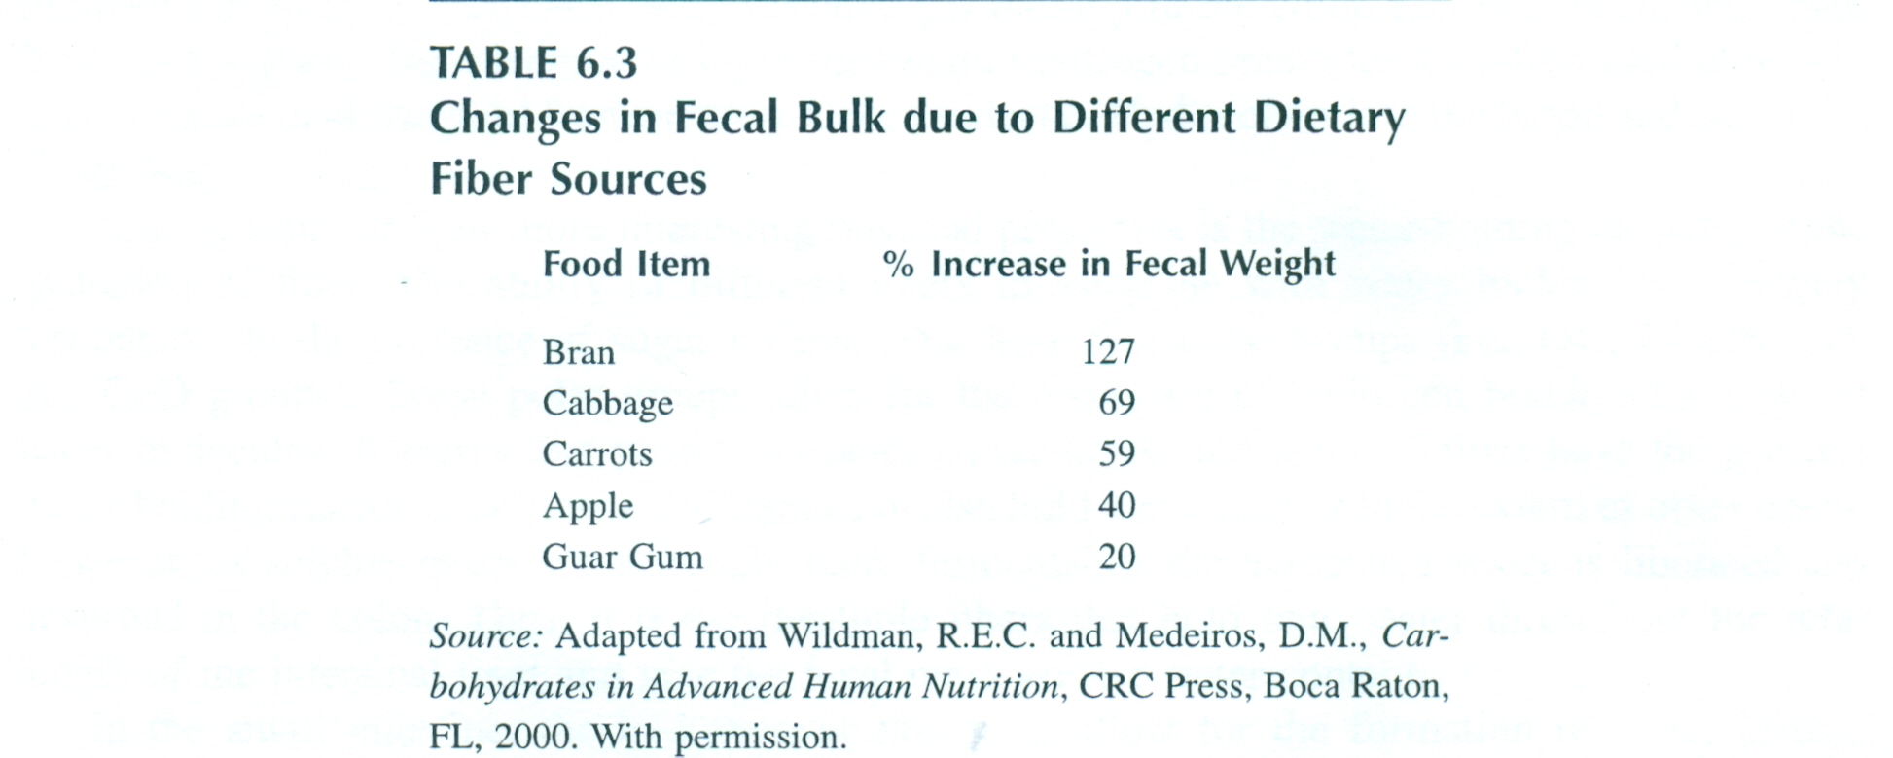

Slide 19
RELATIONSHIP BETWEEN CHOLESTEROL LEVELS AND CHD
Coronary heart disease (CHD) is the leading cause of death in the Western world after cancer according to the American Heart Association’s 2005 Biostatistical Fact Sheet and reports from numerous medical organizations in Europe.
In contrast to popular belief, CHD is a leading cause of death among women as well.
Many risk factors can influence CHD, such as smoking, age, male sex, menopause, diabetes, serum cholesterol levels, and hypertension.
Some of these risk factors are modifiable, such as smoking and serum cholesterol levels, and some are not, such as male sex or menopause.

Slide 20
Among the most important risk factors that may be controlled are serum cholesterol levels.
Many studies have established that high total-cholesterol levels and low-density lipoprotein (LDL) cholesterol levels are risk factors for CHD and mortality.4–6 The well-known Framingham Study was among the first to establish a statistical relationship between serum lipoproteins and CHD.
Other important studies using very large cohorts from the Multiple Risk Factor Intervention Trial (MRFIT) and from various countries have since strengthened the notion that serum cholesterol is a risk factor for CHD.

Slide 21
Elevated serum cholesterol levels can result from a variety of influences. Severely high serum cholesterol is usually due to familial hypercholesterolemia, a condition characterized by genetic defects in LDL-receptor activity that result in accumulation of LDL cholesterol in the blood.
Elevated serum cholesterol may also occur as a secondary effect of disorders such as diabetes, hypothyroidism, and alcoholism.
More commonly, cholesterol disorders are characterized by mild or moderate hypercholesterolemia and are generally dietary in origin.
Intake of saturated fats, trans fatty acids can also increase plasma LDL levels by decreasing LDL-receptor synthesis.

Slide 22
A. ROLE OF FIBER IN REDUCING SERUM CHOLESTEROL
Fiber has been implicated in reducing the risk for CHD.
Many large epidemiological studies, such as the Nurses’ Health Study and the Scottish Heart Health Study, have demonstrated a reduced risk for CHD in both men and women who consume higher amounts of dietary fiber.
Soluble fibers, in particular, are thought to exert a preventative role against heart disease as they appear to have the ability to lower serum cholesterol levels.
A recent meta-analysis examining soluble fiber sources from pectin, oat bran, guar gum, and psyllium reported a small but significant reduction in serum Cholesterol levels.

Slide 23
Many other studies have found that a high intake of soluble fiber results in decreased serum cholesterol levels.
These studies generally report a decrease in total cholesterol and LDL cholesterol with no changes in high-density lipoprotein (HDL) or triglycerides.
Indeed, it is now recognized that soluble fiber is a viable intervention to reduce serum cholesterol levels by clinically significant amounts, thereby reducing a known risk factor for CHD.

Slide 24
Oat bran, in particular, has received a great deal of attention as a fiber source with an appreciable level of soluble fiber that has been shown to reduce plasma cholesterol levels under controlled conditions.
A review of the literature demonstrates that oat bran has been repeatedly proved to play a role in reducing serum cholesterol levels and is generally recommended by the nutrition and medical community as an important part of the diet.
A meta-analysis done by Ripsin and colleagues reviewed results from ten trials and concluded that a significant amount of cholesterol reduction occurred when at least 3 g of soluble fiber from oat bran was consumed daily.

Slide 25
The long-term interest in oat bran has led to the identification of β-glucan as the active compound responsible for for LDL reduction.
In addition to oat bran, yeast has also been identified as a concentrated source of β-glucan and is currently under investigation for its potential as a commercial additive in a variety of food products.
A relatively new product that is known by the patented name Fibercel® is composed of purified β-glucan derived from the yeast Saccharomyces cerevisiae, the species found in baker’s and brewer’s yeast.
This product is currently under investigation in clinical trials to establish its efficacy in treating individuals with high cholesterol levels.
If proved successful, it could be used as an additive in foods such as salad dressing, frozen desserts, and cream cheese.

Slide 26
Recent studies using Konjac-mannan fiber (a highly soluble fiber also known as glucomannan) have also yielded very promising results by reducing risk factors for CHD.
Subjects supplemented with a daily average of 23 g of Konjac-mannan in the form of biscuits experienced a lower total HDL cholesterol ratio and LDL cholesterol, lower systolic blood pressure, and improved their glycemic control.
These results were significantly better than those achieved with an identical diet using wheat bran instead of Konjac-mannan diet, thereby demonstrating the effectiveness of the soluble fiber in influencing not only cholesterol, but other CHD risk factors, as well.
Konjacmannan fiber is well known for having among the highest viscosity of all the soluble fiber types.

Slide 27
The use of Konjac-mannan fiber may also lead one to speculate that highly soluble fibers, such as Konjac-mannan, may be more effective at reducing cholesterol levels than other soluble fibers.
It must be remembered, however, that the use of Konjac-mannan entails supplementation in existing foods, such as breads or biscuits, rather than eating an actual product such as oatmeal cereal.
This may have practical relevance as it is far simpler for the typical consumer to buy instant cereal and eat it daily for breakfast than to buy Konjac-mannan fiber and supplement it in baked goods on a daily basis.

Slide 28
Other types of soluble fibers have been extensively studied for their ability to lower serum cholesterol amounts.
Psyllium has received attention over the years as a soluble fiber that can reduce cholesterol levels.
Psyllium plant stalks contain tiny seeds, also called psyllium, covered by husks, which is the source of the fiber.
There is a great deal of soluble fiber in psyllium; in fact, 71% of the weight of psyllium is derived from soluble fiber.

Slide 29
In contrast, only 5% of oat bran by weight is made of soluble fiber; in other words, the soluble fiber in 1 tablespoon of psyllium is equal to 14 tablespoons of oat bran.
The active fraction of psyllium seed husks that is thought to be responsible for the cholesterol-lowering effects is a highly branched arabinoxylan that is composed of a xylose backbone with arabinose-and xylose-containing side chains.25 Interestingly, arabinoxylan from psyllium is not fermented by colonic bacteria, apparently due to still unidentified structural features of the molecule.

Slide 30
Other types of soluble fibers have been extensively studied for their ability to lower serum cholesterol amounts.
Psyllium has received attention over the years as a soluble fiber that can reduce cholesterol levels.
Psyllium plant stalks contain tiny seeds, also called psyllium, covered by husks, which is the source of the fiber.
There is a great deal of soluble fiber in psyllium; in fact, 71% of the weight of psyllium is derived from soluble fiber.
In contrast, only 5% of oat bran by weight is made of soluble fiber; in other words, the soluble fiber in 1 tablespoon of psyllium is equal to 14 tablespoons of oat bran.

Slide 31
The active fraction of psyllium seed husks that is thought to be responsible for the cholesterol-lowering effects is a highly branched arabinoxylan that is composed of a xylose backbone with arabinose-and xylose-containing side chains.
Interestingly, arabinoxylan from psyllium is not fermented by colonic bacteria, apparently due to still unidentified structural features of the molecule.

Slide 32
B. MECHANISMS FOR LOWERING OF SERUM CHOLESTEROL BY FIBER
There are several possible mechanisms by which soluble fiber is thought to reduce serum cholesterol levels; many are related to the ability of soluble fibers to form viscous gels in the intestinal tract.
Among these potential mechanisms are reduced cholesterol absorption in the presence of soluble fiber, increased excretion of bile acids, an alteration of bile-acid type present in the gut, and possible influences of short-chain fatty-acid production by intestinal flora upon cholesterol synthesis.

Slide 33
It has been proposed that soluble fiber reduces plasma cholesterol through its ability to bind bile acids in the gastrointestinal tract.
As soluble fibers bind bile acids in the intestinal tract, micelle formation is altered and reabsorption of bile acids is subsequently impaired, resulting in the excretion of the fiber–bile complex through the feces.
There are two classes of bile acids, primary and secondary.
Primary bile acids (cholic and chenodeoxycholic acid) are those synthesized directly from the liver, whereas secondary bile acids (deoxycholic and lithocholic acid) are produced after modification of primary bile acids by bacterial action in the colon.
It has been demonstrated that consumption of oat bran doubles the loss of bile acids and specifically increases the loss of deoxycholic acid (secondary bile acid) by 240% in human subjects.

Slide 34
C. OTHER RELEVANT CONSIDERATIONS FOR FIBER AND CHD RISK
Fiber has also been implicated in reducing risk for CHD through mechanisms other than plasmacholesterol modification.
One such example is through modification of blood-clotting ability.

Slide 35
It was demonstrated that individuals consuming 18.5 g or more of dietary fiber had a 42% risk for elevated proteinplasma C-reactive than those consuming 8.5 g or less.
Similar findings were reported after analysis of survey data from the National Health and Nutrition Examination data as well.
Using this data, a 41% lower risk of elevated C-reactive protein was found in individuals consuming high-fiber diets, after adjusting for smoking, BMI, physical activity, total energy, and fat intake.
Given the recent focus on C-reactive protein as a plasma marker of inflammation, and the emerging role of inflammation in the pathogenesis of atherosclerosis, it is noteworthy that dietary fiber may act in ways beyond its cholesterol-lowering ability.

Slide 36
D. FIBER AS ADJUNCT THERAPY TO STATIN MEDICATION
Current medical practice is to use statin drugs to reduce elevated plasma-cholesterol levels.
There are many types of statin drugs used today, but they all share the common feature of inhibiting hepatic enzyme HMG CoA reductase.
As dietary fiber is thought to reduce cholesterol levels through other mechanisms in addition to HMG CoA inhibition, it has been proposed that combining fiber therapy with medication may be an effective approach to reduce cholesterol.

Slide 37
A recent study examined the precise role of dietary fiber as adjunct therapy to statin medication and found that hypercholesterolemic patients taking 10 g of psyllium per day along with a 10 mg dose of simvastatin had the same degree of cholesterol reduction as those taking 20 mg of simvastatin alone.

Slide 39
IV. HEALTH CLAIMS ASSOCIATED WITH FIBER AND CHD
Soluble fiber from foods such as [name of soluble fiber source, and, if desired, name of food product], as part of a diet low in saturated fat and cholesterol, may reduce the risk of heart disease.
A serving of [name of food product] supplies __ grams of the [necessary daily dietary intake for the benefit] soluble fiber from [name of soluble fiber source] necessary per day to have this effect.

