Slide 1
Happy New Year

Slide 2
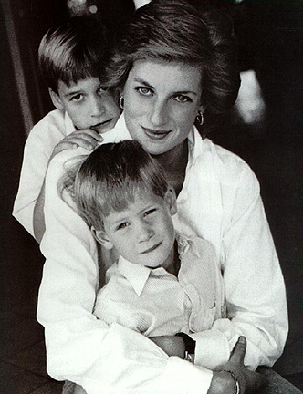
Head Injury

Slide 3
New year resolution??

Slide 4
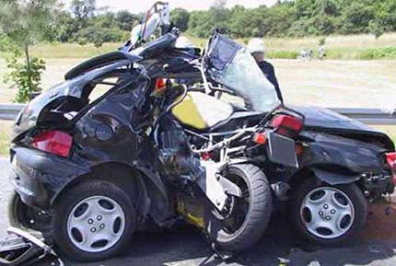
History
A 25 year old man is rushed to the emergency room after an motorbike accident. He had trauma to left side of skull.

Slide 7
He was pale .His blood pressure was 90/60, and his heart rate was 120 beats per minutes.

Slide 8
How would you manage this patient

Slide 9
class’s turn
Airway
Breathing
circulation
X ray skull
Secondary survery
Exposure
Iv line
Ct scan
Fluids
Blood
Prophylatic antiobiotics
Tetanus
Vitlas
G C S
Painkiller
Trachoestomy
Suturing
Reffered to NS

Slide 10
ATLS GUIDELINES

Slide 11
Primary survey
Airway and C spine control
Breathing
Circulation
Deformity(N)
Exposure

Slide 12
Secondary survey
A complete head to toe examination

Slide 13
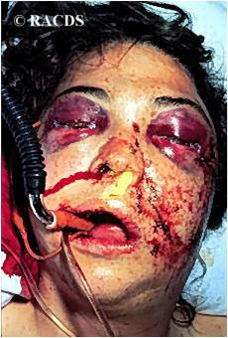
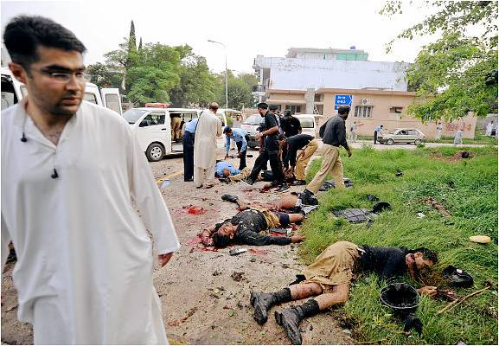
ATLS:Trimodal Death distribution
First peak instantly (brain, heart, aorta injury)
Second peak minutes to hours(liver,spleen injury)
Third peak days to weeks (sepsis, MSOF)
ATLS focuses on the second peak…..

Slide 14
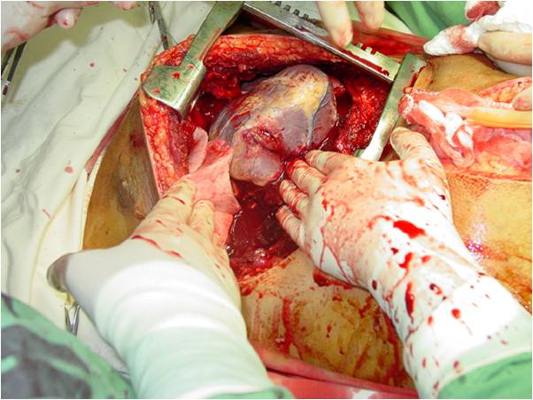
Second peak
Liver laceration, splenic ruptures, pancreatico-duodenal injuries, retroperitoneal injuries.
Bladder rupture, renal contusion, renal laceration, urethral injury…
Pelvic fractures, femur fractures, humerus fractures…

Slide 15
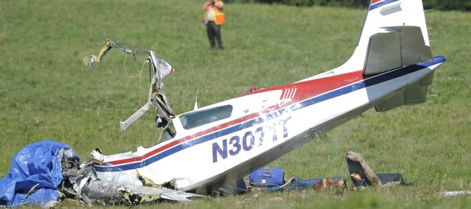

Slide 16
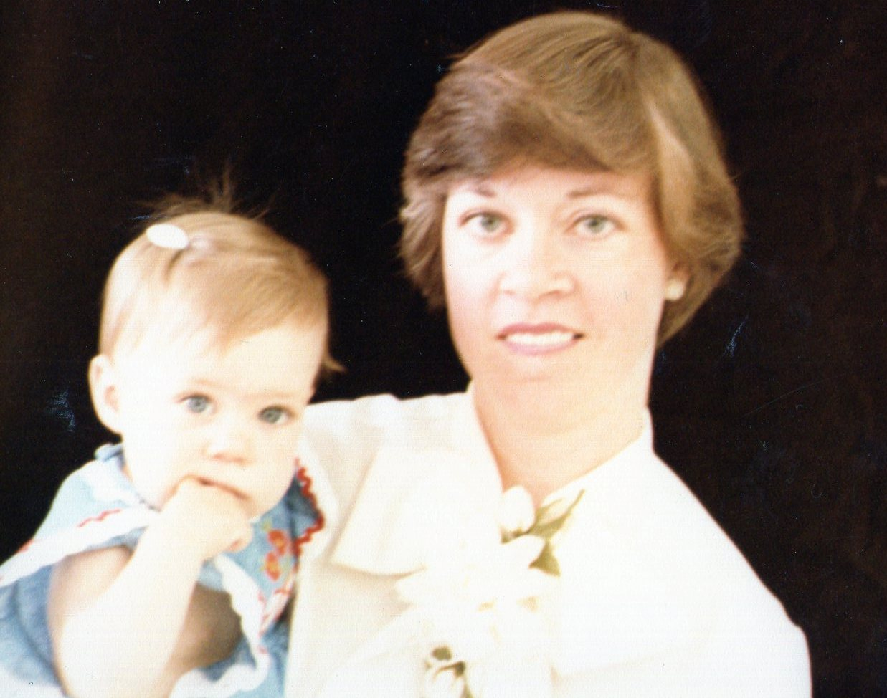
"When I can provide better care in the field with limited resources than what my children and I received at the primary care facility, there is something wrong with the system, and the system has to be changed."

Slide 17
Concepts of ATLS
Treat the greatest threat to life first.
A detailed history is not essential to begin the evaluation
“ABCDE” approach

Slide 18
The lack of a definitive diagnosis should never impede the application of an indicated treatment ”J Styner”

Slide 19
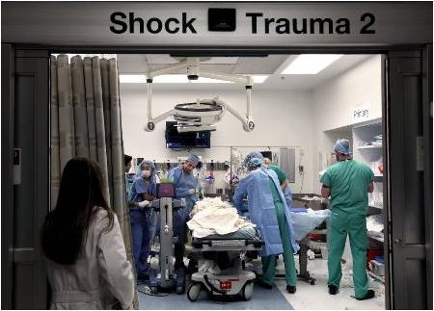
Trauma Roles
Trauma captain leads the team
Interventionalists(Radiologist)
Nurses
Recorder

Slide 20
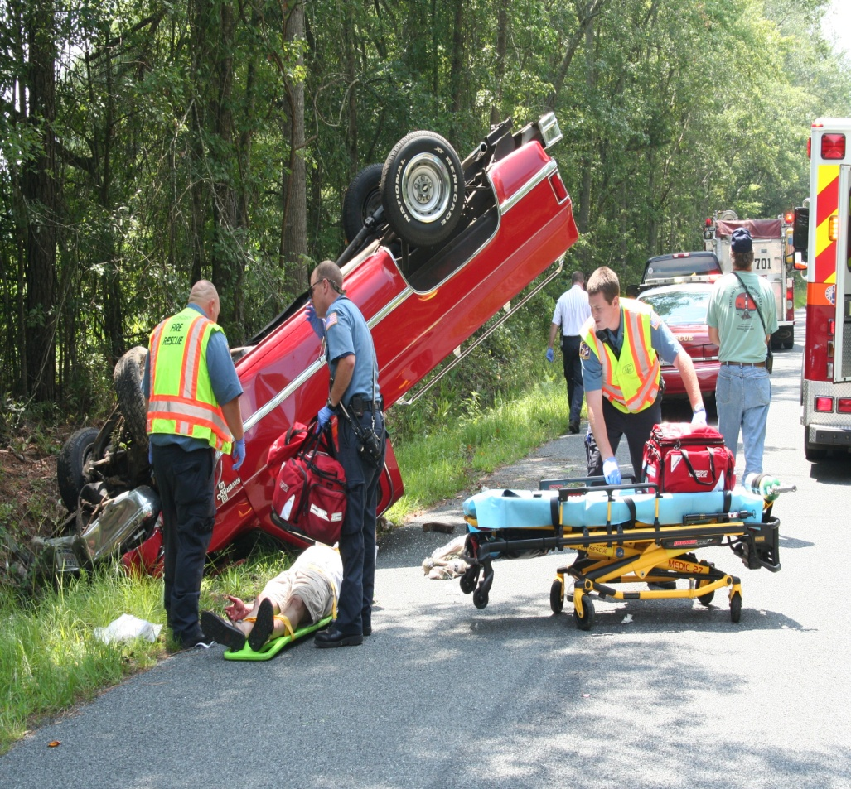
EMS…. 1122

Slide 21
A and E

Slide 22
Primary Survey
Patients are assessed and treatment priorities established based on their injuries, vital signs, and injury mechanisms.
A Airway and c-spine protection
B Breathing and ventilation
C Circulation with hemorrhage control
D Disability/Neurologic status
E Exposure/Environmental control

Slide 23
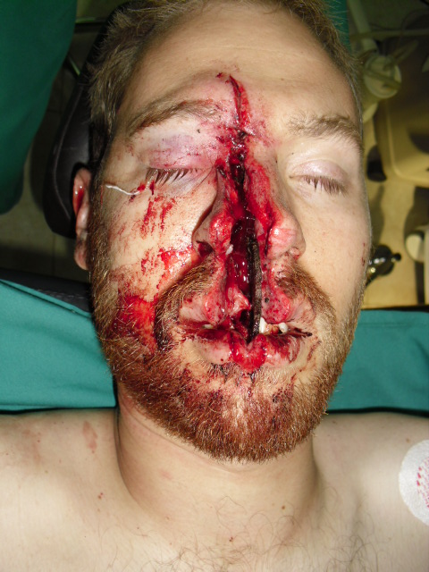
Airway
How do we evaluate the airway?

Slide 24
A- Airway
Airway should be assessed for patency.
Is the patient able to communicate verbally?
Inspect for any foreign bodies
Examine for stridor, hoarseness, gurgling, pooled secretions or blood.

Slide 25
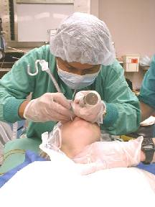
Airway Interventions
Supplemental oxygen
Suction
Chin lift/jaw thrust
Oral/nasal airways
Definitive airways
Endotracheal Intubation for comatose patients (GCS<8)
Tracheostomy in selected patients.

Slide 26
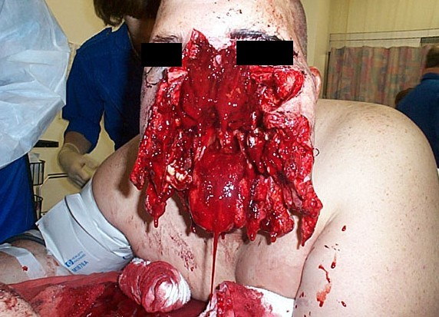
Difficult Airway

Slide 27
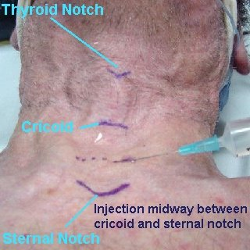
A tracheostomy

Slide 28
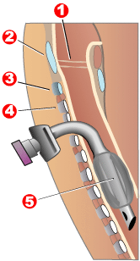

Slide 29
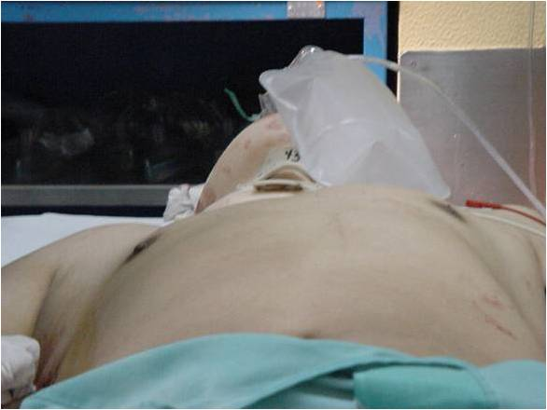
Breathing
What can we look for clinically to assess a patient’s ‘breathing’ status?

Slide 30
B- Breathing
Inspect, palpate,percuss and auscultate
Deviated trachea, crepitus, flail chest, sucking chest wound, absence of breath sounds
CXR to evaluate lung fields.

Slide 31
Flail Chest

Slide 32
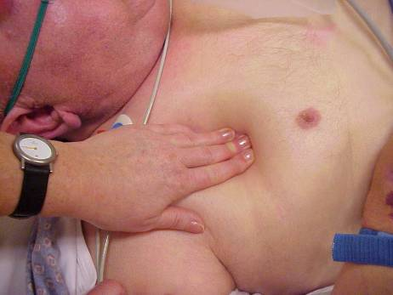
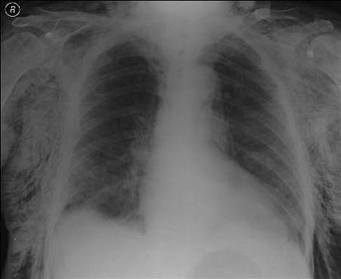
Subcutaneous Emphysema

Slide 33
Breathing Interventions
Ventilate with 100% oxygen
Needle decompression if tension pneumothorax suspected
Chest tubes for pneumothorax / hemothorax
Occlusive dressing to sucking chest wound

Slide 34
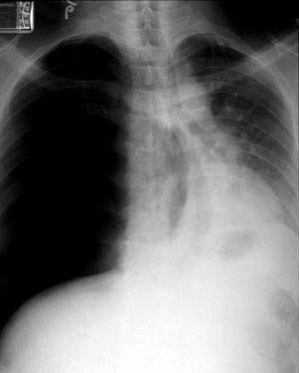
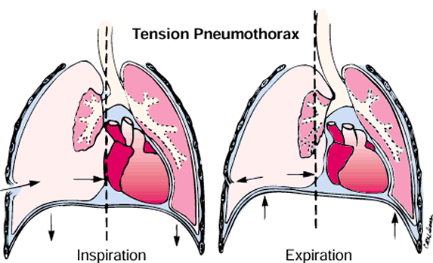
Tension Pneumothorax
How do you treat this?

Slide 35
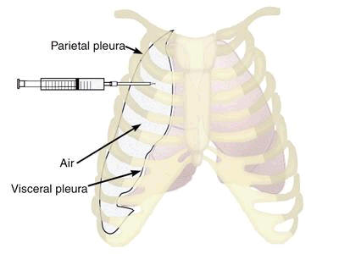
Needle decompression

Slide 36
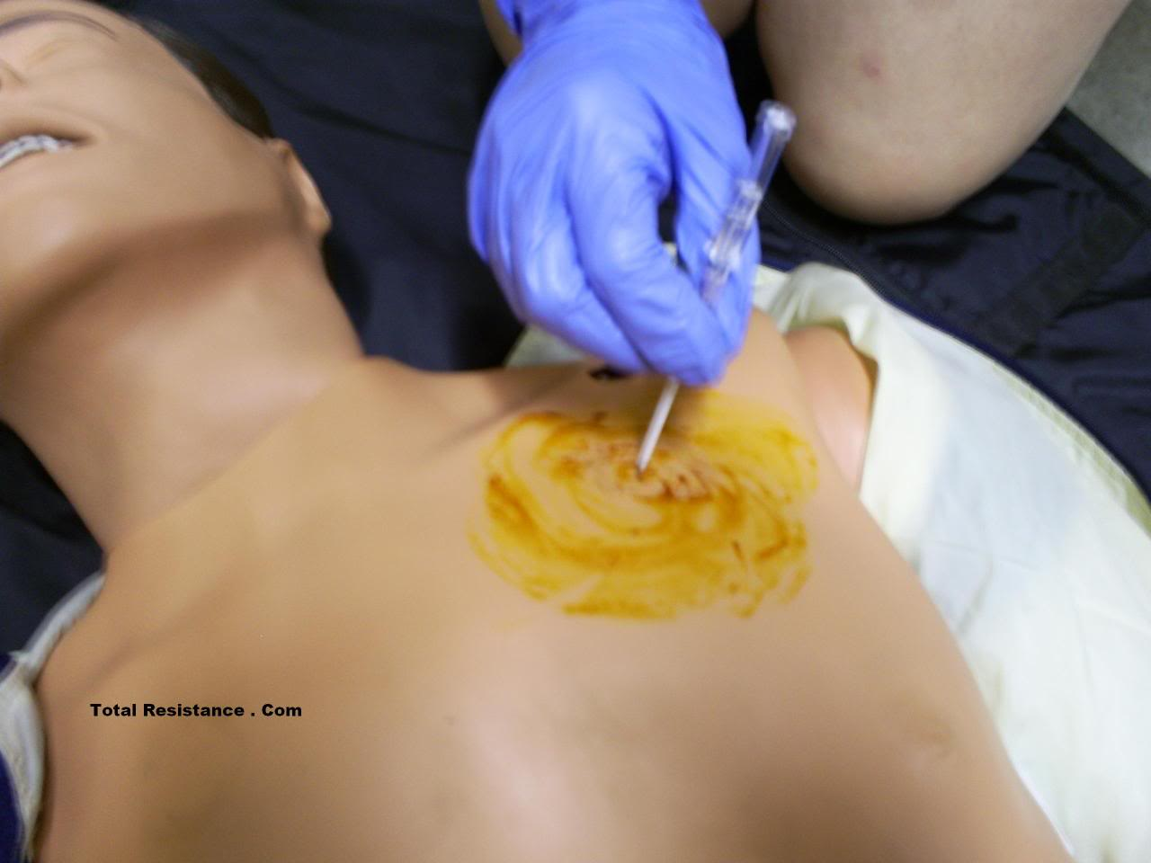

Slide 37
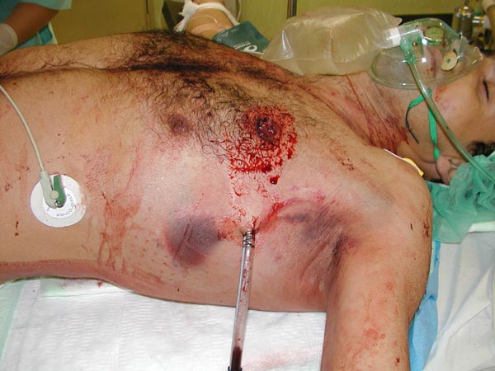
Chest Tube

Slide 38
Breathing

Slide 39
C- Circulation
Hemorrhagic shock should be assumed in any hypotensive trauma patient.
Rapid assessment of hemodynamic status
Level of consciousness
Skin color
Pulses in four extremities
Blood pressure and pulse pressure

Slide 40
Circulation Interventions
Apply pressure to sites of external hemorrhage
Establish IV access
2 large bore IVs
Central lines if indicated
Volume resuscitation
Have blood ready if needed
Notes:
Contraindications of foley catheter (signs of possible urethral injury): 1. Blood at urethral meatus 2. Perineal eccymosis 3. Blood in the scrotum 4. High riding prostate 5. Pelvic Fractures
If suspicious of urethral injury---retrograde urethrogram prior to insertion

Slide 41
Massive Intrathoracic and Intraabdominal bleed

Slide 42
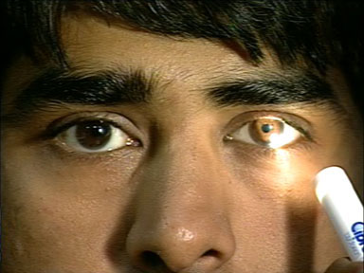
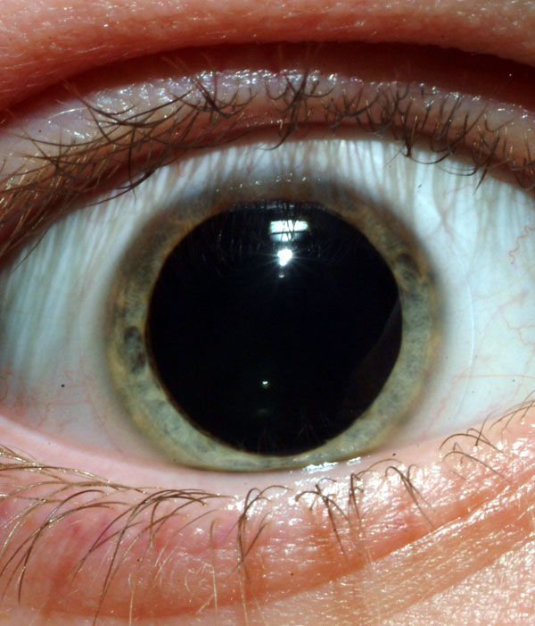
D- Disability(neurological Exam)
Level of consciousness
Pupil size and reactivity

Slide 43
GCS
EYE | VERBAL | MOTOR
Spontaneous 4 | Oriented 5 | Obeys 6
Verbal 3 | Confused 4 | Localizes 5
Pain 2 | Words 3 | Flexion 4
None 1 | Sounds 2 | Decorticate 3
 | None 1 | Decerebrate 2
 |  | None 1

Slide 44
Definition
Head injury is defined as any trauma to the head other than superficial injuries to the face (NICE 2017)
Traumatic brain injury (TBI) is a non specific term describing blunt, penetration or blast injuries to the brain. TBI can be classified as mild, moderate or severe, typically based on the GCS

Slide 45
Basic Anatomy

Slide 46
Head Injury

Slide 47
Head Injury Types
Contusion
Subdural hematoma
Extradural hematoma
Traumatic subarachnoid haemorrhage
Skull fracture
Concussion
Scalp laceration

Slide 48
Cerebral Contusion
Bruising to the brain surface
Usually caused by trauma of brain being thrown around inside the skull
Often accompanied by cerebral oedema
Contusions size and oedema can increase post injury
Peak risk for swelling is days 3-5 post injury
Increase risk of seizure activity

Slide 49
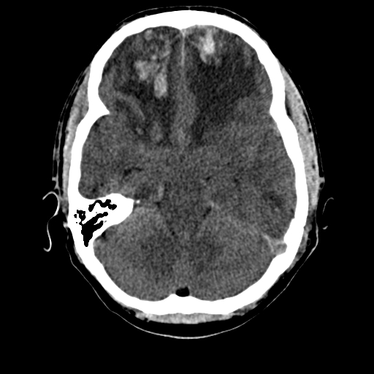
Cerebral Contusion

Slide 50
Subdural Haematoma
Blood gathers between the inner layer of the dura mater and the arachnoid mater. Usually resulting from tears in bridging veins which cross the subdural space
Venous bleed
Subdural haemorrhage may cause an increase in intracranial pressure (ICP) which can cause compression of and damage to delicate brain tissue

Slide 51
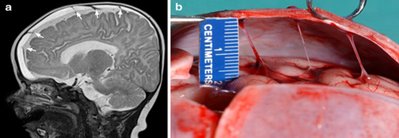
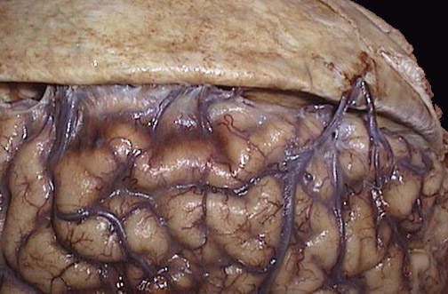
Subdural Haematoma
Tear in a “Bridging Vein”
Caution:
Alcohol dependant patients
Elderly patients
Anti-coagulant usage

Slide 52
Subdural Haematoma

Slide 53
Extradural Haematoma
Extradural hematoma is when bleeding occurs between the tough outer membrane covering the brain and the skull
Arterial bleed

Slide 54
Extradural Haematoma
More common in younger patients
Usually results from an arterial bleed
Patients often have a “LUCID PERIOD” with relatively few symptoms followed by a rapid deterioration
Carry good prognosis if diagnosed in time

Slide 55
Concussion
A concussion is a mild traumatic brain injury caused by a blunt jolt or blow to the head
The sudden movement causes the brain to bounce around or twist inside the skull
This leads to stretching and damaging of brain cells and causes chemical changes in the brain

Slide 56
Concussion

Slide 57
Concussion
Concussion is regarded as a traumatic brain injury
Can result from a direct or indirect blow to the head
LOC is not required
Children are more vulnerable
Symptoms can evolve over minutes or hours after the event
Helmets / scrum caps do not protect against concussion

Slide 58
Interventions
Elevated ICP due to head injury
Mannitol
Steroids
Emergency decompression

Slide 59
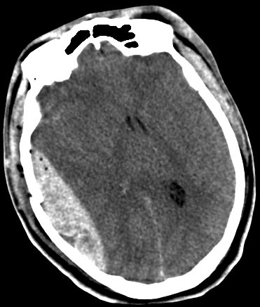
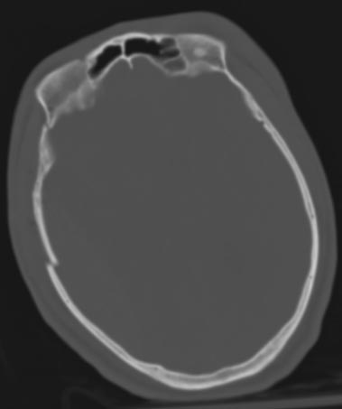
Extradural Hematoma

Slide 60
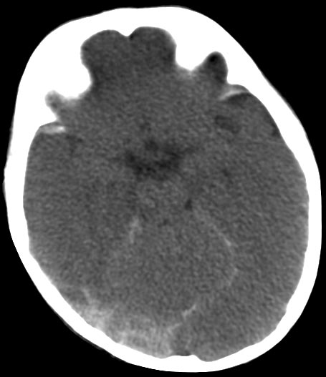
Subdural Hematoma with SAH

Slide 61
Burr hole procedure

Slide 62
Craniotomy

Slide 63
Glasgow coma scale

Slide 64
Thank you

