Slide 1
Print Media

Slide 2
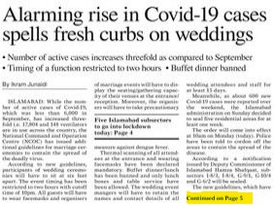
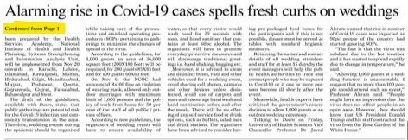
Kill: To strike out copy or take out type not to be printed.
Jump: To continue a story from one page to another.

Slide 3
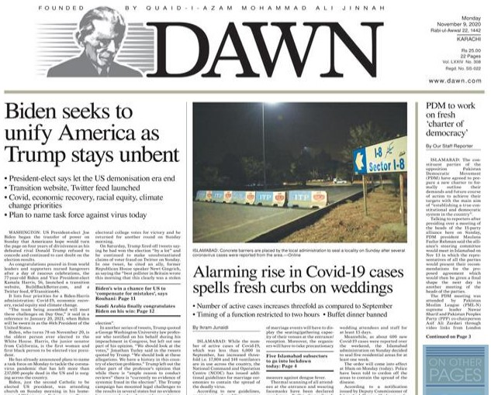
Lead: The main and first story of newspaper is called lead.

Slide 4
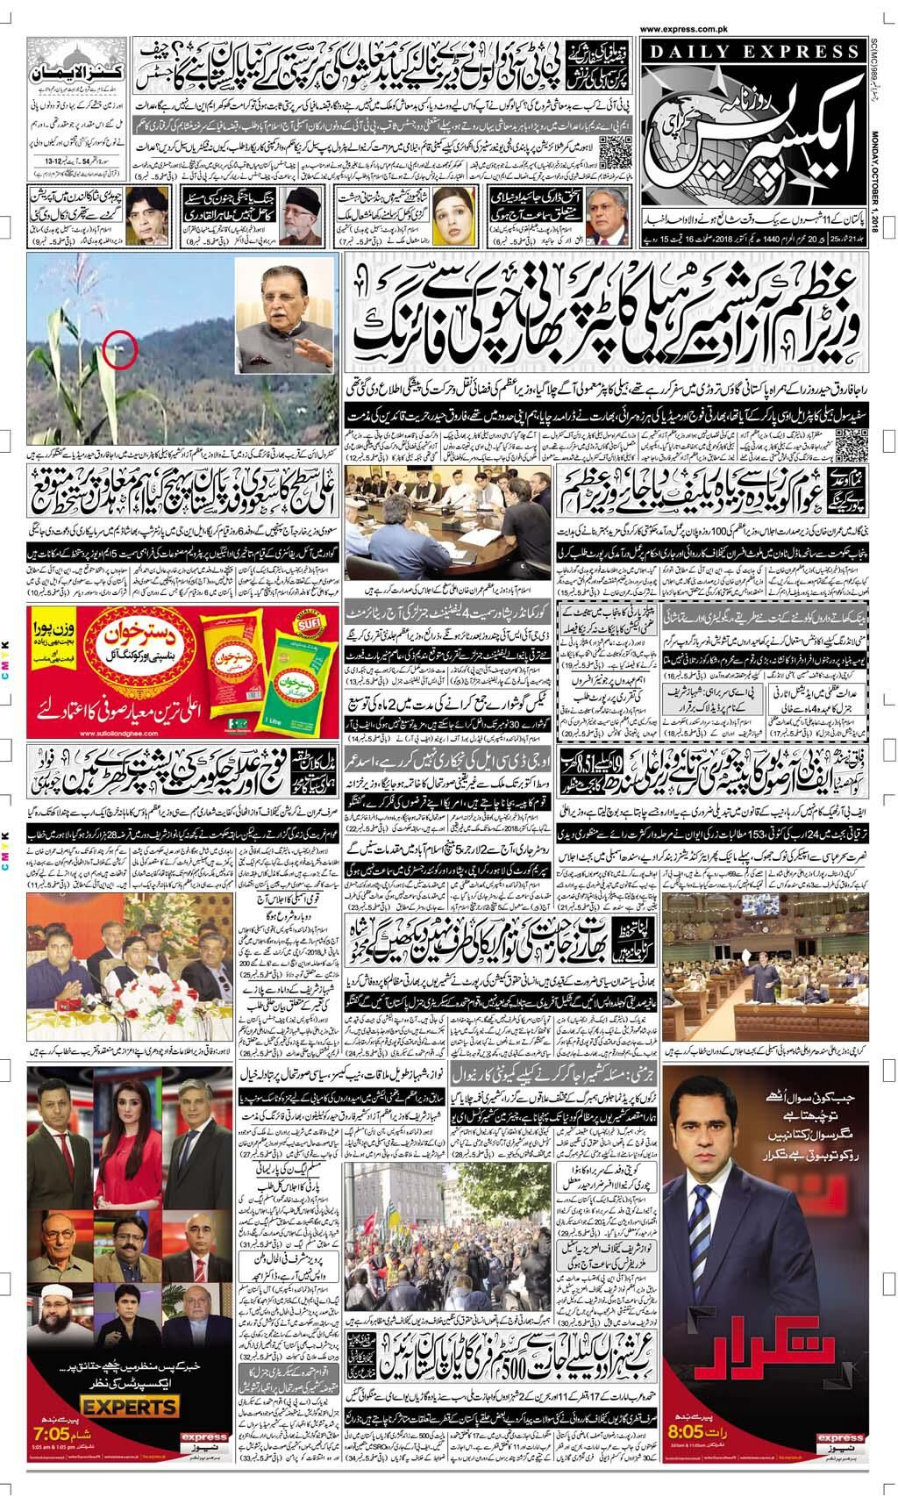
Make-up: To position editorial, pictorial and advertising elements on a page to prepare it for the camera and printing.

Slide 5
Newsprint: The uncoated, machine-finished paper on which newspapers are printed.
Plate: An aluminum sheet that the negative is transferred to so that it can be run on the press.
Source: The supplier of information, such as a person, book, survey, etc.
Stringer: A part-time reporter or correspondent.

Slide 6
Managing Editor : The editor who directs the daily gathering, writing and editing of news and the placement of news in the paper; working for him or her are the city editor, the copy editor, etc

Slide 7
Syndicate: Association which buys and sells stories, features, columns, editorials, and other materials for newspaper use
Scoop: A story obtained before other newspapers or other media receive the information

Slide 8
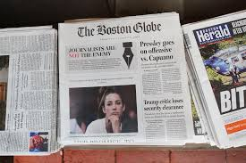
Wire Services: Newsgathering agencies such as AP that gather and distribute news to subscribing newspapers
Tabloid: Taking the standard size of the newspaper and folding into half, usually stitched or stapled and trimmed.

