Slide 2
Aviation, High Altitude, and Space Physiology
Dr. Muntaha yasir

Slide 3
So its all about what happened to body when it ascends and what are the effects of low oxygen pressure on the body ..??

Slide 4
Barometric Pressure
Atmospheric pressure, also known as barometric pressure (after the barometer), is the pressure within the atmosphere of Earth.
at sea level the barometric pressure is 760 mm Hg
at 10,000 feet, only 523 mm Hg; and
at 50,000 feet, 87 mm Hg.

Slide 5
in high-altitude as the barometric pressure decreases, the atmospheric (Po2) decreases proportionately, remaining at all times slightly less than 21 percent of the total
barometric pressure; at sea level Po2 is about 159 mm Hg,
but at 50,000 feet Po2 is only 18 mm Hg

Slide 6
ALVEOLAR PO2
NORMAL PCO2 AT SEA LEVEL IN ALVEOLI IS 40mmhg
NORMAL WATER VAPOR PRESSURE REGARDLESS OF ALTITUDE IS 40mmhg
Both of these in alveoli decreases po2 in alveoli at very high altitude..
In aclimatized person .RR INC. Pco2 decreases UPTO 7 mmhg at very high altitude

Slide 7
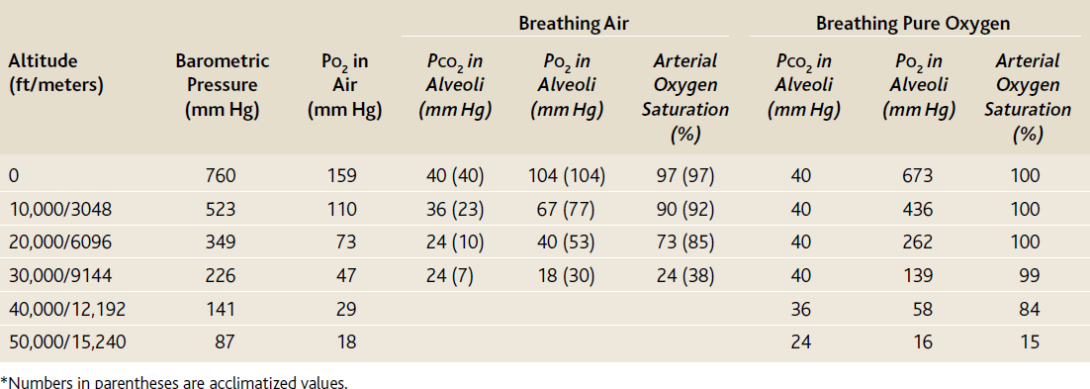
Alveolar Po2 at Different Altitudes:

Slide 8
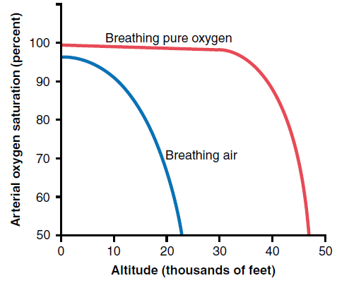
Effect of Breathing Pure Oxygen on Alveolar Po2 at Different Altitudes:

Slide 9
When a person breathes pure oxygen most of the space in the alveoli formerly occupied by nitrogen becomes occupied by oxygen.
So person can go higher without developing symptoms..
In aclimatized person alveolar po2 inc due to inc RR.

Slide 10
ACUTE EFFECTS OF HYPOXIA
At an altitude of about 12,000 feet:
drowsiness, lassitude,mental and muscle fatigue, sometimes headache, occasionally nausea, and sometimes euphoria.
These effects progress to a stage of twitchings or seizures above 18,000 feet
end, above 23,000 feet in the unacclimatized person,in coma, followed shortly thereafter by death.
One of the most important effects of hypoxia is decreased mental proficiency, which decreases judgment, memory, and performance of discrete motor movements.

