Slide 1
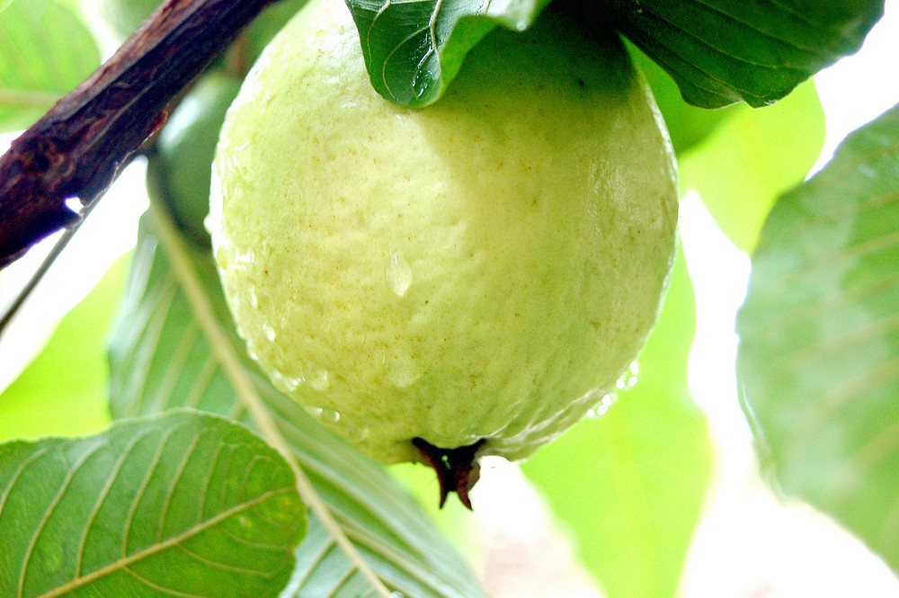
GUAVA

Slide 2
Introduction
Native to tropical America, Peru, Mexico and Cuba
High dietary value, good taste and rich source of vitamin C
Punjab: Shiekhupura, Gujranwala and Lahore district
Sindh: Pear shaped small seed core- Larkana, Dadu, Shikarpur and Hyderabad district
KPK: Mardan and Hazara district

Slide 3
Area (000 ha)
Production (000 Tonnes)
Total : 512.3

Slide 4
B. name : Psidium guajava
Family name: Myrtaceae
P. Cattleianums (strawberry guava)
P. Araca
P. Guineense

Slide 5
Tree
Naturally busy and spreading
Bark of the trunk tends to be bright, smooth and scaly
Leaves
Light green
7-15 cm long
Oblong and pubescent below
Flowers
Flower buds are mixed, complete
Born singly or in group of 2-3 in the axils of leaves
Fruit: berry with a large seedy core
Round or Pyriform
Red, yellowish and white fleshed
Skin may be smooth
Dominant musky flavor with mild acidity

Slide 6
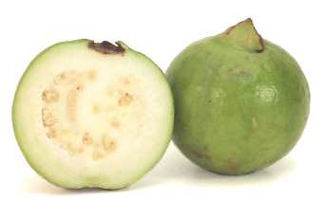
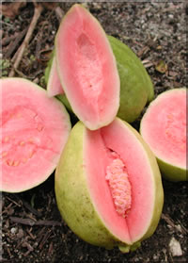
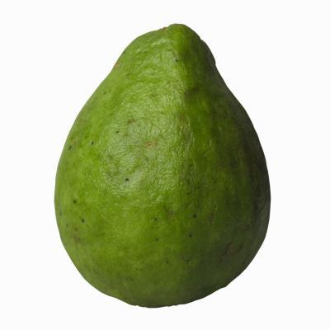

Slide 7
Soil and Climate
Grown in tropical and subtropical regions
Can be grown on wide range of soils – heavy clay to light sandy soil
pH range: 4.5 – 8.5
Tolerant to wet and saline conditions
Proper care and good soil will make guava trees highly productive
Cold sensitive and can't resist long periods of frost
Mean summer temperature requirement for commercial guava production – 20 ºC (Minimum requirement)
Temperature below this range may lead to complete crop loss
Optimum temperature: 23 ºC – 28ºC
Guava doesn’t tolerate high temperatures of desert regions
Rains and high humidity during ripening – skin damage

Slide 8
Propagation and Planting
Generally propagated through seeds
Selected fruits soaked in water for several days until the seeds separate and settle down
These seeds germinate better because testa is somewhat soft
Seed planted in beds
Some good varieties propagated vegetatively through budding and grafting and cuttings
Seedlings raised as rootstock and grafted/budded in March and August
Soft-wood stem cuttings
Plants grown in nursery will later shifted to orchards – square system
Also raised as Fillers in mango orchard – start bearing in 2 years

Slide 9
Cultural Practices
Careful irrigation
Young trees – irrigation frequency must be high
Heavy irrigation during fruiting – induce good fruit development
Withholding irrigation during spring – reduces bloom
Prolong drought conditions until summer - inhibit fruiting
Pruning frequently – only to remove suckers, dried and diseased woods
Age of Plant | FYM | Urea | DAP | SoP
One year old | 20 kg | 125 g
2 year | kg | 250 g | 250 g
3 year | 30 kg | 500 g | 500 g | 500 g
4 year | kg | 750 g | 750 g | 750 g
5 year and > 5 year | 50 kg | 1 kg | 1 kg | 1 kg

Slide 10
Problems
Fruit Fly
Very destructive to guava – summer crop particularly
Female punctures the fruit to lay eggs – larvae hatch after few days and start eating the fruit flesh
Fruit drops and quickly rots on the ground
Control: buried the fallen fruit
Diptrex – 250 g per 100 L water – spray
Traps 4-6 in one acre and used methyl euginol
Dieback
Occurs where spring and early irrigation stopped to discourage the summer crop
Lack of available moisture and foliage reduces transpiration

