Slide 1
Consequences of Einstein’s postulates

Slide 2
EX:20.2

Slide 3
Sol: 20.2

Slide 4
EX 20.3

Slide 5
Sol: 20.3

Slide 6
EX:20.4

Slide 7
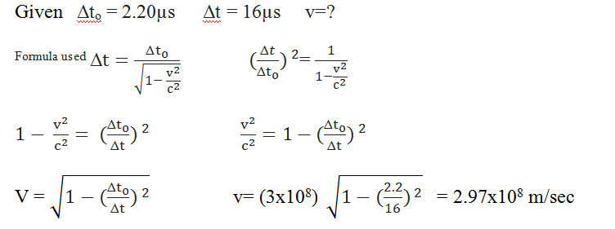
Sol: 20.4

Slide 8
Ex: 20.5

Slide 9
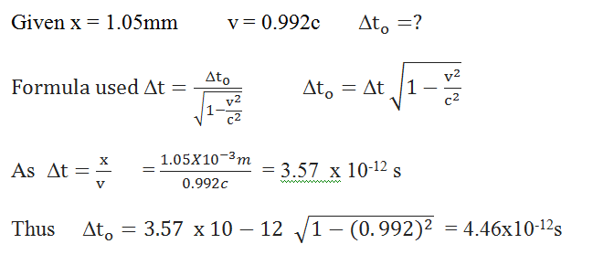
Sol: 20.5

Slide 10
Ex: 20.6

Slide 11
Sol: 20.6

Slide 12
Ex: 20.7

Slide 13
Sol: 20.7

Slide 14
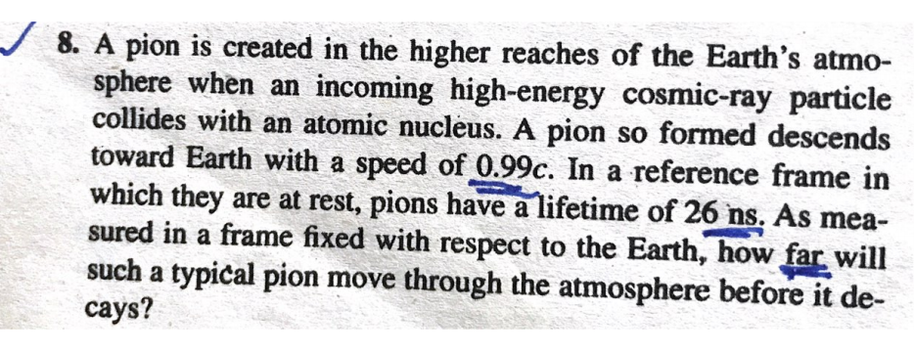
Ex: 20.8

Slide 15
Sol: 20.8
15

Slide 16
The Lorentz Transformation

