Slide 1
Multimedia Systems And Design
Overview of Text as Multimedia Element

Slide 2
Objectives
At the end of this chapter, students should be able to:
Understand the history and development of text
Understand the importance and significance of text in multimedia
Identify the terms and concept related to text
Describe the application of text in multimedia systems

Slide 3
History Of Text
Text and symbols have been used for communication for about 6000 years
It was mainly used for vital information at the time (politics, taxes etc.)
Proved to be long-lasting and was only comprehensible by those who understood it – safe for secret messages.
Has become the means by which we learn, share, and preserve knowledge

Slide 4
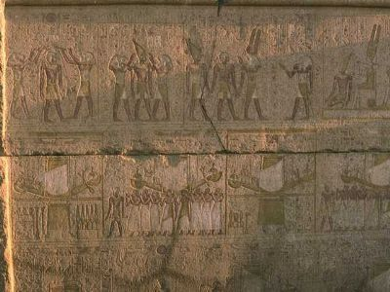
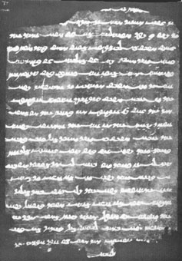
History Of Text
Text or forms of written documents often change over time. Sometimes, this leads to the extinction of very old languages and there is no one left who understands them.

Slide 5
Text In Computers
ASCII - American Standard Code for Information Interchange,
Codes for representing English characters as numbers, with each letter assigned a number from 0 through 127.
An example would be the ASCII code for uppercase M which is, 77.
Most computers use ASCII codes to represent text, which makes it possible (standardization) to transfer data from one computer to another.

Slide 6
ASCII
The standard ASCII character set uses just 7 bits for each character.
There are several larger character sets that use 8 bits, which gives them 128 additional characters.
The extra characters are used to represent non-English characters, graphic symbols, and mathematical symbols.
Several companies and organizations have proposed extensions for these 128 characters.

Slide 7
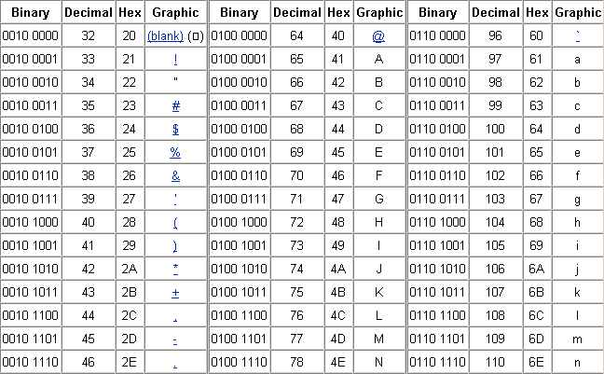
ASCII (Examples)

Slide 8
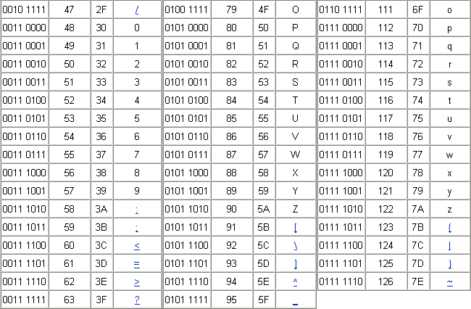
ASCII (Examples)

Slide 9
ASCII
Since the standard byte (unit of data storage) on personal computers is 8 bits, and ASCII uses only 7 bits, the obvious thing to do was to put the eighth bit into use, doubling the number of characters that could be represented.
This could be a problem with older software that used the eighth bit as a checksum (a digit representing the sum of the correct digits in a piece of data, against which comparisons can be made to detect errors) or mode flag, but it eventually became commonplace for computers to use all eight bits for character storage.
Unfortunately, it took a while for a standard to emerge regarding just what characters were in those other 128 positions (representing numbers from 128 to 255).

Slide 10
EBCDIC
Abbreviation of Extended Binary-Coded Decimal Interchange Code.
It is an IBM code for representing characters as numbers. This is widely used on large IBM computers.
most other computers, including PC and Macintosh, however, use ASCII codes.

Slide 11
Power of Meaning
•
In multimedia words appear in titles , menus , navigation aids and narrative or content
Multimedia authors weave words , symbols , sounds and images – blend text in to the mix to create integrated tools and interfaces for acquiring , displaying and disseminating messages and data
British council survey on English
•
•
One billion people speak English as their first, second or foreign language
More than two thirds of world’s scientists read English
Three quarters of world’s mail is written in English
80% of world’s information that is stored on computers is written in English

Slide 12
FONTS
Design for a set of characters.
A font is the combination of typeface and other qualities, such as size, pitch, and spacing.
For example, Verdana is a typeface that defines the shape of each character.
Within Verdana, however, there are many fonts to choose from -- different sizes, italic, bold, and so on.
The term font is often used incorrectly as a synonym for typeface.

Slide 13
Typeface
Popular typefaces include Verdana, Helvetica, and Times New Roman.
The typeface represents one aspect of a font. The font also includes such characteristics as size, weight, italics, and so on.
There are two general categories of typefaces: serif and sans serif.
Sans serif typefaces are composed of simple lines, whereas serif typefaces use small decorative marks to embellish characters and make them easier to read.

Slide 14
Typeface
Verdana is a sans serif type and Times Roman is a serif type

Slide 15
Fonts and Type Faces
•
Typeface in printing refers to the surface of a block of Type that makes the impression ie the impression made by this surface
Typeface is the primary design while the Font is a particular implementation and variation of typeface such as bold or italics
Major difference between typefaces is whether there are tiny horizontal lines at the top and bottom (Serif)
A typeface usually comprises of an alphabet of letters , numerals , punctuation marks , and symbols
•
•
•

Slide 16
Different types of Typefaces contd
•
Script typefaces simulate handwriting or calligraphy - They do not lend themselves to quantities of body text, as people find them harder to read than many serif and sans-serif typefaces; they are typically used for logos or invitations
•
Blackletter fonts, the earliest typefaces used with the invention of the printing press, resemble the black letter calligraphy of that time-Many people refer to them as gothic script

Slide 17
Different types of Typefaces contd
Display typefaces are used exclusively for decorative purposes, and are not suitable for body text-They have the most distinctive designs of all fonts, and may even incorporate pictures of objects, animals, etc. into the character designs-They usually have very specific characteristics (e.g. evoking the Wild West, Christmas, horror films, etc.) and hence very limited uses

Slide 18
Different types of Typefaces
•
Symbol, or Dingbat, typefaces consist of symbols (such as decorative bullets, clock faces, railroad timetable symbols, CD-index, or TV-channel enclosed numbers) rather than normal text characters.
•
Faux or simulated, fonts are typefaces in which the font is made to look like characters of another writing system, typically Latin characters made using the style of another script-Arabic, Chinese ,Hebrew,Japanese and Sanskrit are all readily available in faux fonts

Slide 19
Other Characteristics
The height of characters in a font is measured in points. One point being approximately 1/72 inch.
The width is measured by pitch, which refers to how many characters can fit in an inch. Common pitch values are 10 and 12.
For example, a document printed at 10-pitch, will have more spaces between its characters than a document printer at 11-pitch. Also, a document printed at 10-pitch will yield more pages than the same document printed at 11-pitch.

Slide 20
Other Characteristics
A font is said to be fixed pitch (monospaced) if every character has the same width.
If the widths vary depending on the shape of the character, it is called a proportional font/pitch and has no pitch value.
When selecting a point size and pitch, we must consider the size of the font and the pitch.
Selecting a larger point size for text that will be printed at a lower pitch (e.g. 10-pitch) might cause the words to be squeezed.
On the other hand, selecting a smaller point size (e.g. 10 points) for a document that will be printed at a larger pitch (e.g. 8-pitch) will spread out the words too far.

Slide 21
Other Characteristics

Slide 22
Text - Design Issues
When using text in multimedia, we must strike a balance between what is necessary and aesthetics (beautification).
Web pages that are meant to provide a lot of information can be packed with text because the user is interested to read every detail.
However, if you are making a presentation to an astute audience (like I am), use few words and be concise.

Slide 23
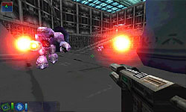
Text - Design Issues
With several elements making up multimedia, there is no need to overuse any one of them, especially text.
If we can convey a story with a picture, use it.
If we can convey hundreds of pictures, text and music with just one video, do it.
Different applications have different needs when it comes to text.
For example, a first-person shooter game might use little text when compared to an electronic encyclopaedia, which uses huge amounts.

Slide 24
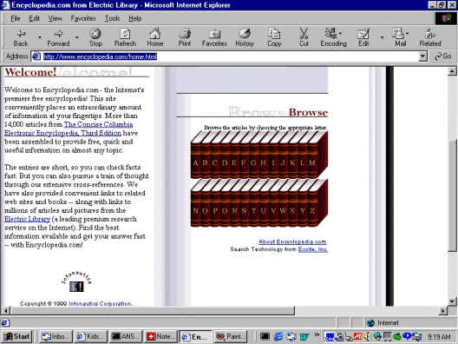
An Electronic Encyclopedia Uses A Lot Of Text

Slide 25
Text - Design Issues
As you work with multimedia systems and authoring programs, the need for text labels and messages becomes less.
Buttons are often metaphorical (representing something in the real world).
For example, a door on the first page of a website means ‘Enter’.
Colors are also used to denote things that would otherwise require cluttering your interface with text.
For example, a big red button would be a kill or danger switch.

Slide 26
Text Encryption
Encryption is the translation of data into arcane language or secret code (cipher text)
This is done mainly to prevent unauthorized people from reading something not meant for them
It has been used for thousands of years and has recently become highly sophisticated with the advent of computers and their enormous processing capability
One example is the ‘Shift By Three’ technique which was supposedly used by Julius Caesar some 2000 years ago

Slide 27
Simple Text Encryption
(“Shift By 3 – Julius Caesar”)
Hello
+3 char (key=3)
K h o o r
Encrypted Code

Slide 28
Modern-Day Encryption
Usually uses symmetric and asymmetric cryptosystems.
Symmetric cryptosystems use the same key (the secret key) to encrypt and decrypt a message.
Asymmetric cryptosystems use one key (the public key) to encrypt a message and a different key (the private key) to decrypt it.
The arrival of powerful personal computers has increased the need to implement better and more sophisticated encryption techniques, especially for highly classified information.

Slide 29
Steganography
Hiding information by embedding messages within other, seemingly harmless messages.
Steganography (covered writing) works by replacing bits of useless or unused data in regular computer files (such as graphics, sound, text, HTML, etc. ) with bits of different, invisible information. This hidden information can be plain text, cipher text, or even images.
Unlike encryption, steganography cannot be detected.
Therefore, it is used when encryption is not permitted or desired. Or, more commonly, steganography is used to supplement encryption.
An encrypted file may still hide information using steganography, so even if the encrypted file is deciphered, the hidden message is not ordinarily seen.

Slide 30
Steganography
It dates back to ancient Greece, where common practices consisted of etching messages in wooden tablets and covering them with wax, or tattooing a shaved messenger's head, letting his hair grow back, then shaving it again when he arrived at his contact point.
In this digital age, much more sophisticated (and practical) techniques are used in steganography.
The obvious reason for using steganography as opposed to cryptography is that anything encrypted would immediately draw attention that information is being deliberately concealed, whereas a message sent using steganography, by all appearances, is just another gif image or MP3 file.
It is a relatively simple but effective practice and can be done with software available commercially or downloaded from the Internet.

Slide 31
Printing -Some definitions
•
Type Design is the art and craft of designing typefaces and people who design them are Type Designers.
Typographers are responsible for the layout of the printed word on the page.
•
•
Type Setter sets and arranges the type in the position indicated.
Type Designers are also known as Font Developers.
•

Slide 32
Bit Mapped and Vector Graphics System Fonts
•
Computers and devices use two methods to represent fonts.
•
One is a bit-mapped font where every character is represented by an arrangement of dots.
•
To print a bit-mapped character, a printer simply locates the character's bit-mapped representation stored in memory and prints the corresponding dots.
•
Each different font, even when the typeface is the same, requires a different set of bit-maps.

Slide 33
Vector Graphics Fonts
•
The second method uses a vector graphics system to define fonts.
In vector graphics systems, the shape or outline of each character is defined geometrically.
The typeface can be displayed in any size, so a single font description really represents innumerable fonts.
For this reason, vector fonts are called scalable fonts as they can be scaled to any size.
A scalable font is really one font in which the outlines of each character are geometrically defined.
The most popular languages for defining scaleable fonts are
PostScript and TrueType.
•
•
•
•
•

Slide 34
True Type
•
An outline font technology developed jointly by Microsoft
and Apple
•
Because TrueType support is built into all Windows and Macintosh operating systems anyone using these operating systems can create documents using TrueType fonts
Since being introduced in 1991, TrueType has quickly become the dominant font technology for everyday use
An outline font is scalable because, given a geometrical description of a typeface, a printer or other display device can generate the characters at any size
•
•

Slide 35
True Type
•
What differentiates a scalable font from an outline font (aside from offering innumerable sizes of each font) is that outline fonts have the added advantage that they make the most of an output device's resolution - The more resolution a printer or monitor offers, the better an outline font will look.
•
Besides the scalability of vector fonts, their other advantage over bit-mapped fonts is that they make the most of high- resolution devices.
•
Bit-mapped fonts look almost the same whether printed on a 300-dpi printer or a 1,200-dpi printer - In contrast, vector fonts look better at higher resolutions.

Slide 36
Screen Fonts
•
Despite the advantages of vector fonts, bit-mapped fonts are still widely used.
One reason for this is that small vector fonts do not look very good on low-resolution devices, such as display monitors (which are low-resolution when compared with laser printers.
•
•
Many computer systems, therefore, use bit-mapped fonts for screen displays.
These are sometimes called screen fonts.
A screen font basically resembles the font for a document, so that what you see on the screen will look very similar to the end-result (printed document).
•
•

Slide 37
Screen Fonts
•
Though vector fonts seem to offer more benefits, some professionals still prefer to use bit-mapped fonts on high-resolution printers because characters can be individually tailored to the printing device.
•
An additional drawback of vector fonts is that every character must be generated as it is needed. This is a computation-intensive process that requires a powerful micro-processor to make it acceptably fast.

Slide 38
Legibility and Readability
•
Text should be smooth, flowing, and pleasant to read.
The hallmarks of good text type are legibility and readability.
•
•
Legibility refers to clarity; it's how readily one letter can be distinguished from all others.
•
Readability refers to how well letters interact to compose words, sentences and paragraphs. When evaluating the choices, the operative word is medium.

Slide 39
The measurement of Type

Slide 40
Some definitions
•
ascender -The part of lowercase letters (such as k, b, and
d) that ascends above the x-height of the other lowercase letters in a face.
•
baseline -The imaginary line on which the majority of the characters in a typeface rest.
•
cap height -The height from the baseline to the top of the uppercase letters in a font. This may or may not be the same as the height of ascenders. Cap height is used in some systems to measure the type size.

Slide 41
Some definitions
•
descender -The part of lowercase letters (such as y, p, and q) that descends below the baseline of the other lowercase letters in a font face. In some typefaces, the uppercase J and Q also descend below the baseline.
•
face -One of the styles of a family of faces. For example, the italic style of the Garamond family is a face.
•
family -Also known as a font family. A collection of faces that were designed and intended to be used together. For example, the Garamond family consists of roman and italic styles, as well as regular, semi-bold, and bold weights. Each of the style and weight combinations is called a face

Slide 42
Some definitions
•
font - One weight, width, and style of a typeface. Before scalable type, there was little distinction between the terms font, face, and family. Font and face still tend to be used interchangeably, although the term face is usually more correct.
•
font family - Also known as family. The collection of faces that were designed together and intended to be used together. For example, the Garamond font family consists of roman and italic styles, as well as regular, semi-bold, and bold weights. Each of the style and weight combinations is called a face

Slide 43
Some definitions
•
kerning - The adjustment of horizontal space between individual characters in a line of text. Adjustments in kerning are especially important in large display and headline text lines. Without kerning adjustments, many letter combinations can look awkward. The objective of kerning is to create visually equal spaces between all letters so that the eye can move smoothly along the text.
•
Kerning may be applied automatically by the desktop publishing program based on tables of values. Some programs also allow manual kerning to make fine adjustments.

Slide 44
Some definitions
•
leading (pronounced: ledding) - The amount of space added between lines of text to make the document legible. The term originally referred to the thin lead spacers that printers used to physically increase space between lines of metal type.
Most applications automatically apply standard leading based on the point size of the font. Closer leading fits more text on the page, but decreases legibility.
Looser leading spreads text out to fill a page and makes the document easier to read.
Leading can also be negative, in which case the lines of text are so close that they overlap or touch.

Slide 45
Some definitions
•
point - A unit of measure in typography. There are approximately 72 points to the inch. A pica is 12 points.
•
point size - The common method of measuring type. The distance from the top of the highest ascender to the bottom of the lowest descender in points. In Europe, type is often measured by the cap-height in millimeters.

Slide 46
Some definitions
•
tracking - The average space between characters in a block of text. Sometimes also referred to as letter spacing.
•
weight - The relative darkness of the characters in the various typefaces within a type family. Weight is indicated by relative terms such as thin, light, bold, extra-bold, and black.
width - One of the possible variations of a typeface within a type family, such as condensed or extended.
•
•
x-height - Traditionally, x-height is the height of the lowercase letter x. It is also the height of the body of lowercase letters in a font, excluding the ascenders and descenders. Some lower- case letters that do not have ascenders or descenders still extend a little bit above or below the x-height as part of their design.
The x-height can vary greatly from typeface to typeface at the same point size.

Slide 47
Character Widths

Slide 48
Height to width Ratio

Slide 49
Height to width Ratio
Medium height-to-width ratio
We identify letters by their physical characte- ristics – stems, bars, loops, curves, and so on; the clearer they are the more legible the letter
As letters are compressed (or expanded), these features get distorted–diagonal strokes, for example, become quite vertical–and so are harder to identify

Slide 50
X-Height

Slide 51
Stroke Weight

Slide 52
Stroke Weight
•
Look for small variations in stroke weight.
•
The best text faces have stroke weights that vary somewhat, which make converging lines that help the eye flow smoothly.
Avoid extremes. Modern styles vary too much; at high resolution they are beautiful.
•
•
Super thin strokes disappear in a dazzle.
Sleek geometric styles vary little or not at all, so are too uniform.
•

Slide 53
Mirrors

Slide 54
Counters

Slide 55
Counters
•
Avoid overlarge counters.
•
Counters are the enclosed spaces inside letters.
•
Avoid typestyles whose counters are very large in relation to the stroke weight.
•
In the case of Avant Garde, note how much greater the space inside the letters is than the space outside. This will slow down the read.

Slide 56
Type Quirks

Slide 57
Type Quirks
•
Avoid quirkiness.
•
Typographic sprites are fun to look at and great for heads, but in text they wear out their welcome fast.
•
Why? The extra swashiness gives the eye too much to follow and is very tiring.

Slide 58
Using Text in Multimedia
•
Text in Multimedia is used for
Titles and headlines ( what it is all about)
Menus (where to go)
Navigation (how to get there)
Content ( what you see when you get there)

Slide 59
Designing with Text
•
If message is a part of interactive project or website where user is seeking information , great deal of text can be packed on the screen.
Too little text on the screen requires annoying page turns and unnecessary mouse clicks and waits.
Too much text can make the screen seem overcrowded and unpleasant.
•
If the message is presentation slides for public speaking
– Use bulleted points on large fonts and few words with lots of white space – audience should focus on the speaker rather than reading the slides.

Slide 60
Choosing Text Fonts
•
•
For small type use most legible font available.
Use as few different faces as possible in the same work – vary size and weight of the typeface using italic or bold.
•
Explore effects of different colors and placing text on different backgrounds - reverse type for a stark white-on- black message.
In large size headlines adjust kerning.
Use anti-aliased text to get a gentle and blended look.
•
•

Slide 61
Menus for Navigation
•
An interactive MM project or web site typically consists of a body of information (content) through which a user navigates by pressing a key/clicking a mouse/pressing touch screen.
•
Simplest menus consist of text lists of topics – user chooses a topic , click it and go there.
•
Text is helpful to users to provide perpetual cues about their location within the body of content .

Slide 62
Buttons for Interaction
•
Buttons are objects such as blocks of text , a triangle or a photograph that make things happen when they are clicked.
They manifest properties such as highlighting or other visual or sound effects to indicate that the target was hit.
Automatic button making tools are supplied with MM and HTML page authoring systems.
Any font can be used for buttons - Pick a font for that is legible.
•
•
•

Slide 63
Fields for Reading
•
Experiments have shown that reading text on a computer screen is slower and more difficult than a hardcopy.
•
Only a few paragraphs of text are recommended to be displayed per page.
Portrait is taller-than-wide orientation used for printed documents like A4 size (8.5 X 11 inch)
Landscape is wider- than-tall orientation which is normal to monitors.
•

Slide 64
Fields for Reading
•
There are four solutions for a block of text that is taller than what will fit
Put the text into a scrolling field (used by browsers).
Put the text into a single field in a project window and let the user move the whole window up or down ( used by Adobe Acrobat Reader).
Break text into fields that fit monitor-sized pages and design control buttons to flip through pages.
Use a special monitor that is taller than it is wide – used for print based type-setting and layout.

Slide 65
HTML Documents
Standard document format used pages on the web is called Hyper Text Markup language.
In HTML document we can specify typefaces, sizes, colors and other properties by “marking up” the text in the document with tags.
When MM features are added to HTML it is called Dynamic HTML (DHTML).
Pleasing documents can be laid out in HTML using block quote indents , tables, frames and horizontal rules.

Slide 66
Symbols and Icons
•
Symbols
are stand-alone graphic constructs.
convey meaningful messages (ex: symbols of trash can and hour glass).
are treated as text or visual words because they carry meaning.
Symbols such as trash can and hour glass are called icons which are symbolic representation of objects common to GUI of many operating systems .
Pictures , icons, moving images are easily recalled and remembered by viewers .

Slide 67
Animating Text
Used to attract viewer’s attention when displaying text. Animate bulleted text and have it fly on the screen.
Grow a headline a character at a time.
Fly in some keywords , dissolve others , rotate or spin others etc – Don’t overdo special effects , they will become boring.
Special Tools for creating 3D text.
Xaos Tools’ TypeCaster allows one to create 3D text using TrueType and Type1 Adobe fonts.
Use Illustrator or FreeHandEPS to create still images in 3D and animate results to create Quick Time movies.

Slide 68
Hypermedia and Hypertext
•
Multimedia becomes interactive multimedia when the user is given some control over what information is viewed and when it is viewed.
•
Interactive multimedia becomes hypermedia when its designer provides a structure of linked elements through which a user can navigate and interact.

Slide 69
Hypertext
•
Operation of the Web relies mainly on hypertext as its means of interacting with users.
•
Basically the same as regular text - it can be stored, read, searched, or edited - with an important exception: hypertext contains connections within the text to other documents.

Slide 70
Example of Hypertext
•
Suppose you were able to somehow select (with a mouse or with your finger) the word "hypertext" in the sentence before
In a hypertext system, you would then have one or more documents related to hypertext appear before you - a history of hypertext, for example, or the Webster's definition of hypertext
These new texts would themselves have links and connections to other documents - continually selecting text would take you on a free-associative tour of information
In this way, hypertext links, called hyperlinks, can create a complex virtual web of connection.
•
•
•

Slide 71
Hypermedia
•
Hypermedia is hypertext with a difference - hypermedia documents contain links not only to other pieces of text, but also to other forms of media - sounds, images, and movies.
•
Images themselves can be selected to link to sounds or documents.
•
Hypermedia simply combines hypertext and multimedia.

Slide 72
Applications of hypertext systems
•
•
•
•
•
•
Electronic publishing and reference works. Technical documentation.
Educational courseware . Electronic catalogs.
Interactive fiction.
Text and image databases.

