Slide 1
Stripe (Yellow) Rust of Wheat:
Dr. Salman Ahmad
March 27, 2020

Slide 2
Description and Importance:
Generally occur throughout wheat production areas at low temperature
Losses due to this are 50-55% with some field destroyed completely

Slide 3
Etiology:
Causal organism: Puccinia striformis f.sp. tritici
Order: Uredinales
Family: Puccinaceae

Slide 4
Symptoms:
Small yellowish uredia appear in narrow linear rows on the leaf.
Uredia can also be seen on spikes.
Yellow spore mass is exposed for wind dispersal.
Plants show poorly developed root system

Slide 5
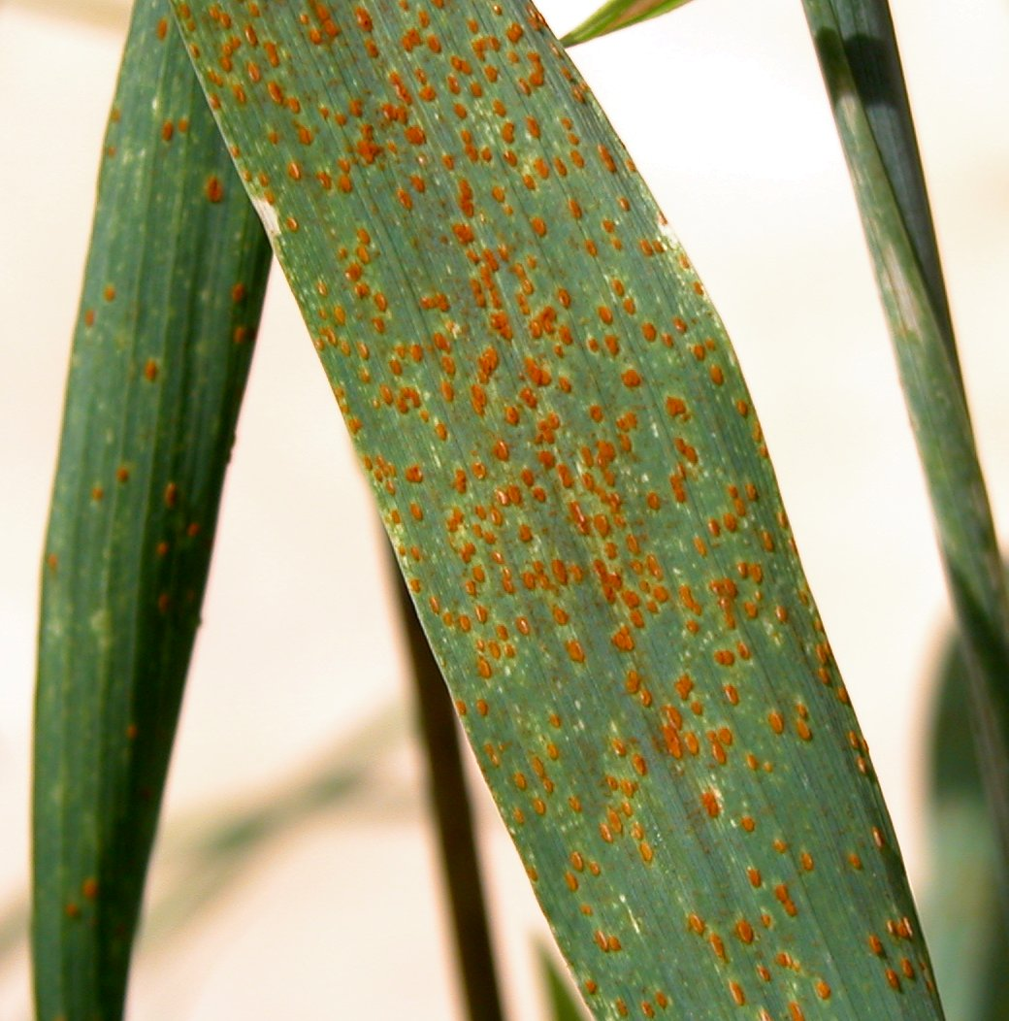
Yellow rust Wheat Brown rust of wheat

Slide 6
Disease cycle:
Uredospores are single source of inoculum
Inoculum comes from volunteer plants
Fungus survive between crop seasons by dormant mycelium & uredia
Windblown uredospores are secondary source

Slide 7
Epidemiology:
Free water on leaves & temp 0-25°C required for spore germination
Appear in Dec, Jan, opt temp 12.8-18.3°C

Slide 8
Management:
Resistant varieties (Anaj 2017, Akbar 2019)
Cultivation of early sowing and early maturing varieties.
Avoiding thick sowing and heavy irrigation.
Avoiding heavy doses of nitrogenous fertilizers.
Judicious use of potassic fertilizer help in minimizing the susceptibility of plants
Use fungicides i.e. Nativo, Bayleton, Tilt

