Slide 1
Lecture 5 Community Health & Nutrition Programs
By dr. umer farooq

Slide 2
Program
“A program is an ongoing activity, which is carried out for an indefinite period of time till the achievement of objectives according to the specifications”
Example : Expanded Program of Immunization (EPI)
A) Vertical Program : A single program of health services for the community. The staff is concerned only with one activity e.g Immunization
Examples : EPI, Malaria Control Program, TB control Program

Slide 3
B) Horizontal Program : All health service delivery program that covers the two dimensions of health i.e. personal health and community health
Examples : Social Action Plan (SAP I & SAP II), National Program to Family Planning, Primary Health Care Programs (Benazir Program, Prime minister Program)
When a Vertical program is merged with existing health facility it becomes a Horizontal program

Slide 4
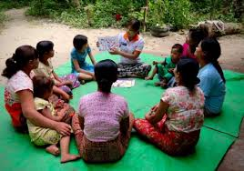
Community Health and Nutrition Programs
Rapid improvements in health and nutrition in developing countries can be ascribed to specific, deliberate, health- and nutrition-related interventions and to changes in the underlying social, economic, and health environments
Community-based programs under many circumstances provide the crucial contact of people with trained workers which is instrumental in improving health
In community-based programs, workers interact with households to protect their health and nutrition and to facilitate access to treatment of sickness
Commonly, people go regularly to a central point in their community—for example, for growth monitoring and promotion—or are visited at home by a health and nutrition worker

Slide 5
Steps to Develop A Health Program
1. Consultation :
Match your interests with a community’s areas of concern. Consult with staff who are knowledgeable about area communities
2. Coordination :
Coordinate with other group members on how best to approach community leaders and other community residents

Slide 6
3. Discussion with Community :
Begin discussions with community leaders and community members about their health concerns. Let them know about the interests and resources your team could contribute to a health program. Meet in the community whenever possible

Slide 7
4. Advisory Board :
Form an advisory board that includes people who have been interviewed about community health needs. Or consult with the Division of Community Health to find an existing group who could serve as the advisory board. Work with this advisory board to find an area of common concern. Do not start with your own idea of what the topic or the approach should be

Slide 8
5. Program Planning :
Use a series of discussions with the advisory board and others to develop a program plan. Invite local health agencies and organizations to become partners in developing this community health program

Slide 9
6. Program Funding :
If the program is intended to continue, make plans for financial sustainability. If it is not intended to continue, be sure everyone involved or contacted by the program knows those plans and when it will end

Slide 10
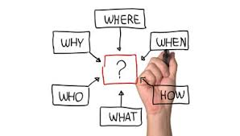
7. Evaluation Planning :
With the Community Advisory Board (CAB), plan evaluations that can be used during the program to monitor progress (formative evaluation) and after the program to measure results (summative evaluation). Share the results of these evaluations with your CAB and other community members

Slide 11
8. Implementation :
Implement the program. Keep the CAB and other contacts in the community aware of the project's successes and challenges. Be honest and open to suggestions to improve or re-direct the program

Slide 12
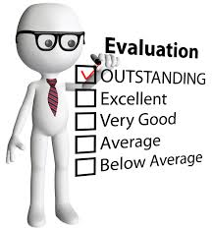
9. Use Process Evaluation :
Use process evaluation data to modify the program to improve it. Share aggregate data and analysis
10. Outcome Evaluation:
Use outcome evaluation data to document the program's impact. Share aggregate data and analysis

Slide 13
11. Appreciation :
Thank all who have contributed to program development and implementation and acknowledge their contributions
12. Publication :
Disseminate program outcomes to all involved and to wider audiences. If you plan to publish, seek authority approval before beginning your project. Ask the CAB members if any would like to co-author with you. Draft articles must be reviewed with the CAB and other partners to maintain trust. Any publication should acknowledge the community partners by name. Any press interested in the program should interview key partners. Accept responsibility when confronted by the press for problems in a project and share credit for success. Get help from a communication expert when dealing with the press

Slide 14
Thank You

