Slide 1
Chapter 5: z-scores

Slide 2
z-Scores and Location
By itself, a raw score or X value provides very little information about how that particular score compares with other values in the distribution.
A score of X = 53, for example, may be a relatively low score, or an average score, or an extremely high score depending on the mean and standard deviation for the distribution from which the score was obtained.
If the raw score is transformed into a z-score, however, the value of the z-score tells exactly where the score is located relative to all the other scores in the distribution.

Slide 3
z-Scores and Location (cont.)
The process of changing an X value into a z-score involves creating a signed number, called a z-score, such that
a. The sign of the z-score (+ or –) identifies whether the X value is located above the mean (positive) or below the mean (negative).
b. The numerical value of the z-score corresponds to the number of standard deviations between X and the mean of the distribution.

Slide 4
z-Scores and Location (cont.)
Thus, a score that is located two standard deviations above the mean will have a z-score of +2.00. And, a z-score of +2.00 always indicates a location above the mean by two standard deviations.

Slide 5
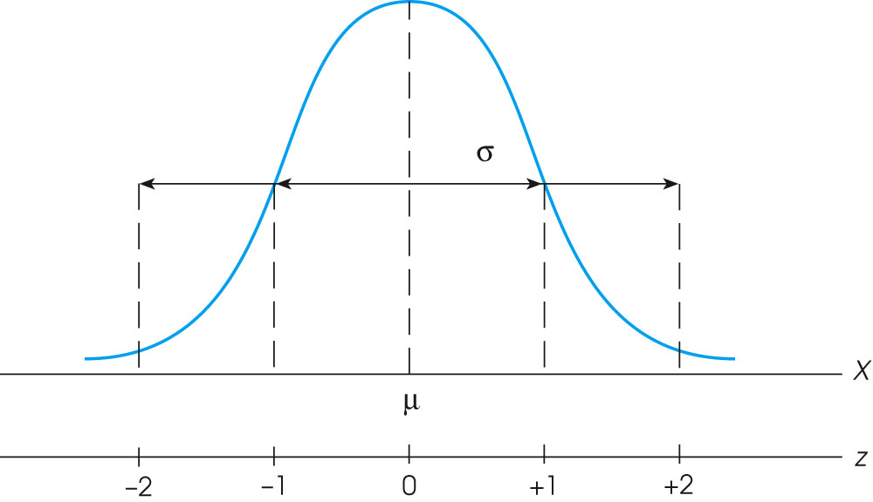
Notes:
Figure 5.3
The relationship between z-score values and locations in a population distribution.
Figure 5.5
An entire population of scores is transformed into z-scores. The transformation does not change the shape of the population, but the mean is transformed into a value of 0 and the standard deviation is transformed to a value of 1.

Slide 6
Transforming back and forth between X and z
The basic z-score definition is usually sufficient to complete most z-score transformations. However, the definition can be written in mathematical notation to create a formula for computing the z-score for any value of X.
X – μ
z = ────
σ

Slide 7
Transforming back and forth between X and z (cont.)
Also, the terms in the formula can be regrouped to create an equation for computing the value of X corresponding to any specific z-score.
X = μ + zσ

Slide 8
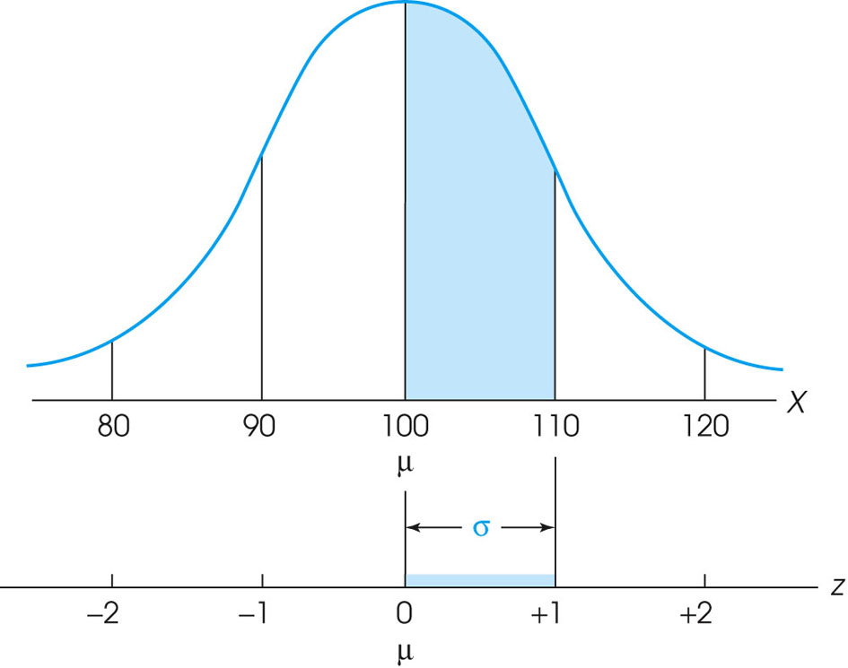
Notes:
Figure 5.6
Following a z-score transformation, the X-axis is relabeled in z-score units. The distance that is equivalent to 1 standard deviation on the X-axis (σ = 10 points in this example) corresponds to 1 point on the z-score scale.

Slide 9
Z-scores and Locations
In addition to knowing the basic definition of a z-score and the formula for a z-score, it is useful to be able to visualize z-scores as locations in a distribution.
Remember, z = 0 is in the center (at the mean), and the extreme tails correspond to z-scores of approximately –2.00 on the left and +2.00 on the right.
Although more extreme z-score values are possible, most of the distribution is contained between z = –2.00 and z = +2.00.

Slide 10
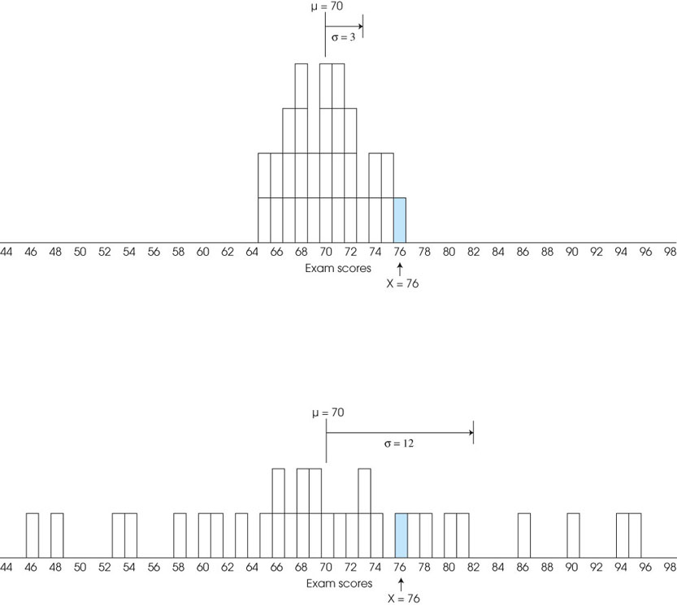
Notes:
Figure 5.2
Two distributions of exam scores. For both distributions, μ = 70, but for one distribution, σ = 3, and for the other, σ = 12. The relative position of X = 76 is very different for the two distributions.

Slide 11
Z-scores and Locations (cont.)
The fact that z-scores identify exact locations within a distribution means that z-scores can be used as descriptive statistics and as inferential statistics.
As descriptive statistics, z-scores describe exactly where each individual is located.
As inferential statistics, z-scores determine whether a specific sample is representative of its population, or is extreme and unrepresentative.

Slide 12
z-Scores as a Standardized Distribution
When an entire distribution of X values is transformed into z-scores, the resulting distribution of z-scores will always have a mean of zero and a standard deviation of one.
The transformation does not change the shape of the original distribution and it does not change the location of any individual score relative to others in the distribution.

Slide 13
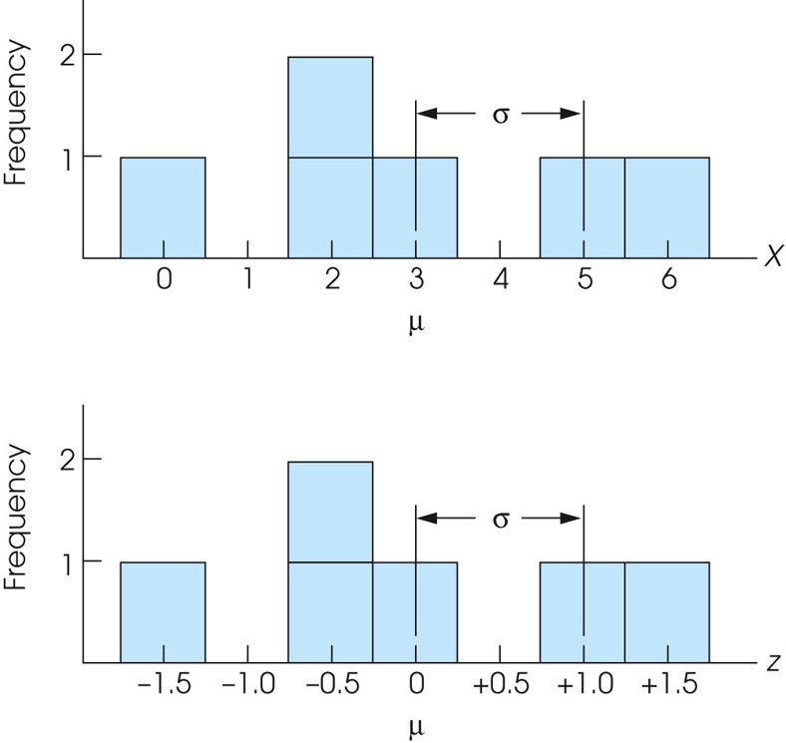
Notes:
Figure 5.7
Transforming a distribution of raw scores (a) into z-scores (b) will not change the shape of the distribution.

Slide 14
z-Scores as a Standardized Distribution (cont.)
The advantage of standardizing distributions is that two (or more) different distributions can be made the same.
For example, one distribution has μ = 100 and σ = 10, and another distribution has μ = 40 and σ = 6.
When these distribution are transformed to z-scores, both will have μ = 0 and σ = 1.

Slide 15
z-Scores as a Standardized Distribution (cont.)
Because z-score distributions all have the same mean and standard deviation, individual scores from different distributions can be directly compared.
A z-score of +1.00 specifies the same location in all z-score distributions.

Slide 16
z-Scores and Samples
It is also possible to calculate z-scores for samples.
The definition of a z-score is the same for either a sample or a population, and the formulas are also the same except that the sample mean and standard deviation are used in place of the population mean and standard deviation.

Slide 17
z-Scores and Samples (cont.)
Thus, for a score from a sample,
X – M
z = ─────
s
Using z-scores to standardize a sample also has the same effect as standardizing a population.
Specifically, the mean of the z-scores will be zero and the standard deviation of the z-scores will be equal to 1.00 provided the standard deviation is computed using the sample formula (dividing n – 1 instead of n).

Slide 18
Other Standardized Distributions Based on z-Scores
Although transforming X values into z-scores creates a standardized distribution, many people find z-scores burdensome because they consist of many decimal values and negative numbers.
Therefore, it is often more convenient to standardize a distribution into numerical values that are simpler than z-scores.

Slide 19
Other Standardized Distributions Based on z-Scores (cont.)
To create a simpler standardized distribution, you first select the mean and standard deviation that you would like for the new distribution.
Then, z-scores are used to identify each individual's position in the original distribution and to compute the individual's position in the new distribution.

Slide 20
Other Standardized Distributions Based on z-Scores (cont.)
Suppose, for example, that you want to standardize a distribution so that the new mean is μ = 50 and the new standard deviation is σ = 10.
An individual with z = –1.00 in the original distribution would be assigned a score of X = 40 (below μ by one standard deviation) in the standardized distribution.
Repeating this process for each individual score allows you to transform an entire distribution into a new, standardized distribution.

