Slide 1
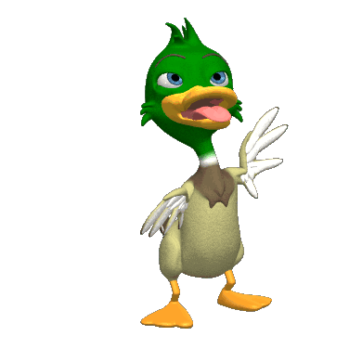
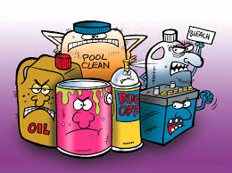
Physical method of
waste disposal

Slide 2
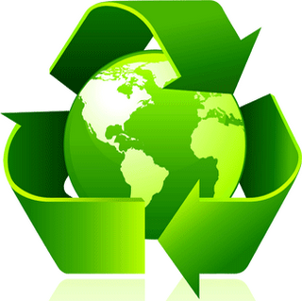
Waste management
or
Waste disposal
It is all the activities and actions required to manage waste from its inception (A first part or stage) to its final disposal.
Waste are generated during the extraction of raw materials, the processing of raw materials into intermediate and final products, the consumption of final products, or other human activities.
This includes collection, transport, treatment and disposal of waste together with monitoring and regulation

Slide 3
Functional Elements of solid waste management system
There are six functional elements in the activities associated with the management of solid wastes from the point of generation to final disposal site. These are:
1. Waste generation
2. On-site handling (sorting, storage and processing)
3. Collection
4. Transfer and transport
5. Processing and recovery
6. Disposal

Slide 4
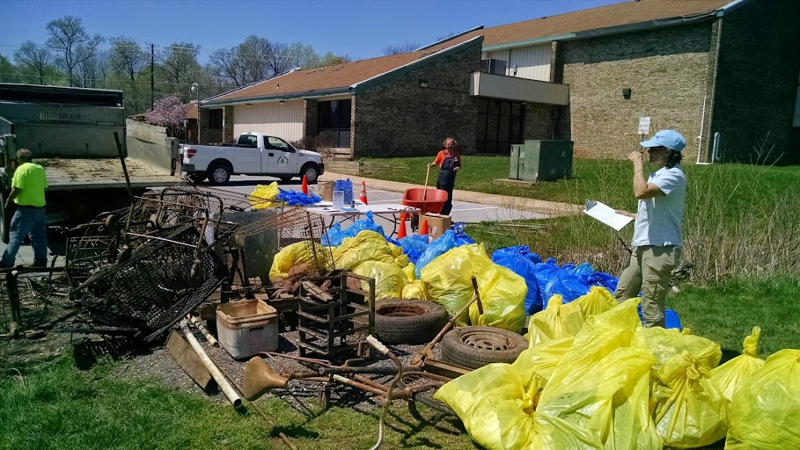
1- Waste generation:
Those activities in which materials are identified as no longer being of value and are either thrown away or gathered together for disposal.
2- On-site (Handling, storage, and processing):
Activities associated with the handling, storage, and processing of solid wastes at or near the point of generation.

Slide 5
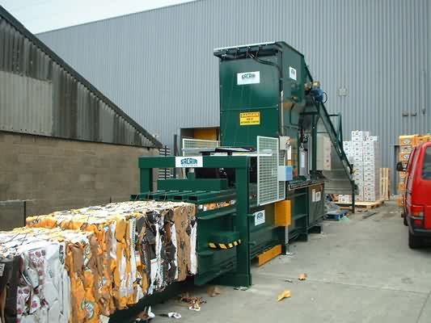
3- Collection:
Those activities association with the gathering of solid wastes and the hauling of wastes to the location where the collection vehicle is emptied.
4- Transfer and transport:
Those activities association with
The transfer of wastes from the smaller collection vehicle to the larger transport equipment.
The subsequent transport of the wastes, usually over long distance, to the disposal site.

Slide 6
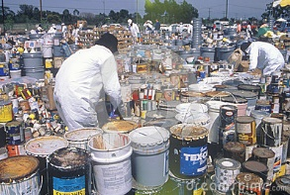
5- Processing and recovery:
Those techniques equipment and facilities used both to improve the efficiency of the other functional elements and to recover useable materials, conversion products, or energy from solid wastes.
6- Disposal:
Those activities associated with ultimate disposal of solid wastes Interrelationship of functional elements comprising a solid waste management system.

Slide 7
Factors to Consider in Treating and Disposing of Solid Waste
1- Disposal
Final operational state for cleanliness.
2- Process
Manipulation of waste, after disposal.
3- Treatment
Process to achieve sanitary results by reduction of hazardous effects to human and environment.

Slide 8
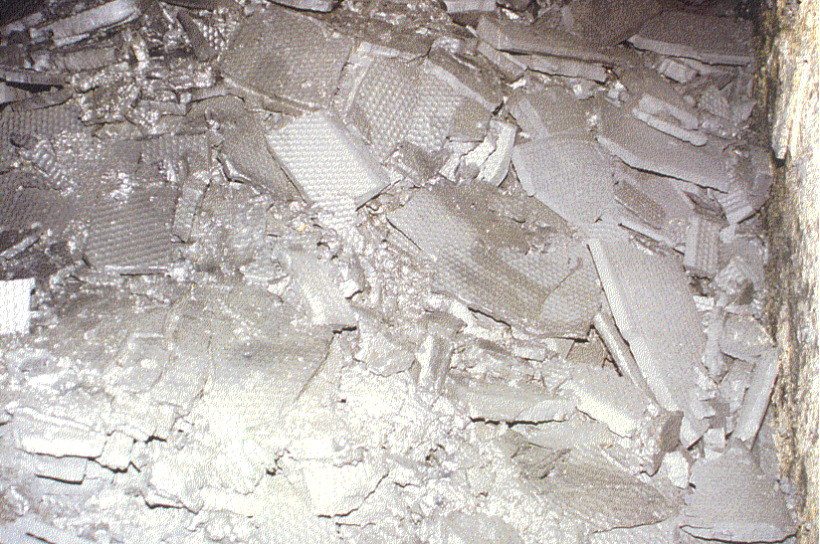
Treatment residues
All physico-chemical treatment processes generate residues which may:
be hazardous wastes themselves
be more concentrated than original waste
be suitable for recycling
require further treatment
need to be landfilled
Sludge from physico-chemical treatment after pressing
Notes:
Slide 5 Treatment residues
All physico-chemical treatment processes generate residues. These residues are often themselves hazardous waste, and may be more concentrated than the original waste although lower in total volume.
If the residue stream is pure, it may be suitable for recycling eg oils from flotation, metals if segregated. Alternatively they may require further treatment, such as solidification eg mixed metal sludges (see also Chapter 6.4 Stabilisation and solidification). Others may require incineration eg distillation residues (see also Chapter 6.5 Thermal treatment). Ultimately there will usually be some residue remaining for landfill disposal eg solidified wastes, incineration residues.

Slide 9
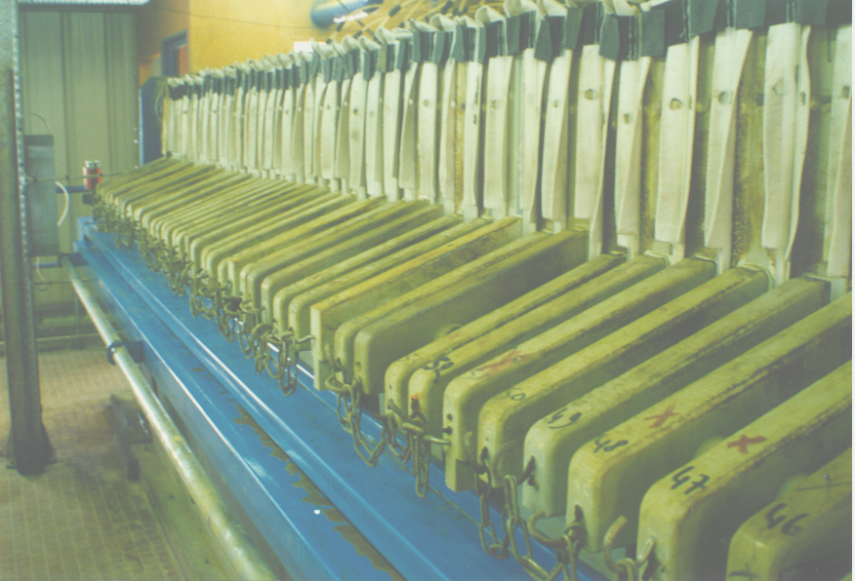
Physical processes
Many different physical treatment processes are simple and low-cost.
Choice depends on physical form of waste and its characteristics
Filter press
Notes:
Slide 6 Physical processes
There are a large number of different physical treatment processes, most of which are simple and low-cost. They include the options shown on the slide.
Many physical processes rely on gravity, but this basic principle may be adapted in different ways within different processes in an attempt to optimise its effects.
Other physical treatment processes use the different properties of materials eg boiling points. particle sizes.
The choice of process is dictated by the form of the waste (eg dry powder, liquid) as well as its characteristics.
The next 7 slides look at some of the alternative physical treatment options.

Slide 10
Physical Method of wastes
disposal
Machine processing
Thermal Processes
Incineration
Pyrolysis
Screening
Oil Separation
Sedimentation
Flotation
Land Fill
10. COMPACTION
11. Filtration
12. Burial

Slide 11
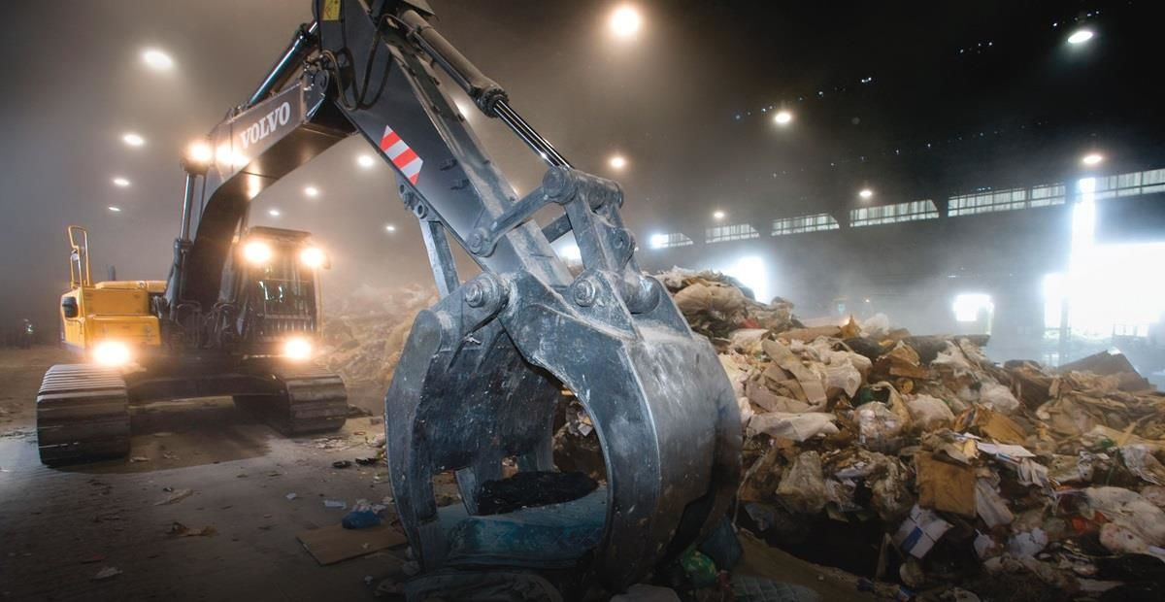
Physical Method Of Wastes Disposals
1. Machine processing of waste
Crushing: divide, mix and homogenize the waste.
b) Compaction: Reduction of spaces, that is compression of waste at low cost.
c) Recovery: Separation of materials that could be recycled.

Slide 12
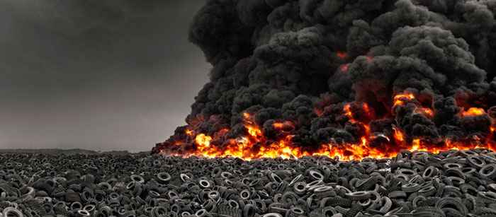
2. Thermal Processes
It is defined as the combination of temperature and time required to eliminate wastes products.
In this method disposal or breakdown of the wastes is carried out by using the heat energy (Direct Fire)

Slide 13
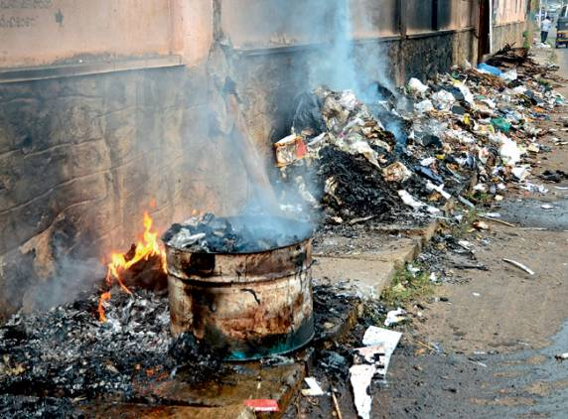
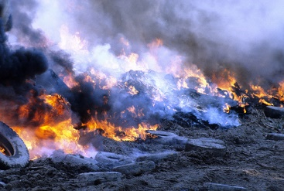
Advantages
1. Thermal energy is produced that can be reuse. 2. Cost effective. 3. Easy mechanism. Disadvantages:-
Huge production of Carbon-di-oxide (CO2) in the atmosphere. Apart from CO2, other harmful gases like NOx and SOx are also generated lead to Acid Rain.
Exhausted gases harms outside environment badly.
Low overall efficiency.
It is responsible for raise in sea water level.
A large quantity of ash is produced as well as dust that lead to a high particulate matter in the surrounding areas.

Slide 14
3- Incineration
Incineration is a waste treatment process that involves the combustion of solid waste at 1000 °C in furnace.
Waste materials are converted into ash, flue gas, and heat.
The ash is mostly formed by the inorganic constituents of the waste and gases due to organic waste.
The heat generated by incineration is used to generate electric power.
Incineration converts waste into ash, flue gas (A passage to carry off smoke) and heat.
The flue gases can be dispersed into the atmosphere, but first they must be cleaned of any gaseous and particulate pollutants.

Slide 16
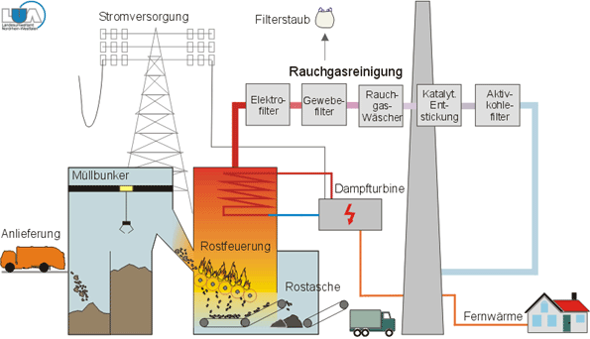
Fusing Point of Ash
Fusing point of ash is the temperature at which the ash resulting from the burning of waste will form a solid (clinker) by fusion and agglomeration (The act of collecting in a mass).
Typical required temperatures are: 1000 - 1200 °C

Slide 17
ADVANTAGES
The weight of the waste is reduced to 25% of the initial value.
No risk of polluting local streams and ground waters as in landfills.
Incineration plants can be located close to residential areas.
Gases are used to generate power.
DISADVANTAGES
Expensive
Required skilled labor.
The chemicals that would be released into the air could be strong pollutants and may destroy ozone layer (major disadvantage).
High energy requirement.

Slide 18
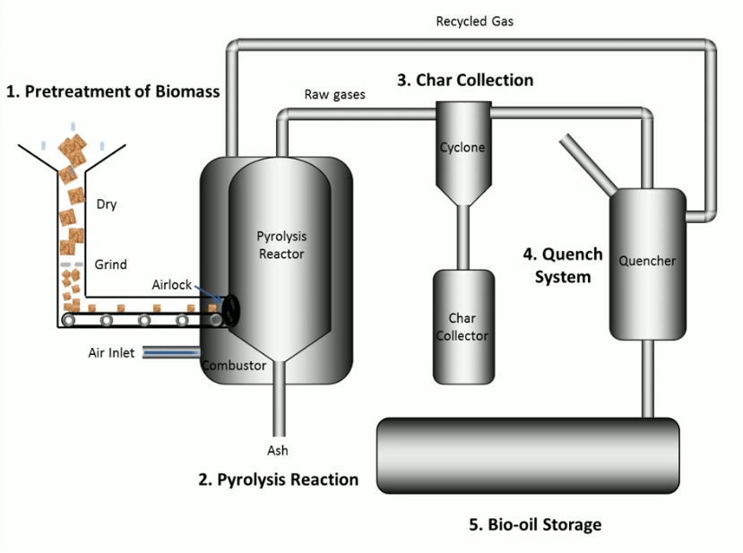
4- PYROLYSIS:-
Pyrolysis is defined as thermal degradation of waste in the absence of air to produce char (Coal), pyrolysis oil and syngas.
It is also defined as destructive distillation of waste in the absence of oxygen.
External source of heat is employed in this process.

Slide 19
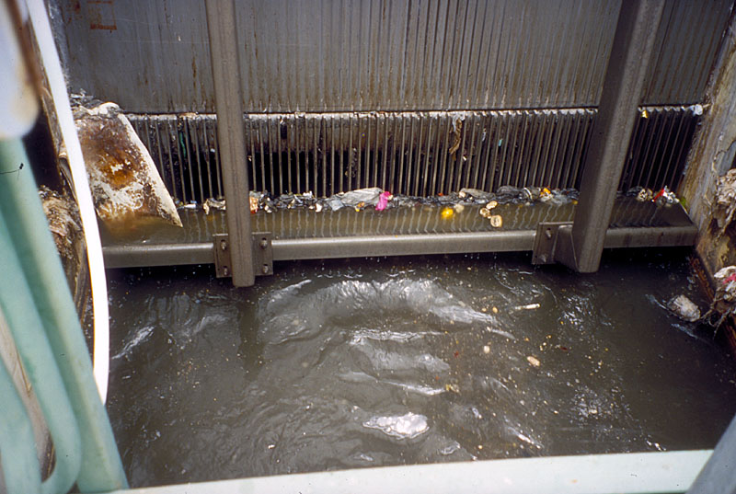
5- Screening
A screen is a device with openings, generally of uniform size that is used to retain the coarse solids found in wastewater.
The first unit operation encountered in wastewater-treatment plants is screening.
According to the size of openings, screens are designated as coarse or fine. Coarse screens have openings of ¼ inch or more, and fine screens have openings of less than ¼ inch.

Slide 20
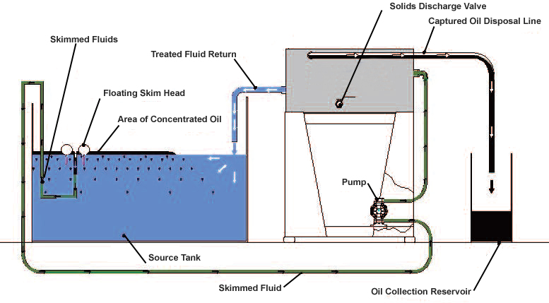
6- Oil Separation
It is a process in which Floatables, namely non-emulsified oil and organics separates from wastewater.

Slide 21
7- Sedimentation
Sedimentation is the separation of undissolved substances from water, by gravitational settling, of suspended particles that are heavier than water.
Sedimentation is used for separation of;
Particulate matter in water
Separation of biological-floc (A small loosely aggregated mass) in the sludge
Separation of chemical-floc in the sludge.
It is also used for solids concentration in sludge thickeners.
Sedimentation basins are constructed in a variety of shapes and sizes, circular tanks or rectangular tanks.
The basin is comprised of four zones according to function:
1-The inlet zone. 2-The settling zone.
3-The sludge zone. 4-The outlet zone.

Slide 22
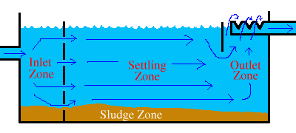
The inlet zone is a region where the incoming suspension is distributed uniformly over the cross-section of the tank.
In the settling zone, the particles settle at the same rate as they would in a pre-form.
Sludge zone, In this zone solids collect in the bottom of the tank.
In the outlet zone, the clarified liquid is collected uniformly over the cross-section of the basin.

Slide 23
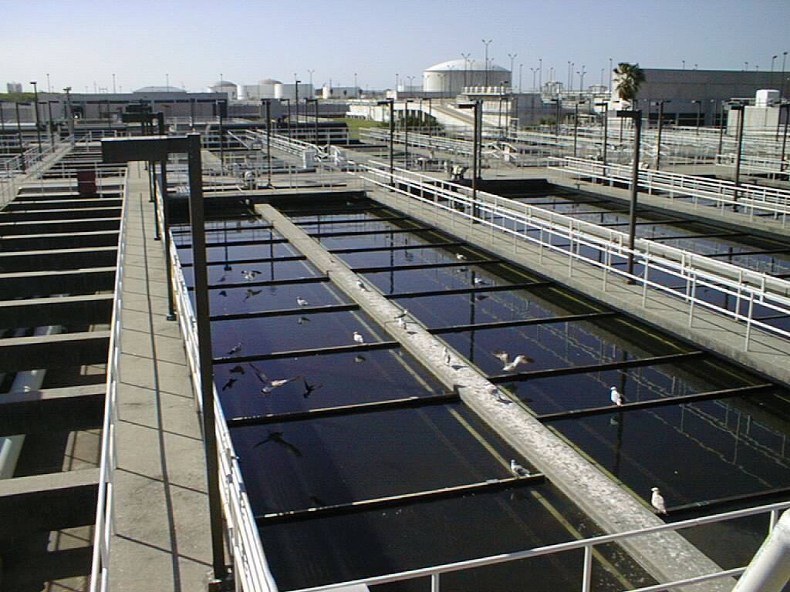
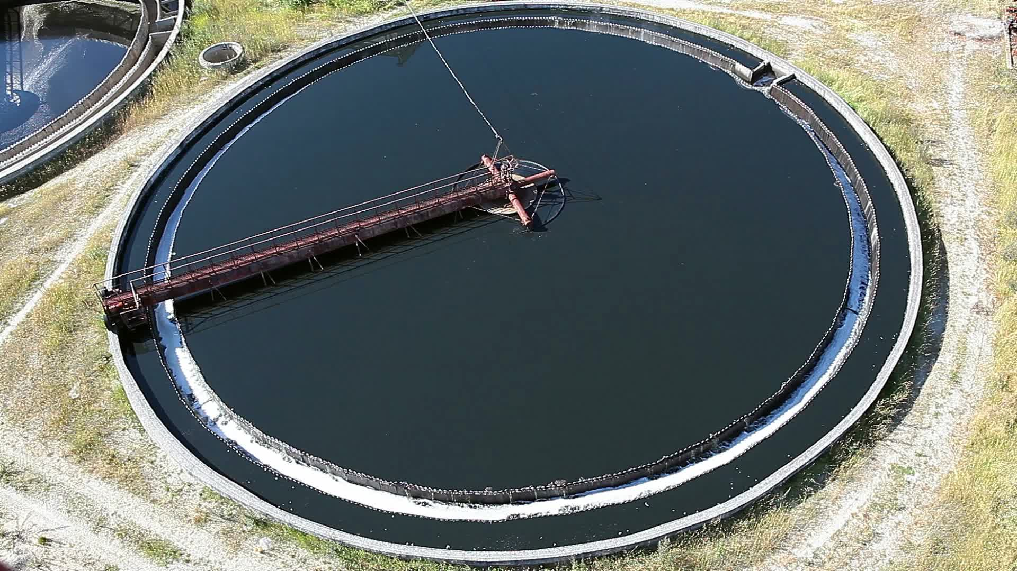
Basins
A- Rectangular basin B- Circular basin

Slide 24
8- Flotation
Flotation is a unit operation used to separate solid or liquid particles from a liquid phase.
Separation is brought by introducing fine gas (usually air bubbles) into the liquid phase.
The bubbles attach to the particulate matter, and the buoyant force of the combined particle and gas bubble is great enough to cause the particle to rise to the surface to form a scum blanket, which is removed by a skimming mechanism.
Principal advantage of flotation over sedimentation is that very small or light particles that settle slowly can be removed more completely and in a shorter time.

Slide 25
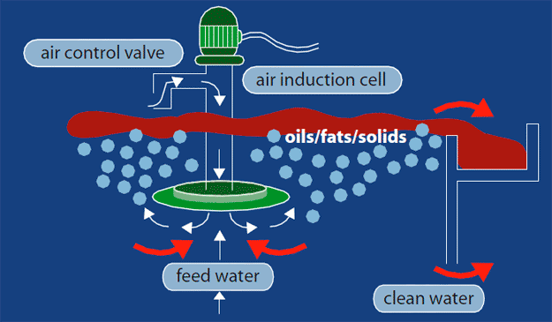
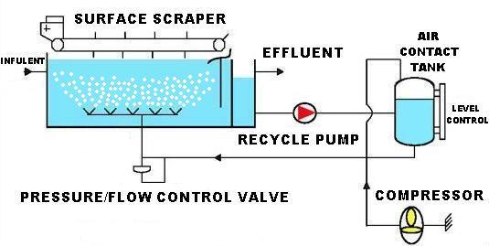
Types Of Flotation Systems
1. Air Flotation
In this system, air bubbles
are formed by introducing
the gas phase directly into
the liquid phase
2. Vacuum Flotation
This process consists of
saturating the wastewater
with air either directly in an
aeration tank.

Slide 26
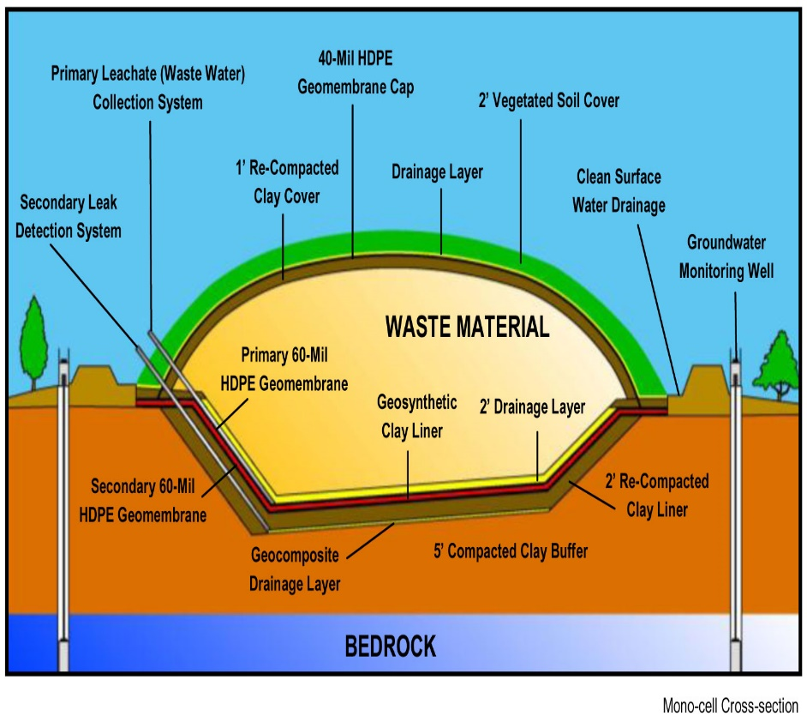
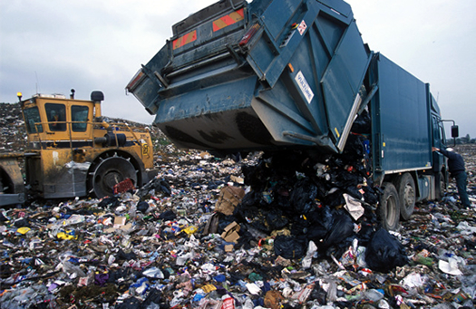
9- Land fill
It is the most traditional method of waste disposal.
“Waste is directly dumped into mining voids or borrow pits”.
Disposed waste is compacted and covered with soil gases generated by the decomposing waste materials are often burnt to generate power.
It is generally used for domestic waste.

Slide 27
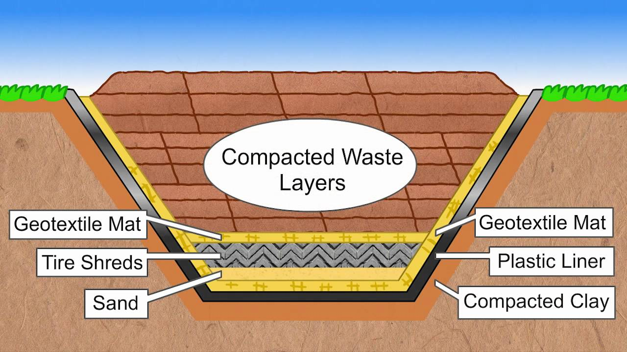
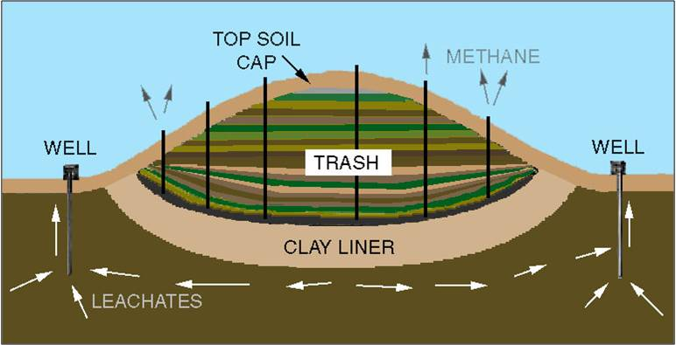
Types of Landfill
1- Sanitary Landfill
a) Mechanical
b) Normal
2- Converted Landfill
a) Mechanical
b) Normal

Slide 28
Site Selection and Assessment
These issues should be considered during site selection and assessment:
All conditions
Ecology on the site
Flora and Fauna
Geology/Topography
Hydrology
Soil
Climate
Other
Other Activities
Operational Plan
Investments and Costs
Implementation Plan

Slide 29
ADVANTAGES
Landfill site is a cheap waste disposal option for the local council.
Lots of different types of waste can be disposed of by landfill in comparison to other waste disposal methods.
The gases given off by the landfill site could be collected and used for generating power.
DISADVANTAGES
The site will look ugly while it is being used for landfill.
Dangerous gases are given off from landfill sites that cause local air pollution and contribute to global warming.
Local streams could become polluted with toxins seeping through the ground from the landfill site.
Once the site has been filled it might not be able to be used for redevelopment as it might be too polluted.

Slide 30
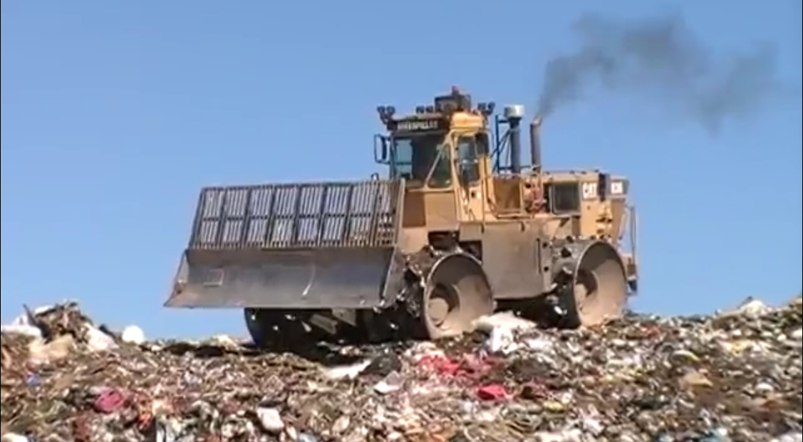
10- COMPACTION:
In this method the waste is compacted or compressed by external pressure.
It also breaks up large or fragile items of waste.

Slide 31
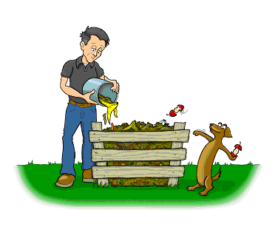
11- Manure pits
Mostly used in rural areas
Digging “manure pits” is to prevent the refuses thrown around the houses.
The garbage, cattle dung, straw, and leaves should be dumped into the manure pits and covered with earth.
In 5-6 month’s time the refuse is converted into manure which can be returned to the field.

Slide 32
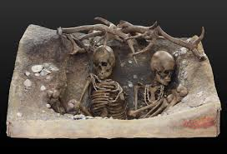
12- Burial
Suitable for small camp
A trench 1.5m wide & 2 m deep is excavated (Recover through digging)
The refuse is covered with 20 -30cm of earth
When the level in the trench is 40cm from ground level, the trench is filled with earth & compacted
4-6 months duration required.

Slide 33
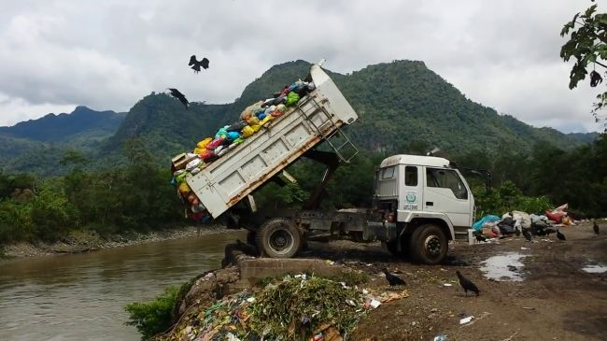
13-Dumping
It is the practice of transfer of waste (household waste, industrial, nuclear waste, etc.) from one place to another place.
These waste are divided into three separate lists on the basis of toxicity:
1- Green List
2- Amber List
3- Red List

Slide 34
1-Green List
These items are considered to be non-hazardous and more environmentally friendly. Some of these items may include paper and plastic that can be recycled.
2- Amber List
Materials are consider that containing both non-hazardous and hazardous parts. These materials can contain metal bearing wastes, organic and inorganic wastes or organic or inorganic constituents.
3- Red List
This includes reasonably hazardous materials. These materials contain principally organic or inorganic constituents, which include polychlorinated biphenyl (PCBs) as well as Radio active wastes.

Slide 35
Other methods
Immobilization
It is a collective term for a range of treatment processes that primarily aim to make hazardous waste safe for disposal by reducing the potential for waste component leaching
Stabilization
Techniques by which hazardous wastes are converted into a more stable form.
Solidification
Techniques that create a solid mass of either the original waste, or waste that has been stabilized.

Slide 36
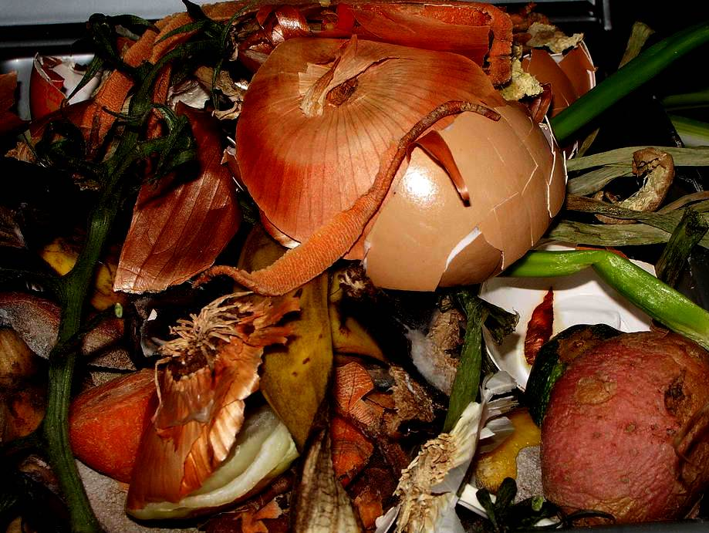
Vermicomposting
It is a method of disposal of kitchen and plate wastes, which serves the dual purpose of disposing off the garbage as well as proving eco-friendly.

Slide 37
Impacts of waste on health
Chemical poisoning through chemical inhalation
Uncollected waste can obstruct the storm water runoff resulting in flood
1. Low birth weight
2.Cancer
3. Congenital malformations
4. Neurological disease
Notes:
Numerous epidemiology studies have been conducted to evaluate whether the health of people living near hazardous waste disposal sites is being adversely affected(Moeller, 20050.

Slide 38
Impacts of waste on health
Nausea and vomiting
Increase in hospitalization of diabetic residents living near hazard waste sites.
Mercury toxicity from eating fish with high levels of mercury.
Resulted in high algal population in rivers and sea

Slide 39
Impacts of waste on Environment
Waste breaks down in landfills to form methane, a potent greenhouse gas
Change in climate and destruction of ozone layer due to waste biodegradable
Littering, due to waste pollutions, illegal dumping, Leaching: is a process by which solid waste enter soil and ground water and contaminating them.

Slide 40
Preventive measures
Systematic solid waste management
garbage collection according to the schedule set
Involving public in plans for waste treatment and disposal
Educate people on different ways of handling waste
Household level of proper segregation of waste, recycling and reuse
Process and product substitution example use paper bag instead of plastic bags

Slide 41
