Slide 1
Post harvest Technology-FST 508
Prof. Dr. SARFRAZ HUSSAIN
Institute of Food Science & Nutrition

Slide 2
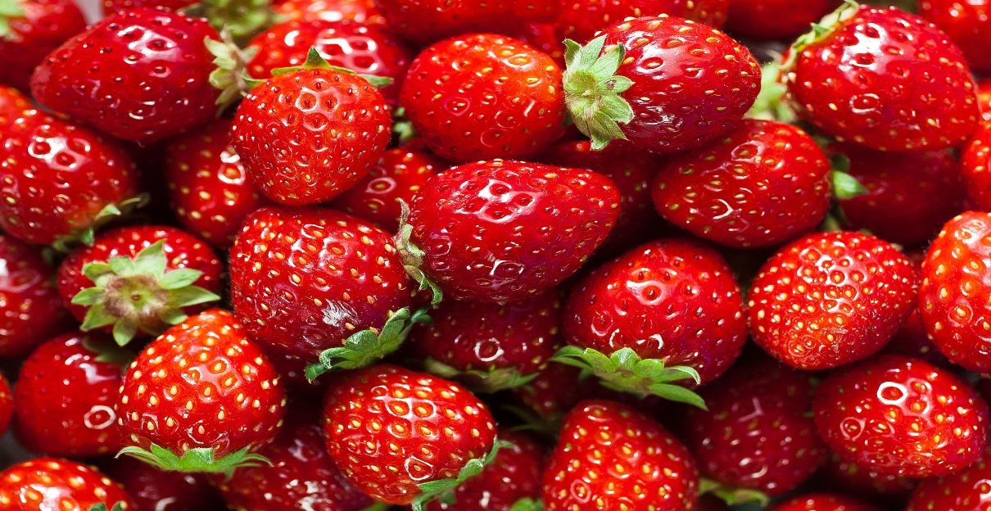
Introduction
Strawberry is an attractive, luscious tasty and nutritious fruit with a distinct and pleasant aroma and delicate flavor.
It has a unique place among the cultivated berry fruit it is a man made hybrid

Slide 4
uses
In addition to being consumed fresh, strawberries can be frozen, made into preserves, as well as dried and used in such things as cereal bars. Strawberries are a popular addition to dairy products, as in strawberry flavored ice cream, milkshakes, smoothies and yogurts.

Slide 5
Maturity and Harvesting
Harvesting is determined on the berry surface color
They are harvested when fully matured because the eating quality does not improve after harvested once
For acceptable flavor, a minimum 7% soluble solids
maximum 0.8% titratable acidity are recommended.
Strawberries have a relatively high rate of respiration (50-100 mL of C02 per kg per hour at 20°C)
They produce very little ethylene (<0.1 ppm per kg per hour at 20°C)

Slide 6
Harvesting
Strawberries are usually hand harvested and packed in field
Berries are harvested with the calyxes attached
must be held gently to avoid bruising injury and discoloration.
Place gently in packing material and avoid droping to prevent impact bruising
Harvest should be as frequent as needed to avoid over-mature berries.
Fruit should be sorted carefully, to discard any fruit with fungal lesions or injuries.
Harvesting, sorting, and packing should be done simultaneously in the field. Packaging strawberries in the field has the advantage that berries are only handled once.
Studies of fruit quality loss have shown that most damage occurs in the field during picking and packing. Therefore, minimizing berry handling is critical to good quality maintenance and postharvest life.

Slide 7
Cooling and low temperature
Good temperature management is the single most important factor in reducing strawberry deterioration and maximizing postharvest life. The best way to slow spoilage is to quickly remove field heat
harvest berries at cooler part of the day
maintain the berries as close to 0°C as possible.
high fruit temperature causes metabolic activities, decay development, and internal breakdown.
Any failure to maintain produce at low temperatures during handling, storage, and transportation will result in loss of quality and marketability.

Slide 8
Berries held at 20°C have only ¼ to ½ the life expectancy of those held at 0°C and market life will be reduced to only a few hours if strawberries are held near 30°C, as may occur in the field.
Due to their dark color, strawberries in direct sun exposure will absorb heat and quickly warm to above air temperature

Slide 9
Precooling
it is essential for strawberries to cool down within 1 hour of harvest.
Cooling delays of 2, 4, 6, or 8 hours reduces marketability by 20, 37, 50, or 70%, respectively, after holding the fruit at 25°C.
The most common method to precool berries is forced-air cooling, which is the most widely adaptable and fastest cooling method for small-scale operations.
Cold air is forced to circulate rapidly through the containers (versus around the containers as in room cooling), allowing the cold air to be in direct contact with the warm berries.

Slide 10
Pallets of strawberries are positioned so that the cold air must pass through the package openings and around individual berries.
The most common design consists of a tunnel, which is formed by leaving space between two rows of loaded pallets, and covering the top and one end of the tunnel with a tarp.

Slide 11
With the exhaust fan operating, air is removed from the tunnel and a slightly negative air pressure is created. Cold air from the room then flows through package openings and around warm berries to reach the tunnel.
The cooling rate and efficiency of the system depend on a number of factors:
1) the temperature difference between the fruit and the cold air,
2) the air flow rate,
3) the accessibility of the fruit to the cold air, and
4) the dimensions of the air channel.
An inefficient system will increase the cooling time, thus increasing the operating cost and reducing the marketable weight and quality of the fruit.

Slide 12
Storage conditions
Optimum storage conditions for strawberries are 0°C and 90-95% relative humidity. In such conditions, strawberries can have 7-10 days of storage-life.
The highest freezing point is 0.8°C for strawberries, although berries with high soluble solids content are less likely to freeze.
Strawberries are not stored for long time period
Holding berries under optimum storage conditions even during short marketing periods is beneficial to quality retention.
Detrimental processes to berry quality are reduced at low temperatures, such as respiration, softening, moisture loss, and decay development.

Slide 13
Storage Conditions
Strawberries are subject to rapid water loss, causing them to shrivel and deteriorate,
These symptoms will affect berry appearance before they affect eating quality.
Relative humidity of a storage room should be maintained at 90-95%, as strawberries will shrivel below 90% relative humidity.
But excessive condensation of free water on the berries should be avoided.
Good sanitation of the storage and handling facilities is important to minimize contamination by decay pathogens. In addition, some molds growing in storage rooms can impart off-flavors to the stored berries.
Therefore, any decayed or contaminated berries and containers should be removed and disposed of promptly, and storage rooms should be periodically cleaned and sanitized.

Slide 14
Modified Atmospheres
Modified atmosphere (MA) packaging or storage generally refers to enclosure within a sealed semi-permeable plastic film
in which the oxygen (O₂) is lower and the carbon dioxide (CO₂) is higher than the concentrations found in fresh air.
MA with 15-20% CO₂ and 5-10% O₂ reduces the growth of Botrytis cinerea (grey mold rot) and decay causing organisms in strawberries.
In addition MA reduces the respiration and softening rates of berries, thereby extending the postharvest life.
Exposure of strawberries to <2% O2 and/or >25% CO2 can cause off-flavors and brown discoloration, depending on cultivar, duration of exposure, and temperature.

Slide 15
The standard CO₂ treatment for strawberries is to completely enclose pallet loads of berries in sealed plastic bags, pull a slight vacuum, then add CO₂ to create a 12-15% CO₂ atmosphere within the bag and around the fruit.
To prevent any accumulation of excess CO2 by respiration, the amount of CO2 produced by the respiring berries should balance with the bag permeability.
Attention should be paid to avoid puncturing the bags during handling. It is important that the berries are thoroughly cold prior to treatment, as the plastic pallet cover will impede further cooling and condensation can form when the fruit are not fully cooled.

Slide 16
Diseases
Diseases are the greatest cause of postharvest losses in berries. Prompt cooling, storage at the lowest safe temperature, preventing physical injury to the fruit, and utilizing high CO₂ (10-15%) are the best methods for disease control.
In addition, care should be taken to keep diseased or wounded berries out of packages, as rot can spread from diseased to nearby healthy berries.

Slide 17
Gray mold (Botrytis cinerea) is the most common problem in strawberries.
This disease can develop during storage if berries have been contaminated though harvest and handling wounds
The organism can also invade flower blossoms and remain dormant in the berry until ripening begins.
Gray mold is most serious during rainy or foggy periods in the field.
Surface mycelia from infected berries can directly penetrate adjacent healthy berries to produce a nest of rotting berries.
this nest can continue to enlarge and may spread throughout the basket or flat.
Avoiding mechanical injuries and good temperature management are effective control measures.
This fungus continues to grow at 0°C, albeit growth is very slow at this temperature.

Slide 18
Continued….
Rhizopus rot (Rhizopus stolonifer) can also be a problem in strawberries.
Cooling the fruit and keeping them below 5°C is very effective against this fungus, since it will not grow at these temperatures. Therefore, good temperature management can make it a less severe problem during storage and marketing, but it may cause severe losses in the field.
Infected berries are soft and watery, and the fungus may produce long, whiskery growth on berries under high humidity conditions. Similar to gray mold, rhizopus rot can spread from infected berries to adjacent healthy ones, producing a nesting effect.

Slide 19
Marketing
During fresh marketing the strawberries are displayed on shops with frequent sprinkling of ice water
While in bigger stores they are kept under controlled temperatures in display freezer

