Slide 1
Olives
Olea europaea L. grown on over 8 million ha
Traditionally concentrated in the Mediterranean area
Southern European countries 74.9% of the world production
Spain being the main producer (38.7%), followed by Italy (21%) and Greece (12.9%).
Other important olive oil producers are Turkey, Tunisia and Syria (17.1%) as well as Jordan, Morocco and Algeria.

Slide 2
Major Problems of Olive Cultivation
Low mean production per unit area of about 2 t/ha of olives
Low content of oil (24%) of fresh weight .
Fruit production starts 3–5 years after planting
Alternate bearing reduce of the lifetime of olive orchards to no more than 50–60 years.

Slide 3
Plant Botany
The olive is a long-living evergreen tree that grows up to 15 m at maturity.
Life span is typically longer than 500 years.
Trees older than 2,000 years are still under cultivation.
Flowers are hermaphroditic and wind pollinated
Cultivars are self-incompatible.
Olive fruit is a drupe
Oil accumulates in the mesocarp

Slide 4
Fig Green olive drupes; at ripening the colour will turn to reddish or black

Slide 5
Ancient olive still under cultivation in Apulia (Italy). Olive trees may survive for thousands of years and many of them can be found along the entire Mediterranean
area of cultivation. Plants like this represent the most ancient cultivated living plants of the
world

Slide 6
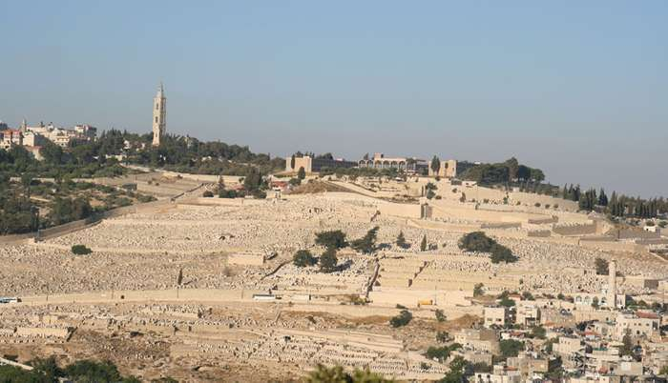
A view of mount olives Jerusalem

Slide 7
Sisters Olive Trees of Noah

Slide 8
Virgin olive oil
Virgin olive oil is mechanically extracted by pressing or centrifuging crushed fruits without any chemical treatment.
Main component of triglycerides is the mono-unsaturated oleic acid (18:1), which represents 57–80% of total fatty acids, followed by linoleic (18:2) (7–19%), linolenic (18:3) (0.6–0.8%), palmitic (16:0) and stearic (18:0) acids.
Virgin olive oil represents a vast range of microconstituents (more than 230 compounds) including phenolics, tocopherols, aliphatic and triterpenic alcohols, sterols (and their precursor squalene
Oleuropein is a a non-toxic antioxidant which have anti-tumor agent with direct effects against tumor cells

Slide 9
Other types
Refined oil is obtained from low quality virgin olive oil after chemical and physical refining treatments, which lead to removal of contaminants or degraded compounds.
Olive-pomace oil is obtained by treating olive pomace with solvents.

Slide 10
Genetic resources
The genus Olea belongs to the Oleaceae family, sub-family Oleideae.
The genus includes two sub-genera: Olea and Paniculatae
Olea europaea taxonomy, the species includes six sub-species based on morphology and geographical distribution
– subsp. europaea, represented by two botanical varieties: cultivated olive
(var. europaea) and wild olive (var. sylvestris),
– subsp. cuspidata, distributed along south Asia, on the Arabian peninsula,
and throughout east and south Africa;
– subsp. laperrinei, restricted to the Sahara region;
– subsp. maroccana, present in Morocco;
– subsp. cerasiformis, typical of Madeira island;
– subsp. guanchica, restricted to the Canary Islands.
Wild and cultivated olives are diploid (2n = 2x = 46)

Slide 11
Breeding Goals
Shortening the unproductive period,
Increasing fruit number and size, increasing oil content and quality (fatty acid composition, phenol content, etc.)
Reduction of alternate bearing, dwarfing or modifying tree architecture to facilitate mechanical pruning and harvesting
Improving resistance to pests, in particular olive fruit fly,
and diseases such as leaf peacock spot Verticillium wilt, and olive knot. Pseudomonas savastanoi.
Improve cold tolerance to allow cultivation in colder areas and to promote self-fertility in order to reduce reliance on pollinators.

