Slide 1
Lec 13 Nutrition during Infancy
By dr. Umer farooq

Slide 2
Nutrition during Infancy
Initially, the infant drinks only breast milk or formula but later begins to eat some foods, as appropriate.
Common sense in the selection of infant foods along with a nurturing, relaxed environment support an infant’s health and well-being.

Slide 3
Energy and Nutrient Needs
An infant grows fast during the first year.
Growth directly reflects nutrient intake and is an important parameter in assessing the nutrition status of infants and children.
Health care professionals measure the heights and weights of infants and children at intervals and compare the measurements with standard growth curves for gender and age and with previous measures of each child (see the “How to,” on the next slide).

Slide 5
Energy Intake and Activity
A healthy infant’s birthweight doubles by about five months of age and triples by one year, typically reaching 20 to 25 pounds.
The infant’s length changes more slowly than weight, increasing about 10 inches from birth to one year.
By the end of the first year, infant growth slows considerably; during the second year, an infant typically gains less than 10 pounds and grows about 5 inches in height.
Not only do infants grow rapidly, but their energy requirement is remarkably high—about twice that of an adult, based on body weight.

Slide 6
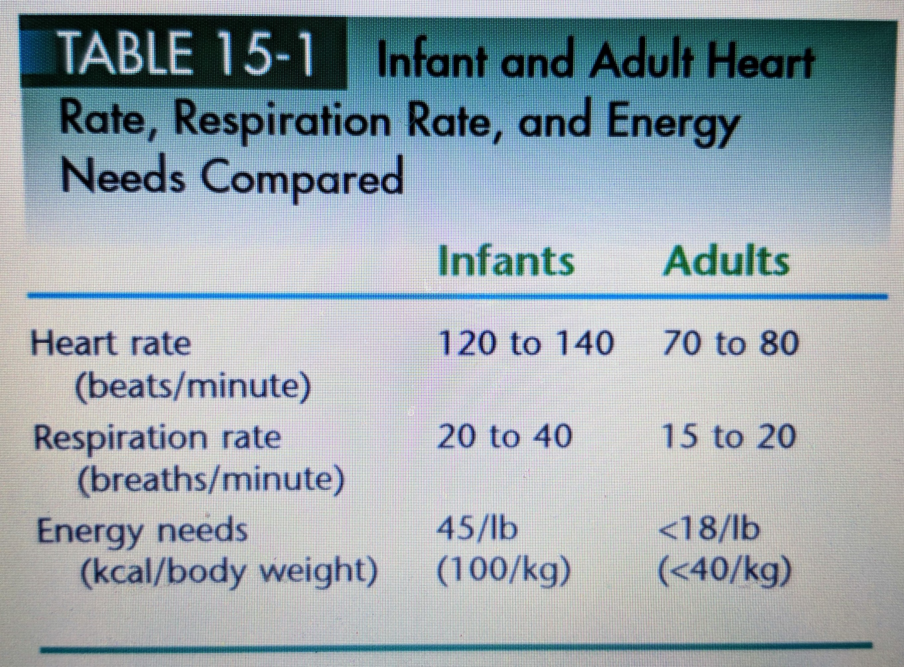
A newborn baby requires about 450 kcalories per day, whereas most adults require about 2000 kcalories per day.
In terms of body weight, the difference is remarkable. Infants require about 100 kcalories per kilogram of body weight per day, whereas most adults need fewer than 40 (see Table 15-1).
After six months, the infant’s energy needs decline as the growth rate slows, but some of the energy saved by slower growth is spent in increased activity.

Slide 7
Energy Nutrients
Recommendations for the energy nutrients—carbohydrate, fat, and protein—during the first six months of life are based on the average intakes of healthy, full-term infants fed breast milk.
During the second six months of life, recommendations reflect typical intakes from solid foods as well as breast milk.
Carbohydrates provide energy to all the cells of the body, especially those in the brain, which depend primarily on glucose to fuel activities.
Relative to the size of the body, an infant’s brain is larger and uses relatively more glucose—about 60 percent of the day’s total energy intake.
Fat provides most of the energy in breast milk and standard infant formula. Its high energy density supports the rapid growth of early infancy.

Slide 8
No single nutrient is more essential to growth than protein.
All of the body’s cells and most of its fluids contain protein; it is the basic building material of the body’s tissues.
Excess dietary protein can cause problems, too, especially in a small infant. Too much protein stresses the liver and kidneys, which have to metabolize and excrete the excess nitrogen. Signs of protein overload include acidosis, dehydration, diarrhea, elevated blood ammonia, elevated blood urea, and fever. Such problems are not common, but they have been observed in infants fed inappropriate foods, such as fatfree milk or concentrated formula.

Slide 9
Vitamins and Minerals
As with the energy nutrients, the recommendations for the vitamins and minerals are based on the average amount of nutrients consumed by thriving infants breastfed by well-nourished mothers.
An infant’s needs for most of these nutrients, in proportion to body weight, are more than double those of an adult. Figure 15-2 illustrates this by comparing a five-month-old infant’s needs per unit of body weight with those of an adult man. Some of the differences are extraordinary

Slide 11
Water
One of the most essential nutrients for infants, as for everyone, is water. The younger the infant, the greater the percentage of body weight is water.
During early infancy, breast milk or infant formula normally provides enough water to replace fluid losses in a healthy infant. Even in hot, dry climates, neither breastfed nor bottle-fed infants need supplemental water.
Because much of the fluid in an infant’s body is located outside the cells—between the cells and in the blood vessels—rapid fluid losses and the resulting dehydration can be life-threatening.
Conditions that cause rapid fluid loss, such as diarrhea or vomiting, require treatment with an electrolyte solution designed for infants.

Slide 12
Breast Milk
Breast milk excels as a source of nutrients for infants.
Its unique nutrient composition and protective factors promote optimal infant health and development throughout the first year of life.
Exclusive breastfeeding for 6 months, and breastfeeding with complementary foods for at least 12 months for infants is recommended.
Experts add, though, that iron-fortified formula, which imitates the nutrient composition of breast milk, is an acceptable alternative. After all, the primary goal is to provide the infant nourishment in a relaxed and loving environment

Slide 13
Frequency and Duration of Breastfeeding
Breast milk is more easily and completely digested than formula, so breastfed infants usually need to eat more frequently than formula-fed infants do.
During the first few weeks, approximately 8 to 12 feedings a day, on demand, as soon as the infant shows early signs of hunger such as increased alertness, activity, or suckling motions, promote optimal milk production and infant growth.
Crying is a late indicator of hunger. An infant who nurses every two to three hours and sleeps contentedly between feedings is adequately nourished.
As the infant gets older, stomach capacity enlarges and the mother’s milk production increases, allowing for longer intervals between feedings. Even though the infant obtains about half the milk from the breast during the first two or three minutes of sucking, breastfeeding is encouraged for about 10 to 15 minutes on each breast.
The infant’s sucking, as well as the complete removal of milk from the breast, stimulates lactation.

Slide 14
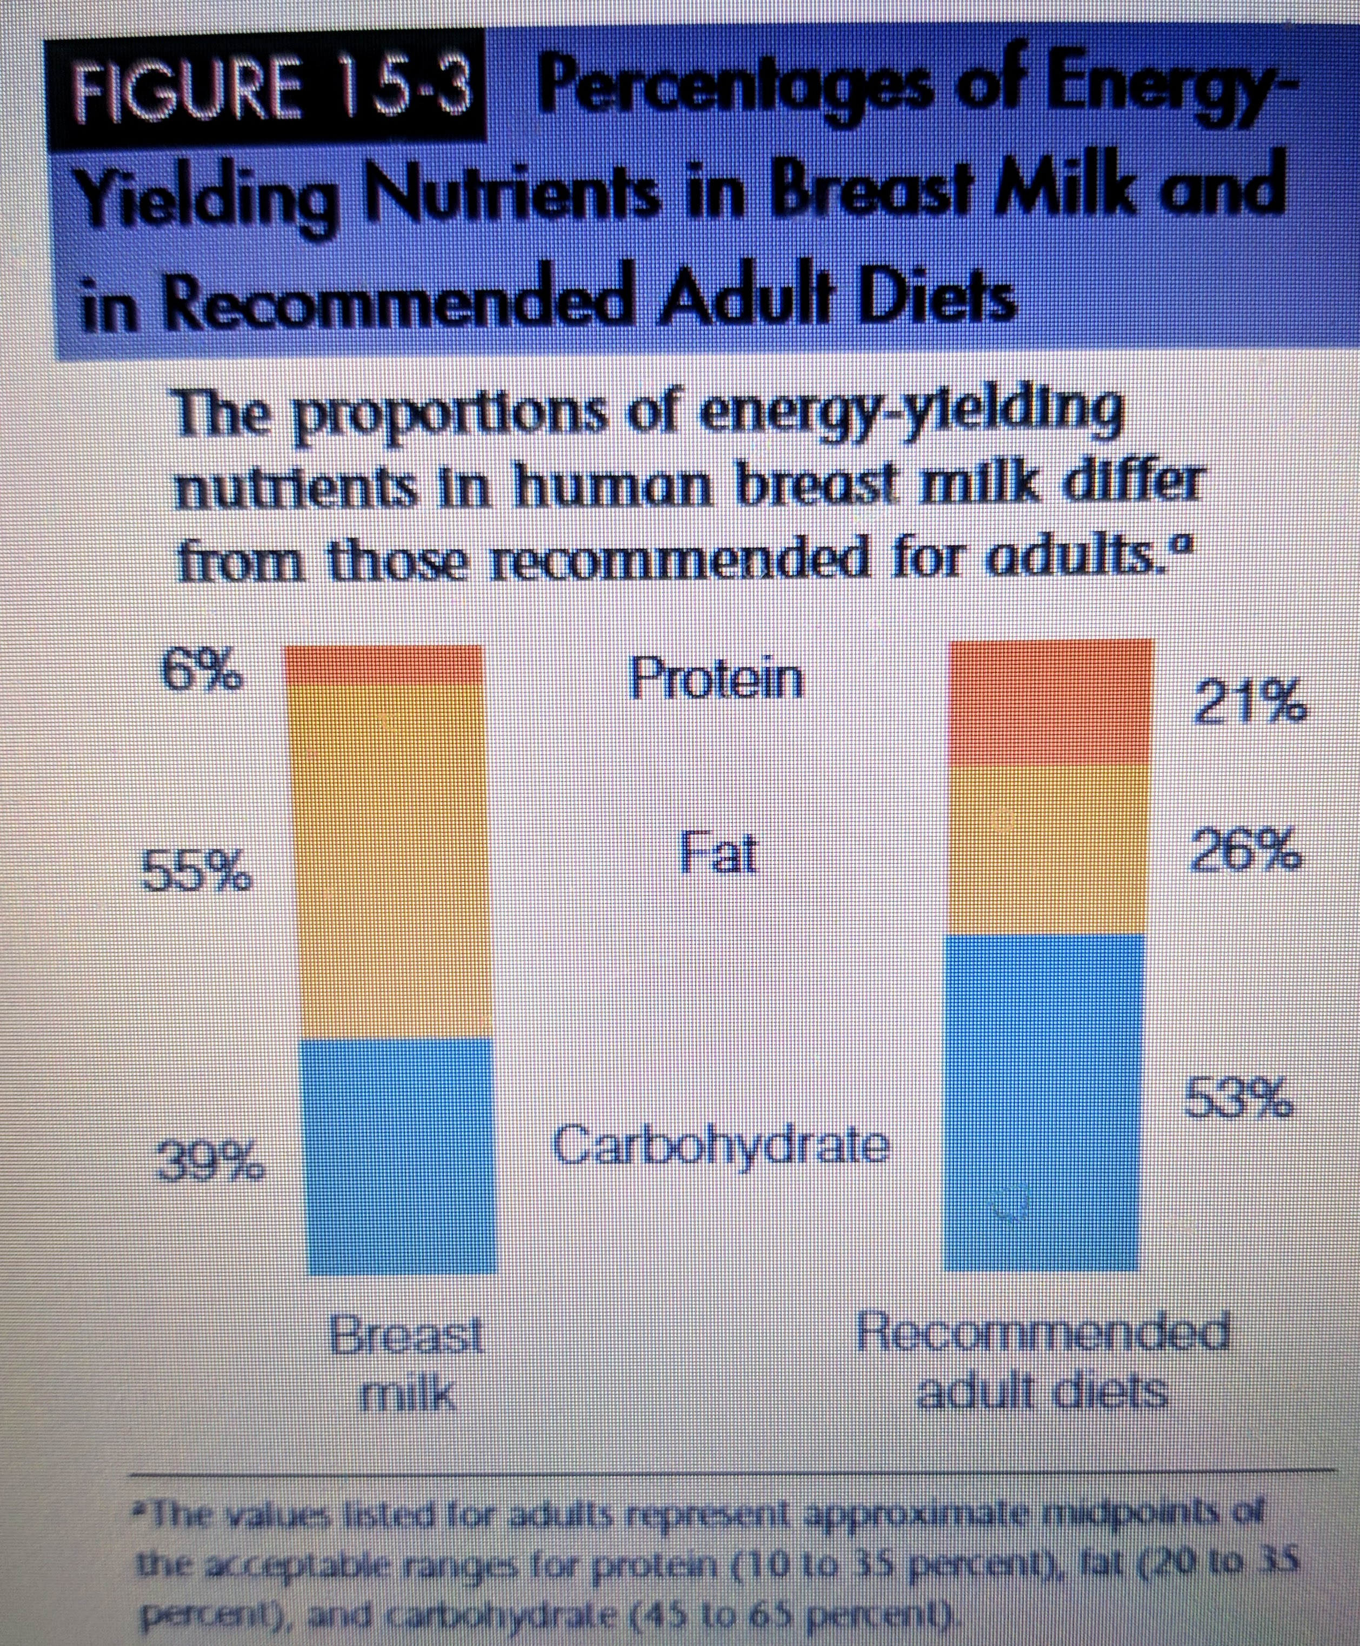
Energy Nutrients
The energy-nutrient composition of breast milk differs dramatically from that recommended for adult diets (see Figure 15-3). Yet for infants, breast milk is nature’s most nearly perfect food, providing the clear lesson that people at different stages of life have different nutrient needs.
The carbohydrate in breast milk (and infant formula) is the disaccharide lactose. In addition to being easily digested, lactose enhances calcium absorption.
The amount of protein in breast milk is less than in cow’s milk, but this quantity is actually beneficial because it places less stress on the infant’s immature kidneys to excrete the major end product of protein metabolism, urea. Much of the protein in breast milk is alpha-lactalbumin, which is efficiently digested and absorbed.

Slide 15
As for the lipids, breast milk contains a generous proportion of the essential fatty acids linoleic acid and linolenic acid, as well as their longer-chain derivatives arachidonic acid and DHA (docosahexaenoic acid).
Infant formula used to provide only linoleic acid and linolenic acid, but now arachidonic acid and DHA are also included.
Vitamins
With the exception of vitamin D, the vitamins in breast milk are ample to support infant growth.
The vitamin D in breast milk is low, and vitamin D deficiency impairs bone mineralization. Vitamin D deficiency is most likely in infants who are not exposed to sunlight daily, have darkly pigmented skin, and receive breast milk without vitamin D supplementation.
It is recommended that a vitamin D supplement for all infants who are breastfed exclusively, and for any infants who do not receive at least 500 milliliters (15 ounces) per day of vitamin D–fortified formula.

Slide 16
Minerals
The calcium content of breast milk is ideal for infant bone growth, and the calcium is well absorbed.
Breast milk contains relatively small amounts of iron, but the iron has a high bioavailability.
Zinc also has a high bioavailability, thanks to the presence of a zinc-binding protein.
Breast milk is low in sodium, another benefit for immature kidneys.
Fluoride promotes the development of strong teeth, but breast milk is not a good source.
Supplements
Pediatricians may routinely prescribe liquid supplements containing vitamin D, iron, and fluoride. Table 15-2 offers a schedule of supplements during infancy. In addition, giving a single dose of vitamin K to infants at birth is recommended to protect them from bleeding to death.

Slide 18
Immunological Protection
In addition to nutritional benefits, breast milk offers immunological protection. Not only is breast milk sterile, but it actively fights disease and protects infants from illnesses.
Such protection is most valuable during the first year, when the infant’s immune system is not fully prepared to mount a response against infection.
During the first two or three days after delivery, the breasts produce colostrum, a premilk substance containing mostly serum with antibodies and white blood cells.
Colostrum (like breast milk) helps protect the newborn from infections against which the mother has developed immunity. The maternal antibodies swallowed with the milk inactivate disease-causing bacteria within the digestive tract before they can start infections.
This explains, in part, why breastfed infants have fewer intestinal infections than formula-fed infants

Slide 19
In addition to antibodies, colostrum and breast milk provide other powerful agents that help to fight against bacterial infection. Among them are bifidus factors, which favor the growth of the “friendly” bacterium Lactobacillus bifidus in the infant’s digestive tract, so that other, harmful bacteria cannot become established.
An iron-binding protein in breast milk, lactoferrin, keeps bacteria from getting the iron they need to grow, helps absorb iron into the infant’s bloodstream, and kills some bacteria directly. The protein lactadherin in breast milk binds to, and inhibits replication of, the virus that causes most infant diarrhea.
Breastfeeding also protects against other common illnesses of infancy such as middle ear infection and respiratory illness.
In addition, a growth factor that is present in breast milk stimulates the development and maintenance of the infant’s digestive tract and its protective factors.
Several breast milk enzymes such as lipase also help protect the infant against infection. Clearly, breast milk is a very special substance.

Slide 20
Allergy and Disease Protection
In addition to protection against infection, breast milk may offer protection against the development of allergies.
Compared with formula-fed infants, breastfed infants have a lower incidence of allergic reactions, such as asthma, recurrent wheezing, and skin rash.
This protection is especially noticeable among infants with a family history of allergies.
Similarly, breast milk may offer protection against the development of cardiovascular disease.
Compared with formula-fed infants, breastfed infants have lower blood pressure and lower blood cholesterol as adults.

