Slide 1
Spinal Cord Injury Management

Slide 2
Outlines
Hand function
Different level lesion
Tendonesis grip
Muscle length

Slide 3
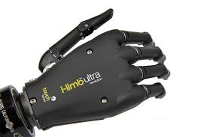
Upper limb function
Stereognosis
Dexterity
Balance
Support
Communication
Strength
Manipulation

Slide 4
Shoulder girdle
Scapula ……normal movements
Scapulo humeral rhythm
Elevation with external rotation

Slide 5
Hand
Hand position
Thumb movements
Function participation
Position of relaxation
Position of function
Position of immobilization

Slide 6
Recovery of function in hand needs
Specificity
Intensity
Motivation
Rich environment
Varied practice

Slide 7
Normal
Reach
Grasp
Manipulation
Release
HAND MANIPULATION
Translation
Shift
Rotation

Slide 8
Components
Reaching
Forward……flexion
Sideways…….abduction
Backward…….extension
Shoulder girdle elevation , elbow extension , different external rotation ,
Opening of aperture , extension of wrist , pronation supination different degree
Grasping
Extension wrist & finger with abduction CMP thumb & fifth finger
Closing of fingers

Slide 9
Holding
Flexion & extension of wrist
Manipulation
Flexion and extension
Lift
First phase….contact of fingers to object
2nd….grip force and load force
3rd….load force overcome weight
4th…..when end of task

Slide 10
Power grip……
Precision grip…….
Anticipatory to grip
Intrinsic……size , shape ,texture
Extrinsic….orientation, distance , location

Slide 11
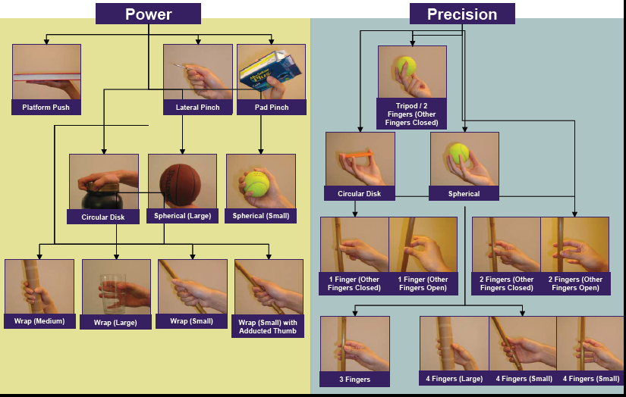

Slide 12
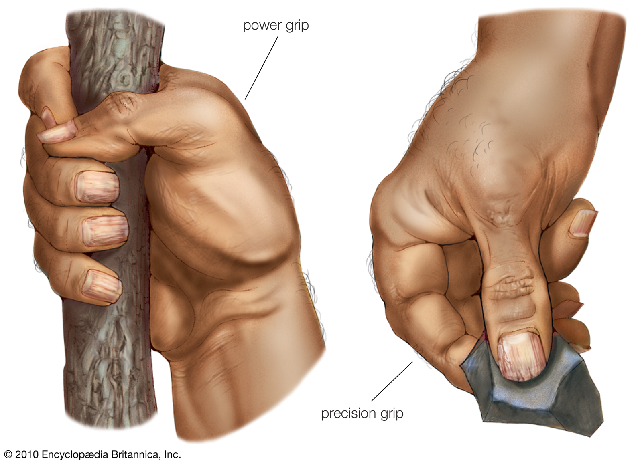

Slide 14
Upper limb recovery
Tactile stimulation
Different texture , temperature, vibration ,stroking
Proprioception
Distraction
Compression

Slide 15
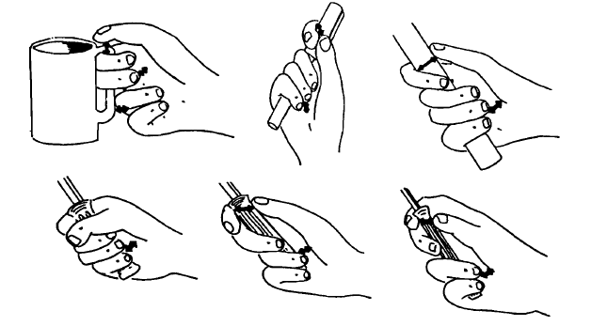

Slide 16
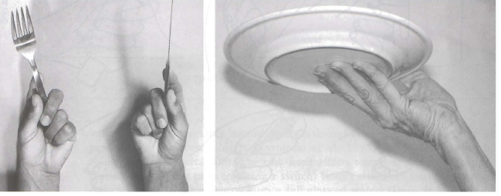

Slide 17
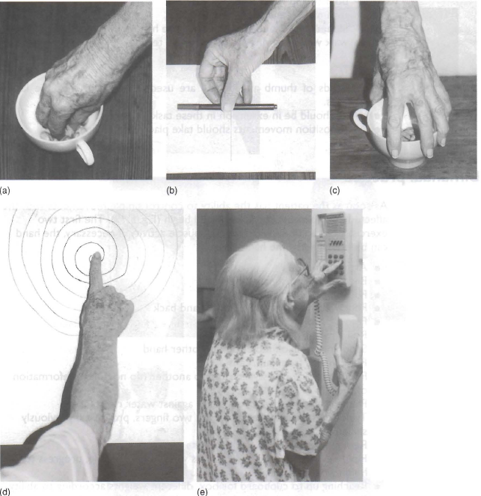

Slide 18
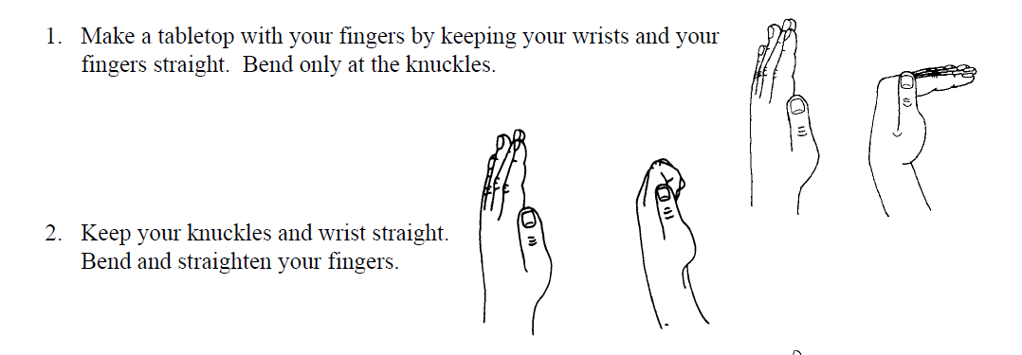
6 Pack Hand Exercise

Slide 19
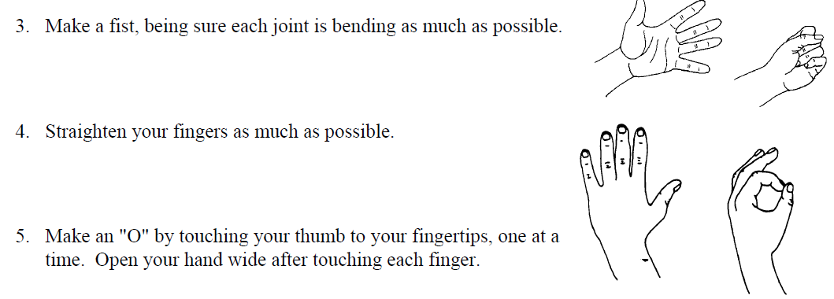

Slide 21
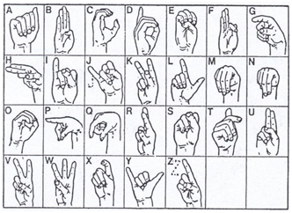

Slide 22
Shoulder positioning in SCI

Slide 23
Protocol of shoulder positioning

Slide 24
Functional Hand Development
Activ functional hand C6 – C7
Closes due to wrist extension

Slide 25
Functional hand Development
passiv funcional hand C5
closes due to supination

Slide 26
Positioning C6 – C7
Positioning of the thumb

Slide 27
Positioning C5
With weak and/or non-innervated wrist extension

Slide 28
Passive Mobilization of the Hand
The hand must be mobilized passively on a regular basis to keep the joins flexible.
The mobilization is performed according to the functional hand model to avoid stretching the shortened flexors.

Slide 29
Mobilization of the Hand

Slide 30
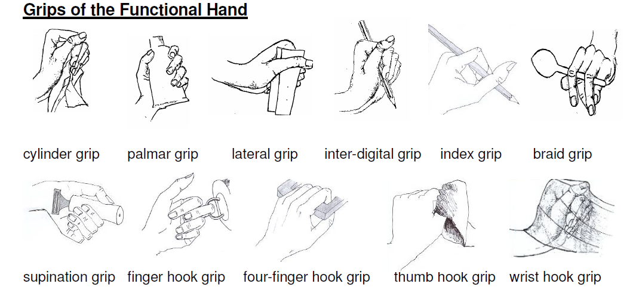

Slide 32
C1-C3 Upper limb function
Dependent on ventilator

Slide 33
C4 upper limb
No upper limb function
Innervated upper trapezius….shoulder shrugging
Preventing contractures
Problem with hygiene and personal care
Prolong stretch and regular passive movements
Splints
MCP hyper extension and IP joint flexion contracture commonly

Slide 34
C4

Slide 35
C4
Use breath, eye blinks, voice, head movements
Mouth stick to turn pages

Slide 36
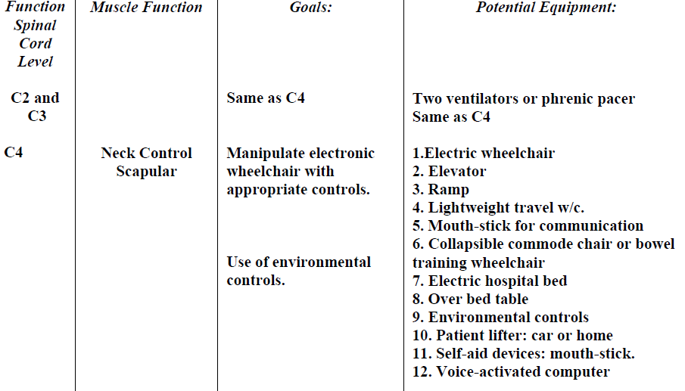

Slide 37
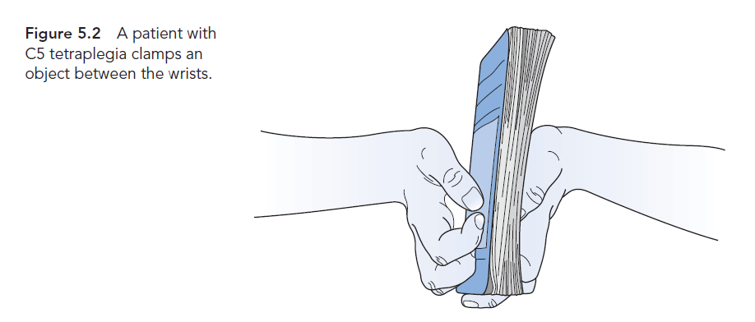
C5 upper limb
Anti gravity strength in Biceps
Deltoid sufficient strength
No wrist muscle strength
Hand to face
Objects clamping between wrist

Slide 38
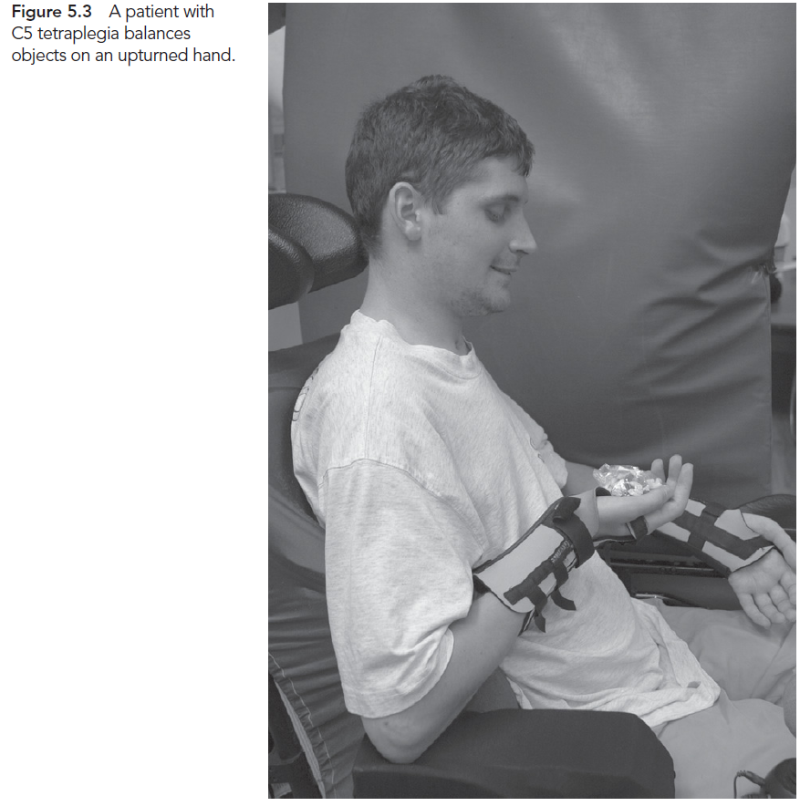
C5 upper limb
Balancing on an up-turned hand

Slide 39
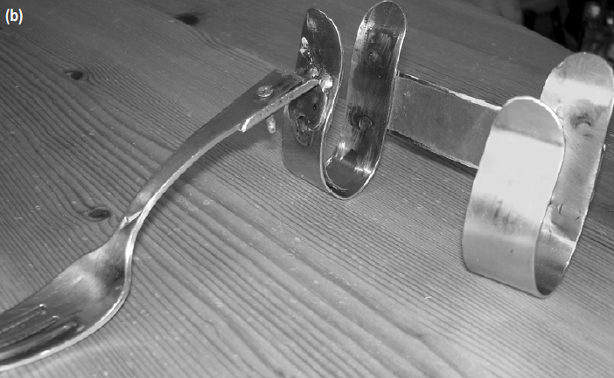
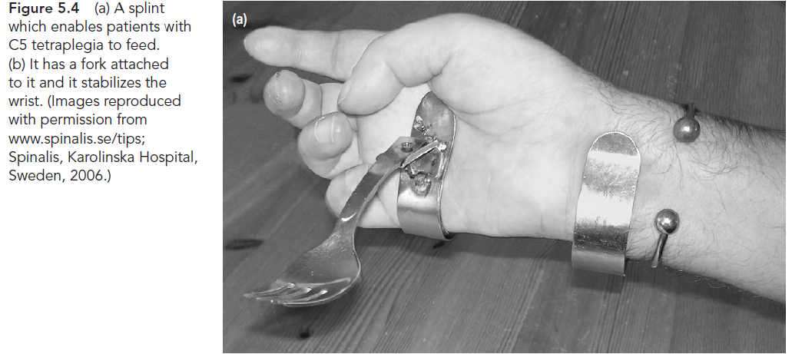
C5 upper limb
Orthotic

Slide 40
C5 upper limb
Splint

Slide 41
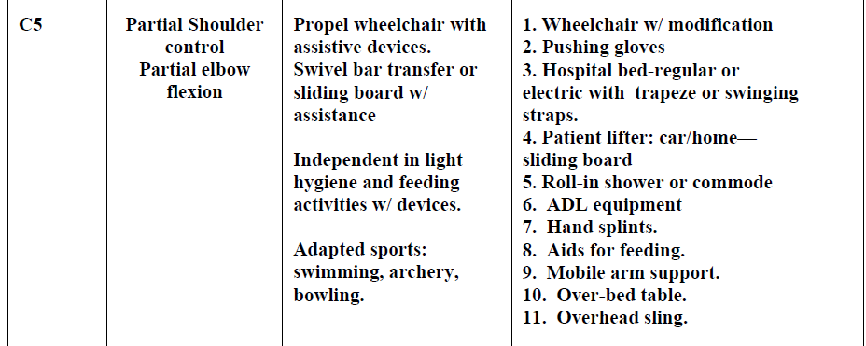
C5 upper limb
Passive Tendonesis grip
Splint
OT
Surgery
Electrical stimulation

Slide 42
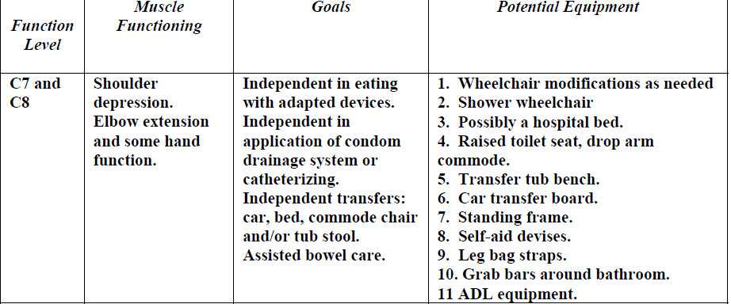

Slide 43
C6 and C7 Upper limb
Reasonable strength
Paralysis of all fingers and thumb flexors
Wrist extensors strength
C7 have strength in wrist flexors and finger extensors
Tendonesis and crude grip
Hand splint , surgery and electrical stimulation

Slide 44
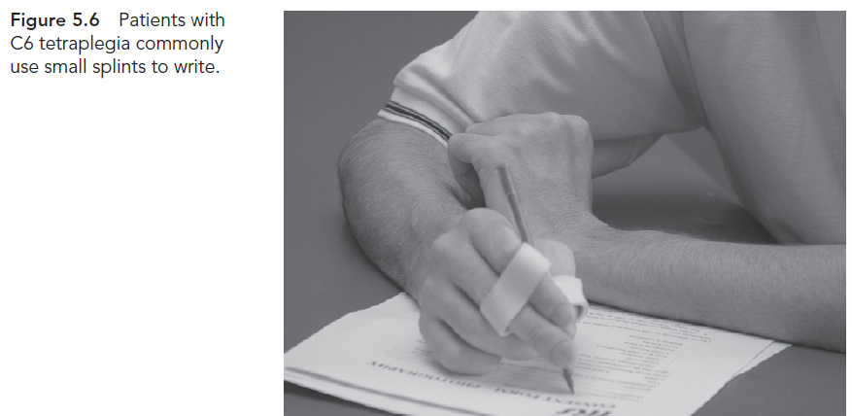
C6 and C7 upper limb

Slide 45
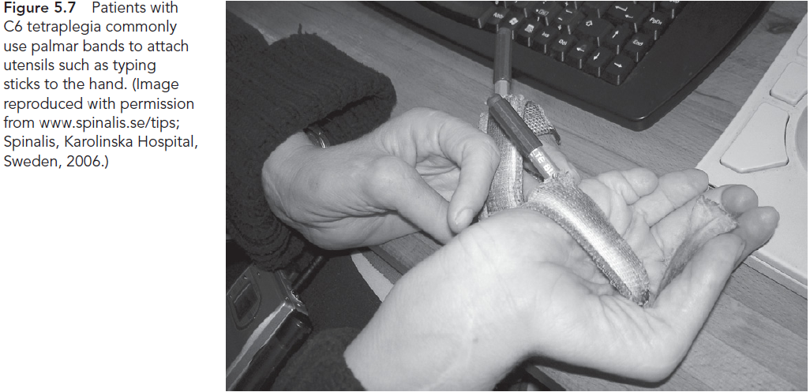
C6 and C7 Upper limb

Slide 46
Tendonesis /Crude or Wrist Grip
C6 and C7
Paralysis of thumb and finger flexor muscles but active wrist extension
Passive tension generated in paralyzed fingers extrinsic and thumb flexors muscles with wrist extension
Open hand with wrist flexed…..active extension in wrist…..passive flexion in fingers and thumb
Thumb and index finger….lateral key or pincer group
Palm of hand

Slide 47
Tendonesis Grip

Slide 48
Tendonesis grip cont’d
Extensibility of thumb adductor muscles
Pincer group if thumb adductor extensible
Lateral key grip if thumb adductors inextensible
Lateral key grip is easier and powerful
Pincer grip difficult but good fine control and less powerful
Over stretching of thumb adductor
Pincer in one hand and lateral in other

Slide 50
Videos
http://www.scipt.org/videos/videos_details.php?videoID=47&author_surname=Sydney

Slide 51
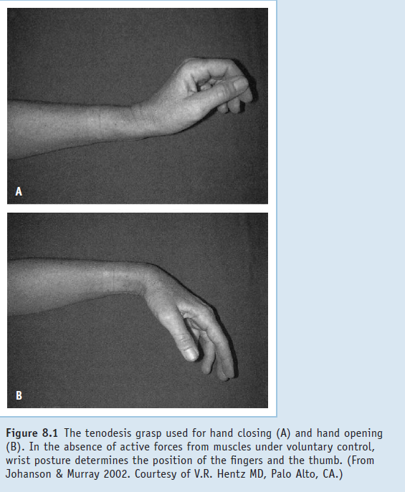

Slide 52
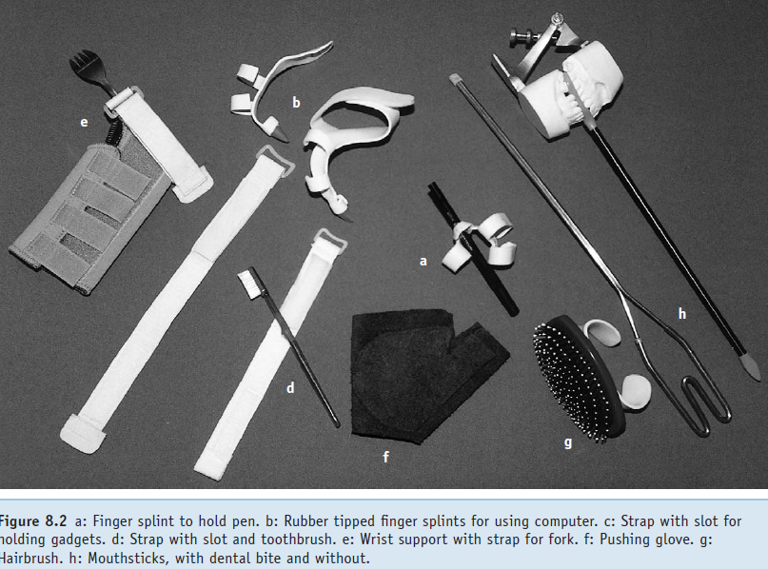

Slide 53
C5 Tendonesis grip
No wrist extension
Forearm Supination and pronation
Passive Tendonesis grip

Slide 54
Splinting and taping to promote a Tendonesis grip
Excessive extensibility of thumb extrinsic and finger flexors
Best is to produce shortening
Splinting and taping
Withheld of patient are likely to have surgery
Surgery relied on good extensibility of finger and thumb flexors muscles

Slide 55
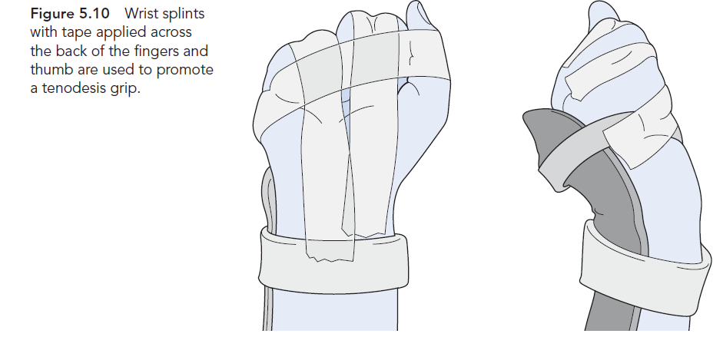
Splints

Slide 56
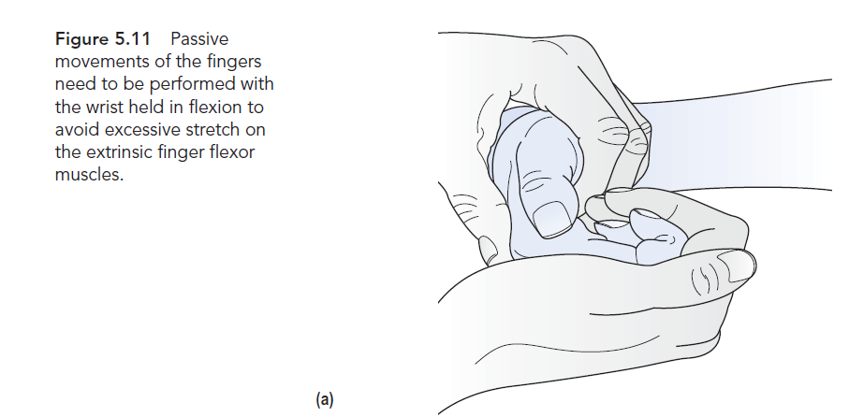
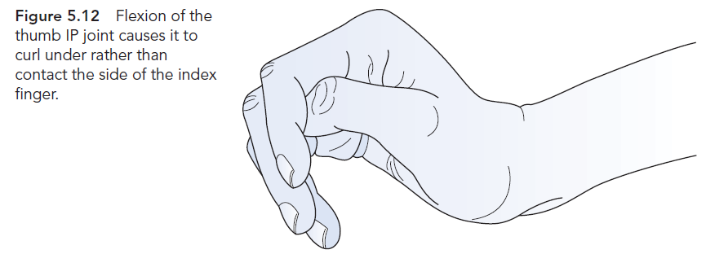
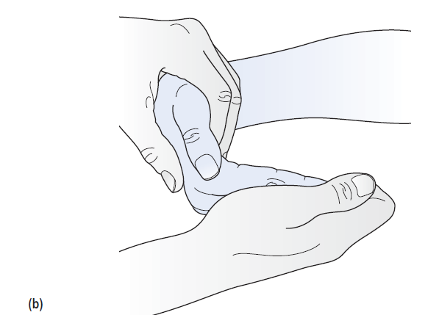

Slide 57
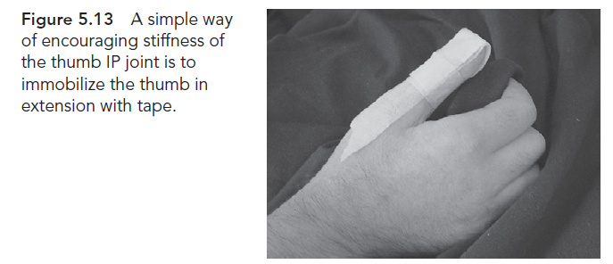

Slide 59
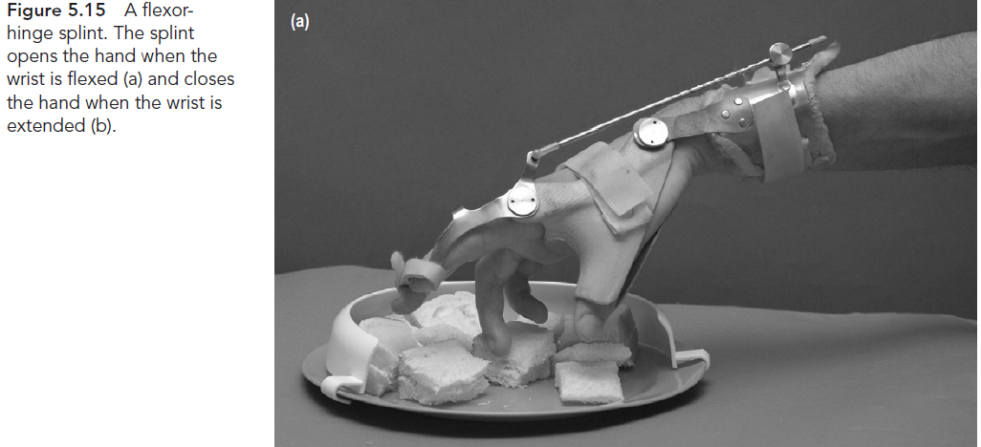

Slide 60
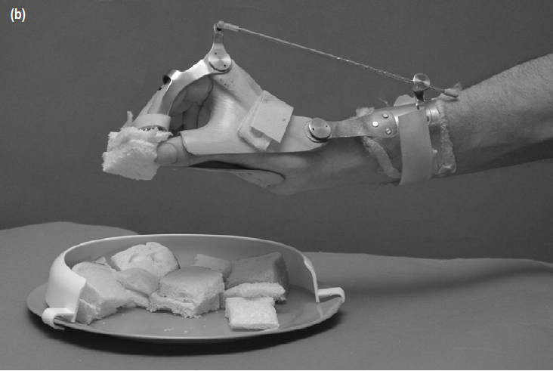

Slide 61
C8 Upper limb
Some strength in thumb and finger
Don’t use Tendonesis grip
Intrinsic muscles loss
Fine control loss
Strengthening of fingers flexors, preventing contracture and practicing hand activities
Orthotic and surgery

Slide 63
Muscle length

Slide 64
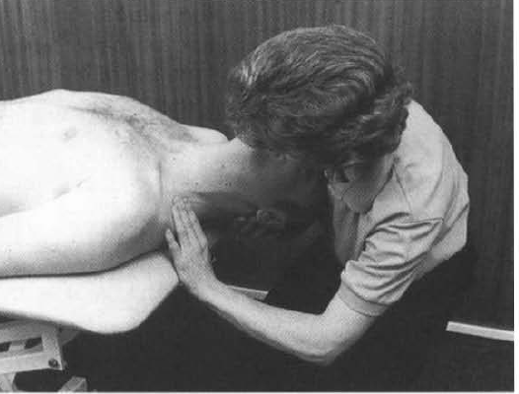
Scalenes
The clinician extends the head and laterally
flexes away and rotates towards the side of testing for
anterior scalene; neutral rotation tests the middle fibers and
Contra lateral rotation tests the posterior scalene muscle

Slide 65
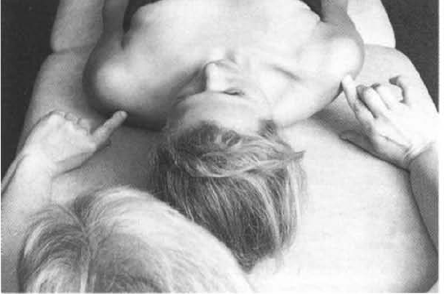
Pect minor

Slide 66
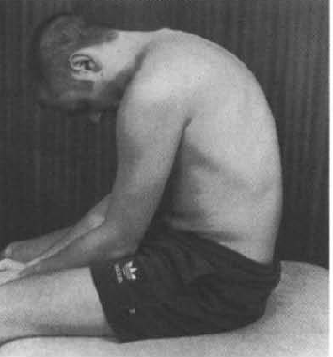
Erector spinae

Slide 67
http://www.asia-spinalinjury.org/
http://www.uab.edu/medicine/sci/faqs-about-spinal-cord-injury-sci/what-recovery-is-expected-following-spinal-cord-injury

Slide 68
Test
SCIM

Slide 69
Questions
Which muscle preserve in the complete injury of C4 lesion.
Which muscle preserve in the complete injury of C5 lesion.
Which muscle preserve in the complete injury of C6 lesion.
Which muscle preserve in the complete injury of C7 lesion.
Which muscle preserve in the complete injury of C8 lesion.
Which muscle preserve in the complete injury of T1 lesion.

Slide 70
Questions
Which hand grip is use for the lesion of C5
Which hand grip is use for the lesion of C6
Which hand grip is use for the lesion of C7
Which hand grip is use for the lesion of C8

Slide 71
Questions
What are different types of hand grip
Which hand grip is easily achievable
Which hand grip is strong
What type of splinting used to improve the hand grip
Which hand grip used to grip the key

