Slide 1
Demography

Slide 2
Definition
Demography is a combination of two Greek words ‘Demos’ meaning people and ‘Graphy’ means science
‘’Science of people’’

Slide 5
According to Donald J. bougue
Demography is a statistical and mathematical study of size, composition and spatial distribution of human population and changes overtime in these aspects through the operation of the five processes of fertility mortality marriage mtgration and mobility

Slide 6
Demography is a branch of social sciences concerned with the study of human population ,their structure and change (through births, deaths and migration)
Relationship with natural environment and with social and economic change

Slide 8
It is a quantitative study of human population
It is also related with human geography which is known as Human geography demography
It provides information about the veriety of population and change in it with respect to time

Slide 15
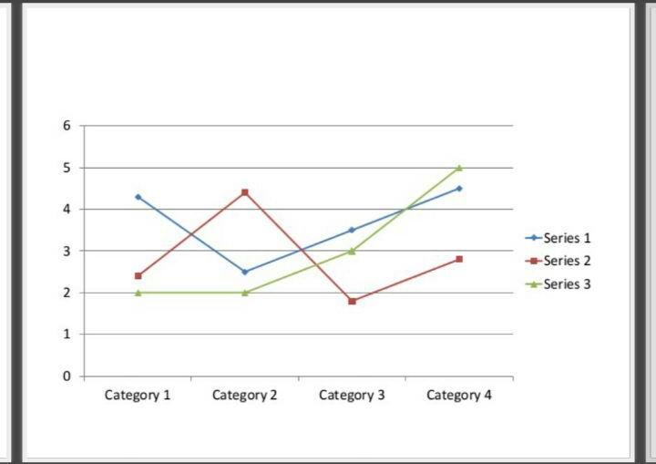

Slide 28
Importance of demography
It help to understand the population dynamics
It covers the structure and variety of population due to births, deaths, migration and emigration
It also help Government and society better prepare to deal for the issues and demands of population

Slide 33
