Slide 1
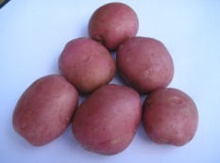
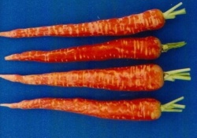
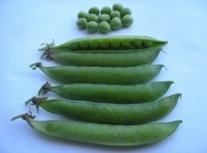
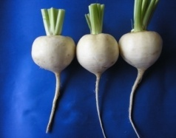
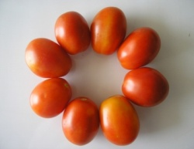
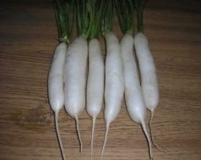
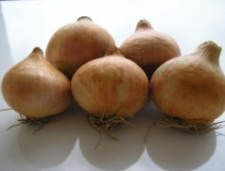
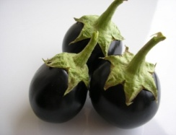
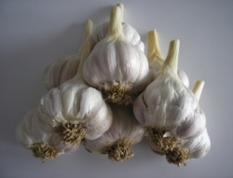
Horticulture?
HORT-201
University College of Agriculture,
University of Sargodha

Slide 2
Dietary Importance
Food comprises of
Carbohydrates
Proteins
Fats
Vitamins
Minerals
Fiber

Slide 3
Starch Potato (19%), Sweet potato (27%)
Proteins Peach, Beans, S. corn
Fats Avocado, Olive, Nuts,
Fiber Cabbage, leafy vegetables, Lettuce, Spinach
Minerals Peach, Plums, Apricot, Dry fruits, Dates, Olive, Leafy vegetables
Vitamins

Slide 4
Vit A Mango, Spinach, Peaches, Carrot
Deff.: Night Blindness, Stones in Kidney
Vit. B Tomato
Deff.: Beri Beri, Heart enlargement
Vit. C Tomato, Citrus, Guava
Vit D Leafy vegetables
Vit E Banana, Onion

Slide 5
Economic Importance
High returns
Source of foreign exchange by exporting fruits, vegetable, flowers and ornamental plants
Source of raw material like paper, perfumes, furniture, medicines, and other cosmetics.

Slide 6
Aesthetic Value
Source of beautification and mental relaxation
Road side plantation
Green belts and green spaces
Parks and gardens
Lawns
Indoor beautification

Slide 7
Role in the Environment
Plants serve as lungs in cleaning environment
Control pollution
Reduce soil erosion
Reduce wind velocity
Mild micro environment

Slide 8
Medicinal Plants
Falsa, Sweet lime, Jaman --- cooling effect
Grape fruit excellent for dieting patients
Bitter gourd and jaman are good for Diabetes
Roses (rose water, rose hip syrup) many medicines
Calendula ---- facial cream

Slide 9
Present Status and Future Scope
Of the total cultivated area in Pakistan only 6% is under horticultural crops.
3.5 % Fruits
2.0 % Vegetables
0.5 % Ornamental plants
In USA, the area under Horticultural crops is more than 20%.

Slide 10
Of the total area planted to vegetables 17 % is under Potatoes
15% Under Chilies
12% Under onions
And rest of area under 30 different types of vegetables.
Major fruits are:
Citrus
Mango
Guava
Dates

Slide 11
Citrus is cultivated on 38% area
Punjab is the leading province in the country
Mango in Sindh, Punjab
Banana and Papaya in Sindh
Grapes in Balochistan
Litchi in Punjab
Stone fruits in NWFP

Slide 12
In Pakistan, per capita consumption of fruits and vegetables are 88g and 90g per day per person, respectively.
According to WHO, a minimum of 450g of fruits and vegetables per day per person is necessary.

