Slide 1
Organizational Behavior (PSYC-6223)
Lecture-13-14

Slide 2
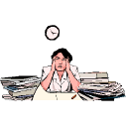
What is Stress?

Slide 3
Three key factors determine the likelihood of stress
Importance: How significant the event is to the person?
Uncertainty: Degree of clarity over what will happen?
Duration: Length of time the demands remain in place

Slide 4
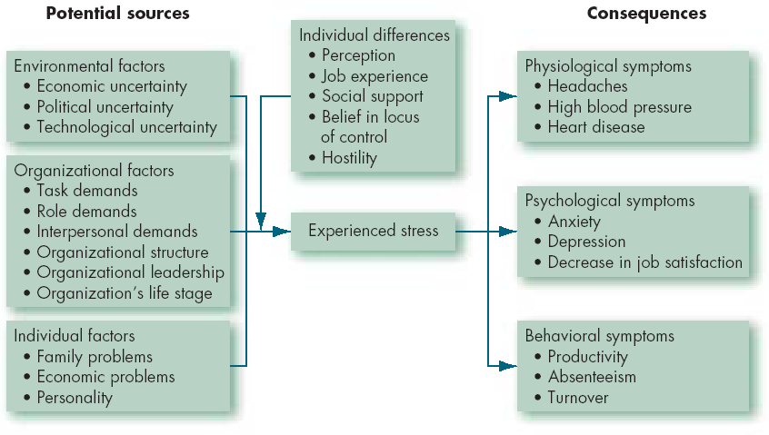
A Model of Stress

Slide 5
Is stress good or bad?

Slide 6
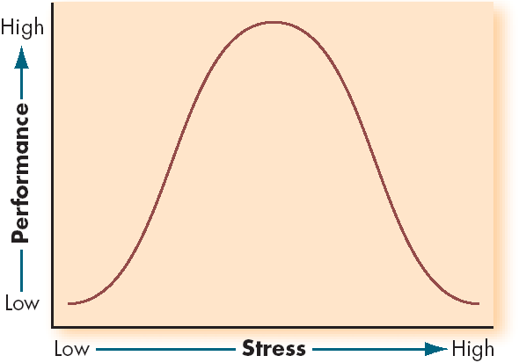
Inverted-U Relationship between Stress and Job Performance

Slide 7
Consequences of Stress
High Levels of Stress
Physiological Symptoms
Psychological Symptoms
Behavioral Symptoms

Slide 8
Recognizing Stress
Short-term physical symptoms
Long-term physical symptoms
Internal symptoms
Behavioral symptoms

Slide 9
Short-Term Physical Symptoms
Faster heart beat
Increased sweating
Cool skin
Cold hands and feet
Feelings of nausea, or 'Butterflies in stomach'
Rapid Breathing
Tense Muscles
Dry Mouth
A desire to urinate
Diarrhea

Slide 10
Long-term Physical Symptoms
Change in appetite
Frequent colds
Illnesses such as:
Asthma
Back pain
Digestive problems
Headaches
Aches and pains
Feelings of intense and long-term tiredness

Slide 11
Internal Symptoms
Worry or anxiety
Confusion, and an inability to concentrate or make decisions
Feeling ill
Feeling out of control or overwhelmed by events
Mood changes:
Depression
Frustration
Hostility

Slide 12
Helplessness
Restlessness
Being more lethargic
Difficulty sleeping
Drinking more alcohol and smoking more
Changing eating habits
Relying more on medication

Slide 13
Behavioral Symptoms
Talking too fast or too loud
Fiddling and twitching, nail biting, grinding teeth, drumming fingers, pacing, etc.
Bad moods
Being irritable
Defensiveness
Being critical
Aggression
Irrationality
Overreaction and reacting emotionally

Slide 14
Reduced personal effectiveness
Being unreasonably negative
Making less realistic judgments
Being unable to concentrate and having difficulty making decisions
Being more forgetful
Making more mistakes
Being more accident prone
Changing work habits
Increased absenteeism
Neglect of personal appearance

Slide 15
Chemical and Nutritional Stress
Caffeine-raises levels of stress hormones
Sweets or chocolate-causes body to release too much insulin
Salt-raises blood pressure
Unhealthy diet-leads to illness which increases stress

Slide 16
Lifestyle and Job Stress
Too much or too little work
Having to perform beyond your experience or perceived abilities
Having to overcome unnecessary obstacles
Time pressures and deadlines
Keeping up with new developments
Changes in procedures and policies
Lack of relevant information, support and advice
Lack of clear objectives
Unclear expectations of your role

Slide 17
Responsibility for people, budgets or equipment
Career development stress:
Under-promotion, frustration and boredom with current role
Over-promotion beyond abilities
Lack of a clear plan for career development
Lack of opportunity
Lack of job security
Stress from your organization or your clients.
Personal and family stresses.

Slide 18
Environment and Job Stress
Your working environment can cause stress
Crowding or invasion of personal space
Insufficient work space
Noise
Dirty or untidy conditions
Pollution
Other environmental causes

Slide 19
Fatigue and Overwork
Stress builds up over a long time
Trying to achieve too much in too little time
“Hurry Sickness”-vicious circle of stress causing you to hurry jobs and do them badly.

Slide 20
Long-Term Stress
Performance
Healthy Tension Fatigue
Exhaustion
ILL HEALTH
BREAKDOWN
Stress

Slide 21
How to Manage Stress?

Slide 22
Optimum Stress Levels
Performance
Too Ideal Too Much
Little Range
Stress Levels

Slide 23
Stress Management & Prevention

Slide 24
Stress Management Procedures for helping people cope with or reduce stress already being experienced
.

Slide 25
Stress Prevention
Focuses on controlling or eliminating stressors that might provoke the stress response.

Slide 26
Stress Management Programs
Training
Time management
Coping skills
Wellness
Assessment
Self-help materials
Group programs
Relaxation

Slide 27
Time
Management
Physical
Exercise
Individual Stress
Management
Relaxation
Training
Social
Support

Slide 28
Dealing with Long-Term Stress
Fatigue and exhaustion
Go to bed earlier
Take a good break (vacation)
Change work commitments if possible
Time management strategies

Slide 29
Dealing with Long-Term Stress
Handling depression
Deep depression is a clinical illness and should be handled professionally
Otherwise
Positive thinking
Talk to people and get support
Get away from situation causing stress

Slide 30
Dealing with Long-Term Stress
Lack of self-confidence
Set personal goals
List your shortcomings and deal with them
List the things that worry you and see if it is really important to worry about them at all.
Write down the things you do well
Positive thinking

Slide 31
Dealing with Long-Term Stress
Relationships
Being more assertive will help
Improve your social skills
Are other people contributing to this problem? Are you better off without them?
Standards
Are your standards impossibly high?

Slide 32
Organizational Stress Management
Goal Setting
Wellness
Programs
Job
Redesigning
Organizational
Communication
Employee
Involvement
Selection
and Placement

Slide 33
Social Support at Work & Home
Family
Spouse
Children
Parents
In-laws
Organizational
Supervisor
Colleagues
Subordinates
Clients
Individual
Religion
Alams, Teachers
Friends
Support groups
Professional
Physicians
Psychologists
Counselors
Lawyers
Clubs
Business associations
Social clubs
Athletic groups
Notes:
24

Slide 34
Avoiding Burn-Out
Re-evaluate goals
Reduce unnecessary commitments
Learn stress management skills
Find out where the stress is coming from (family, job, etc.)

Slide 35
Follow a healthy lifestyle
Get adequate rest
Eat a balanced diet
Get regular exercise
Limit caffeine and alcohol
Develop other interests (hobbies)
Acknowledge your humanity--you have a right to pleasure and relaxation

Slide 36
