Slide 1
Motivation and Emotion
Samreen Umar
Department of Psychology, UOS

Slide 2
What is Motivation
Motivation is an internal process that makes a person move toward a goal. It is an urge to behave or act in a way that will satisfy certain conditions, such as wishes and desires.
Motivations are commonly separated into two drives
Primary drives are innate drives (e.g. Thirst, hunger, and sleep)
Secondary drives are learned by conditioning (e.g. Money).

Slide 3
Types OF MOTIVATION
Motivations can be
Intrinsic (arising from internal factors) these Behaviors are generated by the sense of personal satisfaction that they bring. They are driven by an interest or enjoyment in the task itself that comes from the individual.
Extrinsic (arising from external factors) these Behaviors, in contrast, are performed in order to receive something from others. They do not come from within the individual, but from society—other people.
In reality, our motivations are often a mix of both intrinsic and extrinsic factors, and the nature of the mix can change over time.

Slide 4
Maslow Hierarchy
In 1943, Abraham Maslow proposed a hierarchy of needs that spans the spectrum of motives, ranging from the biological to the social.
Maslow’s theory is based on a simple premise: human beings have needs that are hierarchically ranked.
Maslow organized human needs into a pyramid that includes (from lowest-level to highest-level) physiological, safety, love/belonging, esteem, and self-actualization needs. According to Maslow, one must satisfy lower-level needs before addressing needs that occur higher in the pyramid

Slide 5
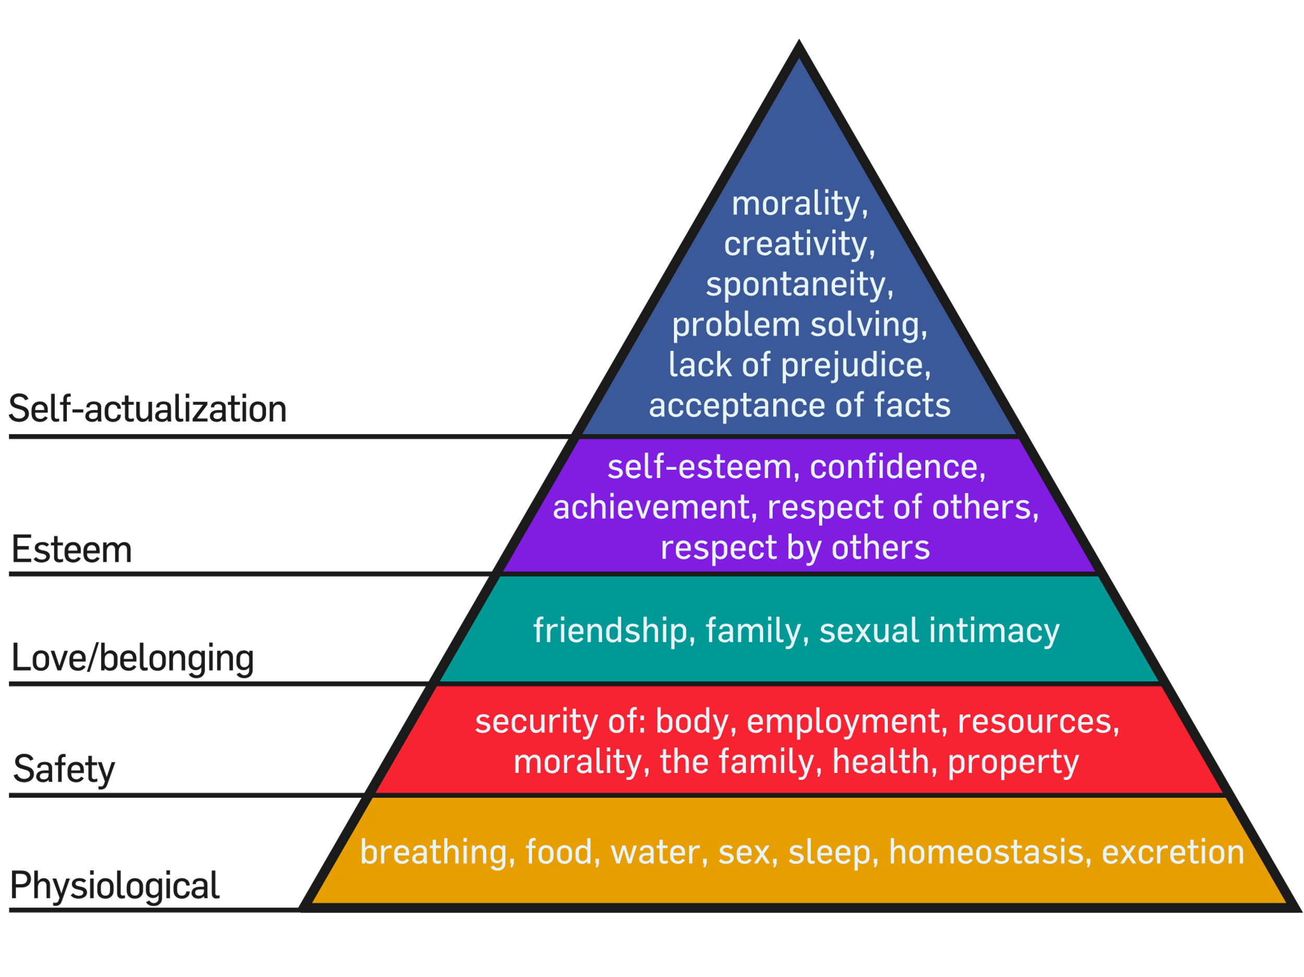

Slide 6
Basic Emotions
Emotions are subjective experiences that involve physiological arousal and cognitive appraisal.
Paul Ekman introduced the six basic emotions of anger, disgust, fear, happiness, sadness, and surprise.
7th emotions “contempt” which is a mixture of disgust and anger
Emotion is not only displayed through facial expression. We also use the tone of our voices, various behaviors, and body language to communicate information about our emotional states.

Slide 7
Theories of emotions
According to the James–Lange theory of emotion, emotions arise from physiological arousal.
Emotions arise from physiological arousal: in essence, that the self-perception of changes in the body produce emotional experiences. According to this theory, we laugh (a physiological response to a stimulus), and consequently we feel happy (an emotion); we cry, and consequently we feel sad.

Slide 8
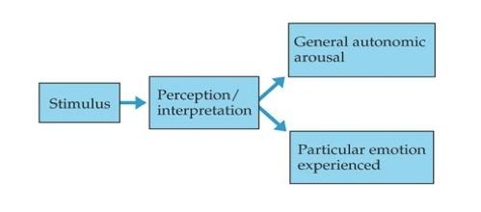
THEORIES OF EMOTIONS
The cannon–bard theory of emotion argues that physiological arousal and emotional experience occur simultaneously but independently
This theory was developed by researchers who criticized the James–Lange theory for its limited ability to account for the wide variety of emotions experienced by human beings. While the Cannon–Bard theory argues that physiological arousal and emotional experience occur simultaneously, yet independently

Slide 9
Why Emotions are Important
Emotions allow other people to understand us. When we interact with other people, it is important to give clues to help them understand how we are feeling. These cues might involve emotional expression through body language, such as various facial expressions connected with the particular emotions we are experiencing.

