Slide 1
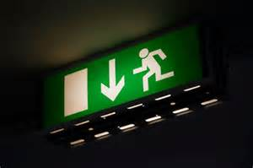
Organization and Administration Of Emergency Care, >>>Factors Dr.Waqas

Slide 2
Factors to consider in the proper organization and administration of emergency care in athletic activity include the following:
1. Development and implementation of an EAP
2. The sports medicine staff and emergency team
3. Initial patient assessment and care
4. Emergency communication
5. Emergency equipment and supplies
6. Venue locations
7. Emergency transportation
8. Emergency care facilities
9. Legal need and documentation

Slide 3
Initial Patient Assessment and Care
Immediate care of any injured person needs to be the main concern for the emergency team.
CHECK—CALL— CARE system

Slide 4
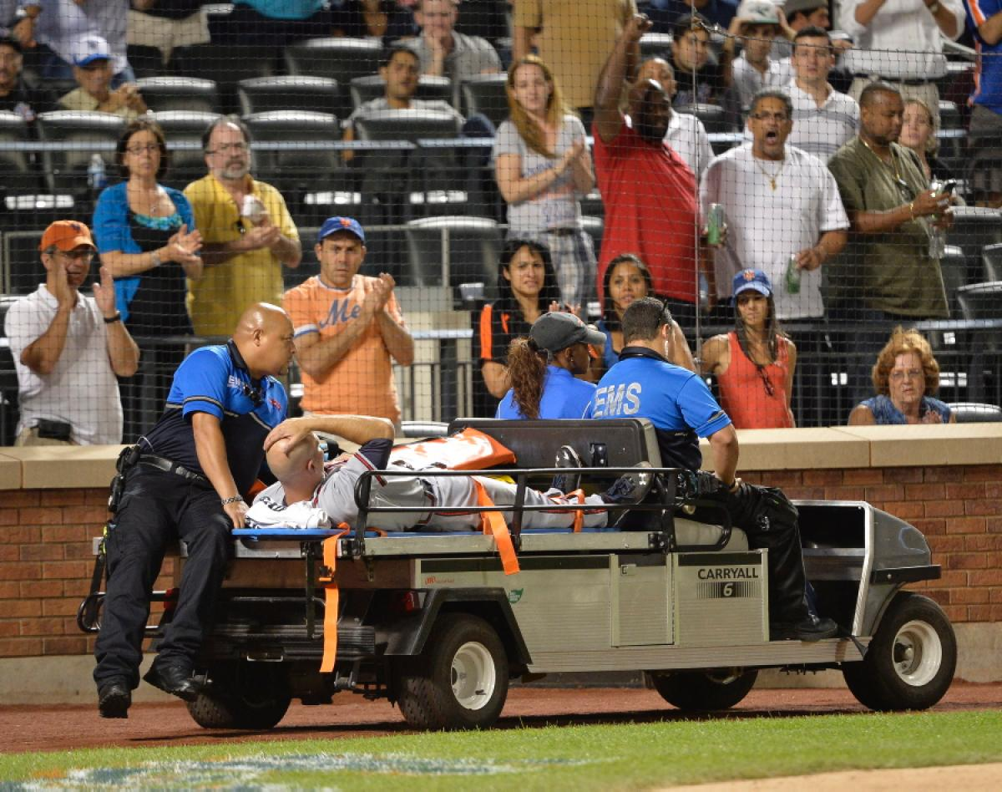

Slide 5
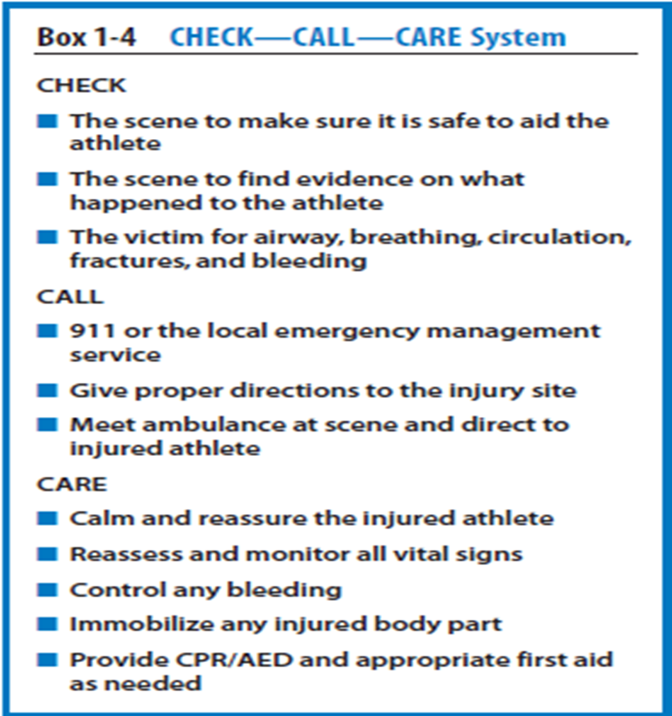

Slide 6
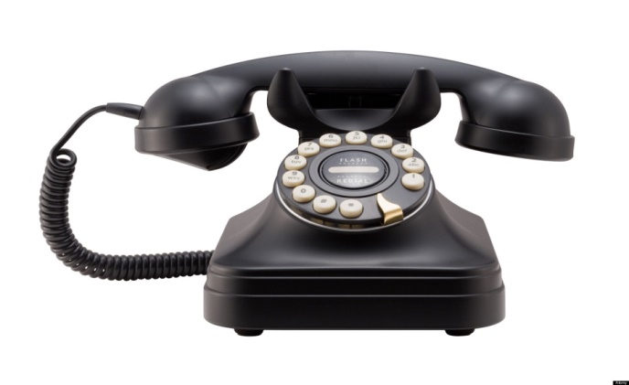
1. Development and implementation of an EAP 2. The sports medicine staff and emergency team 3. Initial patient assessment and care 4. Emergency communication
Communication prior to an event is a good way to establish a positive working relationship between all groups of professionals.
Access to a working telephone or other telecommunications Device.
Check communications system.
Backup communications plan
Currently the most common method of communication is a cellular telephone.
Notes along with telephone

Slide 7
Emergency Equipment & supplies

Slide 8
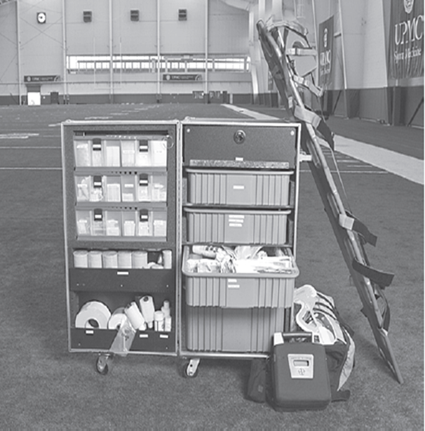

Slide 9
Automated external defibrillator (AED)
A portable electronic device that automatically diagnoses the life threatening cardiac arrhythmias of ventricular fibrillation and ventricular tachycardia in a patient, and is able to treat them through defibrillation.
The application of electrical therapy which stops the arrhythmia, allowing the heart to reestablish an effective rhythm.

Slide 10
Venue Locations
The EAP for each venue should include information concerning the
accessibility to emergency personnel,
communications systems,
emergency equipment
Emergency vehicle transportation.

Slide 11
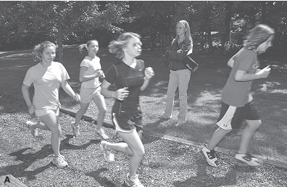
Cross country course

Slide 12
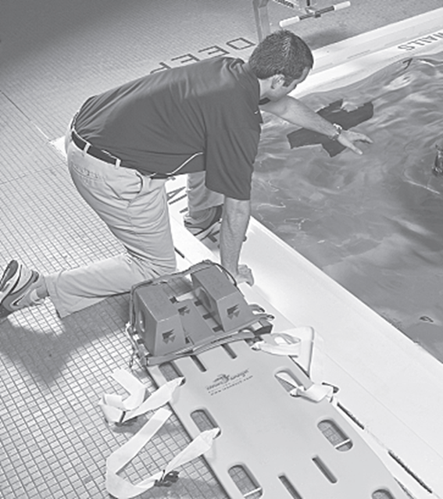
(B) swimming pool

Slide 13
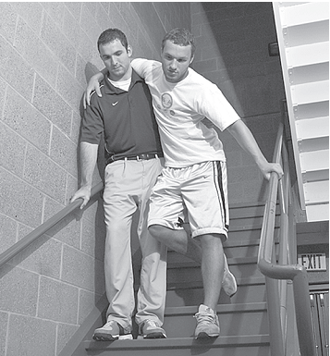
Narrow stairs

Slide 14
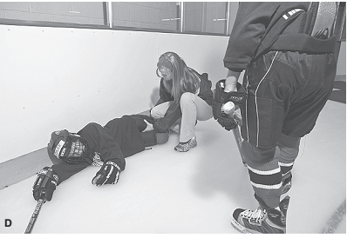
Ice-hockey rink.

Slide 15
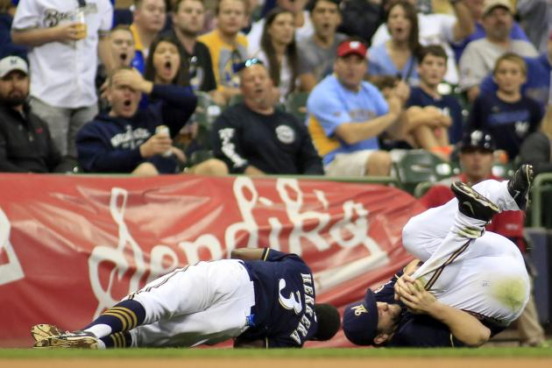
Emergency transportation
An emergency dictates that transport should be via EMS vehicles (ambulance).
when and where an ambulance will be during all athletic events.

Slide 16
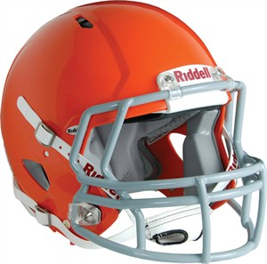
Emergency Care Facilities
Proximity
Facilities (Nearby
Hospitals etc.)

Slide 17
Legal need & Documentation
Possible athletic injury in any sports
Injuries to the head, spine, and limbs are possible in both practice and competition.
Failure to have an EAP lead to legal issues
Charges of negligence

Slide 19
Failure to have an EAP in place, and to rehearse it regularly, may result in inefficient or inadequate care.
which could lead to charges of negligence against the athletic organization administration and
sports medicine team members.

Slide 20
Important documentation
Athlete card
Individual injury evaluation form
Specific person for documentation
Documentation of Practice &Regular
rehearsal EAP
Equipment
Emergency info Palm cards

Slide 21
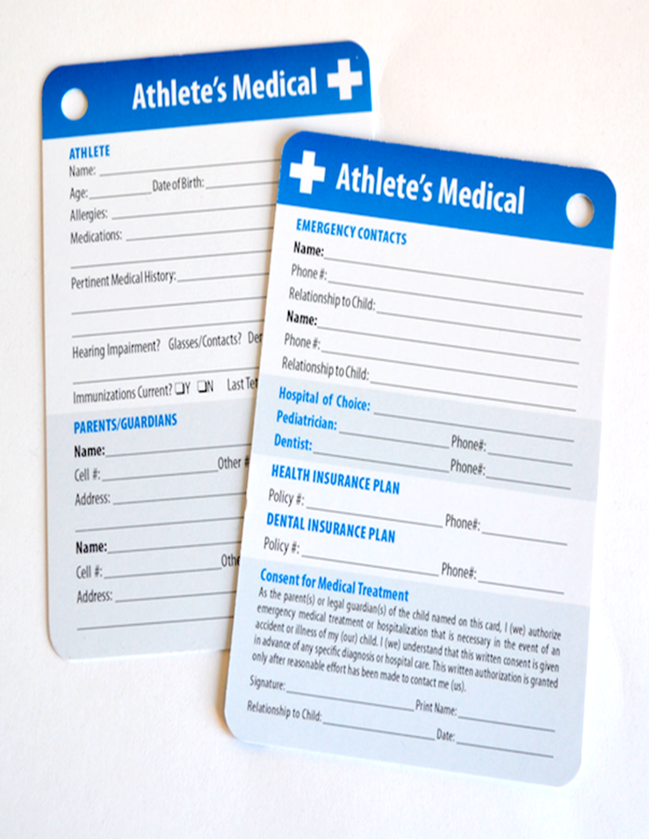

Slide 22
